Slide 1
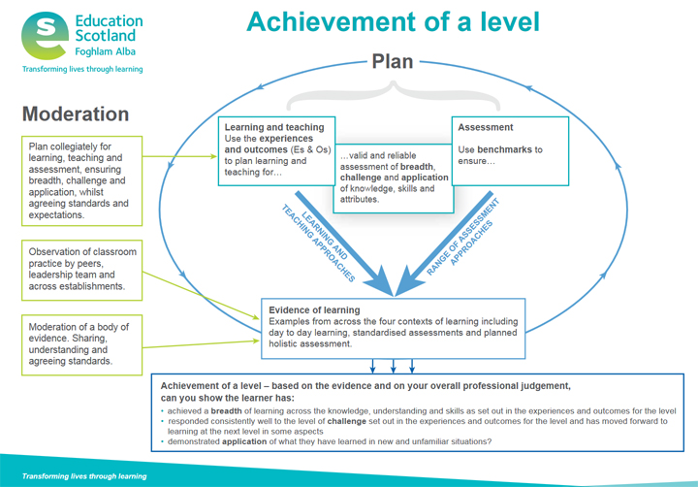

Validity and reliability
Achievement of a level
Evidence of learning

Slide 2
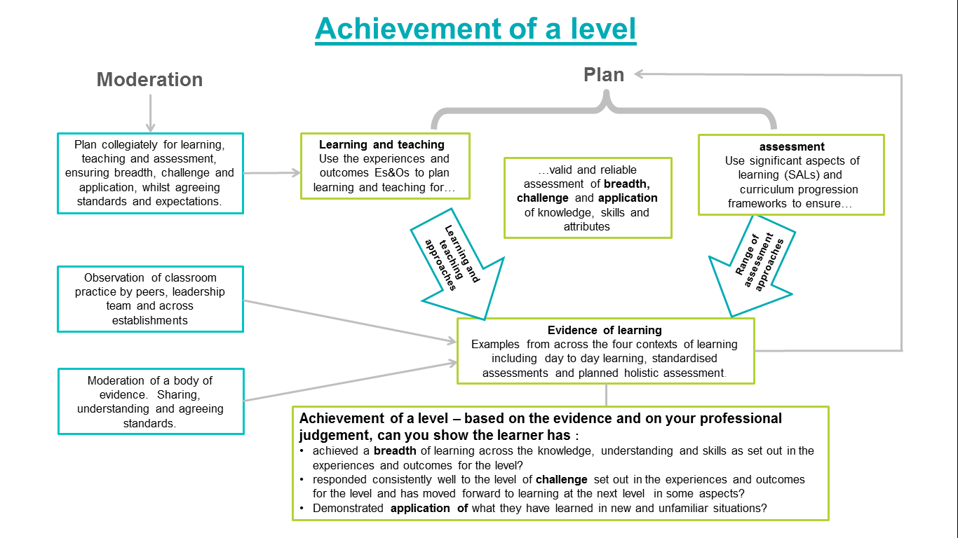

Slide 3
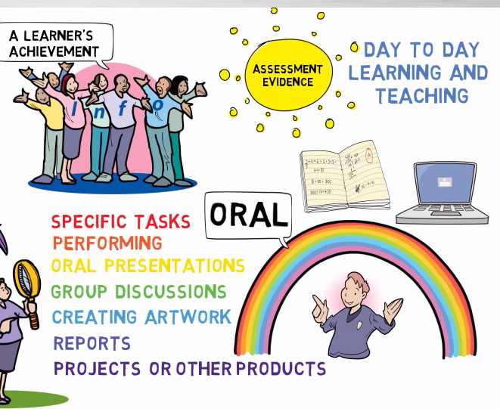
Achievement of a level
Can you show the learner has :
achieved a breadth of learning across the knowledge, understanding and skills as set out in the experiences and outcomes for the level?
How would this be evidenced?

Slide 4
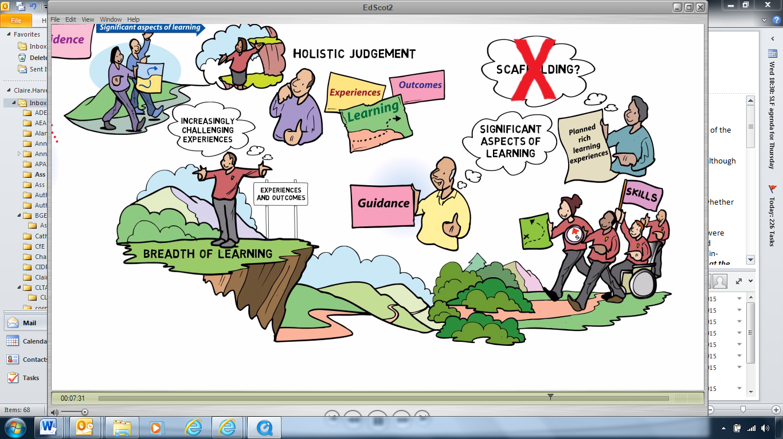
Achievement of a level
Can you show the learner has :
responded consistently well to the level of challenge set out in the experiences and outcomes for the level appropriate to their stage and has moved forward to learning at the next level in some aspects?
How would this be evidenced?

Slide 5
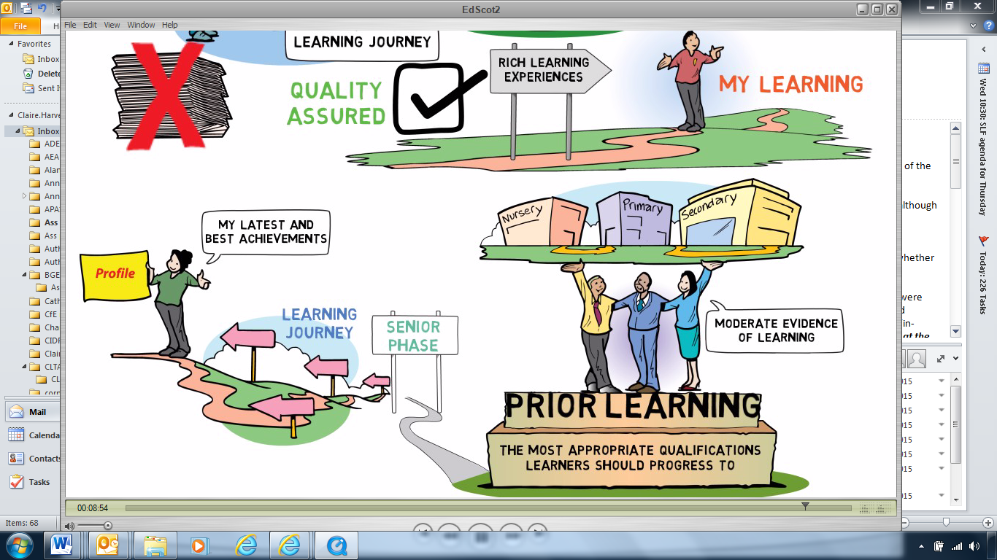
Achievement of a level
Can you show the learner has :
demonstrated application of what they have learned in new and unfamiliar situations?
How would this be evidenced?

Slide 6


Validity and reliability
How confident are you that judgements are valid and reliable?
Using the template ‘Validity and reliability through effective self-evaluation’ reflect on current practice and plan for improvement.
Share
Share
Share

Slide 8
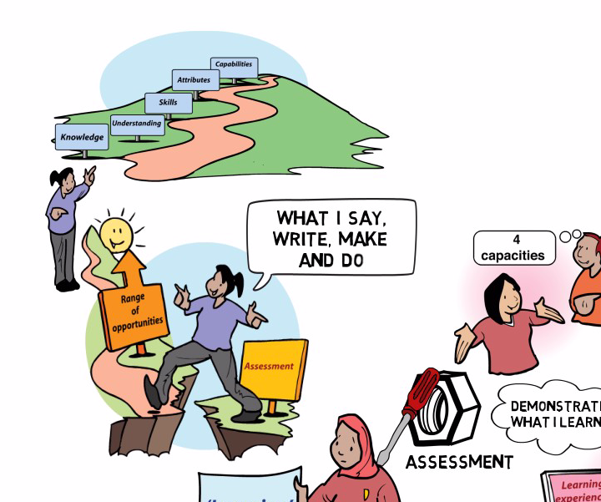
Evidence of learning
A range of assessment evidence:
Gather evidence from the 4 contexts of learning
Day-to-day learning in the classroom
Standardised assessments
Holistic assessments developed by/for teachers

Slide 9
Evidence of learning
What range of assessment evidence do you have?
Using one of the templates ‘A range of evidence from the four contexts for learning’, reflect on current practice and plan for improvement.
Share
Share
Share

Slide 10
Education Scotland
Denholm House
Almondvale Business Park
Almondvale Way
Livingston EH54 6GA
T +44 (0)141 282 5000
E enquiries@educationscotland.gov.uk
www.educationscotland.gov.uk

