Slide 1
An Overview of
Earned Value Management (EVM)
Using EVM to Track Progress

Slide 2
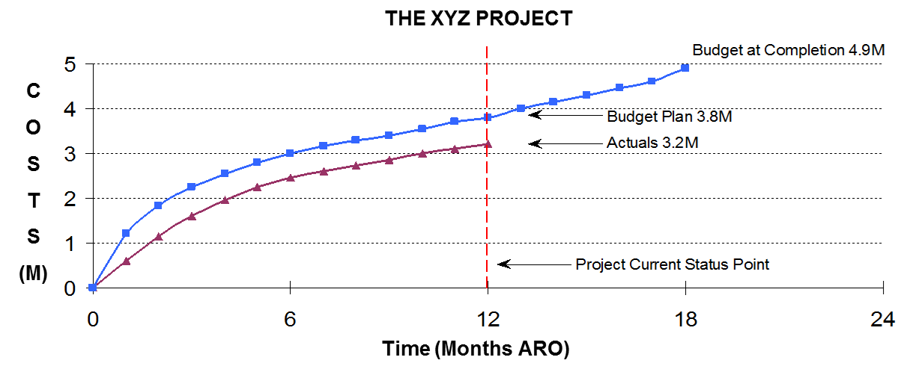
Using Earned Value to Track Progress
What can you tell me about this project?
  Is it… on schedule, ahead schedule, or behind schedule?
  Is it… on budget, over budget, or under budget?
  Will the project finish on time?

Slide 3
Using Earned Value to Track Progress
We know the original budget (the plan)
We know what we spent to date --BUT--
Without additional information to show the project status
we DON’T know what progress we have
--Earned value metrics can give us the whole picture--

Slide 4
Using Earned Value to Track Progress
Definition of Earned Value Management
An Earned Value Management System (EVMS) integrates the project work scope with the schedule and cost elements of the project to optimize status and control

Slide 5
What is Earned Value - A Brief Synopsis
EVMS is based upon breaking the project into manageable pieces called “Work Packages”
  Each work package defines a piece of the work to be performed. It can define several activities or tasks and the resources required to perform them
  Each activity (task) will have one to several resources assigned
    Therefore the activity’s “Work” may be greater than the duration
  Work packages may also have “Other Direct Costs” (ODC) assigned such as materials, subcontractors, vehicles, etc.

Slide 6
What is Earned Value - A Brief Synopsis
EVMS is based upon breaking the project into manageable pieces called “Work Packages”
  WP Budget = (work assigned to each resource) x (resource’s rate) + (ODCs)
  The work package will also describe how this “Budget” will be expended across time - i.e.; The Work Schedule
  Each work package must have an evaluation criteria for determining the percent completion of the activity (task) – “what means done”

Slide 7
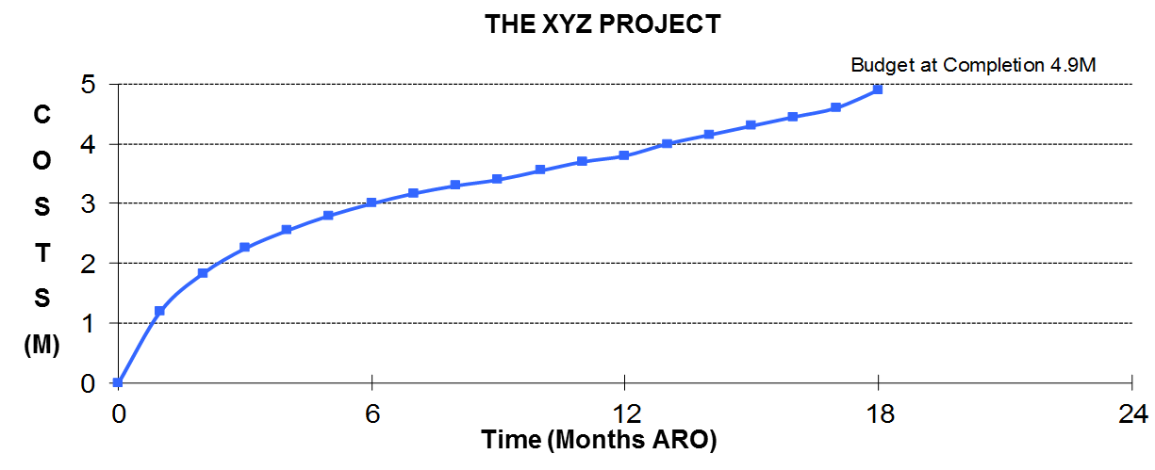
What is Earned Value - A Brief Synopsis
EVMS is based upon breaking the project into manageable pieces called “Work Packages”
  The work packages are then added together across time to create a “Plan” for the project
  (blue line on “The XYZ Project”)

Slide 8
What is Earned Value - A Brief Synopsis
Then the project starts and…
  As the work packages are completed and the performance is evaluated (against the WP evaluation criteria), value is “Earned” against the planned cost (the “WP Budget”) of the work package
Therefore… The value “Earned” against work packages is NOT linked to the actual cost to perform or complete the work

Slide 9
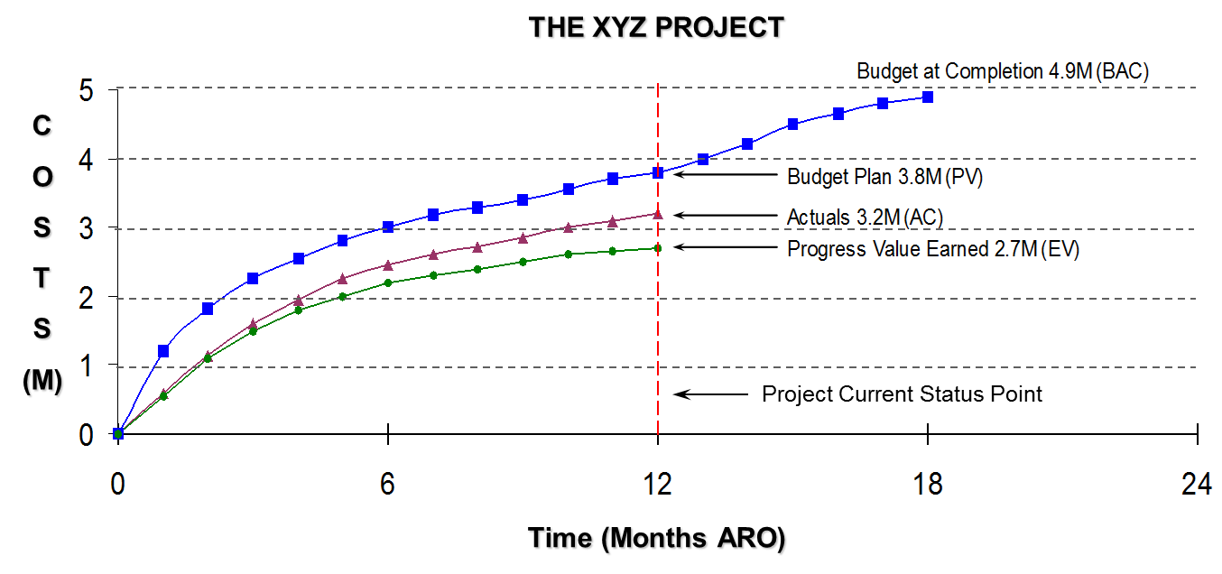
Using Earned Value to Track Progress
So lets take another look at “The XYZ Project”
  This time with earned value performance information included…
  …and we now see THE REAL STORY of our project!

Slide 10
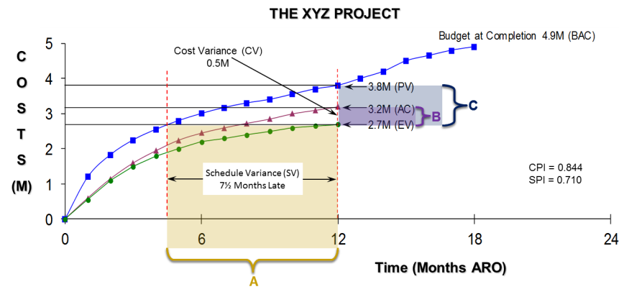

Using Earned Value to Track Progress
Let’s look at some key measurement examples
“A” - This distance reflects the amount the project is behind schedule at the current status time (7½ months late).
“B” - This reflects the cost variance (CV) in dollars (CV=EV-AC = $0.5M).
“C” - This reflects the schedule variance (SV) in dollars (SV=EV-PV = $1.1M).

Slide 11
Using Earned Value to Track Progress
Conclusions for Project XYZ
  At the present time we are 7½ months behind schedule
    (Time at Present EV) - (Time when current EV was Scheduled)
    Point “A” on the Chart
  The project will be completed late
    The Earned Value (EV) line must reach the Budget at Completion (BAC) point ($4.9M) on the graph before the project is complete
    We need to develop an Estimate to Complete (ETC) before we will know “how late”
  Due to the delay in schedule and that the project is already $500K overspent, it will likely cost “much” more to complete this project than was originally planned
    We need to develop an Estimate to Complete (ETC) before we will know the Estimate at completion (EAC)

Slide 12
Using Earned Value to Track Progress
So in summary – The Real Story of “The XYZ Project” is
  We are 12 months into an 18-month, $4.9M project
    Two-Thirds through the original schedule duration
  The project is 7 ½ months behind schedule
  The project is $500K over budget
What do you think the probability is to get this project completed within the schedule and cost constraints?

Slide 13
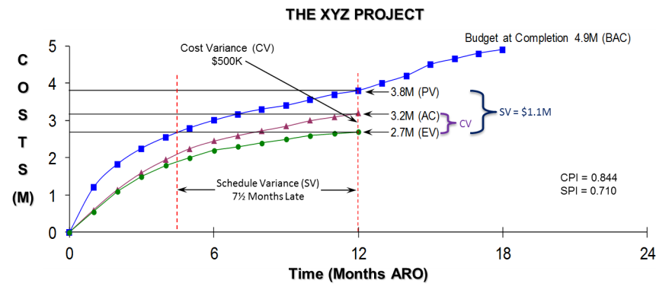
Using Earned Value to Track Progress
…And when should we have started asking the “tough questions”…?

Slide 14
Earned Value Analysis
Formulas helpful in Earned Value Analysis
  Variance Measurements
    Cost Variance (CV) = EV - AC
    Schedule Variance (SV) = EV - PV
    Variance at Completion (VAC) = BAC - EAC
    Cost Variance Percentage (CV %) = CV
    EV
    Schedule Variance Percentage (SV %) = SV
    PV

Slide 15
Earned Value Analysis
Formulas helpful in Earned Value Analysis
  Performance Indices
    Cost Performance Index (CPI) = EV
    AC
    Schedule Performance Index (SPI) = EV
    PV
    To Complete Performance Index (TCPI) = (BAC – EV)
    (EAC – AC)

Slide 16
Earned Value Analysis Tools
Formulas helpful in Earned Value Analysis (cont.)
  Overall Status
    Project Percent Complete (% Complete) = EV x 100%
    BAC
    Percent of Project Budget Spent (% Spent) = AC x 100% BAC (or EAC)
  Estimate at Completion
    Mathematical EAC = BAC - EV + AC = EAC(math)
    Cost Performance EAC = BAC = EAC(CPI)
    CPI
    Composite EAC = (BAC - EV) + AC = EAC(comp)
    CPI x SPI

Slide 17

Earned Value Analysis
Indicators to Look for in Earned Value Analysis
Measurement | A Good Thing | A Bad Thing
Cost Variance (CV) | 0 or + | -
Schedule Variance (SV) | 0 or + | -
CPI | 1.0 | 1.0
SPI | 1.0 | 1.0
VAC | 0 or + | -
TCPI | 1.0 | 1.0

Slide 18

Thank you for your time!
  Thank You for your time and participation!
  For more information on how we can provide your organization with comprehensive project management training and consulting services, please contact our offices.
Edwards Project Solutions
Phone: 800-556-2506
Fax: 443-561-0199
Email: Info@EdwPS.com
Also visit our website at:
www.EdwPS.com

Slide 19
An Overview of
Earned Value Management (EVM)
Supplemental Information

Slide 20
Supplemental Material
EVM Best Practices
Key EVM Definitions
EIA EVMS Guidelines
  Industry EVMS Guidelines

Slide 21
Some EVM Best Practices
Following good EVMS practices will yield good results
  Develop detailed work breakdown (WBS)
    Develop tasks with specific/defined deliverables and labor assigned to complete those deliverables
    Create a WBS dictionary for all the elements of the WBS
    Develop defendable (BOE) estimates for each task (activity) in the WBS
    Develop detailed schedule that “connects” to the WBS
  Map contract requirements (CLINS) and deliverables (CDRLs) to tasks/subtasks
  Enter information into scheduling/tracking tool and establish a project baseline to measure performance against
    EVM cannot be calculated without a baseline
  Map/Track labor hours expended against the project baseline
  Conduct regular (weekly -to- monthly) reviews to determine schedule and overall project status
  Perform periodic Estimates to Complete

Slide 22
Some Key EVM Definitions
  Performance Measurement Baseline (PMB): A time-phased budget plan against which project performance is measured
  Also known as a Budgeted Cost of Work Schedule (BCWS) or Planned Value (PV)
Work Breakdown Structure (WBS): A planned outcome-oriented grouping of project elements that hierarchically organize and defines the total work scope of a project; each descending level represents an increasingly detailed definition of a project’s work
  Control Account (CA): A management control point at which budgets (resource plans) and actual costs are accumulated and compared to earned value for management control purposes; a control account is a natural management point for planning and control since it represents the work assigned to one responsible organizational element (or integrated work team) for a single program WBS element
  Work Package: A task/activity or group of task/activities associated with a control account WBS element scope; it is the point at which work is planned, progress is measured, and earned value is computed
Notes:
22
1

Slide 23
EVM Definitions, cont’d
  Planning Package: A holding account of time phased resources to defined scope within a control account for future work that is not practical to detail into work packages
  Level of Effort (LOE): Work based on project resources that does not result in a finite product or project deliverable; (i.e., management, administration, etc.); work is usually spread across an entire project or a portion of a project
  Control Account Plan (CAP): A project manager’s planning and control point at a specific project’s WBS element that is assigned to a single responsible manager or team leader (Control Account Manager, CAM); contains the following:
  A single WBS element’s scope
  PV and EV
  Actual costs
  Estimate to complete
  Associated cost and schedule variances with explanation, corrective action, and impact for significant variances
Notes:
23
1

Slide 24
EIA EVMS Guidelines
The American National Standards Institute (ANSI) and the Electronic Industries Alliance (EIA) standard guidelines for EVMS with standard ANSI/EIA-748 are available for a fee from Global Engineering Documents
    Website: http://global.ihs.com/
    Phone: (800) 854-7179
Purpose of guidelines
  State the qualities and operational considerations of an integrated management system using earned value analysis methods without mandating detail system characteristics
  Provide organizations the flexibility to establish and apply a management system that suits their management style and business environment

Slide 25
Industry EVMS Guidelines (from ANSI/EIA-748)
 | Industry EVMS Guidelines
1 | Define the authorized work elements for the program. A work breakdown structure (WBS), tailored for effective internal management control, is commonly used in this process.
2 | Identify the program organizational structure including the major subcontractors, responsible for accomplishing the authorized work, and define the organizational elements in which work will be planned and controlled.
3 | Provide for the integration of the planning, scheduling, budgeting, work authorization, and cost accumulation processes with each other, and as appropriate, the program work breakdown structure and the program organizational structure.
4 | Identify the organization or function responsible for controlling overhead (indirect costs).
5 | Provide for integration of the program work breakdown structure and the program organizational structure in a manner that permits cost and schedule performance measurement by elements of either or both structures as needed.
6 | Schedule the authorized work in a manner which describes the sequence of work and identifies significant task interdependencies required to meet the requirements of the program.

Slide 26
Industry EVMS Guidelines (from ANSI/EIA-748)
 | Industry EVMS Guidelines
7 | Identify physical products, milestones, technical performance goals, or other indicators that will be used to measure progress.
8 | Establish and maintain a time-phased budget baseline, at the control account level, against which program performance can be measured. Initial budgets established for performance measurement will be based on either internal management goals or the external customer negotiated target cost including estimates for authorized but undefinitized work. Budgets for far-term efforts may be held in higher level accounts until an appropriate time for allocation at the control account level. If an over-target baseline is used for performance measurement reporting purposes, prior notification must be provided to the customer.
9 | Establish budgets for authorized work with identification of significant cost elements (labor, material, etc.) as needed for internal management and for control of subcontractors.
10 | To the extent it is practicable to identify the authorized work indiscrete work packages, establish budgets for this work in terms of dollars, hours, or other measurable units. Where the entire control account is not subdivided into work packages, identify the far term effort in larger planning packages for budget and scheduling purposes.

Slide 27
Industry EVMS Guidelines (from ANSI/EIA-748)
 | Industry EVMS Guidelines
11 | Provide that the sum of all work package budgets plus planning package budgets within a control account equals the control account budget.
12 | Identify and control level of effort activity by time-phased budgets established for this purpose. Only that effort which is not measurable or for which measurement is impractical may be classified as level of effort.
13 | Establish overhead budgets for each significant organizational component for expenses that will become indirect costs. Reflect in the program budgets, at the appropriate level, the amounts in overhead pools that are planned to be allocated to the program as indirect costs.
14 | Identify management reserves and undistributed budget.
15 | Provide that the program target cost goal is reconciled with the sum of all internal program budgets and management reserves.
16 | Record direct costs in a manner consistent with the budgets in a formal system controlled by the general books of account.

Slide 28
Industry EVMS Guidelines (from ANSI/EIA-748)
 | Industry EVMS Guidelines
17 | When a work breakdown structure is used, summarize direct costs from control accounts into the work breakdown structure without allocation of a single control account to two or more work breakdown structure elements.
18 | Summarize direct costs from the control accounts into the contractor’s organizational elements without allocation of a single control account to two or more organizational elements.
19 | Record all indirect costs which will be allocated to the program consistent with the overhead budgets.
20 | Identify unit costs, equivalent unit costs, or lot costs when needed.
21 | For EVMS, the material accounting system will provide for: Accurate cost accumulation and assignment of cost to control accounts in a manner consistent with the budgets using recognized, acceptable, costing techniques Cost recorded for accomplishing work performed in the same period that earned value is measured and at the point in time most suitable for the category of material involved, but no earlier that the time of actual receipt of material Full accountability of all material purchased for the program including the residual inventory

Slide 29
Industry EVMS Guidelines (from ANSI/EIA-748)
 | Industry EVMS Guidelines
22 | At least on a monthly basis, generate the following information at the control account and other levels as necessary for management control using actual cost data from, or reconcilable with, the accounting system: Comparison of the amount of planned budget and the amount of budget earned for work accomplished . This comparison provides the schedule variance. Comparison of the amount of the budget earned and the actual (applied where appropriate) direct costs for the same work. This comparison provides the cost variance.
23 | Identify, at least monthly, the significant differences between both planned and actual schedule performance and planned and actual cost performance, and provide the reasons for the variances in the detail needed by program management.
24 | Identify budgeted and applied (or actual) indirect costs at the level and frequency needed by management for effective control, along with the reasons for any significant variances.
25 | Summarize the data elements and associated variances through the program organization and/or work breakdown structure to support management needs and any customer reporting specified in the contract.
26 | Implement managerial actions taken as the result of earned value information.

Slide 30
Industry EVMS Guidelines (from ANSI/EIA-748)
 | Industry EVMS Guidelines
27 | Develop revised estimates of cost at completion based on performance to date, commitment values for material, and estimates for future conditions. Compare this information with the performance measurement baseline to identify variances at completion important to company management and any applicable customer reporting requirements including statements of funding requirements.
28 | Incorporate authorized changes in a timely manner, recording the effects of such changes in budgets and schedules. In the directed effort prior to negotiation of a change, base such revisions on the amount estimated and budgeted to the program organizations.
29 | Reconcile current budgets to prior budgets in terms of changes to the authorized work and internal replanning in the detail needed by management for effective control.
30 | Control retroactive changes to records pertaining to work performed that would change previously reported amounts for actual costs, earned value, or budgets. Adjustments should be made only for correction of errors, routine accounting adjustments, effects of customer or management directed changes, or to improve the baseline integrity and accuracy of performance measurement data.
31 | Prevent revisions to the program budget except for authorized changes.
32 | Document changes to the performance measurement baseline.

