Slide 1
WHO Prequalification of Quality Control Laboratories
Jitka Sabartova
WHO Prequalification of Medicines Programme

Slide 2
Objectives
Increase the access to services of QCLs that
Meet recommended standards for testing of medicines, and
Are committed to test medicines for UN agencies
Contribute to capacity building of national QCLs in developing countries (strengthening of health systems)
Technical assistance
Trainings
Guidelines
Notes:
2

Slide 3
Prequalification procedure
Established in 2004 in cooperation with UN agencies
Procedure published in 2004, revised in 2007 and 2011
http://www.who.int/prequal/info_general/documents/TRS961/TRS961_Annex12.pdf
Participation of a QC laboratory is voluntary
Any laboratory (private or governmental) can participate
Scope - chemical and microbiological testing (including LAL test) of medicines (vaccines, biologicals not included)
Based on the following principles
Evaluation of information submitted by the laboratory
On site inspection
Monitoring of performance of prequalified laboratory

Slide 4
Invitation for Expression of Interest
Previous invitations limited to QC laboratories in Africa, currently no regional limitation
3rd EOI published in September 2007
http://www.who.int/prequal/info_applicants/eoi/EOI-QCLabsV3.pdf
Priority in the assessment is given to
National QC laboratories and laboratories providing testing services to the governments
QC laboratories in areas where UN agencies identify the need for quality testing

Slide 5
Steps of the procedure
Expression of interest
Currently free of charge
Submission of laboratory information file
Guidelines for preparing LIF available
Quality Manual can be submitted (amended as necessary)
Evaluation of submitted information
Assessment of laboratory's potential to pass successfully the inspection
Compliance ⇒ WHO organizes an inspection
Gaps ⇒ For a national QCL in a developing country, WHO may organize a pre-audit/ technical assistance
Notes:
5

Slide 6
Steps of the procedure
Site inspection
Planned and coordinated by WHO
2-3 days, external inspectors experienced in QC appointed (preferably from MRA)
Representative of MRA of the country where the QCL is located is invited
Compliance with WHO recommended standards
WHO Good Practices for Pharmaceutical Quality Control Laboratories
http://www.who.int/prequal/info_general/documents/TRS957/GPCL_TRS957_Annex1.pdf
WHO Good practices for pharmaceutical microbiology laboratories
http://www.who.int/prequal/info_general/documents/TRS961/TRS961_Annex2.pdf
WHO Good manufacturing practices – parts relevant to QCLs
http://www.who.int/medicines/areas/quality_safety/quality_assurance/production/en/index.html
Focus on the overall quality system in the laboratory and chemical and microbiological testing, not on individual methods only
Notes:
6

Slide 7
Steps of the procedure
Site inspection (cont)
Report communicated to the laboratory
If corrective actions to be taken by the laboratory, final decision is made after their evaluation
Audit report from another authority (e.g. EDQM)
Compliance with WHO standards is evaluated and WHO inspection may not be necessary
ISO accreditation encouraged and considered but does not cover GMP aspects
If compliant, laboratory is included in the published list and WHOPIR is published
Prequalification does not guarantee future contracts for testing for UN agencies, competitive tendering usually organized
Notes:
7

Slide 8
Steps of the procedure
Monitoring after prequalification
Re-inspections at a frequency based on risk assessment
At least once every 3 years
Evaluation of results from participation in proficiency testing
WHO External Quality Assurance Scheme (EQAAS), ANSM network of Francophone African countries
Brief report requested to be submitted annually
Summary of services provided to UN agencies, number of analysed samples, methods used, complaints received
Changes with significant impact to the laboratory (key personnel, facility, equipment) and update LIF
WHO may suspend or withdraw a laboratory from the list when there is evidence of noncompliance
Notes:
8

Slide 9
www.who.int/prequal
Notes:
9

Slide 10
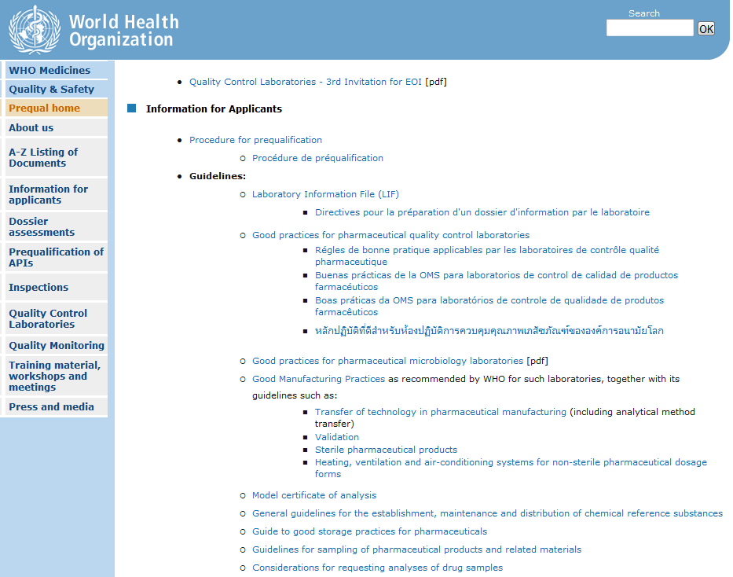
www.who.int/prequal

Slide 11
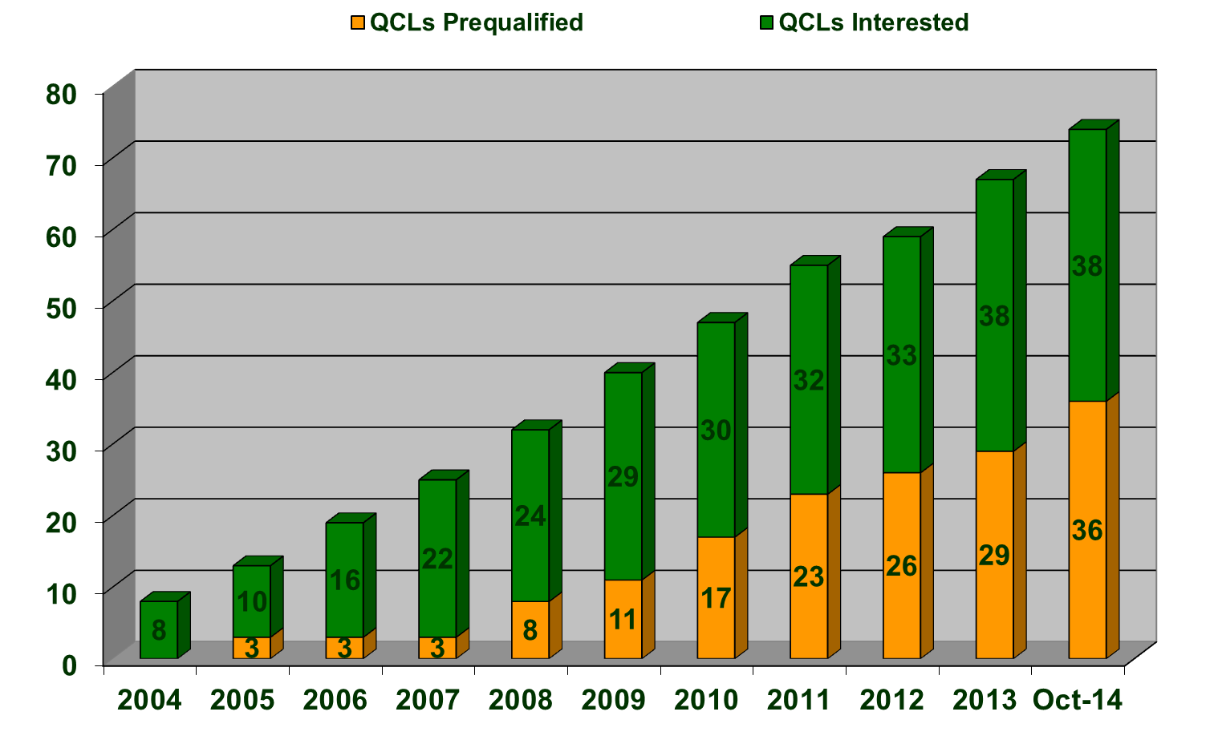
Prequalified/interested QCLs (October 2014)
Notes:
11
04/11/2014
11

Slide 12
Prequalified QCLs (October 2014)
Africa
South Africa, RIIP+CENQAM (2005)
Algeria, LNCPP (2005)
South Africa, Adcock Ingram (2007)
Kenya, NQCL (2008)
Kenya, MEDS (2009)
Tanzania, TFDA (2011)
Zimbabwe, MCAZ (2014)
Americas
Canada, K.A.B.S. Laboratories (2010)
Peru, CNCC (2010)
Uruguay, CCCM (2010)
Bolivia, CONCAMYT (2010)
Brazil, FUNED (2011)
Mexico, CCAYAC (2013)
Brazil, INCQS (2014)
South-East Asia
India, Vimta Labs (2008)
India, SGS (2011)
Thailand, BDN (2012)
India, Stabicon (2013)
Europe
France, CHMP (2008)
Ukraine, CLQCM (2010)
Ukraine, LPA (2010)
Belgium, SGS (2011)
Netherlands, Proxy (2011)
Portugal, INFARMED (2011)
Russia-Moscow, FSBI (2012)
Belarus, RCAL (2012)
Portugal, Laboratorios Basi (2013)
Russia-Rostov on Don, FSBI (2014)
Germany, InphA (2014)
Netherlands, Synergy Health Utrecht (2014)
Switzerland, Intertek (2014)
Eastern Mediterranean
Morocco, LNCM (2008)
Pakistan, Getz Pharma (2014)
Western Pacific
Vietnam, NIDQC (2008)
Singapore, TÜV (2009)
China, NIFDC (2012)

Slide 13
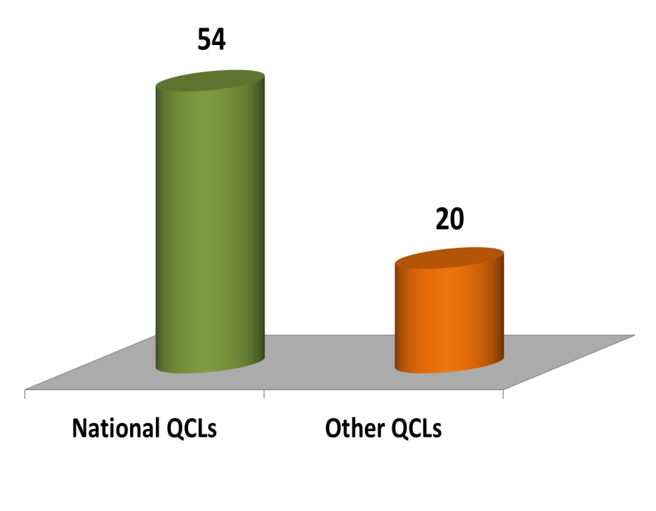
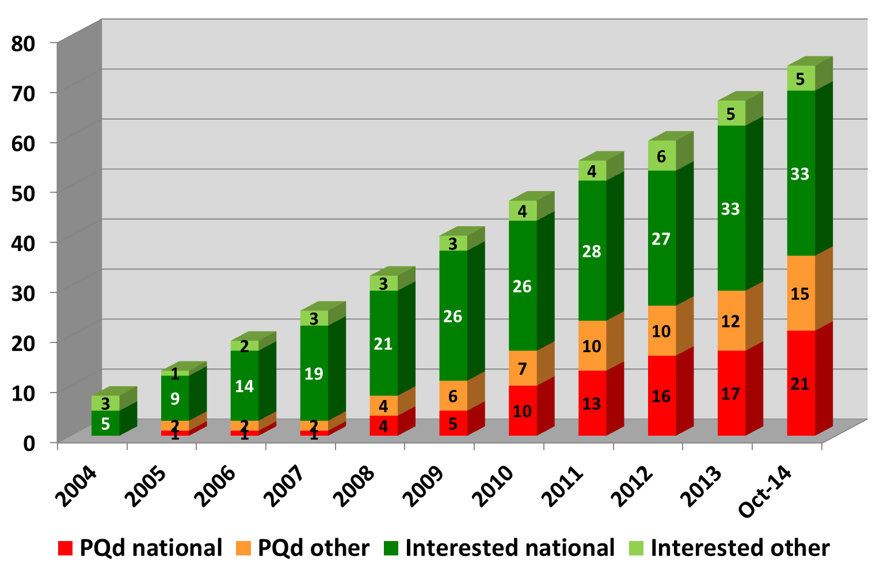
QCLs in the procedure – by status
(October 2014)
Notes:
13
04/11/2014
13

Slide 14
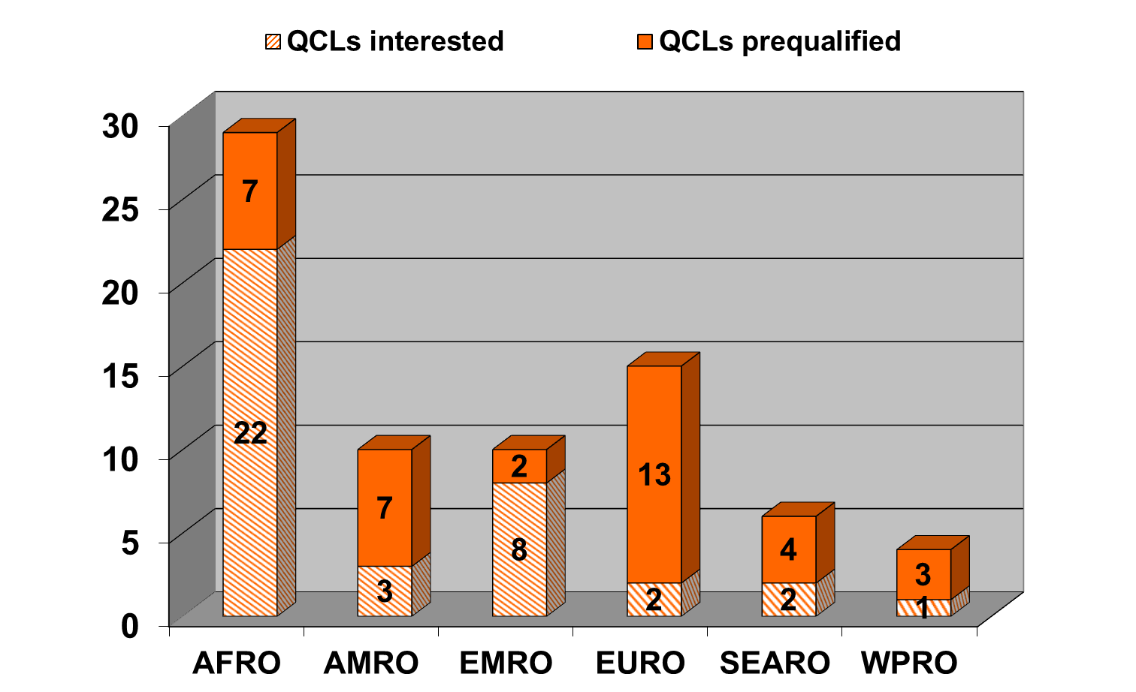
QCLs in the procedure – by region
(October 2014)
Notes:
14
04/11/2014
14

Slide 15
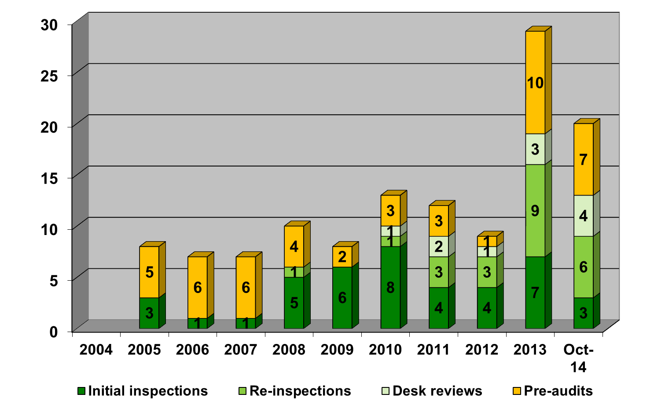
Inspections / Pre-audits performed within QCL prequalification procedure
Notes:
15
04/11/2014
15

Slide 16
Areas of frequently found deficiencies
SOPs not covering all laboratory activities, change control
Internal audits, complaints, corrective and preventive actions
Personnel - qualification, responsibilities, training programme, authorisation
Premises - monitoring of storage conditions; controlled access
Equipment – qualification, maintenance (not scheduled, not documented)
Reference substances - use not documented, traceability to primary standards
Reagents - labelling, stock management, water quality not regularly verified
Records – traceability of results
Back-up of electronic data
Verification of validated analytical methods (pharmacopoeial, manufacturers')
Procedure for atypical and out-of-specification results
Data integrity
Subcontracting tests
Safety procedures – waste management, material safety data sheets, storage of dangerous chemicals

Slide 18
Capacity building
Technical assistance provided to national medicines QCLs in developing countries
46 since 2006 (14 in 2013, 7 in 2014)
Focus on implementation of quality system, microbiology testing/lab design
Training
Training in HPLC (organized with ANSM in March 2013, Tunisia)
6 Workshops on laboratory quality control of reproductive health products (organized with UNFPA in 2011-2013 in Tanzania, Namibia, Ghana, Thailand, Fiji, Djibouti)
WHO Interregional Seminar of QCLs involved in Prequalification in South Africa, October 2014 (training focused on observations marked in red)
WHO External Quality Assurance Assessment Scheme (EQAAS) – Dr Sabine Kopp (kopps@who.int)
Notes:
18

Slide 19
Potential benefits of PQ for QCLs
Possibility to provide testing services to UN agencies and other organizations - financial profit
Recognition as being WHO listed laboratory
Facilitated discussions with manufacturers/customers in case of non-compliant results
Learning process improving the standards of laboratory work
In case on a national QCLs in a developing country, possibility to be assisted by WHO expert consultants and participate in WHO organized trainings

Slide 20
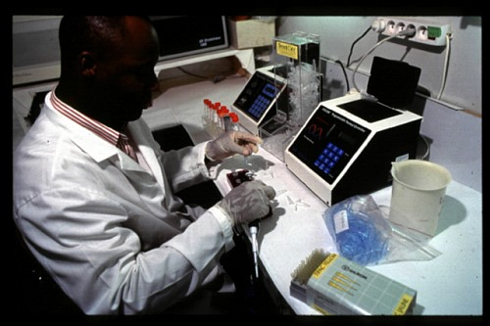
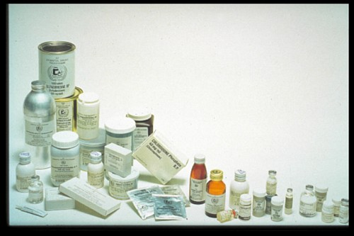
Thanks for your attention
prequallaboratories@who.int
www.who.int/prequal
Notes:
20

