Slide 1
Welcome
Open Forum: Strategic Planning

Slide 2
Forum Purpose and Format
Purpose
Generate ideas
Identify issues
Suggest topics
Format
Strategic plan overview and timeline
Each committee chair presents current thoughts, questions, and preliminary ideas
Open discussion on new ideas

Slide 3
Strategic Plan
FIU’s last strategic plan was the 2001-2010 Millennium Strategic Plan
The appointment of President Mark Rosenberg in the Fall of 2009 coincided with the need to develop a new strategic plan.

Slide 4
President’s Vision
Core Vision:
Becoming a leading urban public research university
Local and global engagement
Renewed emphasis on making sure every student counts
Embracing our identity
Four strategic themes—arts, environment, global, and health
Enhanced Vision:
Consistent Vision:

Slide 5
Timeline
August 2009: Hit the Ground Running
September 2009: White Papers Completed
March 2010 – August 2010: Committees working on Strategic Planning
April 2010: Community Forums
August 2010: Initial Draft Completed
September 2010: Community Forums
December 2010 : Final Board of Trustees Approval
January 2011: Implementation Team Selected

Slide 6
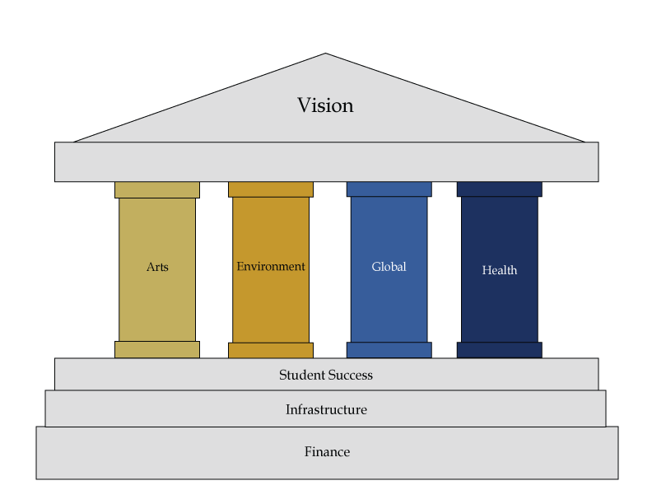
Worlds Ahead

Slide 7
Thematic Committees
Four strategic themes:
Arts
Environment
Global
Health

Slide 8
Foundation Committees
Three university-wide strategic foundations:
Finance
Infrastructure
Student Success

Slide 9
Committee Composition
Chair or Co-Chairs
Support Staff
Board of Trustees Member(s)
Faculty
Staff
Student(s)
Community representative(s)

Slide 10
Committee Chairs /Co-chairs
Themes
Arts - Carol Damian /Brian Schriner
Environment - Michael Heithaus
Global - John Stack
Health - William Pelham
Foundations
Finance - Aime Martinez
Infrastructure - Yong Tao
Student Success - Bill Beesting /Jose Rodriguez

Slide 11
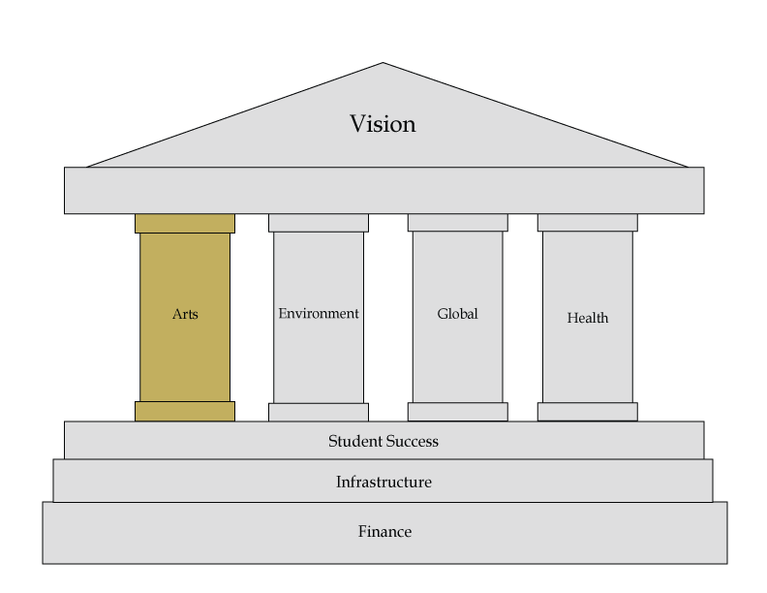
Strategic Planning: The Arts

Slide 12
Strategic Planning: The Arts
Promote the study, appreciation and creation of The Arts
Make FIU a national leader in efforts to study and advance integration of arts and technology
Build strategically collections of University museums and libraries and make them more integral to curriculum
Invest in and strengthen (or create) academic programs (undergraduate and graduate) that build on current programs and intellectual assets
Support the establishment of a Humanities Center to encourage interdisciplinary cooperation in arts and humanities and enhance institutional support for these fields
Invest in outstanding faculty and staff and reward interdisciplinary teaching, research, and engagement

Slide 13
Strategic Planning: The Arts
Engagement
Elevate FIU’s profile locally, nationally, and internationally through The Arts
Develop and strengthen strategic partnerships with local, national and international arts/cultural organizations
Strengthen the role of The Arts in the MDCPS
Use campuses and physical expansion to maximize opportunities to showcase FIU through innovative and outstanding commitment to architecture, design, and signage

Slide 14
Strategic Planning: The Arts
Infrastructure and Financing
Make The Arts a priority for individual, corporate, foundation and government fundraising
Emphasize research that highlights value of creative thinking for a 21st century economy
Emphasize the significant role of The Arts in South Florida’s economic development

Slide 15
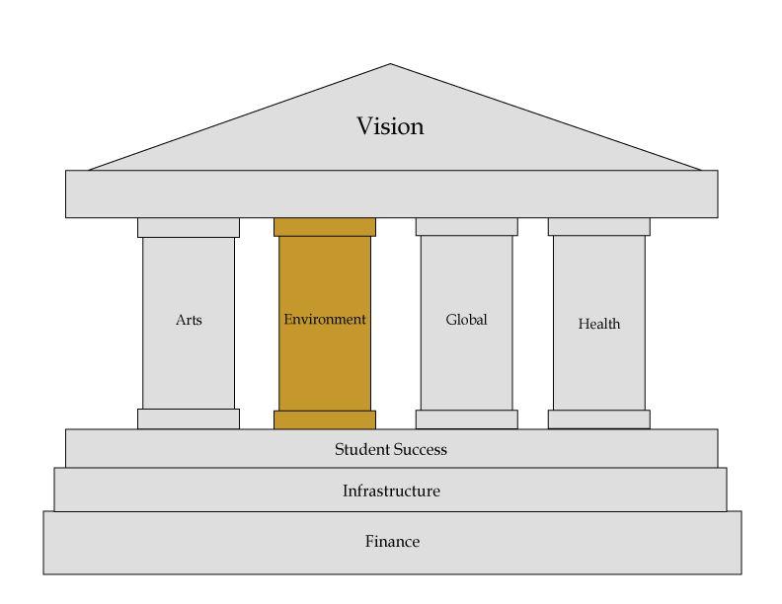
Strategic Planning: Environment

Slide 16
Strategic Planning: Environment
Academic Programs and Teaching
Ensure that all undergraduate students have a basic understanding of environmental issues from local to global scales – component of climate commitment
Incorporate environmental issues into global learning/citizenship
Modify programs where appropriate to meet the changing needs of environmental businesses/agencies to enhance employment prospects of FIU graduates
Enhance funding for graduate programs to increase environmental research opportunities and PhD production through tuition plus
Meet demand for students trained as interdisciplinary researchers
Overcome budgetary constraints to offering world-class programs through collaborations with other universities or on line offerings
Determine effective strategies for sustaining growth in environmental programs at BBC and adequately serving/teaching students at both campuses

Slide 17
Strategic Planning: Environment
Research
Enhance environmental research resources and productivity
Conduct world-class environmental research that is internationally recognized and includes use-based research
Enhance interdisciplinary research
Ensure suitable levels of infrastructure/support services for current and future research
Enhance/support international environmental research collaborations

Slide 18
Strategic Planning: Environment
Engagement
Enhance the impact of FIU research at the local, national and international scales through development of an Environmental Science, Management, and Policy Center whose purpose is to develop new ways to facilitate communication and collaboration among FIU faculty, agency resource managers, and politicians
Develop strategy to enhance K-12 engagement locally, nationally, and globally
Create a dedicated and targeted communication strategy to make public and agencies aware of FIU capabilities
Determine mechanisms for instituting, or becoming a leader in instituting the President’s Climate Commitment and building a sustainable university
Develop leadership position in sustainable buildings to enhance FIUs national and international visibility

Slide 19
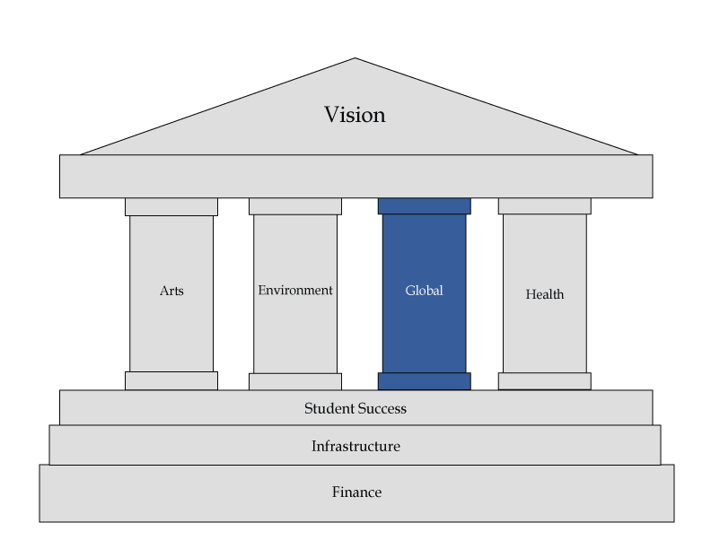
Strategic Planning: Global

Slide 20
Strategic Planning: Global
Academic Programs & Teaching
Create interdisciplinary programs with a Global focus
Expand innovative programs (non-credit and seminar opportunities)
Strengthen the QEP “Global Learning for Global Citizenship”
Increase the presence of international students
Research
Increase research at FIU on Global issues
Foster interdisciplinary research
Target cluster hires with a Global focus
Expand collaborative research with universities around the globe

Slide 21
Strategic Planning: Global
Engagement
Expand and strengthen FIU’s engagement with local, national and international communities
Facilitate research on problem solving at the community level
Identify opportunities in which global, teaching and research, can be integrated into the South Florida economy
Infrastructure & Financing
Expand financial base through collaboration with government, private sector, foundational boards including global partnerships
Intensify and diversity revenue generation
Enhance infrastructural and support services to address current and future research
Enhance the current University Infrastructure

Slide 22
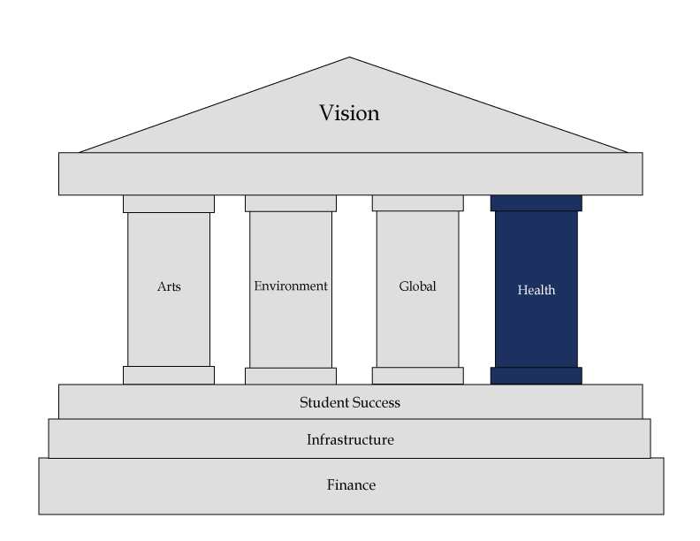
Strategic Planning: Health

Slide 23
Strategic Planning: Health
Academic Programs and Teaching
Evaluate current core and ancillary programs in the Health domain and identify those that should be continued, expanded, or discontinued at both graduate/professional and undergraduate levels
Identify potential interdisciplinary programs across Colleges and Departments for expansion or development
How can we use FIU’s multicultural strengths to build instructional connections throughout the Americas?
How can we use the WEB to maximize efficiencies in graduate and professional training, as well as continuing education for regional, national, and international professionals?
How can we integrate Teaching with Research and Engagement whenever possible?
How can we increase visibility of FIU’s academic programs in South Florida?

Slide 24
Strategic Planning: Health
Research
Dramatically increase external grant funding—particularly federal funding with full indirect costs
Identify areas for targeted cluster hiring of funded senior investigators and for investment in key areas identified in national priorities and the new Healthcare Bill
How do we develop mechanisms to educate and incentivize current faculty regarding grantsmanship?
Identify barriers to research productivity and develop supports in research infrastructure at all appropriate levels (e.g., department, college)
How can we develop interdisciplinary institutes/centers by identifying high priority areas and reducing institutional barriers to collaborative programs?
How can we increase University financial support for research?
How can we increase visibility of research within the University?

Slide 25
Strategic Planning: Health
Engagement
Enhance community engagement in recognition of (1) needs of South Florida and (2) FIU strengths and capabilities?
Identify existing partnerships and expand new relationships with community and governmental agencies in the broad Health domain
How can we develop training opportunities in Health for local and international professionals?
How can we utilize FIU resources to develop and distribute Health information to families in South Florida?
How can we increase involvement of students at all levels in community engagement?
How can we increase visibility of FIU community engagement in South Florida?

Slide 26
Overarching Questions
Enrollment size
In-state /out-of-state
On-campus /off-campus
Undergraduate /graduate
Campuses /locations /centers

Slide 27
Ideas ?
stratplan.fiu.edu
strategy@fiu.edu

