Slide 1
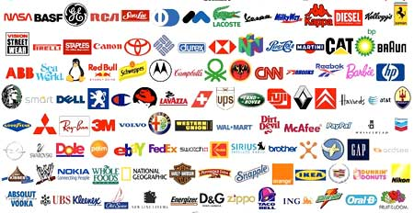
Branding Past – Present – Future

Slide 2
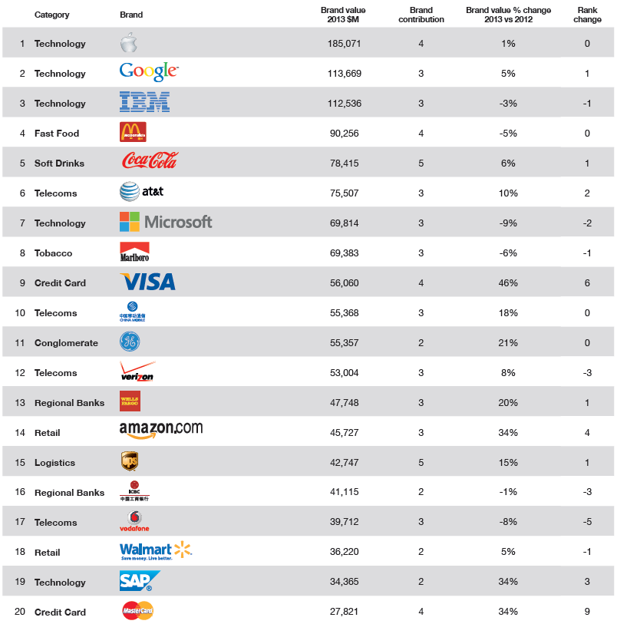
What is
“Brand”?
Automobile?
Electronics?
Nowadays, Innovation Capability Creates
Brand

Slide 3
Let”s a bit touch on “History of Brands”

Slide 4
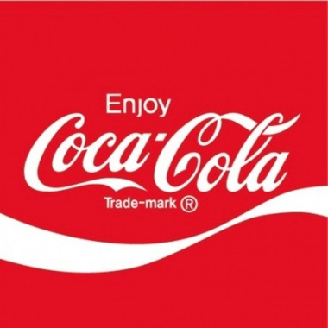
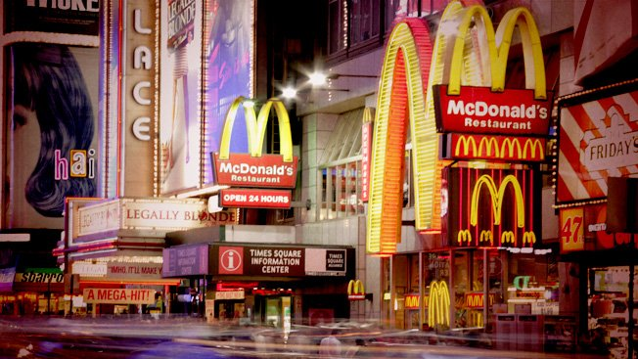
Brands in 70-80’s
Product USP
+
Logo

Slide 5
Brands in 90’s
Product USP
Brand Communication

Slide 6
Classic Brand Theory
3
BASE OF
AUTHORITY
2
SYMBOL
5
EMOTIONAL
BENEFIT
4
FUNCTIONAL
BENEFIT
1
CORE
VALUE
7
BRAND
PERSONALITY
6
IDEAL
CUSTOMER
IMAGE

Slide 7
Classic Brand Theory
Symbol
Base of
Authority
Swoosh
Long term respect for and dedication to sports and athletes
Emotional
Benefit
Functional
Benefit
Core
Value
Ｒ
Exhilaration as if you are a hero
High performance as an athlete
A Sense of Victory
Brand Personality
Ideal
Customer
Image
People who loves sports and pursue winning
Uncompromising winners

Slide 8
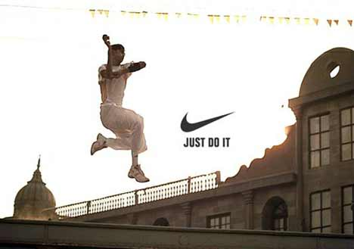
What do they sell?

Slide 9
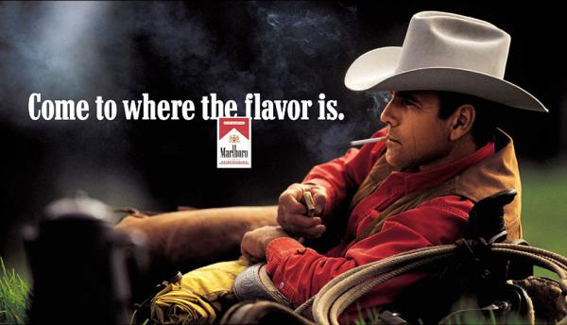
What do they sell?

Slide 10
It was happy days for advertising agency.
We created a fancy brand communication, aired them on TV and print media. Clients were happy.

Slide 11
Internet has changed everything…. (2000-)

Slide 12
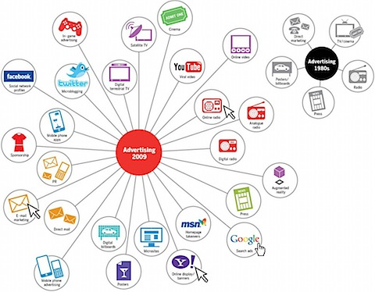
Nowadays….
Media Fragmentation

Slide 13
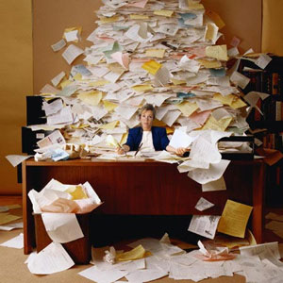
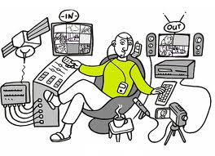
Nowadays….
Flood of Information to consumers

Slide 14
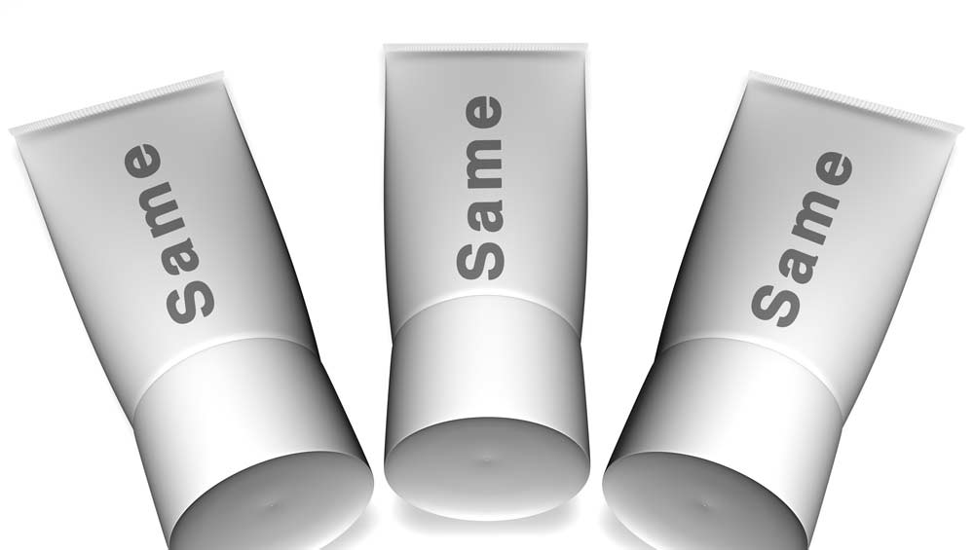
Nowadays….
Flood of Consumer Products

Slide 15
Nowadays….
Consumers are connected each other.
Online community
Consumer generates media.

Slide 16
Nowadays….
People do not believe fancy brand communication through mass media anymore.
People more believe in Consumer Generated Media.
Product itself communicates
From one-way communication to two way and then community communication
Brand Community enhance the brand value.

Slide 17
Up to 90’s
Corporation
Brand
Customer
Brand Promise
Brand Value
Brand Personality
Brand Image
Brand Preference
Brand Loyalty
Purchase Intention
Mission
Vision
Value
Product

Slide 18
Nowadays….
Corporation
Brand
Customer
Promise
Shared Value
Personality
Positioning
Equity
Demand
Connection
Brand Experience
Action
Mission
Vision
Value
Product

Slide 19
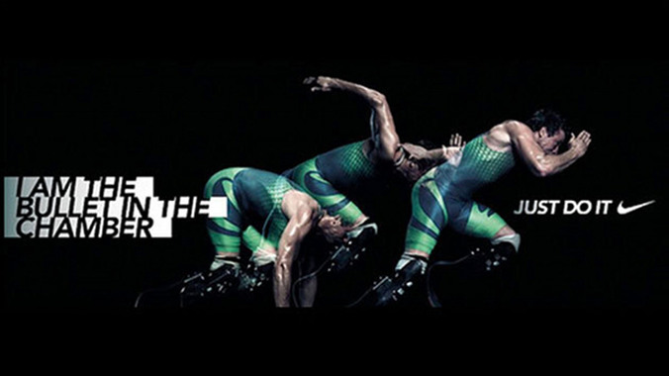
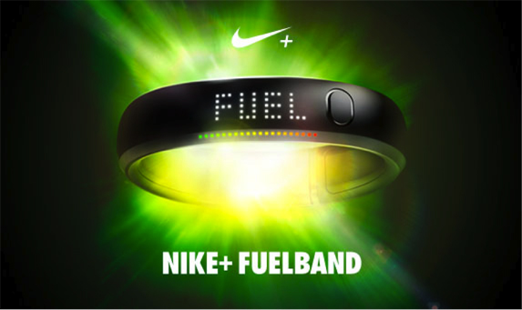
Nike

Slide 20
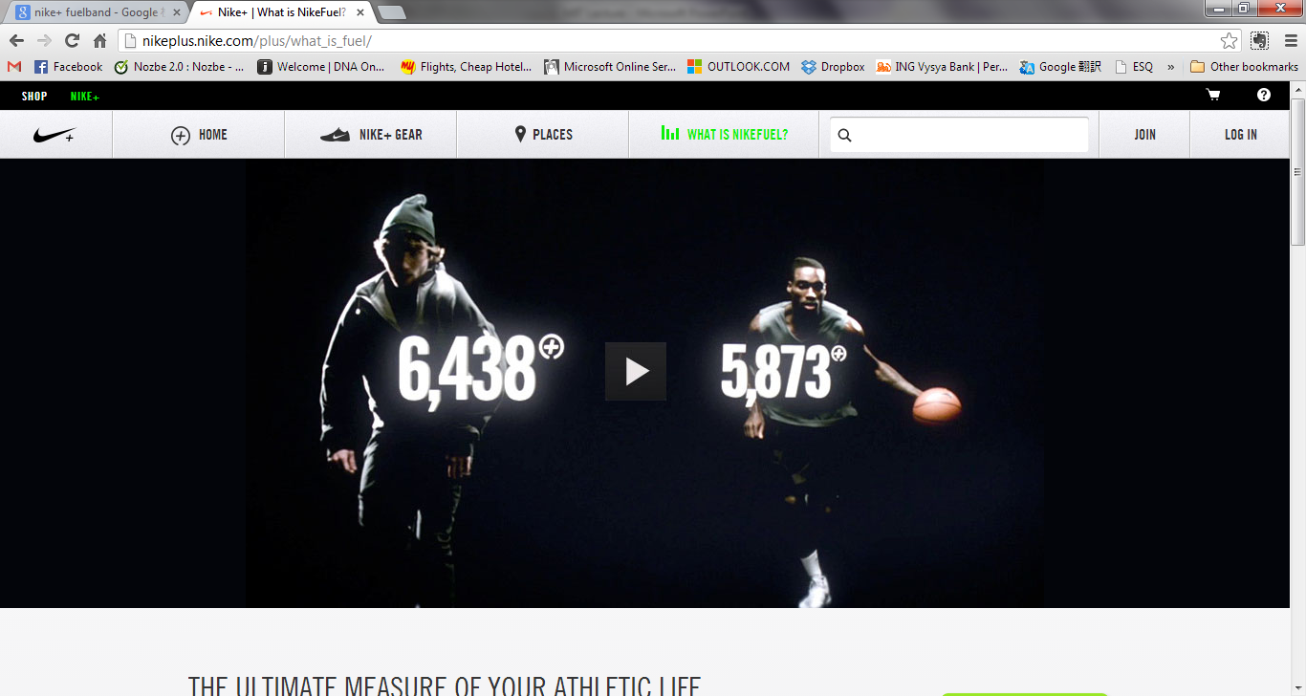
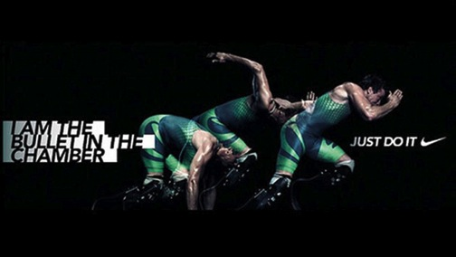
Nike

Slide 21
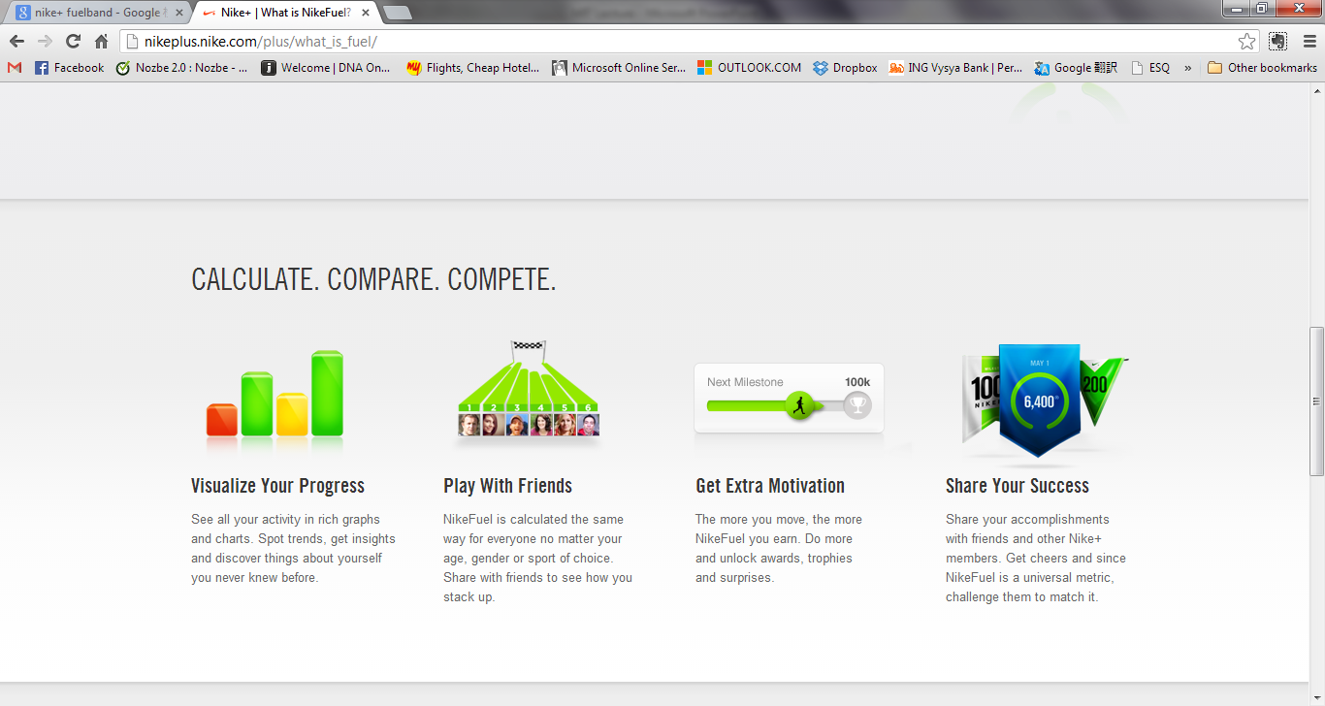
Nike

Slide 22
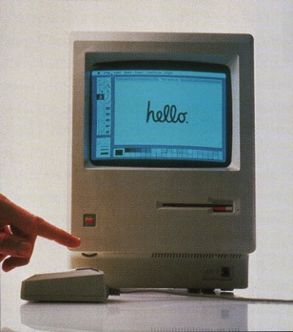
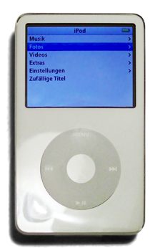
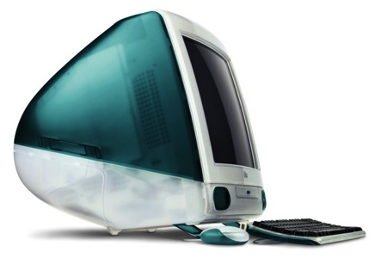
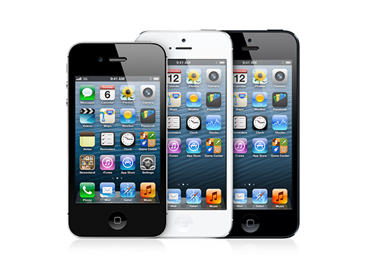
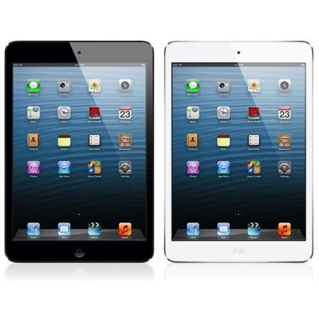
Apple

Slide 23
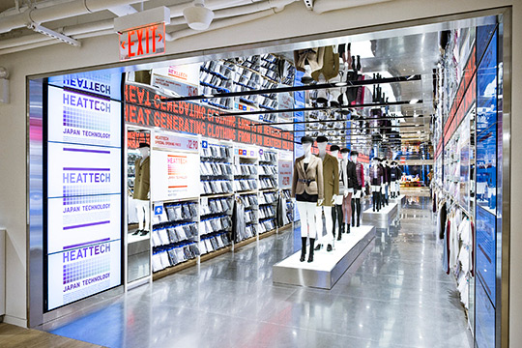
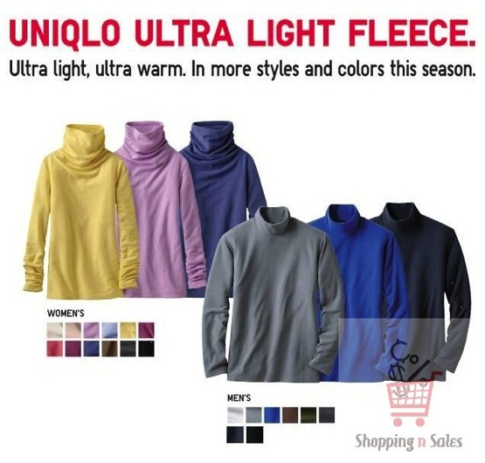
UNIQLO

Slide 24
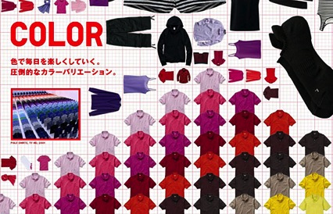
UNIQLO
World Best Quality
At
World Best Price
First in the World
Innovative Products
Create UNIQLO Community to Support Consumers’ Fashion Life

Slide 25
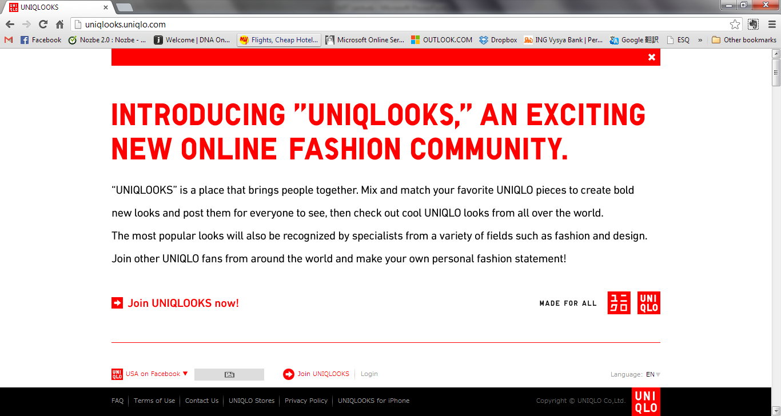
UNIQLO - UNIQLOOKS

Slide 26
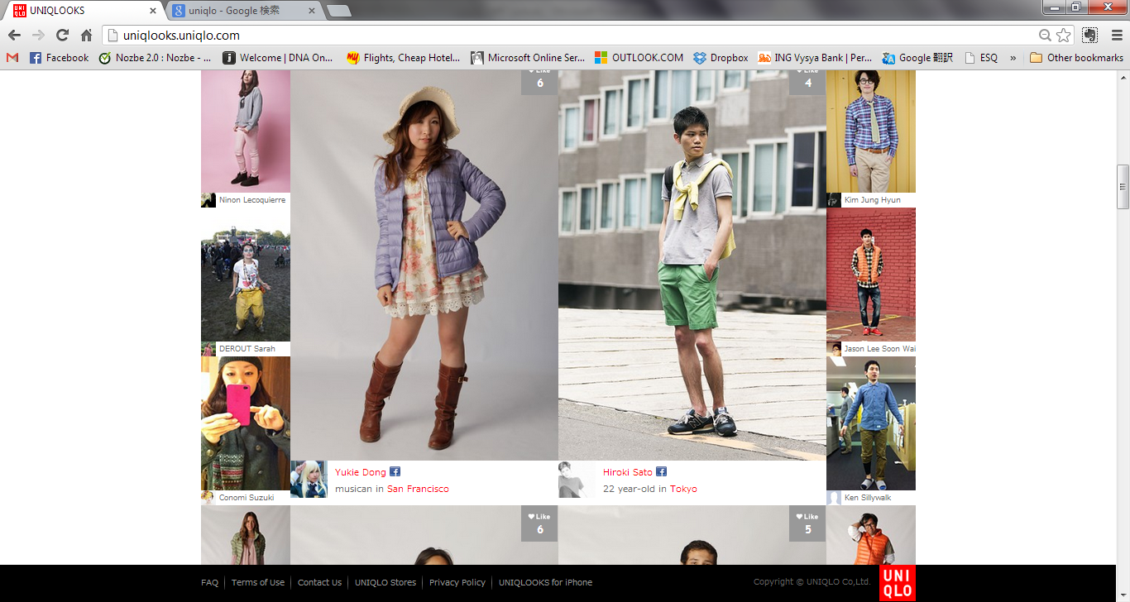
UNIQLO - UNIQLOOKS

Slide 27
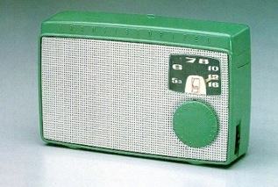
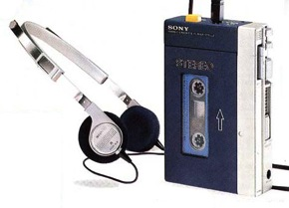
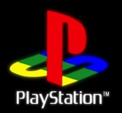
SONY
?

Slide 28
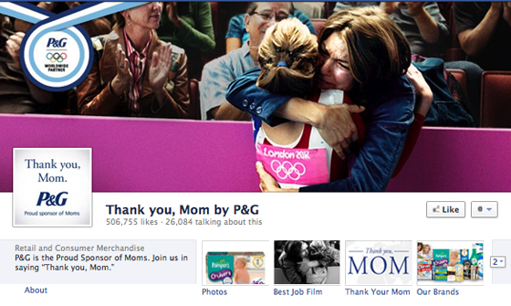
Brand Community Building
P136

Slide 29
How to Build Brand?
No Innovative Product, No Brand.
From One Way Communication To Co-creation
From “Adjective” to “Verb”
Action with Brand
Co-creation of Brand
Create Brand Community
VoC Platform
Brand Loyalty

Slide 30
How to Make Innovative Products?
Of course, no right answer.
Corporate culture to support innovation is mandatory.
From marketing point of view, “Go back to classic ‘Marketing 4P + C’”
100% Customer Driven
Simple, Focused
The Product you are excited by.

Slide 31
Branding case study - india

Slide 32
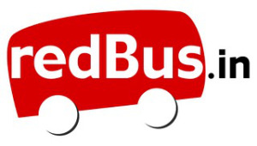

Slide 33
HOW DO YOU GO FROM NOT BEING ABLE TO GO HOME FOR DIWALI TO BEING LISTED BY FAST COMPANY AS ONE OF THE TOP 50 MOST INNOVATIVE COMPANIES IN THE WORLD ALONGSIDE APPLE AND GOOGLE?

Slide 34
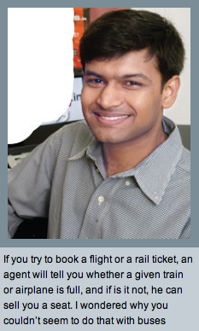
FIND A PROBLEM FOR WHICH A SOLUTION DOESN’T EXIST CURRENTLY.
PHANINDRA SAMA, CEO OF REDBUS.IN

Slide 35
HARDWARE: USE CLOUD COMPUTING TO SAVE 40% ON COSTS
SOFTWARE: USE OPEN SOURCE TECH TO KEEP OPEX DOWN
BIZ MODEL: CONSUMER SOLUTION RATHER THAN B2B SOLUTION
INNOVATE
FROM TOP TO BOTTOM
CUSTOMER ACQUISITION:
FROM THE GROUND UP
SCALE: SOFTWARE PRODUCT TO ONLINE PLATFORM
SCALE: ONE CITY TO 15 CITIES, ONE BUS OPERATOR TO 1003 OPERATORS

Slide 36
INITIATE VC FUNDING TO START UP, NOT TO FIND EASY WAY UP
DON’T START UP A START-UP WITH THE GOAL OF SELLING IT
FIND MENTORS WHO HELP KEEP SINGLE-MINDED EXECUTION FOCUS
INVEST YOUR TIME LIKE YOUR LIFE, NOT A FEW YEARS, DEPENDED ON IT
MOST CRUCIAL SOFTWARE: PEOPLE. INVEST IN THE BEST PROFESSIONALS

Slide 37
MAKE BUS TICKET BOOKING A PAINLESS ONLINE EXPERIENCE
DON’T CHARGE PREMIUM FROM CONSUMER OR OPERATOR
BUSINESS OPPORTUNITY IS FROM AGGREGATION, NOT OVERCHARGING
BUILD THE BRAND THE OLD-FASHIONED WAY: PUT CUSTOMERS FIRST
FOCUS ON ADDRESSING AND ELIMINATING CUSTOMER ISSUES
FASTER & EASIER BOOKING, FASTER TICKET DELIVERY, ASSURED BOOKING
BEAT CONVENTIONAL WISDOM OF “BUS COMMUTERS ARE NOT ONLINE”

Slide 38
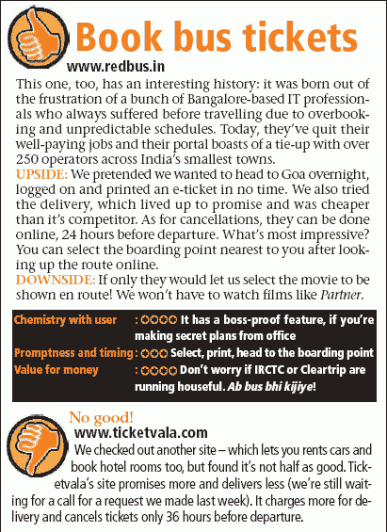
BUILD THE BRAND THE OLD-FASHIONED WAY:
PUT CUSTOMERS FIRST

Slide 39
Search engine optimization
Search engine Marketing
Email marketing
Affiliate marketing
Targeting local communities
Distributing pamphlets in IT parks in Bangalore
Using auto-rickshaws as billboards
BUILD THE BRAND THE NEW-FASHIONED WAY: MAKE TECHNOLOGY YOUR BRAND’S BEST FRIEND

Slide 40
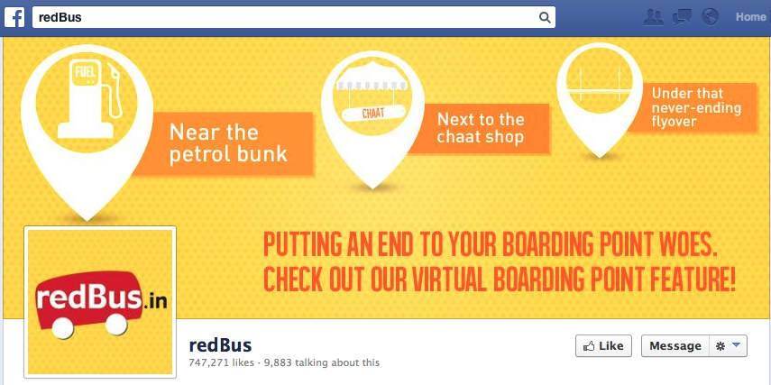
BUILD THE BRAND THE NEW-FASHIONED WAY:
MAKE TECHNOLOGY YOUR BRAND’S BEST FRIEND

Slide 41
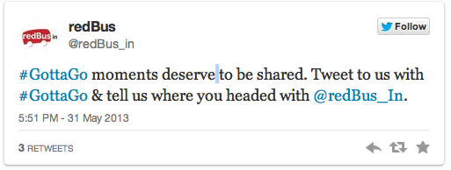
BUILD THE BRAND THE NEW-FASHIONED WAY:
MAKE TECHNOLOGY YOUR BRAND’S BEST FRIEND

Slide 42
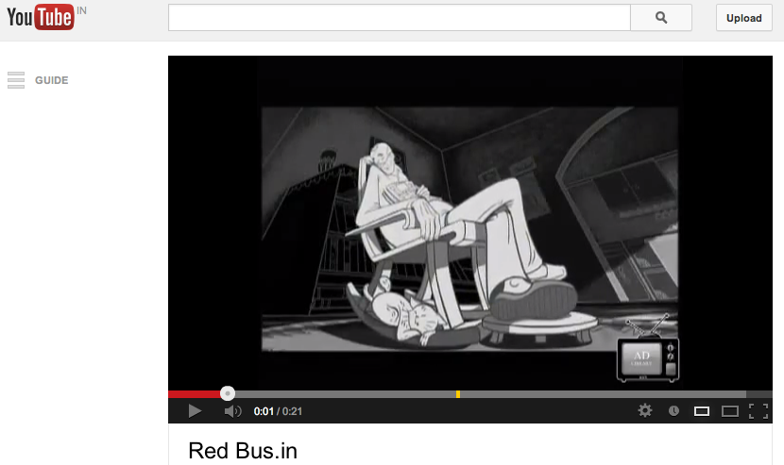
BUILD THE BRAND THE NEW-FASHIONED WAY:
MAKE TECHNOLOGY YOUR BRAND’S BEST FRIEND
http://www.youtube.com/watch?v=y3uaZYNEkkE
http://www.youtube.com/watch?v=a10BZAuQx6o
http://www.youtube.com/watch?v=IDlm8kv3wSM

Slide 43
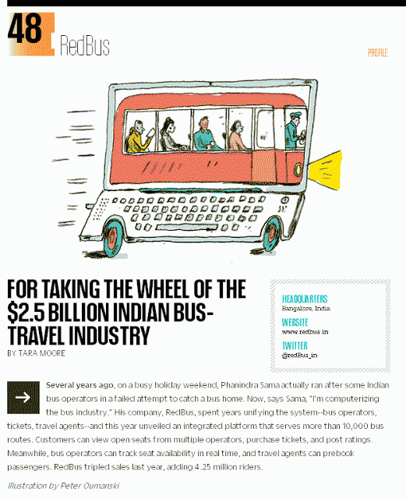
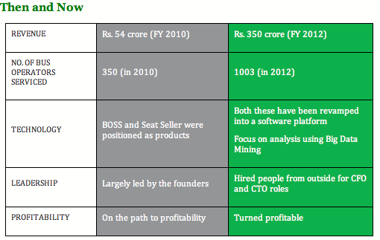
BECOME A ROLE MODEL FOR AN ENTIRE ECOSYSTEM

Slide 44
REFERENCES
http://www.dare.co.in/people/case-studies/building-a-brand-at-redbus.htm
http://www.rediff.com/business/slide-show/slide-show-1-special-how-redbus-made-it-to-the-worlds-top-50-innovations-list/20120222.htm#1
http://www.dazeinfo.com/2013/06/17/redbus-in-acquisition-of-140-million-a-paradigm-shift-for-indian-startups/
http://redbusin.blogspot.in
http://www.thesmartceo.in/cover-story/hop-on-the-redbus.html
http://lighthouseinsights.in/redbus-runs-gottago-on-twitter-this-holiday-season.html
http://micalectureseries.wordpress.com/tag/redbus/

Slide 45
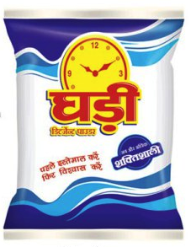

Slide 46
HOW DO YOU SUCCESSFULLY TAKE
ON THE MIGHT OF THE WORLD’S LARGEST FMCG COMPANY FROM
A 3-FLOOR BUILDING ON A DUSTY ROAD IN KANPUR?

Slide 47
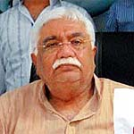
GET YOUR POSITIONING RIGHT
EVERYBODY’S BRAND.
The detergent market has three well-defined segments: Premium which is about 15 per cent of the market and includes brands like Hindustan Unilever’s Surf and Procter & Gamble’s Ariel, midscale (40 per cent of the market; main players are Hindustan Unilever’s Rin and Procter & Gamble’s Tide) and popular (45 per cent of the market where Ghari, Nirma, Hindustan Unilever’s Wheel and Fena’s Fena operate). Ghari is positioned at the bottom of the market where the real volumes lie. Rohit Surfactants Chairman & Managing Director Murlidhar is very clear where his flagship brand is slotted.
“Ghari is everybody’s brand. It is the best solution available in the market and gives you value for your money.”
- MURLIDHAR GYANCHANDANI, CREATOR OF GHARI DETERGENTS

Slide 48
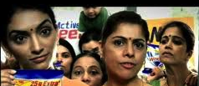
READ THE CONSUMER’S PULSE RIGHT
Detergent is bought largely by the housewife once a week or month, and she happens to be an extremely value-conscious consumer. Consumers, especially those in villages and small towns, have begun to look for cheaper options in staples like soap, detergent and toothpaste so that they can spend more on discretionary items like mobile phones, televisions and automobiles. Their choice of detergent is inevitably one that gives the maximum results at the lowest price.

Slide 49
GET MORE FROM LESS
Ghari’s low prices are a result of Rohit Surfactants and its promoters being willing to settle for a lower net profit margin of 9 per cent — the industry standard is 12 to 13 per cent for the premium players. In other words they are ready to sacrifice some profits for market share.
The company works on a shoestring advertising and marketing budget. In 2009-10, while Ghari did a turnover of Rs 1,825 crore, its marketing team was handed out only Rs 35 crore, or less than 2 per cent, to promote the brand through above- and below-the-line activities. Most national brands have a marketing budget that adds up to 13 to 15 per cent of their turnover.

Slide 50
BREAK THE CLUTTER
The trick in marketing, because of the small budget, is innovation.
The brand set the ball rolling by taking the brand to trains. The first campaign was the Ghari Detergent Express (a summer special) in 2008 that ran between Lucknow and Guwahati for two months. Next came the Pushpak Express that runs between Lucknow and Mumbai. The brand can also be seen on railway crossings in West Bengal and Uttar Pradesh.
In addition, Rohit Surfactants promotes Ghari at roadside shows, magic shows and exhibitions in smaller towns and cities. Customers are unlikely to see other brands at these places — an innovative idea to break the clutter.

Slide 51
PLAY TO YOUR STRENGTHS
Before going national (which would have spread its resources very thin), Rohit Surfactants focused on Uttar Pradesh to begin with.
Uttar Pradesh, with a population of 167 million, accounts for over 12 per cent of the country’s FMCG sales. Thus, of the 3,000 Ghari dealers in the country, 900 are in Uttar Pradesh — 25 of them in Kanpur alone. Nine of the company’s 18 manufacturing units are in Uttar Pradesh. Once the home base was secured, it spread out to other states.
Ghari detergent provides a profit margin of 9% to its dealers, which is substantially lower than the standard 12-13% for premium brands, and at the same time, higher than the 6-7% being offered by the competitors in the same segment. Thus the company has been working towards creating a strong dealer base while keeping its prices low.

Slide 52
REFERENCES
http://www.business-standard.com/article/management/watch-out-for-ghari-express-110110100048_1.html
http://opepiimraipur.blogspot.in/2012/02/gharis-success-against-hul-and-p.html
http://businesstoday.intoday.in/story/indias-best-marketers/8/4804.html

Slide 53
Thank you very much

