Slide 1
Managing Conflict
Facilitated by
Michele C. Boyer, Ph.D., HSPP
Professor of Counseling Psychology Emerita

Slide 2
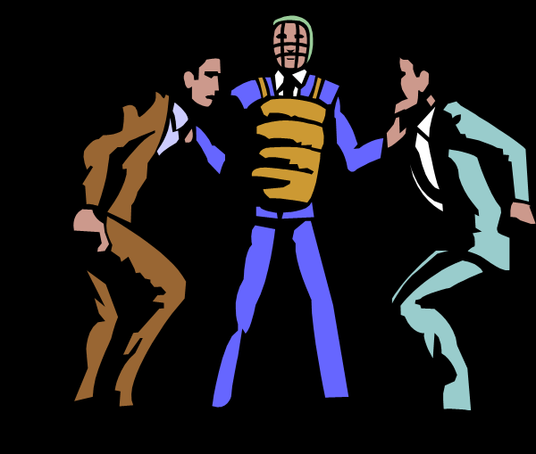

Slide 3
Plan for the Session
Conceptual Overview
Conflict, Communication, Culture
Personal Assessment of Conflict Management Style
Examination and Exploration of a Model of Conflict management
Discuss Case Situations

Slide 4
What is interpersonal conflict?
“an expressed struggle between at least two interdependent parties who perceive incompatible goals, scarce resources, and interference from the other party in achieving their goals”
(Wilmont & Hocker, 2001)

Slide 5
What comes to mind when you think of “conflict?”

Slide 6
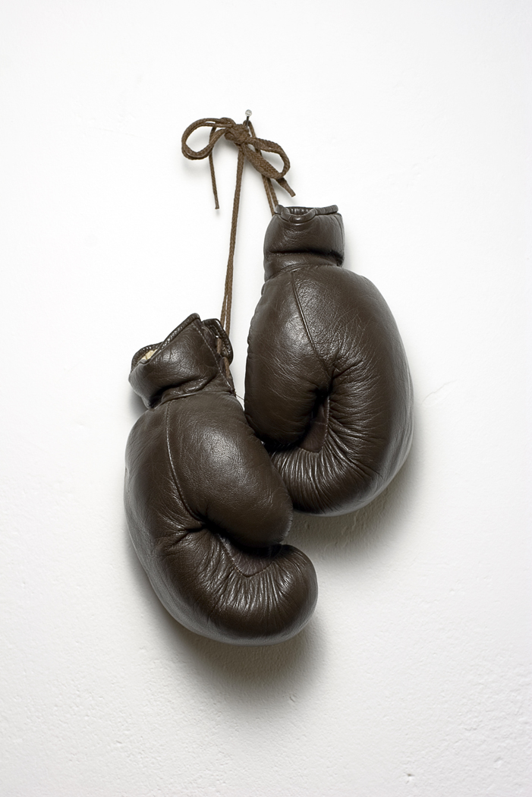

Slide 9
Characteristics of Conflict
A natural part of relating to others
Has Content, Relational, and Procedural Dimensions
Indirect or Direct
Potential for Harm
Potential for Benefit
(Floyd, 2011)

Slide 10
Typical Sources of Conflict
Power
Respect
Distribution of Resources

Slide 11
Conflict is Impacted by ‘Culture’
Male and Female Gender Socialization
Individualism – Collectivism
High Context – Low Context Communication
Low Power Distance – High Power Distance

Slide 12
Conflict is Impacted by ‘Culture’
Time as Monochronic or Polychronic
Uncertainty Avoidance – Uncertainty Acceptance
Verbal and Non-verbal Behavior

Slide 13
Don’t be afraid of opposition.
Remember,
a kite rises against,
not with, the wind.
- Hamilton Mabie

Slide 14
Characteristics of Competent Communicators
Self-Awareness
Adaptability
Empathy
Cognitive Flexibility
Ethical

Slide 15
Signals of Distress
Gottman’s Four Horsemen of the Apocalypse
Criticism
Contempt
Defensiveness
Stonewalling

Slide 16
Conflict Management
Is Complex
Is Impacted by
Personal Characteristics
Contextual Characteristics
Cultural Characteristics

Slide 17
Your TKI Style

Slide 18
Blake & Moulton’s Managerial Grid Dimensions (1960)
High
Orientation
Toward Own
Needs:
Assertiveness
Low
Low High
Orientation Toward Others’ Needs:
Cooperativeness

Slide 19
The Thomas-Kilmann Conflict Mode Instrument (TKI)
Initially a research tool developed in the 1970s
Thomas’ theoretical refinement of Blake and Moulton’s Managerial Grid
Leading measure of conflict-handling behavior
Recently re-normed (gender, race/ethnicity, org level)
Good reliability and validity data
Now computerized and available from Consulting Psychologists Press

Slide 20
Thomas-Kilmann Conflict Styles
Compromising
Competing
Collaborating
Avoiding
Accommodating

Slide 21
Styles and Outcomes
Compete I win/you lose
Avoid I lose/you lose
Accommodate I lose/you win
Compromise I win a little/you win a little
Collaborate I win/you win

Slide 22
Strategy Considerations
Strategies are not inherently ‘Good’ or ‘Bad’
Each strategy has advantages and disadvantages
Develop strategy flexibility

Slide 23
Strategy Considerations
Nature and value of the relationship
Importance and complexity of the issues
Experience of power
Time

Slide 24
Holton Model of Conflict Management
Identify the conflict – who, what, when, where, resolution attempts, consequences?
Identification of solutions – positive attitude, ground rules, interests of the parties, alternatives, criteria (objective and subjective), weigh solutions against criteria
Implement the plan – develop action plan, determine how to handle future conflicts

Slide 25
Scenarios and Discussion

Slide 27
Tips for Success
Focus on the facts, issues, or situations not personalities
Listen carefully-consider what is said and not said
Be mindful of the affective dimension
Consult!
Cultivate a culture of effective and appropriate communication
Learn the preferred conflict resolution styles of others
Consider alternative perspectives
Consider the impact of culture-broadly defined
Use appropriate humor
Encourage and practice self-care

Slide 28
Questions

Slide 29
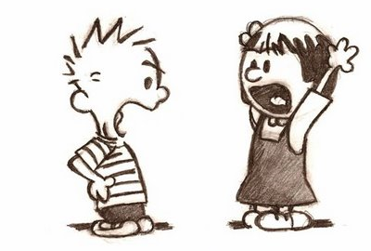

Slide 31
Thank You!

