Slide 1
Marketing Mix Strategies
BA 523 International Marketing
Melike Demirbag Kaplan, PhD

Slide 2
Global Marketing Program
Standardization vs. Adaptation?
Levitt (1983) “the world is becoming standardized and homogeneous, companies should market the same products in the same way in all countries. Technology, causes needs and preferences to converge throughout the world”

Slide 3
Global Marketing Program
Standardized marketing mix involves selling the same products and using the same marketing approaches worldwide
Adapted marketing mix involves adjusting the marketing mix elements in each target market, bearing more costs but hoping for a larger market share and ROI

Slide 4
Standardization
WHEN?
Commonalities in customers’ needs across countries
“Made in” image is important to a product’s perceived value e.g. France for perfumes, Sheffield for stainless steel
Homogeneity of markets, in other words markets available without adaptation e.g. denim jeans
Cultural insensitivity

Slide 5
Standardization
WHY?
Economies of scale in production, marketing/communications, research & development
Minimizing costs
Easier management and control
HOW?
Usually considered in the context of product, pricing, marketing communications; particularly advertising, branding, packaging

Slide 6
Global Standardization
Standardization of products across markets and standardization of the marketing mix worldwide
Addresses needs of global consumers (homogeneous consumer groups sharing similar interests and product/ brand preferences)
Allows for global branding – using the same brand name, logo, image, and positioning everywhere in the world

Slide 9
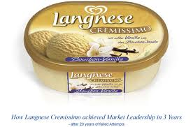
Regional Standardization
Using a uniform marketing strategy in a particular region

Slide 10
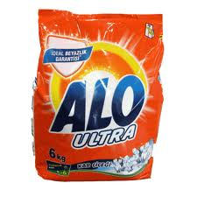

Slide 11
Global Localization (somewhat adaptation)
The practice of global branding and localized marketing adaptation to differences in local culture, legislation, etc.
Modular Adaptation: Offer parts (modules) that can be assembled worldwide in different configurations, depending on market needs
Core Product Strategy: Involves using a standardized strategy for the core product worldwide, but varying certain aspects of the offering (product ingredients, advertising, for example) from market to market

Slide 12
Modular Adaptation
General Motors has established a modular product architecture for all its global automobile products. Future GM cars will be designed using combination of components from 70 different body modules and about a hundred major mechanical components (e.g. Engines, power trains, and suspension systems)

Slide 13
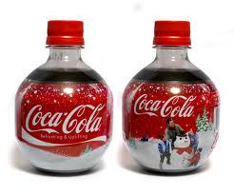
Core product strategy

Slide 14
Adaptation
Mandatory Adaptation: Adapting products to local requirements so that they can legally and physically operate in the respective countries – for example: Left-hand driving in the United Kingdom
Local Non-Mandatory Adaptation: Adapting a product to better meet the needs of the local market, or developing new brands for individual local markets, even though such adaptation is not required

Slide 15
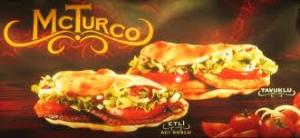

Slide 16
Product Strategy
Straight product extension means marketing a product in a foreign market without any change
Product adaptation involves changing the product to meet local conditions or wants
Product invention consists of creating something new for a specific country market
Maintain or reintroduce earlier products
Create new products

Slide 17
Promotions Strategy
Companies can either adopt the same communication strategy they use at home or change it for each market

Slide 18
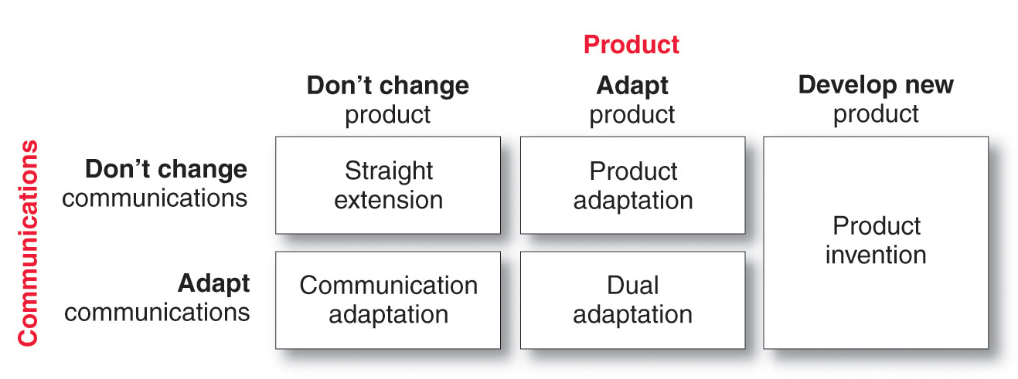
Product & Communications Strategy

Slide 19
Pricing Strategy
Uniform pricing is the same price in all markets but does not consider income or wealth where the price may be too high in some or not high enough in other markets
Market-based pricing is the price the market can pay but does not consider actual costs
Standard markup pricing is a price based on a percentage of cost but can cause problems in countries with high costs

