Slide 1
A Telework Introduction and Training for Managers at Kennesaw State University
Erin Clark
Telework Consultant
Charlotte Weber
Telework Specialist

Slide 2
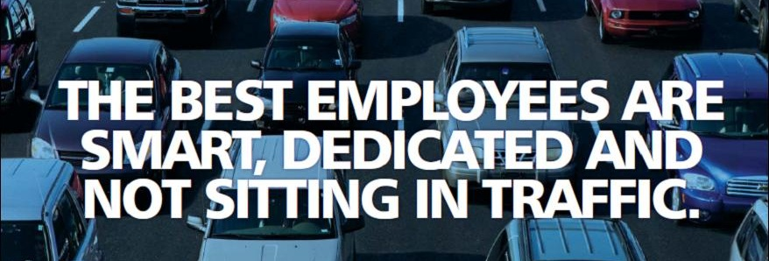
The Average Metro Atlanta Commute
Average Commute is 35 miles; 60 minutes round-trip.
Over 38% of Georgia commuters live in one county and work in another.
18% of household income is spent on transportation costs.
The Braves stadium will add up to 20,000 additional cars to Cobb County roads.

Slide 3
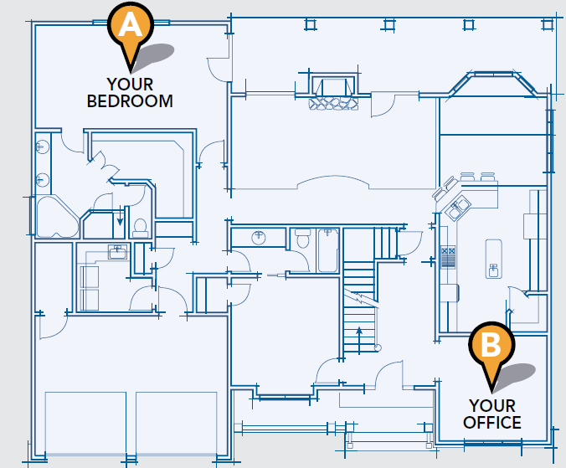
What is Telework?
Extends the workplace beyond the traditional office
Is a voluntary arrangement, not a benefit or entitlement
Only appropriate when job is right, employee is right, technology works, and manager/dean approves the work arrangement
A vital component in business continuity
Your New Commute
Notes:
Remote work location example: Bank HQed in Norcross made arrangements for its employees to work from the nearest branch office.

Slide 4
Telework is NOT…..
For every employee or every job
Always a full-time arrangement
A replacement for child care or dependent care
Sending people home and never seeing or hearing from them again
A substitute for managing personal or other activities

Slide 5
Prevalence and Growth of Telework
Regular work-at-home, among the non-self-employed population, has grown by 103% since 2005 and 6.5% in 2014.
80% to 90% of the U.S. workforce says they would like to telework at least part time.
Industries recruiting the most telework jobs in the first part of 2016 were Healthcare, Technology and Education.
Source: Global Workplace Analytics’ research finds based on stats from the American Community Survey, FlexJobs.com
Notes:
Global Workplace Analytics’ research finds based on stats from the American Community Survey, Flex Jobs.com
2005-2014 American Community Survey (US Census Bureau) data conducted by GlobalWorkplaceAnalytic.com

Slide 6
Telework in Atlanta
33% of metro Atlantans telework at least occasionally
Our region has seen a 22% increase in telework usage over the past four years
The Atlanta region is #2 in the country for a workforce that teleworks
Telework is the #1 commute alternative to driving alone
*2014 Commuter Survey, Microsoft Work Without Walls

Slide 7
The Majority of Employers Offer Telework
% of Employers allowing the following frequencies of Telework
Ad hoc telework (e.g. to meet a repair person, care for a sick child): 85%
Telework on a regular monthly basis (at least one day per month, but not full time): 56%
Telework on a regular weekly basis (at least one day per week, but not full time): 53%
Full-time telework (every regularly scheduled work day): 34%
*2015 Trends in Workplace Flexibility, World at Work

Slide 8
Advantages/ROI of Telework Programs
KSU Advantages
Reduced absenteeism (2-4 days)
Lowered overhead and real estate costs (10-90%)
Expands coverage
Provides workplace flexibility/work-life balance
Vital component to a Business Continuity Plan
KSU + Faculty and Staff Advantages
Increased job satisfaction, loyalty & engagement
Improved morale and productivity (3-20%)
Increased morale, recruitment & retention (50-65%)
Lowered stress and health care expenses
Environmentally friendly “green” program
Source: Global Workplace Analytics, World at Work, FlexJobs.com
Notes:
Improves employee satisfaction
– People are sick of the rat race, eager to take control of their lives, and desperate to find a balance between work and life.
– Two thirds of people want to work from home.
– 36% would choose it over a pay raise.
– A poll of 1,500 technology professionals revealed that thirty-seven percent would take a pay cut of 10% if they could work from home.
– Gen Y’ers are more difficult to recruit (as reported by 56% of hiring managers) and to retain (as reported by 64% of hiring managers) but they are particularly attracted flexible work arrangements (rating among benefits as an * on a 10 scale as impact on overall job satisfaction)
– 80% of employees consider telework a job perk.
• Reduce attrition
– Losing a valued employee can cost an employer $10,000 to $30,000.
– Recruiting and training a new hire costs thousands.
– 14% of Americans have changed jobs to shorten the commute.
– 46% of companies that allow telework say it has reduced attrition.
– 95% of employers say telework has a high impact on employee retention.
– Almost half of employees feel their commute is getting worse; 70% of them feel their employers should take the lead in helping them solve the problem.
– 92% of employees are concerned with the high cost of fuel and 80% of them specifically cite the cost of commuting to work. 73% feel their employers should take the lead in helping them reduce their commuting costs.
– Two-thirds of employees would take another job to ease the commute.
• Reduces unscheduled absences
– 78% of employees who call in sick, really aren’t. They do so because of family issues, personal needs, and stress.
– Unscheduled absences cost employers $1,800/employee per year; that adds up to $300 billion/yr for U.S. companies.
– American Management Association, organizations that implemented a telework program realized a 63% reduction in unscheduled absences.
– Teleworkers typically continue to work when they’re sick (without infecting others).
– Teleworkers return to work more quickly following surgery or medical issues.
– Flexible hours allow teleworkers to run errands or schedule appointments without losing a full day.
• Increases productivity
– Best Buy, British Telecom, Dow Chemical and many others show that teleworkers are 35-40% more productive.
– Businesses lose $600 billion a year in workplace distractions.
– Over two-thirds of employers report increased productivity among their telecommuters.
– Sun Microsystems’ experience suggests that employees spend 60% of the commuting time they save performing work for the company.
– AT&T workers work 5 more hours at home than their office workers
– JDEdwards teleworkers are 20-25% more productive than their office counterpoints
– American Express workers produced 43% more than their office based counterpoints
– Compaq increased productivity 15% – 45%
• Saves employers money
– Nearly six out of ten employers identify cost savings as a significant benefit to telecommuting.
– Alpine Access Remote Agents close 30% more sales than traditional agents the year before. Customer complaints decreased by 90%. And turnover decreased by 88%.
– IBM slashed real estate costs by $50 million.
– McKesson saves $2 million a year.
– Nortel estimates that they save $100,000 per employee they don’t have to relocate.
– Average real estate savings with full-time telework is $10,000 per employee per year.
– Partial telework can offer real estate savings by instituting an office hoteling program.
– Dow Chemical and Nortel save over 30% on non-real estate costs.
– Sun Microsystems saves $68 million a year in real estate costs.
– Offers inexpensive compliance with ADA for disabled workers.
– Saves brick and mortar costs in industries where regulations or needs require local workers (e.g. healthcare, e-tail).
• Equalizes personalities and reduces potential for discrimination
– Hiring sight unseen, as some all-virtual employers do, greatly reduces the potential for discrimination.
– It ensures that people are judged by what they do versus what the look like.
– Communications via focus groups, instant messaging, and the like equalizes personalities. No longer is the loudest voice the one that’s heard.
• Cuts down on wasted meetings
– Asynchronous communications allow people to communicate more efficiently.
– Web-based meetings are better planned and more apt to stay on message.
• Increases employee empowerment
– Remote work forces people to be more independent and self-directed.
• Increases collaboration
– Once telework technologies are in place, employees and contractors can work together without regard to logistics. This substantially increases collaboration options.
• Provides new employment opportunities for the un and under-employed
– 18 million Americans with some college education aren’t working.
– More than twelve percent of the working age population that’s disabled (16 million). A full three quarters of unemployed workers with disabilities cite discrimination in the workplace and lack of transportation as major factors that prevent them from working.
– 24 million Americans work part time.
– Only seventy-five percent of women, still the traditional primary caregivers, age twenty-five to fifty-four participate in the labor force (compared to ninety percent of men). Almost a quarter of women work part-time (16.5 million), compared to ten percent of men.
• Expands the talent pool
– Over 40% of employers are feeling the labor pinch; that will worsen as Boomers retire.
– Reduces geographic boundaries.
– Provides access to disabled workers.
– Offers alternative that would have otherwise kept parents and senior caregivers out of the workforce.
– Offers geographic, socioeconomic, and cultural diversity that would not otherwise be possible.
– Over 70% employees report says the ability telecommute will be somewhat to extremely important in choosing their next job.
• Slows the brain drain due to retiring Boomers
– 75% of retirees want to continue to work – but they want the flexibility to enjoy their retirement.
– 36% of retirees say the ability to work part rather than full time, or to work from home would have encouraged them to keep working – even if it didn’t provide health benefits or meant a temporarily reduced pension.
– 38% of surveyed retirees indicated that being able to work seasonally or on a independent contractor basis would have encouraged them to delay retirement.
– 71% of retired workers who later decided to go back to work, originally retired because of a desire for more flexibility than their job offered.
• Reduces staffing redundancies and offers quick scale-up and scale-down options
– Having access to a flexible at-home workforce allows call centers, airlines, and other to add and reduce staff quickly as needed.
– The need to overstaff, just in case, is greatly reduced.
– 24/7 worldwide coverage is easier to staff with home-based help.
• Environmental Friendly Policies are Good For Companies
– Sun Microsystems reported that its 24,000 U.S. employees participating in the Open Work Program avoided producing 32,000 metric tons of CO2 last year by driving less often to and from work.
– Office equipment energy consumption rate is twice that of home office equipment energy consumption.
– 70% of employees report they would see their companies in a more favorable light if they helped them reduce their carbon emissions.
– 24% of employees say they’d take a pay cut of up to 10% to help the environment.
• Reduces traffic jams
– If traffic continues to grow at the current pace, over the next couple of decades, drivers in Atlanta, Baltimore, Chicago, Denver, Las Vegas, Miami, Minneapolis/St. Paul, Portland, San Francisco-Oakland, Seattle-Tacoma, and Washington, D.C. will be sitting in daily traffic jams worse than the infamous traffic jams that plague Los Angeles eight hours a day.
– As a result, commutes will take almost twice as long, and you’ll have to leave even earlier to allow for traffic jams if you have to arrive someplace at a specific time, producing a further reduction to our national productivity.
– Traffic jams rob the U.S. economy of $78 billion/year in productivity
– Traffic jams idle away almost 3 billion gallons of gas and accounts for 26 million extra tons of greenhouse gases
– Every 1% reduction in vehicles yields a three fold decrease in congestion.
• Prevents traffic accidents
– Half time telework, for the portion of the population that holds telework-compatible jobs and wants to work from home, would save more than 1,600 lives, prevent almost 99,000 injuries, and save over $12 billion a year in direct and indirect costs associated with traffic accidents.
• Take the pressure off our crumbling transportation infrastructure
– Crumbling transportation infrastructure – new roads are being built to meet needs of 10-20 years ago. Less than 6% of our cites roads have kept pace with demand over the past decade.
– By 2025 we’ll need another 104 thousand additional lane miles – that will cost 530 billion.
• Insures continuity of operations in the event of a disaster
– Federal workers are required to telework to the maximum extent possible for this reason.
– Bird flu, terrorism, roadway problems, and weather-related disasters are all drivers.
– Three quarters of teleworkers say they could continue to work in the event of a disaster compared with just 28% on non-teleworkers.
• Improves performance measurement systems
– Drucker, Six Sigma, and management experts agree that goal setting and performance measurement is key to successful management.
– For telework to work, employees must be measured by what they do, not where or how they do it.
• Offers access to grants and financial incentives
– A number of states, including Virginia, Georgia, and Oregon offer financial incentives for businesses to adopt telework. Other states including Arizona, Vermont, Washington, and Connecticut offer free training to encourage companies to give it a try.

Slide 9
Selecting and Training Teleworkers
How to select the right employees and train them to be successful teleworkers…

Slide 10
Characteristics for Ideal Teleworkers
Self-motivated, self-managing
Results-oriented
Conscientious, organized
Independent worker
Flexible
Understands job requirements
Understands organizational policies and procedures
Communicates well with colleagues and clients
Handles change well

Slide 11
Telemanaging through Goal-Setting with Employees
Assist employees in organizing work through one on one meetings prior to teleworking for the first few times
Assigning work to employees
Defining objectives and deliverables
Establishing expectations
Setting timeframes
Reviewing status
Coaching employees

Slide 12
Adjustments When Managing Teleworkers
Managing by results
Trust
Developing good communication and access procedures
Maintaining team environment
Concerns regarding loss of control

Slide 13
Team-Building While Teleworking
Keeping the team together
In-office meetings
Teleconferencing
Social activities
Lunches

Slide 14
Planning for Success
Act on problems as they arise
Be honest with teleworkers
Ask for input from co-workers
Respect the teleworking arrangement
Maintain scheduled team and individual meetings
Integrate a review process
There is an adjustment period

Slide 15
Roles and Responsibilities of Telemanagers
Assist employees in organizing work prior to teleworking for the first few times
Establish communication protocols
Define objectives and deliverables
Establish expectations
Monitor/recognize performance
Set timeframes
Review status periodically

Slide 16
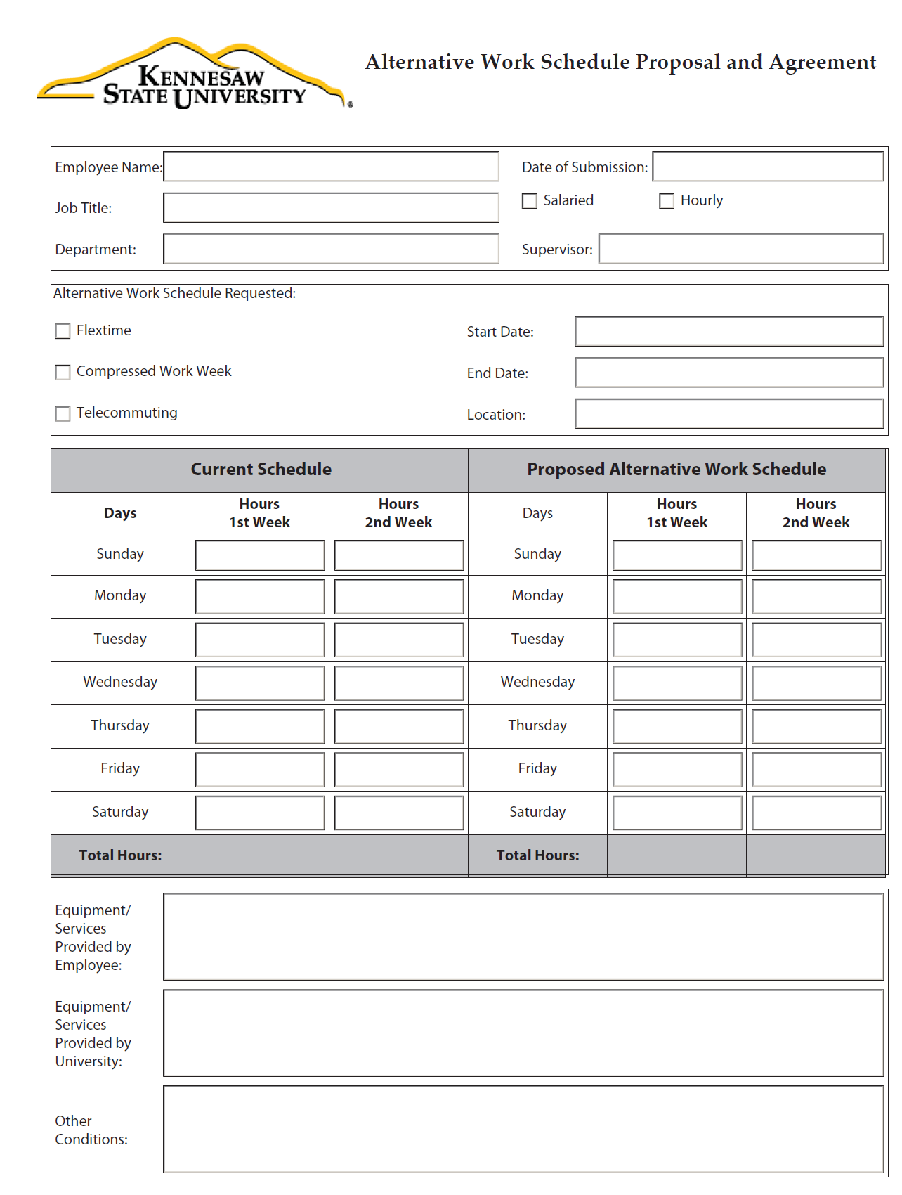
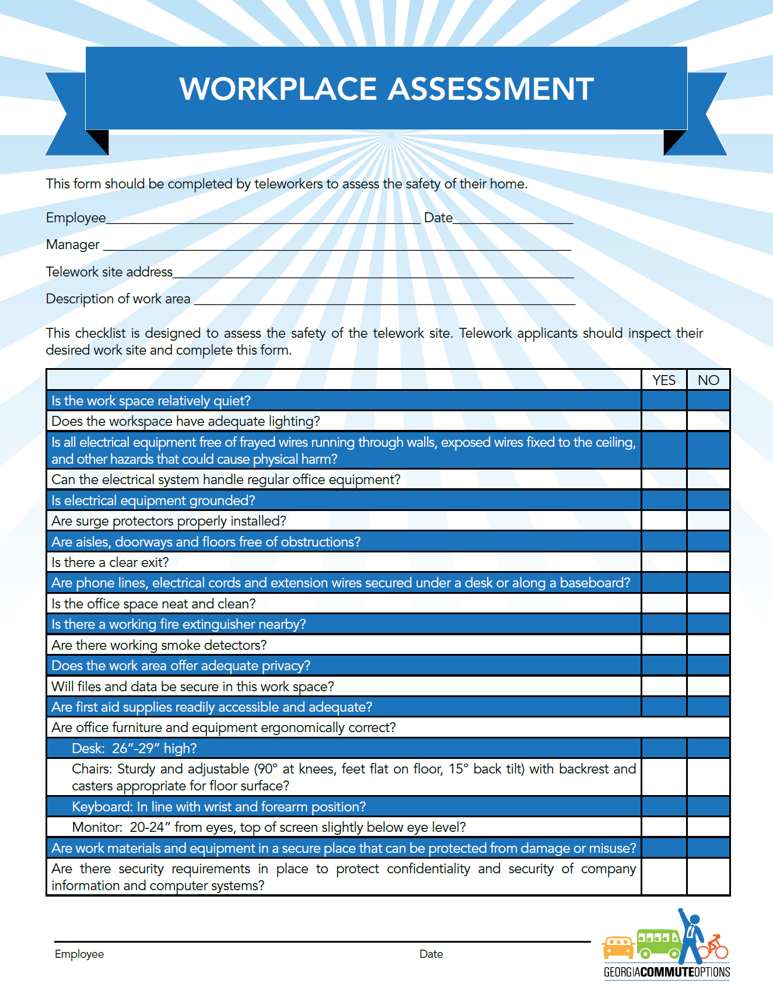
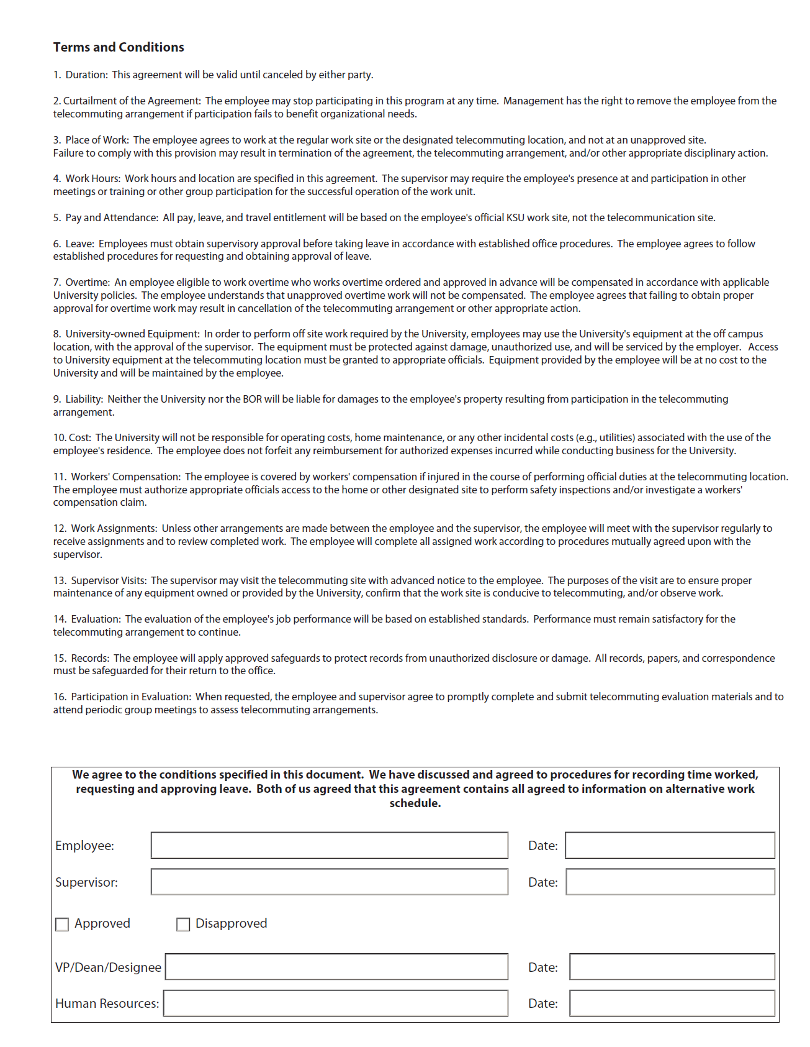
Tools – Telework Agreement/Policy

Slide 17
Questions
Erin Clark – ErinC@gacommuteoptions.com
Charlotte Weber – Telework@gacommuteoptions.com
Jean Aaron- JeanA@gacommuteoptions.com

