Slide 1
The Decision Making Process
Ethical Decision Making and Ethical Leadership

Slide 2
The Ethical Decision Making Process
In business, people make decisions differently than at home
Organizational pressures have a strong influence
The ethical decision making process includes
Ethical issue intensity
Individual factors
Organizational factors
The framework for ethical decision making does not describe how to make ethical decisions
Outlines the factors and processes related to ethical decision making

Slide 3
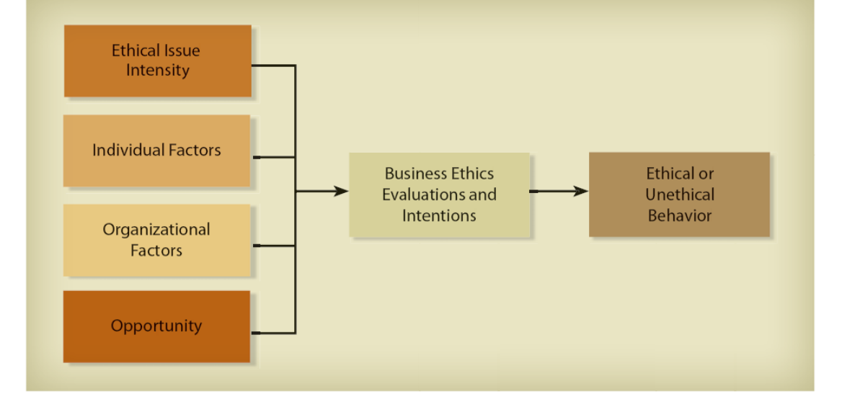
Framework for Understanding Ethical Decision Making in Business

Slide 4
Ethical Issue Intensity
The perceived relevance or importance of an ethical issue to the individual, work group, and/or organization
Reflects the ethical sensitivity of the individual and/or work group
Triggers the ethical decision making process
Individuals are subject to six spheres of influence
Workplace Legal system
Family Community
Religion Profession
Moral intensity: Relates to a person’s perception of social pressure and the harm his/her decision will have on others

Slide 5
Individual Factors
People base their ethical decisions on their own values and principles of right or wrong
Values are learned through socialization
Good personal values decrease unethical behavior and increase positive work behavior
Values are subjective; vary across cultures
An organization may intend to do right, but organizational or social forces can alter this intent
Research shows that various factors influence ethical behavior
Gender–women are more ethical than males
Education, work experience, nationality and age affect ethical decision making

Slide 6
Locus of Control
Relates to individual differences in relation to a general belief about how one is affected by internal versus external events or reinforcements
Managers with
External locus of control go with the flow because that’s all they can do
Internal locus of control believe they can control events; are masters of their destinies and trust in their capacity to influence their environment
Unclear relationship between locus of control and ethical decision making

Slide 7
Organizational Factors
Organizational culture has a stronger influence on employees than individual values
Corporate culture: A set of values, norms, and artifacts that members of an organization share
Ethical culture: Reflects whether the firm has an ethical conscience; is a function of many factors
Significant others: Those who have influence in a work group
Obedience to authority: Helps to explain why many employees unquestioningly follow superior’s orders

Slide 8
Opportunity
The conditions in an organization that limit/permit ethical/unethical behavior
Immediate job context: Where employees work, with whom they work, and the nature of the work
Opportunities for misconduct can be reduced by establishing formal codes, policies, and rules
Aggressive enforcement is required
Knowledge can sometimes lead to unethical behavior
A person who has an information base, expertise, or information about competition has an opportunity to exploit knowledge

Slide 9
Office Supplies Reported Missing Most Often

Slide 10
Business Ethics Evaluations and Intentions
Ethical dilemmas involve situations where rules are vague or in conflict
Critical thinking skills and ability to take responsibility are important
The final step is deciding what action to take based on a person’s intentions
Guilt or uneasiness is the first sign that an unethical decision has occurred
Most businesspeople will make ethical mistakes

Slide 11
Using the Framework to Improve Ethical Decisions
Impossible to objectively determine if a business decision is right or wrong
Understanding how ethical decisions are made will not solve ethical problems
Business ethics involves value judgments and collective agreement about acceptable patterns of behavior
Ethical decision making in business does not rely on personal values and morals
Organizations take on cultures of their own
Informal relationships enforce an ethical culture

Slide 12
Leadership in Corporate Culture
Leadership: The ability or authority to guide and direct others toward achievement of a goal
Leaders provide a blueprint for an organization’s corporate culture and ethics
Leadership styles influence organizational behavior
Including employee’s acceptance of/adherence to organizational norms and values
A challenge for leaders is gaining trust and commitment

Slide 13
The Managerial Role in Developing Ethics Program Leadership

Slide 14
Leadership Styles
Coercive leader: Demands instant obedience and focuses on achievement, initiative, and self-control
Authoritative leader: Inspires employees to follow a vision, facilitates change, and creates a strongly positive performance climate
Affiliative leader: Values people, their emotions and needs, and relies on friendship and trust to promote flexibility, innovation, and risk taking

Slide 15
Leadership Styles (continued)
Democratic leader: Relies on participation and teamwork to reach collaborative decisions
Pacesetting leader: Can create a negative climate because of the high standards that he/she sets
Coaching leader: Builds a positive climate by developing skills to foster long-term success, delegating responsibility, and issuing challenging assignments

Slide 16
Leadership Styles (continued)
Transactional Leaders: Create employee satisfaction through bartering for desired behaviors/performance
Best-suited for rapidly changing situations, including those requiring responses to ethical problems or issues
Transformational leaders: Raise employees’ commitment and foster trust and motivation
Is best for organizations with high ethical commitment and strong stakeholder support

Slide 17
Habits of Strong Ethical Leaders
Developed by Archie Carroll; based on Stephen Covey’s The 7 Habits of Highly Effective People
Ethical leadership is based on holistic thinking that embraces the complex issues that companies face

Slide 18
Habits of Strong Ethical Leaders
1 | Ethical leaders have strong personal character.
2 | Ethical leaders have a passion to do right.
3 | Ethical leaders are proactive.
4 | Ethical leaders consider stakeholders’ interests.
5 | Ethical leaders are role models for the organization’s values.
6 | Ethical leaders are transparent and actively involved in organizational decision making.
7 | Ethical leaders are competent managers who take a holistic view of the firm’s ethical culture.

Slide 19
Understanding Ethical Decision Making and the Role of Leadership
Ethical issue intensity, individual factors, and opportunity result in business ethics evaluations and decisions
An organizational ethical culture is shaped by effective leadership
Top level support is required for ethical behavior
An ethical corporate culture needs shared values and proper oversight
The more you know about ethical decision making, the more likely you will be to make good decisions

