Slide 1
Data Envelopment Analysis
Jin Xiongnan
Herve Kusnik
Khalil

Slide 2
CONTENT
What DEA is
History of DEA
How DEA works
Case Study
Conclusion

Slide 3
What is DEA ?
Data Envelopment Analysis (DEA) is a linear programming methodology to measure the efficiency of multiple decision-making units (DMU) when the production process presents a structure of multiple inputs and outputs.

Slide 4
What is DEA ?
Increasingly popular management tool
is commonly used to evaluate the efficiency of a number of producer
It’s an extreme point method and it compares each producer with only the "best" producers
producer is usually referred to as a decision making unit (DMU)
DEA has been used for both production and cost data.

Slide 5
CONTENT
What DEA is
History of DEA
How DEA works
Case Study
Conclusion

Slide 6
Why DEA was created?
In microeconomic production theory a firm’s input and output combinations are depicted using a production function. Using such a function one can show the maximum output which can be achieved with any possible combination of inputs, that is, one can construct a production technology frontier.
Some 30 yearsago DEA set out to answer the question of how to use thisprinciple in empirical applications whileovercoming the problemthat for actualfirms one cannever observe all the possible input-outputcombinations.

Slide 7
Why DEA was created?
Building on the ideas of Farrell (1957), the seminalwork "Measuring the efficiency of decisionmakingunits" by Charnes, Cooper & Rhodes (1978) applieslinearprogramming to estimate an empirical production technologyfrontier for the first time.
The main developments of DEA in the 1970s and 1980s are documented by Seiford&Thrall (1990).
Notes:
Sincethen, there have been a large number of books and journal articles written on DEA or applying DEA on various sets of problems.DEA has also been used to compare efficiencyacrossfirms. There are several types of DEA with the most basic being CCR based on Charnes, Cooper &Rhoades. The main developments of DEA in the 1970s and 1980s are documented by Seiford&Thrall (1990).

Slide 8
CONTENT
What DEA is
History of DEA
How DEA works
Case Study
Conclusion

Slide 9
How it works?
➔ Utilizing the selected variables, such as unit cost and output, DEA software searches for the points with the lowest unit cost for anygiven output, connectingthose points to form the efficiencyfrontier
➔Anycompany not on the frontierisconsidered inefficient.

Slide 10
How it works?
Utilizingsome variable to establish the efficiencyfrontier:
Number of employees.
Service quality.
Environmentalsafety.
Fuel consumption.

Slide 11
How it works?
Utilizingsome variable to establish the efficiencyfrontier:
Number of employees.
Service quality.
Environmentalsafety.
Fuel consumption.
Define the efficiencyfrontier.

Slide 12
How it works?
Utilizingsome variable to establish the efficiencyfrontier:
Number of employees.
Service quality.
Environmentalsafety.
Fuel consumption.
Define the efficiencyfrontier.
A numerical coefficient isgiven to eachfirm, definingits relative efficiency.

Slide 13
CONTENT
What DEA is
History of DEA
How DEA works
Case Study
Conclusion

Slide 14
DEA Case
During the 1980’s the Electronic industry is the most activity department among the economics. And the competition is very serious. Hence the innovation strategies of computer, communication and software company are very important. Hence it makes lots of sense of evaluating the company’s or department’s performance with the strategy.
COMPUTER
SOFTWARE
COMMUNICATION

Slide 15
The Efficiency Of U.S. Electronic Company
Data
The data is from the database in CD of COMPUSTAT running on IBM’s PC which is offered by Lotus.

Slide 16
The Efficiency Of U.S. Electronic Company
The first groups are the most 8 profitable companies in three departments.(based on NI from 1980-1988)
The second groups are the least 6 profitable companies in three departments.
The third groups are consisted with the first seven companies from group 1 and last 4 from group 2.

Slide 17
GROUP 1
IBM,DEC,
HWP,HIT
APPL,AMH
CYR,TAN

Slide 18
GROUP 1
GROUP 2
IBM,DEC,
HWP,HIT
APPL,AMH
CYR,TAN
BEEV,GES,
DGN,EEC,
FLP,MEM

Slide 19
GROUP 1
GROUP 2
IBM,DEC,
HWP,HIT
APPL,AMH
CYR,TAN
BEEV,GES,
DGN,EEC,
FLP,MEM
GROUP 3
IBM,DEC,HWP,APPL,AMH,CYR,TAN,BEEV,DGN,FLP,MEM

Slide 20
GROUP 1
GROUP 2
IBM,DEC,
HWP,HIT
APPL,AMH
CYR,TAN
BEEV,GES,
DGN,EEC,
FLP,MEM
GROUP 3
IBM,DEC,HWP,APPL,AMH,CYR,TAN,BEEV,DGN,FLP,MEM

Slide 21
The Efficiency Of U.S. Electronic Company
INPUT
OUTPUT
company
SALES VOLUME
NET INCOME
CAPITAL MARGIN&STOCK MARGIN
EMPLOYEE
CAPITAL
COST

Slide 22
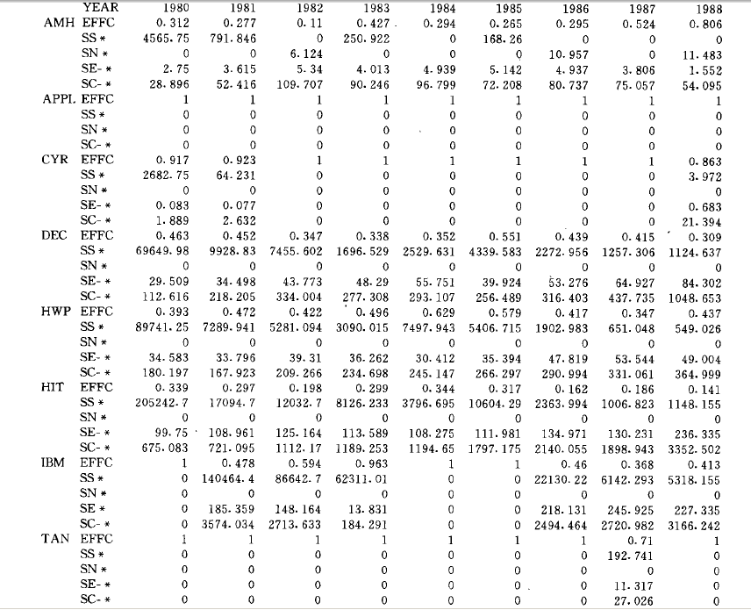
EFFICIENCY
SALES
PROFIT
EMPLOYEE
CAPITAL

Slide 23
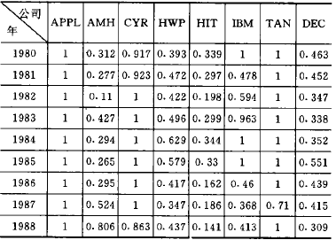
EFFC of Computer company

Slide 24
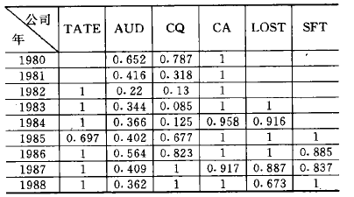
EFFC of Communication company

Slide 25
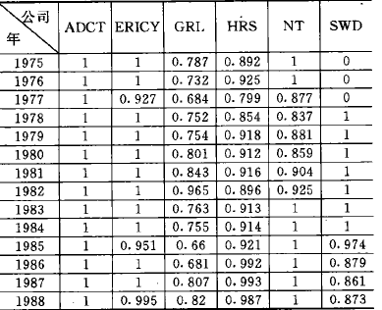
EFFC of Software company

Slide 26
The Efficiency Of U.S. Electronic Company
Conclusion
The company whose benefit are high doesn’t mean its efficiency is high
New company do well in the efficiency
The performance influenced by the surrounding too.

Slide 27
CONTENT
What DEA is
History of DEA
How DEA works
Case Study
Conclusion

Slide 28
The advantages of DEA
no need to explicitly specify a mathematical form for the production function
proven to be useful in uncovering relationships that remain hidden for other methodologies
capable of handling multiple inputs and outputs
capable of being used with any input-output measurement
the sources of inefficiency can be analyzed and quantified for every evaluated unit

Slide 29
The disadvantages of DEA
results are sensitive to the selection of inputs and outputs
=> we have to choose relevant criteria
you cannot test for the best specification
the number of efficient firms on the frontier tends to increase with the number of inputs and output variables

Slide 30
THANK YOU

