Slide 1
Operating System
A program that controls and supports the usage of computer systems
Main objectives of an OS:
Convenience
Efficiency
Ability to evolve
Notes:
An OS is a program that controls the execution of application programs and acts as
an interface between applications and the computer hardware. It can be thought of
as having three objectives:
• Convenience: An OS makes a computer more convenient to use.
• Efficiency: An OS allows the computer system resources to be used in an efficient
manner.
• Ability to evolve: An OS should be constructed in such a way as to permit the
effective development, testing, and introduction of new system functions without
interfering with service.

Slide 2
Usage
Users of a computer system:
programs - use memory, use CPU time, use I/O
devices
human users:
programmers - use program development tools such as debuggers, editors
end users - use application programs, e.g. Internet explorer

Slide 3
Computer System: hardware + software
OS is a part of the computer software, it is a program.
the first to be executed when the computer is switched on
controls and supports the execution of other programs and the overall usage of the computer system

Slide 4
Control
The operating system controls the usage of the computer resources - hardware devices and software utilities.
  Processors
  Main memory
  Secondary Memory
  Peripheral devices
  Information

Slide 5
Support
Services to assist the users of the computer system:
  For the programmers:
    Utilities - debuggers, editors, file management, etc.
  For the end users - interface to the application programs
  For programs - loads instructions and data into memory, prepares I/O devises for usage, handles interrupts and error conditions.

Slide 6
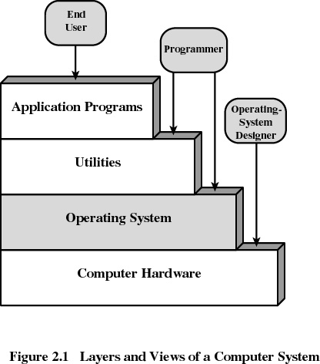

Slide 7
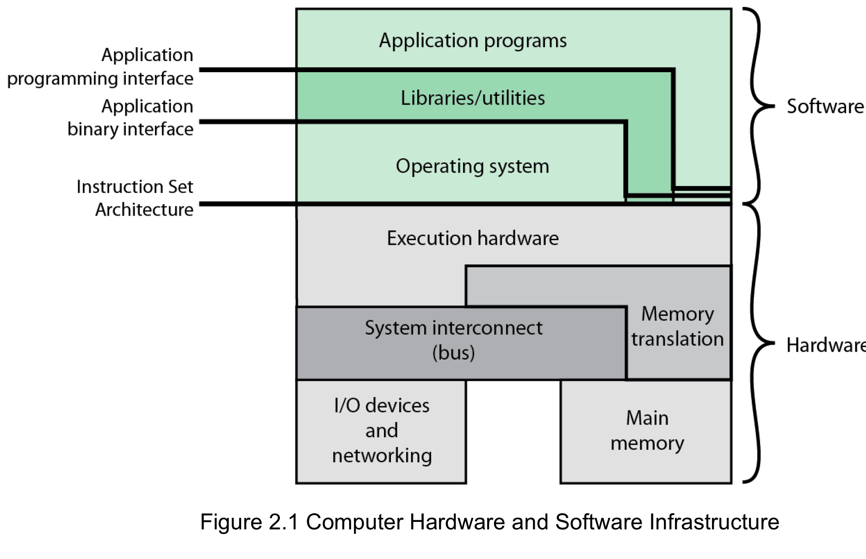
Computer Hardware and Software Infrastructure
Notes:
The Operating System as a User/Computer Interface
The hardware and software used in providing applications to a user can be viewed
in a layered or hierarchical fashion, as depicted in Figure 2.1 . The user of those
applications, the end user, generally is not concerned with the details of computer
hardware. Thus, the end user views a computer system in terms of a set of applications.
An application can be expressed in a programming language and is developed
by an application programmer. If one were to develop an application program as a
set of machine instructions that is completely responsible for controlling the computer
hardware, one would be faced with an overwhelmingly complex undertaking.
To ease this chore, a set of system programs is provided. Some of these programs
are referred to as utilities, or library programs. These implement frequently used
functions that assist in program creation, the management of files, and the control of
I/O devices. A programmer will make use of these facilities in developing an application,
and the application, while it is running, will invoke the utilities to perform
certain functions. The most important collection of system programs comprises the
OS. The OS masks the details of the hardware from the programmer and provides
the programmer with a convenient interface for using the system. It acts as mediator,
making it easier for the programmer and for application programs to access and
use those facilities and services.

Slide 8
Evolution of
Operating Systems
Stages include:
Serial Processing
Simple Batch Systems
Multiprogrammed Batch Systems
Time Sharing Systems
Notes:
In attempting to understand the key requirements for an OS and the significance of the major features of a contemporary OS, it is useful to consider how operating systems have evolved over the years.

Slide 9
Serial Processing
Earliest Computers:
Problems:
Scheduling:
  Users sign up for computer time
      time allocations could run short or long, resulting in wasted computer time
      Setup time
  a considerable amount of time was spent just on setting up the program to run
No operating system
    programmers interacted directly with the computer hardware
Computers ran from a console with display lights, toggle switches, some form of input device, and a printer
Notes:
With the earliest computers, from the late 1940s to the mid-1950s, the programmer
interacted directly with the computer hardware; there was no OS. These computers
were run from a console consisting of display lights, toggle switches, some form of
input device, and a printer. Programs in machine code were loaded via the input
device (e.g., a card reader). If an error halted the program, the error condition was
indicated by the lights. If the program proceeded to a normal completion, the output
appeared on the printer.
These early systems presented two main problems:
• Scheduling : Most installations used a hardcopy sign-up sheet to reserve computer
time. Typically, a user could sign up for a block of time in multiples of a
half hour or so. A user might sign up for an hour and finish in 45 minutes; this
would result in wasted computer processing time. On the other hand, the user
might run into problems, not finish in the allotted time, and be forced to stop
before resolving the problem.
• Setup time: A single program, called a job , could involve loading the compiler
plus the high-level language program (source program) into memory,
saving the compiled program (object program) and then loading and linking
together the object program and common functions. Each of these steps could
involve mounting or dismounting tapes or setting up card decks. If an error
occurred, the hapless user typically had to go back to the beginning of the
setup sequence. Thus, a considerable amount of time was spent just in setting
up the program to run.
This mode of operation could be termed serial processing , reflecting the fact
that users have access to the computer in series. Over time, various system software
tools were developed to attempt to make serial processing more efficient. These
include libraries of common functions, linkers, loaders, debuggers, and I/O driver
routines that were available as common software for all users.

Slide 10
Simple Batch Systems
Early computers were very expensive
  important to maximize processor utilization
Monitor
  user no longer has direct access to processor
  job is submitted to computer operator who batches them together and places them on an input device
  program branches back to the monitor when finished
Notes:
Early computers were very expensive, and therefore it was important to maximize
processor utilization. The wasted time due to scheduling and setup time was
unacceptable.
To improve utilization, the concept of a batch OS was developed. It appears
that the first batch OS (and the first OS of any kind) was developed in the mid-1950s
by General Motors for use on an IBM 701 [WEIZ81]. The concept was subsequently
refined and implemented on the IBM 704 by a number of IBM customers. By the
early 1960s, a number of vendors had developed batch operating systems for their
computer systems. IBSYS, the IBM OS for the 7090/7094 computers, is particularly
notable because of its widespread influence on other systems.
The central idea behind the simple batch-processing scheme is the use of a
piece of software known as the monitor . With this type of OS, the user no longer has
direct access to the processor. Instead, the user submits the job on cards or tape to a
computer operator, who batches the jobs together sequentially and places the entire
batch on an input device, for use by the monitor. Each program is constructed to
branch back to the monitor when it completes processing, at which point the monitor
automatically begins loading the next program.

Slide 11
Job Control Language (JCL)
Special type of programming language used to provide instructions to the monitor
what compiler to use
what data to use
Notes:
The monitor performs a scheduling function: A batch of jobs is queued up,
and jobs are executed as rapidly as possible, with no intervening idle time. The monitor
improves job setup time as well. With each job, instructions are included in a
primitive form of job control language (JCL) . This is a special type of programming
language used to provide instructions to the monitor. A simple example is that of a
user submitting a program written in the programming language FORTRAN plus
some data to be used by the program. All FORTRAN instructions and data are on a
separate punched card or a separate record on tape. In addition to FORTRAN and
data lines, the job includes job control instructions, which are denoted by the beginning
$.

Slide 12
Modes of Operation
User Mode
user program executes in user mode
certain areas of memory are protected from user access
certain instructions may not be executed
Kernel Mode
monitor executes in kernel mode
privileged instructions may be executed
protected areas of memory may be accessed
Notes:
Considerations of memory protection and privileged instructions lead to the
concept of modes of operation. A user program executes in a user mode , in which
certain areas of memory are protected from the user’s use and in which certain
instructions may not be executed. The monitor executes in a system mode, or what
has come to be called kernel mode , in which privileged instructions may be executed
and in which protected areas of memory may be accessed.
Of course, an OS can be built without these features. But computer vendors
quickly learned that the results were chaos, and so even relatively primitive batch
operating systems were provided with these hardware features.

Slide 13

Problems with Simple Batch System
Bad utilization of CPU time - the processor stays idle while I/O devices are in use
Notes:
With a batch OS, processor time alternates between execution of user programs
and execution of the monitor. There have been two sacrifices: Some main
memory is now given over to the monitor and some processor time is consumed by
the monitor. Both of these are forms of overhead. Despite this overhead, the simple
batch system improves utilization of the computer.

Slide 14
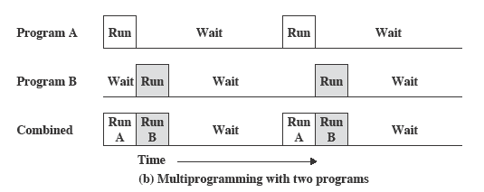
Multiprogramming
There must be enough memory to hold the OS (resident monitor) and one user program
When one job needs to wait for I/O, the processor can switch to the other job, which is likely not waiting for I/O
Notes:
This inefficiency is not necessary. We know that there must be enough
memory to hold the OS (resident monitor) and one user program. Suppose that
there is room for the OS and two user programs. When one job needs to wait for
I/O, the processor can switch to the other job, which is likely not waiting for I/O
( Figure 2.5b ).

Slide 15
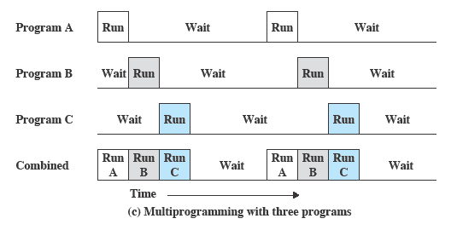
Multiprogramming
New features:
Memory management - to have several jobs ready to run, they must be kept in main memory
Job scheduling - the processor must decide which program to run.
Notes:
Furthermore, we might expand memory to hold three, four, or more
programs and switch among all of them ( Figure 2.5c ). The approach is known as
multiprogramming , or multitasking . It is the central theme of modern operating
systems.

Slide 16
Time-Sharing Systems
Can be used to handle multiple interactive jobs
Processor time is shared among multiple users
Multiple users simultaneously access the system through terminals, with the OS interleaving the execution of each user program in a short burst or quantum of computation
Notes:
Just as multiprogramming allows the processor to handle multiple batch jobs
at a time, multiprogramming can also be used to handle multiple interactive jobs. In
this latter case, the technique is referred to as time sharing , because processor time is
shared among multiple users. In a time-sharing system, multiple users simultaneously
access the system through terminals, with the OS interleaving the execution of each
user program in a short burst or quantum of computation. Thus, if there are n users
actively requesting service at one time, each user will only see on the average 1/ n
of the effective computer capacity, not counting OS overhead. However, given the
relatively slow human reaction time, the response time on a properly designed system
should be similar to that on a dedicated computer.

Slide 17
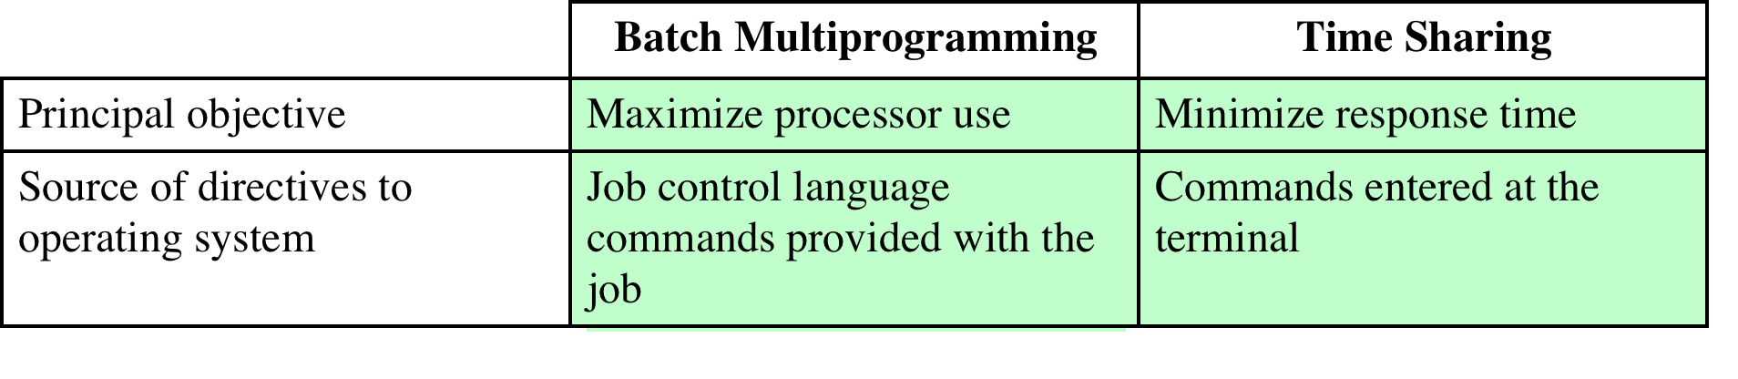
Batch Multiprogramming vs. Time Sharing
Table 2.3 Batch Multiprogramming versus Time Sharing
Time sharing is multiprogramming.
The key differences between time-sharing systems and batch multiprogramming systems are given in the table above.
Notes:
Both batch processing and time sharing use multiprogramming. The key
differences are listed in Table 2.3 .

Slide 18
Major Advances
Operating Systems are among the most complex pieces of software ever developed
Major advances in development include:
Memory management
Information protection and security
Scheduling and resource management
System structure
Processes
Notes:
Operating systems are among the most complex pieces of software ever developed.
This reflects the challenge of trying to meet the difficult and in some cases
competing objectives of convenience, efficiency, and ability to evolve. [DENN80a]
proposes that there have been four major theoretical advances in the development
of operating systems:
• Processes
• Memory management
• Information protection and security
• Scheduling and resource management
Each advance is characterized by principles, or abstractions, developed to
meet difficult practical problems. Taken together, these five areas span many of
the key design and implementation issues of modern operating systems. The brief
review of these five areas in this section serves as an overview of much of the rest
of the text.

Slide 19
Process
Fundamental to the structure of operating systems
A process can be defined as:
a program in execution
an instance of a running program
the entity that can be assigned to, and executed on, a processor
a unit of activity characterized by a single sequential thread of execution, a current state, and an associated set of system resources
Notes:
Central to the design of operating systems is the concept of process. This term was
first used by the designers of Multics in the 1960s [DALE68]. It is a somewhat
more general term than job. Many definitions have been given for the term process ,
including
• A program in execution
• An instance of a program running on a computer
• The entity that can be assigned to and executed on a processor
• A unit of activity characterized by a single sequential thread of execution, a
current state, and an associated set of system resources

Slide 20

Causes of Errors
Improper synchronization
  a program must wait until the data are available in a buffer
  improper design of the signaling mechanism can result in loss or duplication
Nondeterminate program operation
  a program may change the content of memory used by another program
  the order in which programs are scheduled may affect their outcome
Deadlocks
  it is possible for two or more programs to be hung up waiting for each other to release resources
Failed mutual exclusion
  more than one user or program attempts to make use of a shared resource at the same time
  only one routine at at time allowed to perform an update against the file
Notes:
Efforts to design a system were vulnerable to subtle programming errors whose effects could be observed only when certain relatively rare sequences of actions occurred.
These errors were difficult to diagnose because they needed to be distinguished from application software errors and hardware errors.
Even when the error was detected, it was difficult to determine the cause, because the precise conditions under which the errors appeared were very hard to reproduce.
In general terms, there are four main causes of such errors:
Improper synchronization:
Often a routine must be suspended awaiting an event elsewhere in the system.
e.g. a program that initiates an I/O read must wait until the data are available in a buffer before proceeding.
In such cases, a signal from some other routine is required.
Improper design of the signalling mechanism can result in signals being lost or duplicate signals being received.
Failed mutual exclusion:
Often more than one user or program will attempt to make use of a shared resource at the same time.
e.g. two users may attempt to edit the same file at the same time.
If these accesses are not controlled, an error can occur.
There must be some sort of mutual exclusion mechanism that permits only one routine at a time to perform an update against the file.
Nondeterminate program operation:
The results of a particular program normally should depend only on the input to that program and not on the activities of other programs in a shared system.
But when programs share memory, and their execution is interleaved by the processor, they may interfere with each other by overwriting common memory areas in unpredictable ways.
Thus, the order in which various programs are scheduled may affect the outcome of any particular program.
Deadlocks:
It is possible for two or more programs to be hung up waiting for each other.
e.g. two programs may each require two I/O devices to perform some operation (e.g., disk to tape copy).
One of the programs has seized control of one of the devices and the other program has control of the other device.
Each is waiting for the other program to release the desired resource.
Such a deadlock may depend on the chance timing of resource allocation and release.

Slide 21
Solution: Components of a Process
A process contains three components:
  an executable program
  the associated data needed by the program (variables, work space, buffers, etc.)
  the execution context (or “process state”) of the program
  The execution context is essential:
  it is the internal data by which the OS is able to supervise and control the process
  includes the contents of the various process registers
  includes information such as the priority of the process and whether the process is waiting for the completion of a particular I/O event
Notes:
We can think of a process as consisting of three components:
• An executable program
• The associated data needed by the program (variables, work space, buffers, etc.)
• The execution context of the program
This last element is essential.
The execution context, or process state, is the internal data by which the OS is able to supervise and control the process.
This internal information is separated from the process, because the OS has information not permitted to the process.
The context includes all of the information that the OS needs to manage the process and that the processor needs to execute the process properly including:
contents of the various processor registers, such as the program counter and data registers
And information of use to the OS, such as the priority of the process and whether the process is waiting for the completion of a particular I/O event.

Slide 22
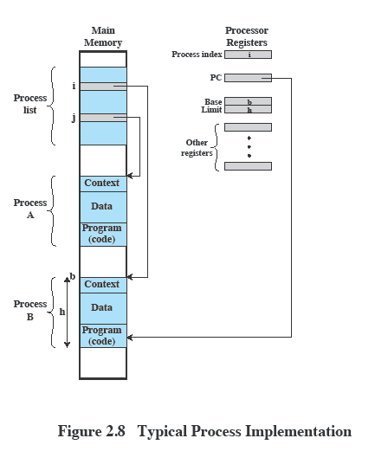
Process Management
The entire state of the process at any instant is contained in its context
New features can be designed and incorporated into the OS by expanding the context to include any new information needed to support the feature
Notes:
Figure 2.8 indicates a way in which processes may be managed. Two processes,
A and B, exist in portions of main memory. That is, a block of memory is
allocated to each process that contains the program, data, and context information.
Each process is recorded in a process list built and maintained by the OS. The
process list contains one entry for each process, which includes a pointer to the
location of the block of memory that contains the process. The entry may also
include part or all of the execution context of the process. The remainder of the
execution context is stored elsewhere, perhaps with the process itself (as indicated
in Figure 2.8 ) or frequently in a separate region of memory. The process index
register contains the index into the process list of the process currently controlling
the processor. The program counter points to the next instruction in that process
to be executed. The base and limit registers define the region in memory occupied
by the process: The base register is the starting address of the region of memory
and the limit is the size of the region (in bytes or words). The program counter and
all data references are interpreted relative to the base register and must not exceed
the value in the limit register. This prevents interprocess interference.
In Figure 2.8 , the process index register indicates that process B is executing.
Process A was previously executing but has been temporarily interrupted. The
contents of all the registers at the moment of A’s interruption were recorded in its
execution context. Later, the OS can perform a process switch and resume execution
of process A. The process switch consists of storing the context of B and restoring
the context of A. When the program counter is loaded with a value pointing into A’s
program area, process A will automatically resume execution.

Slide 23
Memory Management
The OS has five principal storage management responsibilities:
process isolation
long-term storage
protection and access control
support of modular programming
automatic allocation and management
The above requirements are satisfied by means of virtual memory and file system facilities
Notes:
The needs of users can be met best by a computing environment that supports
modular programming and the flexible use of data. System managers need efficient
and orderly control of storage allocation. The OS, to satisfy these requirements, has
five principal storage management responsibilities:
• Process isolation: The OS must prevent independent processes from interfering
with each other’s memory, both data and instructions.
• Automatic allocation and management: Programs should be dynamically
allocated across the memory hierarchy as required. Allocation should be
transparent to the programmer. Thus, the programmer is relieved of concerns
relating to memory limitations, and the OS can achieve efficiency by assigning
memory to jobs only as needed.
• Support of modular programming: Programmers should be able to define program
modules, and to create, destroy, and alter the size of modules dynamically.
• Protection and access control: Sharing of memory, at any level of the memory
hierarchy, creates the potential for one program to address the memory space
of another. This is desirable when sharing is needed by particular applications.
At other times, it threatens the integrity of programs and even of the OS itself.
The OS must allow portions of memory to be accessible in various ways by
various users.
• Long-term storage: Many application programs require means for storing
information for extended periods of time, after the computer has been
powered down.

Slide 24
Virtual Memory
Allows programmers to address memory from a logical point of view
Allows process to be comprised of a number of fixed-size blocks, called pages
Conceived to meet the requirement of having multiple user jobs reside in main memory concurrently
Notes:
Typically, operating systems meet these requirements with virtual memory
and file system facilities. The file system implements a long-term store, with information
stored in named objects, called files. The file is a convenient concept for the
programmer and is a useful unit of access control and protection for the OS.
Virtual memory is a facility that allows programs to address memory from
a logical point of view, without regard to the amount of main memory physically
available. Virtual memory was conceived to meet the requirement of having multiple
user jobs reside in main memory concurrently, so that there would not be a hiatus
between the execution of successive processes while one process was written out
to secondary store and the successor process was read in.

Slide 25
Paging
Program references a word by means of a virtual address
    consists of a page number and an offset within the page
    each page may be located anywhere in main memory
    Provides for a dynamic mapping between the virtual address used in the program and a real (or physical) address in main memory
Notes:
Because processes vary
in size, if the processor switches among a number of processes it is difficult to pack
them compactly into main memory. Paging systems were introduced, which allow
processes to be comprised of a number of fixed-size blocks, called pages. A program
references a word by means of a virtual address consisting of a page number
and an offset within the page. Each page of a process may be located anywhere
in main memory. The paging system provides for a dynamic mapping between the
virtual address used in the program and a real address , or physical address, in main
memory.

Slide 26
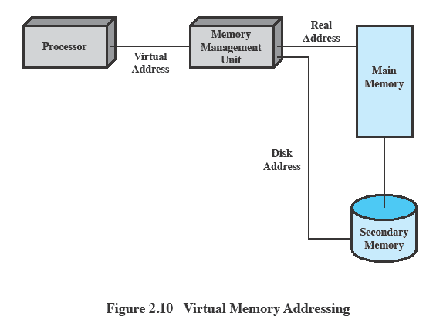
Virtual Memory
Addressing
Notes:
Figure 2.10 highlights the addressing concerns in a virtual memory scheme.
Storage consists of directly addressable (by machine instructions) main memory
and lower-speed auxiliary memory that is accessed indirectly by loading blocks
into main memory. Address translation hardware (memory management unit) is
interposed between the processor and memory. Programs reference locations using
virtual addresses, which are mapped into real main memory addresses. If a reference
is made to a virtual address not in real memory, then a portion of the contents
of real memory is swapped out to auxiliary memory and the desired block of data
is swapped in. During this activity, the process that generated the address reference
must be suspended. The OS designer needs to develop an address translation mechanism
that generates little overhead and a storage allocation policy that minimizes
the traffic between memory levels.

Slide 27
Information Protection and Security
Controlling access to computer systems and the information stored in them
Availability: Concerned with protecting the system against interruption.
Confidentiality: Assures that users cannot read data for which access is unauthorized.
Data integrity: Protection of data from unauthorized modification.
Authenticity: Concerned with the proper verification of the identity of users.
Main issues
availability
confidentiality
data integrity
authenticity
Notes:
The growth in the use of time-sharing systems and, more recently, computer networks
has brought with it a growth in concern for the protection of information.
The nature of the threat that concerns an organization will vary greatly depending
on the circumstances. However, there are some general-purpose tools that can be
built into computers and operating systems that support a variety of protection and
security mechanisms. In general, we are concerned with the problem of controlling
access to computer systems and the information stored in them.
Much of the work in security and protection as it relates to operating systems
can be roughly grouped into four categories:
• Availability: Concerned with protecting the system against interruption.
• Confidentiality: Assures that users cannot read data for which access is
unauthorized.
• Data integrity: Protection of data from unauthorized modification.
• Authenticity: Concerned with the proper verification of the identity of users
and the validity of messages or data.

Slide 28
Scheduling and
Resource Management
Key responsibility of an OS is managing resources
Resource allocation policies must consider:
fairness
differential responsiveness
efficiency
Notes:
A key responsibility of the OS is to manage the various resources available to it (main memory space, I/O devices, processors) and to schedule their use by the various active processes.
Any resource allocation and scheduling policy must consider three factors:
Fairness:
Typically, we would like all processes that are competing for the use of a particular resource to be given approximately equal and fair access to that resource.
This is especially so for jobs of the same class, that is, jobs of similar demands.
Differential responsiveness:
On the other hand, the OS may need to discriminate among different classes of jobs with different service requirements.
The OS should attempt to make allocation and scheduling decisions to meet the total set of requirements.
The OS should also make these decisions dynamically.
e.g. if a process is waiting for the use of an I/O device, the OS may wish to schedule that process for execution as soon as possible to free up the device for later demands from other processes.
Efficiency:
The OS should attempt to
maximize throughput,
minimize response time, and
accommodate as many users as possible.
These criteria conflict;
Finding the right balance for a particular situation is an ongoing problem for operating system research.

Slide 29
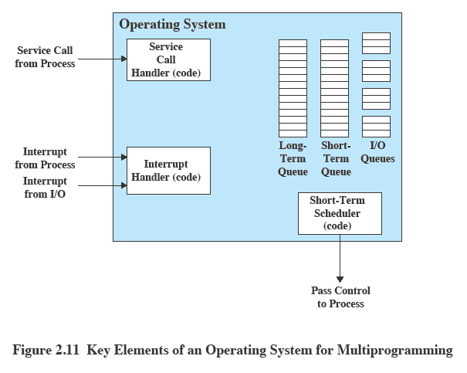
Key Elements of an
Operating System
Notes:
Figure 2.11 suggests the major elements of the OS involved in the scheduling
of processes and the allocation of resources in a multiprogramming environment.
The OS maintains a number of queues, each of which is simply a list of processes
waiting for some resource. The short-term queue consists of processes that are in
main memory (or at least an essential minimum portion of each is in main memory)
and are ready to run as soon as the processor is made available. Any one of these
processes could use the processor next. It is up to the short-term scheduler, or
dispatcher, to pick one. A common strategy is to give each process in the queue
some time in turn; this is referred to as a round-robin technique. In effect, the
round-robin technique employs a circular queue. Another strategy is to assign
priority levels to the various processes, with the scheduler selecting processes in
priority order.
The long-term queue is a list of new jobs waiting to use the processor. The
OS adds jobs to the system by transferring a process from the long-term queue to
the short-term queue. At that time, a portion of main memory must be allocated
to the incoming process. Thus, the OS must be sure that it does not overcommit
memory or processing time by admitting too many processes to the system. There
is an I/O queue for each I/O device. More than one process may request the use of
the same I/O device. All processes waiting to use each device are lined up in that
device’s queue. Again, the OS must determine which process to assign to an available
I/O device.
The OS receives control of the processor at the interrupt handler if an interrupt
occurs. A process may specifically invoke some OS service, such as an I/O
device handler by means of a service call. In this case, a service call handler is the
entry point into the OS. In any case, once the interrupt or service call is handled, the
short-term scheduler is invoked to pick a process for execution.
The foregoing is a functional description; details and modular design of this
portion of the OS will differ in various systems. Much of the research and development
effort in operating systems has been directed at picking algorithms and data
structures for this function that provide fairness, differential responsiveness, and
efficiency.

Slide 30
Different Architectural Approaches
Different approaches and design elements have been tried:
Microkernel architecture
Multithreading
Symmetric multiprocessing
Distributed operating systems
Object-oriented design
Demands on operating systems require new ways of organizing the OS
Notes:
The rate of change in the demands on operating systems requires not just modifications and enhancements to existing architectures but new ways of organizing the OS.
A wide range of different approaches and design elements has been tried in both experimental and commercial operating systems, but much of the work fits into the following categories:
• Microkernel architecture
• Multithreading
• Symmetric multiprocessing
• Distributed operating systems
• Object-oriented design

Slide 31
Microkernel Architecture
Assigns only a few essential functions to the kernel:
  The approach:
address spaces
interprocess communication (IPC)
basic scheduling
simplifies implementation
provides flexibility
is well suited to a distributed environment
Notes:
Most operating systems, until recently, featured a large monolithic kernel .
Most of what is thought of as OS functionality is provided in these large kernels,
including scheduling, file system, networking, device drivers, memory management,
and more. Typically, a monolithic kernel is implemented as a single process, with
all elements sharing the same address space. A microkernel architecture assigns
only a few essential functions to the kernel, including address spaces, interprocess
communication (IPC), and basic scheduling. Other OS services are provided by
processes, sometimes called servers, that run in user mode and are treated like any
other application by the microkernel. This approach decouples kernel and server
development. Servers may be customized to specific application or environment
requirements. The microkernel approach simplifies implementation, provides flexibility,
and is well suited to a distributed environment. In essence, a microkernel
interacts with local and remote server processes in the same way, facilitating construction
of distributed systems.

Slide 32
Multithreading
Technique in which a process, executing an application, is divided into threads that can run concurrently
Thread
dispatchable unit of work
includes a processor context and its own data area to enable subroutine branching
executes sequentially and is interruptible
Process
a collection of one or more threads and associated system resources
programmer has greater control over the modularity of the application and the timing of application related events
Notes:
Multithreading is a technique in which a process, executing an application, is
divided into threads that can run concurrently. We can make the following distinction:
• Thread: A dispatchable unit of work. It includes a processor context (which
includes the program counter and stack pointer) and its own data area for a
stack (to enable subroutine branching). A thread executes sequentially and is
interruptible so that the processor can turn to another thread.
• Process : A collection of one or more threads and associated system resources
(such as memory containing both code and data, open files, and devices). This
corresponds closely to the concept of a program in execution. By breaking
a single application into multiple threads, the programmer has great control
over the modularity of the application and the timing of application-related
events.
Multithreading is useful for applications that perform a number of essentially
independent tasks that do not need to be serialized. An example is a database server
that listens for and processes numerous client requests. With multiple threads running
within the same process, switching back and forth among threads involves
less processor overhead than a major process switch between different processes.
Threads are also useful for structuring processes that are part of the OS kernel as
described in subsequent chapters.

Slide 33
Symmetric
Multiprocessing (SMP)
Term that refers to a computer hardware architecture and also to the OS behavior that exploits that architecture
Several processes can run in parallel
Multiple processors are transparent to the user
    these processors share same main memory and I/O facilities
    all processors can perform the same functions
The OS takes care of scheduling of threads or processes on individual processors and of synchronization among processors
Notes:
Symmetric multiprocessing (SMP) is a term that refers to a computer hardware
architecture (described in Chapter 1 ) and also to the OS behavior that exploits
that architecture. The OS of an SMP schedules processes or threads across all of the
processors.
Multithreading and SMP are often discussed together, but the two are
independent facilities. Even on a uniprocessor system, multithreading is useful for
structuring applications and kernel processes. An SMP system is useful even for
nonthreaded processes, because several processes can run in parallel. However, the
two facilities complement each other and can be used effectively together.
An attractive feature of an SMP is that the existence of multiple processors is
transparent to the user. The OS takes care of scheduling of threads or processes on
individual processors and of synchronization among processors.

Slide 34
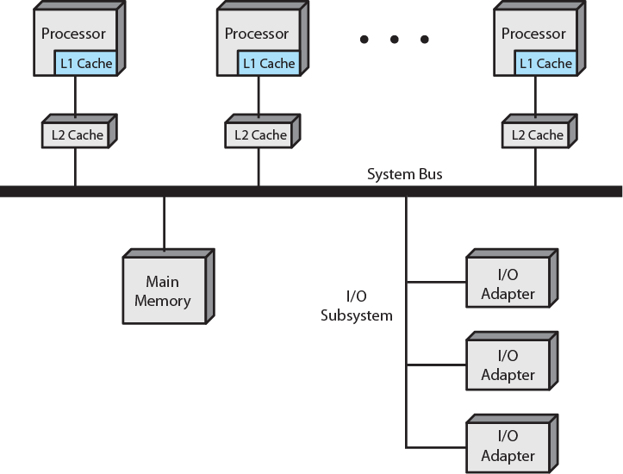
SMP Organization

Slide 35
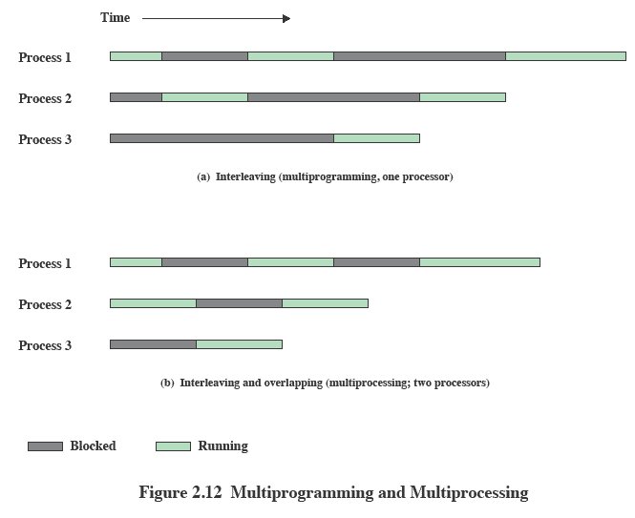
Multiprogramming
Multiprocessing
Notes:
If the work to be done by a computer can be organized so that
some portions of the work can be done in parallel, then a system with multiple
processors will yield greater performance than one with a single processor of
the same type. This is illustrated in Figure 2.12 . With multiprogramming, only
one process can execute at a time; meanwhile all other processes are waiting
for the processor. With multiprocessing, more than one process can be running
simultaneously, each on a different processor.

Slide 36
OS Design
Distributed Operating System
Object-Oriented Design
Provides the illusion of
  a single main memory space
  single secondary memory space
  unified access facilities
State of the art for distributed operating systems lags that of uniprocessor and SMP operating systems
Used for adding modular extensions to a small kernel
Enables programmers to customize an operating system without disrupting system integrity
Eases the development of distributed tools and full-blown distributed operating systems
Notes:
A different problem is to provide the appearance of a single
system for a cluster of separate computers—a multicomputer system. In this
case, we are dealing with a collection of entities (computers), each with its own
main memory, secondary memory, and other I/O modules. A distributed operating
system provides the illusion of a single main memory space and a single secondary
memory space, plus other unified access facilities, such as a distributed file system.
Although clusters are becoming increasingly popular, and there are many cluster
products on the market, the state of the art for distributed operating systems lags
that of uniprocessor and SMP operating systems. We examine such systems in
Part Eight.
Another innovation in OS design is the use of object-oriented technologies.
Object-oriented design lends discipline to the process of adding modular extensions
to a small kernel. At the OS level, an object-based structure enables programmers
to customize an OS without disrupting system integrity. Object orientation also
eases the development of distributed tools and full-blown distributed operating
systems.

Slide 37
Summary
Operating system objectives and functions:
    convenience, efficiency, ability to evolve
    user/computer interface
    resource manager
    Evolution:
        serial processing, simple batch systems, multiprogrammed batch systems, time sharing systems
Process
Memory management
    real address, virtual address
    Scheduling and resource management
    Multithreading
    Symmetric multiprocessing (SMP)
        distributed OS
        object oriented design
Notes:
Summary of Chapter 2.

