Slide 1
Domain-Specific Embedded Systems
Carlos Padilla

Slide 2
Overview
Automobile Industry
Network Applications

Slide 3
History
Growth of Electronics in Cars
Programming Languages
C
Some C++ but not using all of C++ functionality

Slide 4
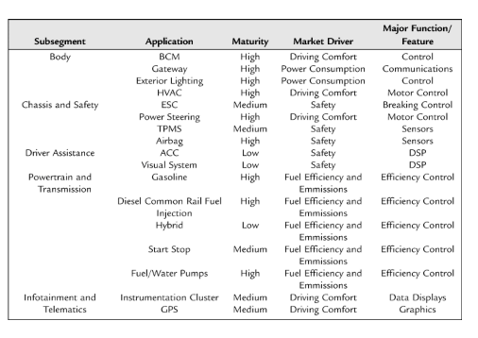
Automotive Segments
Body
Chassis and Safety
Driver Assistance
Powertrain and transmission
Infotainment and Telematics

Slide 5
Body
Responsible for
Comfort
Safety and Networking
CAN
MOST
LIN
FlexRay
Ethernet
Windows
Doors
HVAC

Slide 6
Chassis and Safety
This area is generally concerned with driver Safety
Examples
Anti-lock Braking System
Reducing crashes by 30% in regular vehicles, 60% in SUVs
Tire Pressure Monitoring System

Slide 7
Driver Assistance
Advanced Driver Assistance System (ADAS)
Adaptive Cruise Control
Radar system
Blind spot detection
Crash Detection
High/Low beam detection
360 degree camera support
Map based ADAS support
http://adasis.ertico.com/wp-content/uploads/sites/13/2014/09/ADASIS_Brochure.pdf

Slide 8
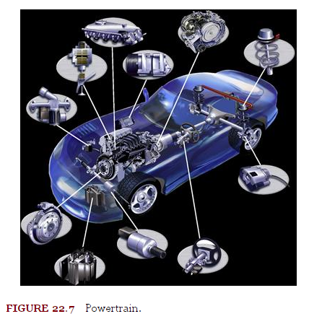
Powertrain and Transmission
Emphasis on improving fuel efficiency
High pressure injection systems
Meet CO₂ emission standards
Hybrid Engines

Slide 9
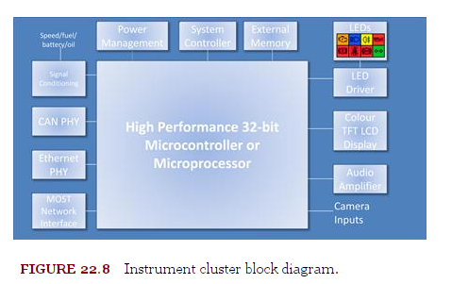
Infotainment and Telematics
Multimedia support
Media player
Phone Integration
Bluetooth Support
3G/4G suppport
High definition screens
Telematics support
GPS
Navigation System

Slide 10
Automotive quality
Safety is important in automotive systems and hence the quality of the software is very important. Engineers must design and implement their system with the following in mind
Planning for Murphy’s law
Plan for unlikely failure
Fault-tolerant communications
ACK/NACK, parity, recovery
Fault-tolerant software
Ensure system does not fall apart
Different components may have contradictory information
Zero-defect software
Test early and often to avoid defects from being caught too late

Slide 11
Automotive quality
Risk management and failure modes
Identify high risk, create plans, and set priorities to deal with them
ISO 31000
Failure modes and effects analysis (FMEA)
Occurrence, Severity, Detection
Multiply these to get Risk Priority Number (RPN)
High RPN should be dealt with first

Slide 12
Development
Subsystem interoperability
Modularity
Software specifications
SRS document, emphasis on safety
ISO 830 SRS standard
Software architecture
Model of how system is organized, hierarchy, relationships
Modeling
Help engineers understand functional, non functional, and quality requirements for system
Autocoding and drivers
Converting Diagrams to code, code templates. Drivers to interact with low level hardware

Slide 13
Testing and Diagnostics
Bench testing
Code coverage: regression testing, unit testing, etc
Trace and debug
Ability to find and fix failures in software
Final-phase testing
Testing in the car, hardware in the loop
Calibration
Fine-tuning system to maximize performance
Maintenance/ product lifetime support
Support system for 15 years
Diagnostics
MIL Data logger, OBD II , DTC

Slide 14
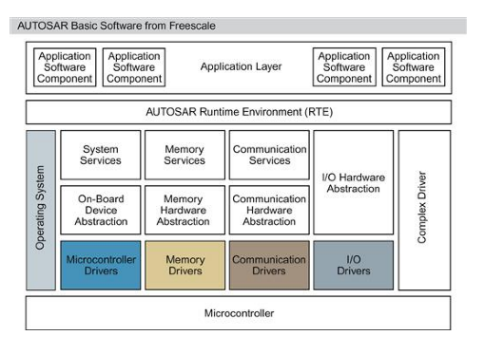
Automotive Standards
Standards allow engineers to follow similar guidelines
Allows integration with third party sources
Promote safety standards
MISRA
The Motor Industry Software Reliability Association
MISRA C
AUTOSAR
AEC
Automobile Electronics Council

Slide 15
AUTOSAR
Stands for Automotive Open Software Architecture
Purpose is to standardize interfaces, structures, and communication across car manufactures and third party providers
Component based architecture
Issues with AUTOSAR
Lacks information on timing requirements
Additional computation and memory needed

Slide 16
Paper: AUTOSAR Test Automation
Purpose of paper is to develop test automation using AUTOSAR
Car manufactures continue to provide most safety and comfort features
The addition of these features increases the number of electronics in the car
As number of embedded systems in a car increases so does the cost
Due to the software needed and testing required
Test automation offers a robust and efficient way of testing the ever increasing number of embedded components

Slide 17
Client Server Model
A client server design pattern with AUTOSAR was used
AUTOSAR Components
Client
Server
Server provides services to the clients
Clients use services provided by server
N >= 0 Clients to 1 Server

Slide 18
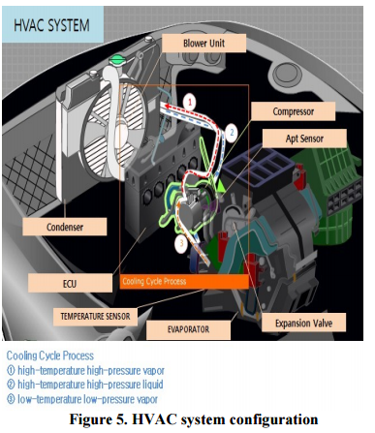
HVAC System
1 Server
ECU
5 Clients (Control units)
Blower unit
Compressor
Apt sensor
Expansion valve
Temperature sensor
Serial Communication (RS232)
Blower unit, Compressor
CAN Communication
Apt Sensor, Expansion Valve, Temperature Sensor

Slide 19
HVAC System: Clients
Blower unit
Cool down temp of Air-conditioner gas.
Fan speed depends on gas temperature
Compressor
Power from Engine
Transfers AC gas to Evaporator after compressing to low temperature low pressure gas
Apt sensor
Monitors AC line pressure to avoid accidents
Expansion valve
Controls force of cool down
Temperature sensor
Monitors inside and outside temperature
Transfers temperature difference to ECU (Server) based on user input

Slide 20
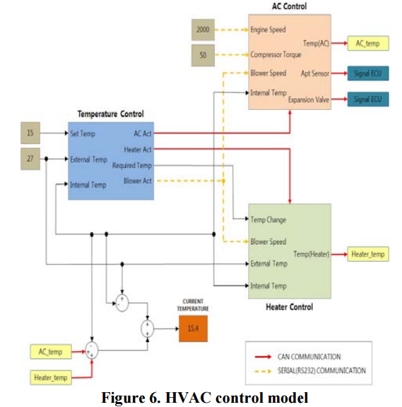
HVAC Control Model

Slide 21
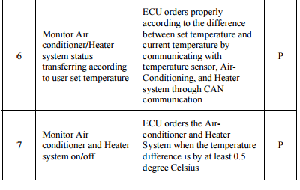
Test for HVAC

Slide 22
Strengths of Paper
Make strong case for increased test automation
Through this method ECU and control units could be tested without having to assemble the entire system
Changing out parameters for Engine speed and Compressor torque is easier than attempting to achieve these values manually
Allows for testing a variety of scenario by simply changing a few parameter values
Good Structure
Outlines purpose, provides background info, explains experiment, good diagrams

Slide 23
Weaknesses of Paper
Weak Conclusion
Short, more of summary
Does not address some weakness of AUTOSAR
Timing requirements
Extra memory and computational processing
Very short test case list
Some translation issues

Slide 24
Relevance
As cars system become more complex and filled with additional embedded systems efficient ways of testing must be found to keep costs down

Slide 25
Safety and Security
Automotive safety
ISO 26262
ASIL
Automotive security
Past: Car alarms etc.
Present: Hacking
Future: Counterfeiting (modules)

Slide 26
Future
Improved Performance
Multicore in vehicle
Mobile connectivity
Self driving cars

Slide 27
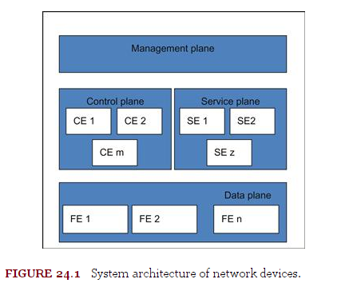
Network Devices
System Architecture
Networking in Offices and Schools
Security: Firewalls
Network Planes
Data, Control, Service, Management
Data Plane
First component to get data from IO (Ethernet)
L3 routing, IPsec, firewall
Service Plane
Handles exception packets
Control Plane
Protocols to interact with peer networks.
Management Plane
HMI for network

Slide 28
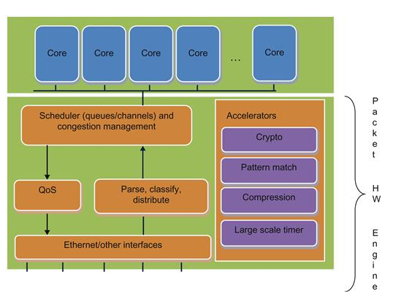
Multicore System on Chip (SoCs)
Contain multiple general purpose cores and multiple peripheral controllers
Reduces cost by integrating multiple cores and IOs into one board
Parser
ARM, MIPS
OS
Linux, BSD

Slide 29
Packet engine hardware (PEH) Block
Purpose is to distribute data to multiple cores
On top of Ethernet layer
Parts that make up PEH block
Parser
Distribution
Classification
Scheduler, queues and channels
Accelerators

Slide 30
PEH Block: Parser
Parse the messages from the Ethernet data block
Check validity of message
If valid extracts fields from data packet
Capable of reassembling fragments

Slide 31
PEH Block: Distribution and Classification
Distribution
Extract data from fields to put place packet in queue
CRC-32 and CRC-64 used to hash packets
Classification
Allows software to assign specific queues for types of packets
Extracts value from packet
Certain packets like GUI may be of higher priority and shouldn’t be left to hash

Slide 32
PEH Block: Scheduler
Queues
Packets placed her by Distribution and Classification
Also used by cores to send out packets or access hardware acceleration engines
Channels
Bundles set of Queues
Cores can access data from one or more channels

Slide 33
PEH Block: Accelerators
Used to handle computationally intensive algorithmic tasks away from cores
Examples
Cryptography
Pattern matching
Compression/decompression
De-duplication
Time management
Ingress Acceleration
Incoming packets
Engress Acceleration
Outgoing packets to interfaces

Slide 34
PEH Block: Buffer Manager
Handles allocation and deallocation of memory
Pools of memory
Avoid software worrying about this memory management

Slide 35
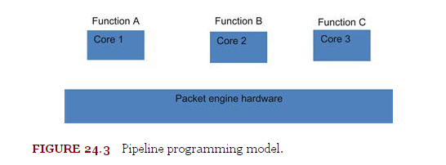
Pipeline programming model
Different Functions processed by different multiple cores
Used often when migrating from single core to multi core to avoid concurrency issues
High Complexity
Throughput is based on functions that demand the most cores, losing efficiency on functions that need less cores
Higher latency of packets (queuing tasks to other functions)
Breaking up functions into multiple packets may be difficult

Slide 36
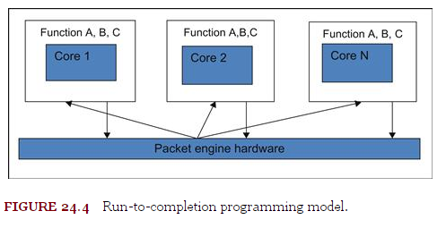
Run-to-completion programming
All cores process all functions
Focus here is in how the work flow is distributed to each flow
Requirements needed to consider
Important packets maintain order within flow
Performance scaling expected to be linear
Latency from ingress and egress should be low

Slide 37
Data-plane infrastructure (DP-Infra)
Used to improve modularity
Many forwarding engines (FE)
Separate common functionality among Fes into modules
Allows reuse
Maintainability
Portability
Used by FEs to interact with Acceleration Engines (AEs)

Slide 38
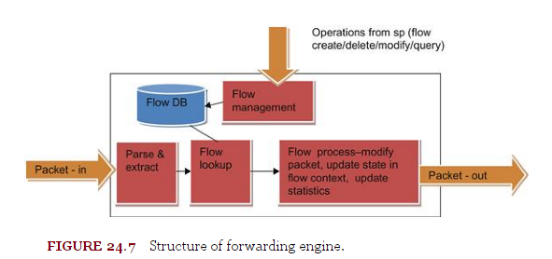
Forward Engine (FE)Structure
First, parses packet headers to extract desired field data.
Next, uses extracted data to match flow context in flow database
Exception packets do not match
Then, process packet based on state of information
Packet may be modified
Lastly, send out updated packet to next FE
Uses DP-Infra

Slide 39
Network application programming Techniques
Hash tables are a common data structure used in network programming
Searching for Packet should be fast to maintain good performance
Avoid locks
Important for packet processing to avoid lock state as much as possible
If cores are made to spin no performance improvement is achieved
Locks are still important for maintaining data integrity
Avoid reference counting
Read-Copy-Update (keep read side unlock, but write side is still locked)
Reference counting used to avoid flow context while being used
Should be avoided because locks are required
Prone to errors, if count is not kept properly

Slide 40
Network application programming Techniques (cont)
Safe reference mechanism
A safe way to access data from a neighboring node
API functions used to allow neighbors to access data
Avoid use of pointers
Removes need for reference counting
Flow parallelization
One data flow processed by one core at a time
Different flows processed across multiple cores

Slide 41
Statistics
Reducing cache thrashing is important
Flow statistics
Global statistics
Keeping data in cache is important to avoid stalls from core
Each core can have its’ own statistics and own cache lines
Statistics acceleration
Multicore SoC with this feature make the previous techniques unnecessary

Slide 42
General performance techniques
Keep relevant data in cache to avoid stalls
Cycles in which the core is just waiting
Software-directed prefetching
Software used to move data in DDR memory into L1 cache
Compiler Built-ins for likely/unlikely
Cores typically expect instructions to be right next to each other
Branching can cause instructions to be DDR instead of cache
This compiler built in setting is used to determine code that is mostly likely to operate together
Keeping important data in cache
Avoid data moving into DDR when it will be used often
Need to be careful when locking data into cache because it minimizes cache available to CPU

Slide 43
General coding guidelines
Avoid initialized variables until necessary not when declared
Reduced unnecessary time spent by core cycles if that data is not needed
Define inline macros
Avoid buffer copies, string comparisons and allocations
Use hardware acceleration when possible

Slide 44
Linux operating system
Popular operating system for network devices
Execution spaces
Kernel
User space
Kernel space used for data and service plane programming
User space is now also being looked at for data plane programming
Translation lookaside buffer (TLB) misses associated with user-space programming
Access to hardware peripherals and hardware accelerators
Deterministic performance

Slide 45
Translation lookaside buffer (TLB)
User space programs use virtual addresses
Virtual addresses do not have one to one correspondence with physical addresses
TLB is used to get physical address from virtual address
Problem
When address is not found TLB a fault is generated and the kernel space must now resolve it
This decreased performance greatly if there are many misses
Solutions
Using Huge pages (hugetlbfs) can reduce misses
Some multicore SoC come with hardware page walk, to avoid performance hits when page is missed

Slide 46
Access to hardware
Problem
Hardware peripherals and hardware accelerators is obtained through physical memory
Accessing hardware through User space involves context switch and buffer copying
Solution
Linux provides memory mapping so hardware registers can be accessed directly by user space
Multicore SoC with IOMMU can convert virtual memory to physical memory

Slide 47
Deterministic performance
Problem
Linux General Purpose OS which causes cores to be share across multiple tasks
Cores are not dedicated and hence cannot be deterministic
Solution
Threads can be created with an affinity to a particular core
Cores can be dedicated to threads and Linux will not assign other processes or threads to these cores

Slide 48
Questions?

Slide 49
Sources
(2013-04-01). Software Engineering for Embedded Systems: Methods, Practical Techniques, and Applications (Expert Guide) (Kindle Location 19943). Elsevier Science. Kindle Edition.
H. Moon, G. Kim, Y. Kim, S. Shin. Automation Test Method for Automotive Embedded Software Based on AUTOSAR, Fourth International Conference on Software Engineering Advances, 2009. ICSEA '09, September 2009
The ADAS Horizon Concept http://adasis.ertico.com/wp-content/uploads/sites/13/2014/09/ADASIS_Brochure.pdf

