Slide 1
Acoustic Features for Speech Recognition: From Mel-Frequency Cepstrum Coefficients (MFCC) to BottleNeck Features(BNF)
F01921031 鍾承道

Slide 2
Outline
Mel-Frequency Cepstrum Coefficients
DFT
Mel Filter Bank
DCT
From human knowledge to data driven methods
Supervised objective
Machine Learning
DNN
Bottle Neck Feature

Slide 3
What are acoustic features?
Features used to describe characteristics of speech signal at every time instant.
Automatic Speech Recognition (ASR) systems take these features $o$ as input and apply machine learning model $θ$ to map them into a sequence of words $w$. (for more info, take Prof. Lee’s Course)
$w=\underset{\overline{w}}{argmax}{P\left(\overline{w}|o;θ\right)}$

Slide 4
What are acoustic features?
Consists of two dimensions :
Features space
Time
For Example:
Fourier transform coefficients, Spectrogram, MFCC, Filter bank output, BNF…
Desired properties of acoustic features for ASR:
Noise Robustness
Speaker Invariance
From the Machine Learning point of view, the design of the feature has to be considered with the learning method applied.

Slide 5
Mel-Frequency Cepstrum Coefficients(MFCC)
The most popular speech feature in from 1990 to the early 2000s
It is the result of countless trial and errors optimized to overcome noise and speaker variation issues under the HMM-GMM framework for ASR.

Slide 6
MFCC (from wiki)
Take the Fourier transform of (a windowed excerpt of) a signal.
Map the powers of the spectrum obtained above onto the mel scale, using triangular overlapping windows.
Take the logs of the powers at each of the mel frequencies.
Take the discrete cosine transform of the list of mel log powers, as if it were a signal.
The MFCCs are the amplitudes of the resulting spectrum.

Slide 7


MFCC
Time Domain Signal
Hamming
Window
Discrete Fourier Transform
$${\left| \right|}^{2}$$
Mel Filter bank
$$log⁡({\left| \right|}^{2})$$
Discrete Cosine Transform
MFCC

Slide 8
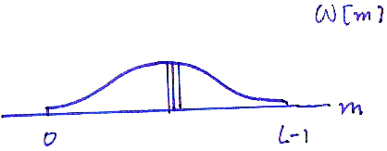
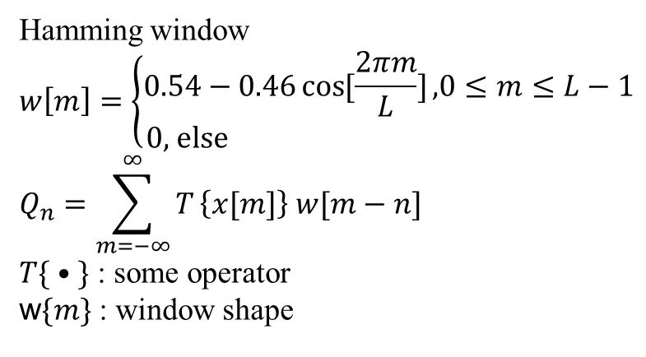
◉ Hamming Window
Hamming window
$$w\left[m\right]=\left\{\begin{aligned}0.54−0.46\cos{[\frac{2πm}{L}]}\text{,}0≤m≤L−1 \\ \text{0, }\text{else} \end{aligned}\right.$$
$$Q_{n}=\sum_{m=−∞}^{∞}{T}\left\{x[m]\right\} w[m−n]$$
$T\{ • \}$ : some operator
w$\{m\}$ : window shape

Slide 9
MFCC
window size = 32ms
hop size 10 ms
For wav encoded at 16k Hz, 0.032 * 1600 = 512 sample points
Short time Fourier transform
Dimension: 512
Time Domain Signal
Hamming
Window
Discrete Fourier Transform
512
$${\left| \right|}^{2}$$
Mel Filter bank
$$log⁡({\left| \right|}^{2})$$
Discrete Cosine Transform
MFCC

Slide 10
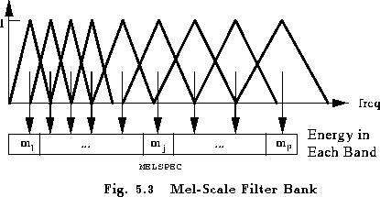
Mel-Filter Bank Outputs
The design is based on human perception:
wider bands for higher frequencies (less sensitive)
narrower bands for lower frequencies (more sensitive)
The response of the spectrogram is recorded as the feature

Slide 11
MFCC
Response of spectrogram
Mel filter banks:
Triangular band-pass filters are selected
Time Domain Signal
Hamming
Window
Discrete Fourier Transform
512
$${\left| \right|}^{2}$$
Mel Filter bank
40
$$log⁡({\left| \right|}^{2})$$
Discrete Cosine Transform
MFCC

Slide 12
Cepstral Coeffiencents
Time -> DFT -> frequency
“Spectral” domain
Frequency -> DCT -> ??(like time)
“Cepstral” domain
Main reason is for data compression
It also suppresses noise: white noise can spread over entire spectrum (like a bias term), taking dct of the spectrogram reduces the damage to only 1 dimension (dc term) in cepstral domain

Slide 13
MFCC
DCT compression:
40 spectral coefficients
into
12 cesptral coefficients
Time Domain Signal
Hamming
Window
Discrete Fourier Transform
512
$${\left| \right|}^{2}$$
Mel Filter bank
40
$$log⁡({\left| \right|}^{2})$$
Discrete Cosine Transform
MFCC
12

Slide 14
The final step
We get a 12 dimension feature for every 10 milliseconds of voice signal
Energy Coefficient(13th ):
The log of the energy of the signal
Delta Coefficient(14~26th ):
the difference between the neighboring features
Measures the change of features through time
Double Delta Coefficient(27~39th ):
the difference between the neighboring delta features
Measures the change of delta through time

Slide 15
MFCC
Time Domain Signal
Hamming
Window
Discrete Fourier Transform
512
$${\left| \right|}^{2}$$
Triangular Filter bank
40
39
$$log⁡({\left| \right|}^{2})$$
Discrete Cosine Transform
12
Add delta, double delta
MFCC

Slide 16
The MFCC framework
The action of applying DFT, mel-Filter bank, and DCT can be viewed as multiplying the input feature by a matrix with predefined weights.
These weights are designed by “human heuristics”

Slide 17
MFCC
Scaling
Function
Matrix
Time Domain Signal
Hamming
Window
Discrete Fourier Transform
512
$${\left| \right|}^{2}$$
Triangular Filter bank
40
39
$$log⁡({\left| \right|}^{2})$$
Discrete Cosine Transform
12
Add delta, double delta
MFCC

Slide 18
Improvement of the MFCC framework
Why not let the data decide what the values of the matrix should be?
Human Knowledge -> Data Driven
Time Domain Signal
Activation Function 1
Weight matrix 1
Activation Function 2
Weight matrix 2
Activation Function L
Weight matrix L
Feature
…

Slide 19
How do we let the data drive the coefficients?
This depends on your objective: What do you want to map the information to?
For speech recognition it is usually words or phones.
Input Signal
Activation Function 1
Weight matrix 1
Activation Function 2
Weight matrix 2
Activation Function L
Weight matrix L
Feature
Output, objective
…

Slide 20


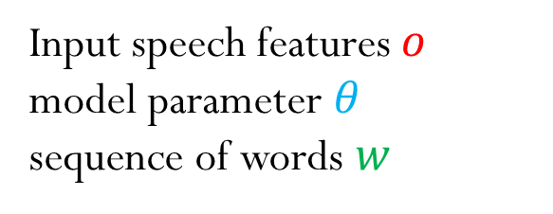

Data driven transformations
The task for ASR:
$w=\underset{\overline{w}}{argmax}{P\left(\overline{w}|o;θ\right)}$.
Input speech features $o$
model parameter $θ$
sequence of words $w$
Input Signal
$$o$$
Activation Function 1
Weight matrix 1
Activation Function 2
Weight matrix 2
Activation Function L
Weight matrix L
Feature
Output, objective
$$w$$
…

Slide 21
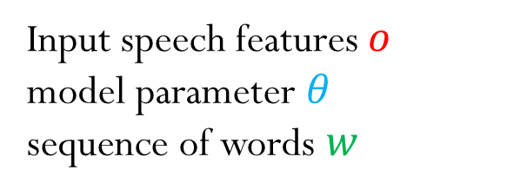
Machine Learning
This is done in two phases:
In the learning phase, we learn the model parameters $θ$ on training data, which are ($o$, $w$) pairs.
In the testing phase, we fix the weights $θ$ and apply the transformation on $o$ to get $w$
Input speech features $o$
model parameter $θ$
sequence of words $w$
$$w=\underset{\overline{w}}{argmax}{P\left(\overline{w}|o;θ\right)}$$

Slide 22
The Deep Neural Network
This is the exact formulation for a machine learning technique called the deep neural network
Input Signal
$$o$$
Activation Function 1
Weight matrix 1
Activation Function 2
Weight matrix 2
Activation Function L
Weight matrix L
Feature
Output, objective
$$w$$
…

Slide 23
The Deep Neural Network
Bigger/Deeper network -> better performance
Requires more data, more computers to train
All the big players: Apple, Google, Microsoft,… meet these requirements
This is why the technique is so popular
Input Features
Activation Function 1
Weight matrix 1
Activation Function 2
Weight matrix 2
Activation Function L
Weight matrix L
Feature
Output, objective
…

Slide 24
BottleNeck Features(BNF)
Features extracted at the final layer right before the output are called bottleneck features
They usually outperform conventional features on their specific task.
Input Feature
Activation Function 1
Weight matrix 1
Activation Function 2
Weight matrix 2
Activation Function L
Weight matrix L
BNF
Feature
Output, objective
…

Slide 25
BottleNeck Features(BNF)
Often BNFs are used as the input to another DNN. The recursion goes on and on.
It is not a far stretch to say that the MFCC technique is obsolete by today’s standard.
Input Feature
Activation Function 1
Weight matrix 1
Activation Function 2
Weight matrix 2
Activation Function L
Weight matrix L
BNF
Feature
Output, objective
…

Slide 26
References
Xu, Min, et al. "HMM-based audio keyword generation." Advances in Multimedia Information Processing-PCM 2004. Springer Berlin Heidelberg, 2005. 566-574.
Zheng, Fang, Guoliang Zhang, and Zhanjiang Song. "Comparison of different implementations of MFCC." Journal of Computer Science and Technology 16.6 (2001): 582-589.
Hinton, Geoffrey, et al. "Deep neural networks for acoustic modeling in speech recognition: The shared views of four research groups." Signal Processing Magazine, IEEE 29.6 (2012): 82-97.
http://en.wikipedia.org/wiki/Mel-frequency_cepstrum
Professor Lin-Shan Lee’s slides
Evermann, Gunnar, et al. The HTK book. Vol. 2. Cambridge: Entropic Cambridge Research Laboratory, 1997.

