Slide 1
Service-Oriented Architecture
INF 123 – Software architecture
tdebeauv@uci.edu

Slide 2
Three-tier architecture
Client invokes
an HTTP operation,
may send data
2. Server accesses
persistent data
Client
(Browser)
DB
Web Server
Presentation
Business
Data
4. Server sends back
status and data
3. Response from DB

Slide 3
Service-oriented architecture
Web Server
Client
(Browser)
Web Server
Web Server
Business,
Mashups
Presentation
Web Server

Slide 4
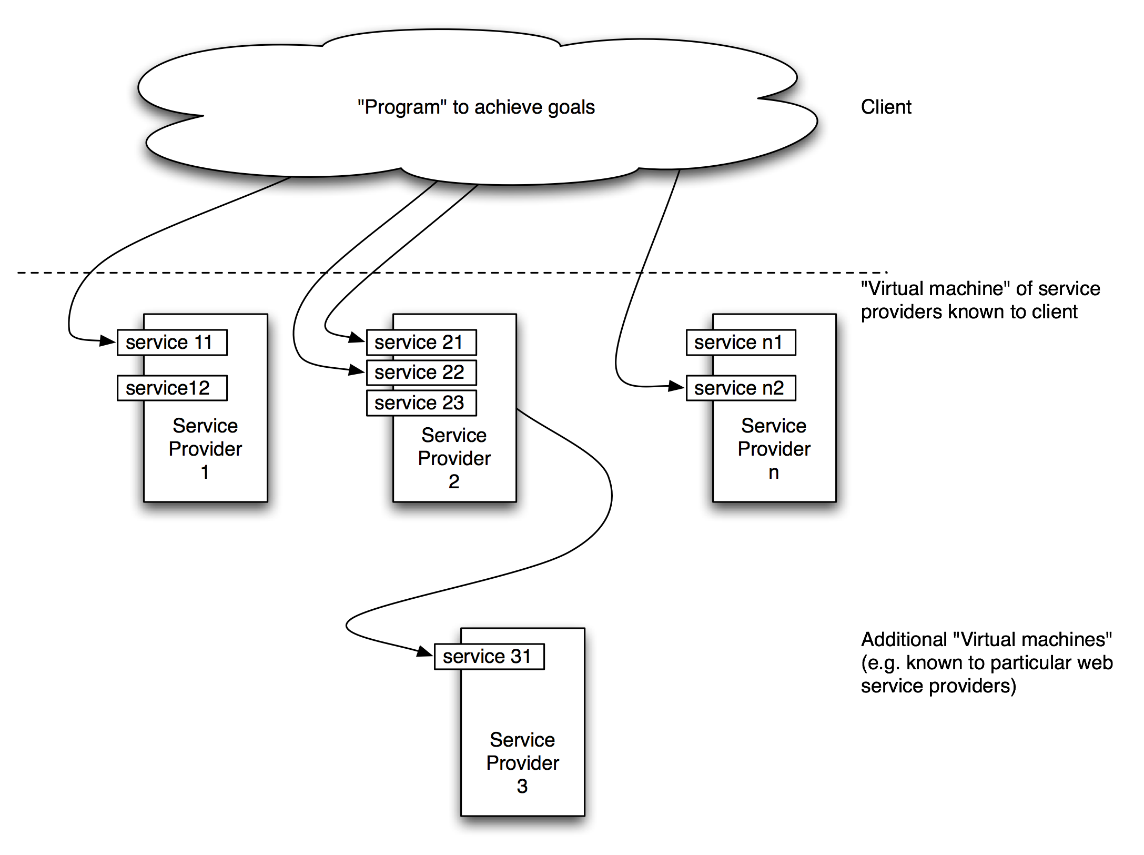
Web services on the Internet

Slide 5
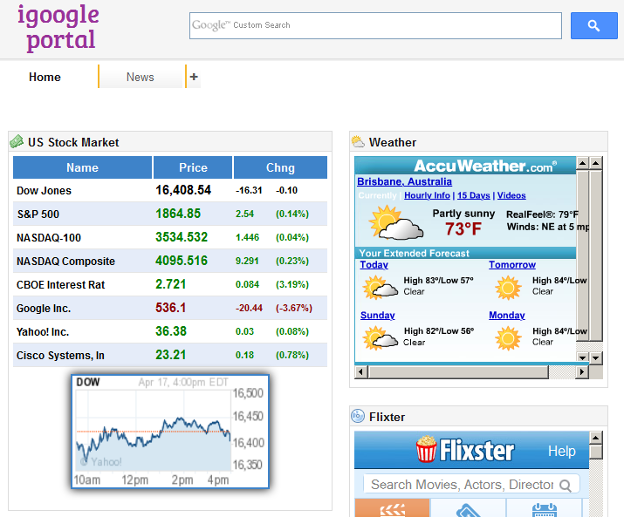
iGoogle

Slide 6
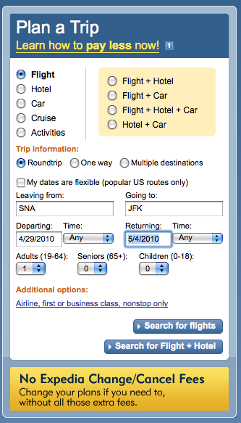
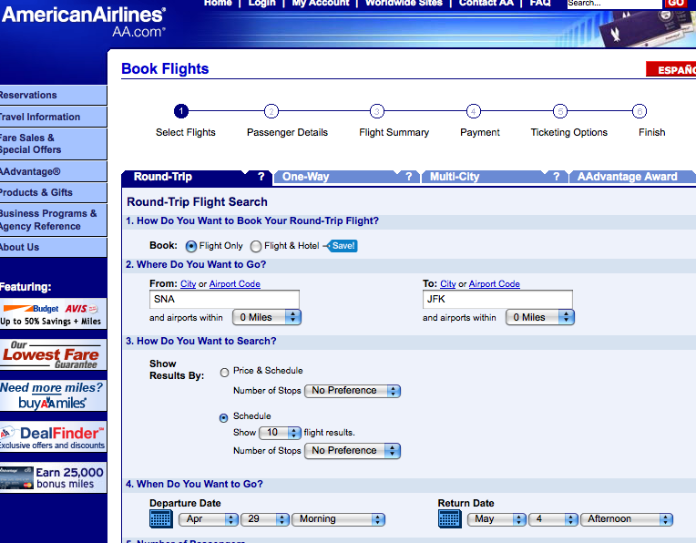
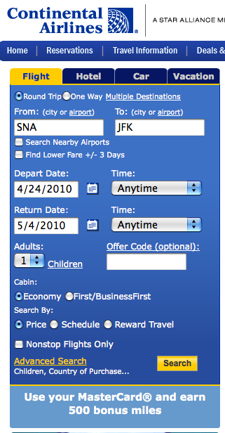
Expedia

Slide 7
Main concerns of SOA
How do I describe the services?
Components
How do the services communicate?
Connectors
How do I combine the services to achieve the business goals?
Application

Slide 8
Service description: WSDL
<?xml version="1.0" encoding="UTF-8"?>
<description xmlns="http://www.w3.org/ns/wsdl"
xmlns:tns="http://www.tmsws.com/wsdl20sample"
xmlns:whttp="http://schemas.xmlsoap.org/wsdl/http/"
xmlns:wsoap="http://schemas.xmlsoap.org/wsdl/soap/"
targetNamespace="http://www.tmsws.com/wsdl20sample">
<types> <!-- Abstract type -->
<xs:schema xmlns:xs="http://www.w3.org/2001/XMLSchema"
xmlns="http://www.tmsws.com/wsdl20sample"
targetNamespace="http://www.example.com/wsdl20sample">
<xs:element name="request"> ... </xs:element>
<xs:element name="response"> ... </xs:element>
</xs:schema> </types>
<interface name="Interface1"><!-- Abstract interfaces -->
<fault name="Error1" element="tns:response"/>
<operation name="Opp1" pattern="http://www.w3.org/ns/wsdl/in-out">
<input messageLabel="In" element="tns:request"/>
<output messageLabel="Out" element="tns:response"/>
</operation>
</interface>
<!-- Concrete Binding Over HTTP -->
<binding name="HttpBinding" interface="tns:Interface1"
type="http://www.w3.org/ns/wsdl/http">
<operation ref="tns:Get" whttp:method="GET"/> </binding>
<!-- Concrete Binding with SOAP-->
<binding name="SoapBinding" interface="tns:Interface1"
type="http://www.w3.org/ns/wsdl/soap" wsoap:protocol="http://www.w3.org/2003/soap/bindings/HTTP/"
wsoap:mepDefault="http://www.w3.org/2003/soap/mep/request-response">
<operation ref="tns:Get" /> </binding>
<!-- Web Service offering endpoints for both bindings-->
<service name="Service1" interface="tns:Interface1">
<endpoint name="HttpEndpoint"
binding="tns:HttpBinding"
address="http://www.example.com/rest/"/>
<endpoint name="SoapEndpoint"
binding="tns:SoapBinding"
address="http://www.example.com/soap/"/>
</service>
</description>

Slide 9
Service communication: SOAP
POST /InStock HTTP/1.1
Host: www.example.org
Content-Type: application/soap+xml; charset=utf-8
Content-Length: 299
SOAPAction: "http://www.w3.org/2003/05/soap-envelope"
<?xml version="1.0"?>
<soap:Envelope xmlns:soap="http://www.w3.org/2003/05/soap-envelope">
<soap:Header>
</soap:Header>
<soap:Body>
<m:GetStockPrice xmlns:m="http://www.example.org/stock">
<m:StockName>IBM</m:StockName>
</m:GetStockPrice>
</soap:Body>
</soap:Envelope>

Slide 10
Service combination
Your app!

Slide 11
Layered protocols

Slide 12
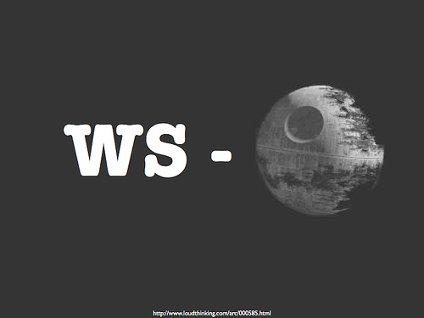
More buzzwords
CORBA, BPEL, REST
OASIS group, Open Group, W3C, OMG, …
Mashups, web 2.0, grid, SaaS, cloud, …

Slide 13
If you’re interested …
http://msdn.microsoft.com/en-us/library/aa480027.aspx

