Slide 1
WEB SERVICES
AND
SERVICE ORIENTED ARCHITECTURE
NETCOMPANY LECTURE SERIES
2014
Notes:
Welcome to the guest lecture in Web Services and Service Oriented Architecture by Netcompany

Slide 2

THOMAS ANDERSEN AND KLAUS ULRIK BJERG

Slide 3
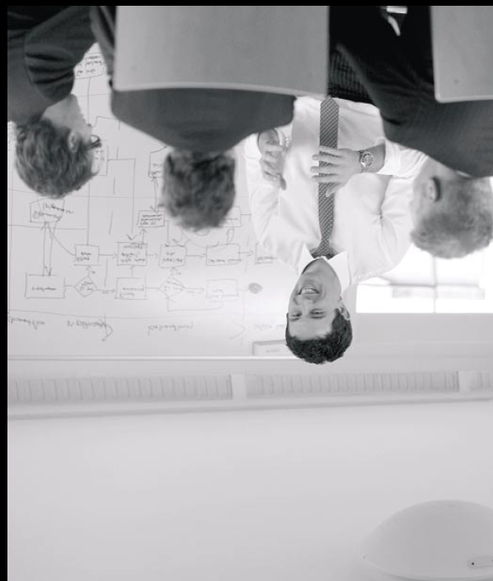
WHO WE ARE
Thomas (Manager)
  Business critical applications for financial, shipping, unions, telecom, central government.
  Mainframe/CICS/DB2, WebSphere Process Server, Java, JEE and .NET.
Klaus (Managing Architect)
  Business applications, enterprise integration, system architecture, e-commerce, knowledge portals, datawarehouse
  .NET, SQL Server, Microsoft Azure, SharePoint, BizTalk Server
Notes:
Thomas:
Since 1998 I have been working as a developer, architect and project manager on various business critical applications.
I startede out developing client/server applications based on thick Windows clients against services on a mainframe.
APM, BEC and HK
Later I moved on to Java/JEE development on WebSphere and WebLogic, first as a developer and later as an architect.
Fiskeridirektoratet, KMS, Telenor and Skat
The last four year my primary work has been as a project manager on a number of .NET web projects
Bluegarden, MBBL and MST
Klaus:

Slide 4
WHO IS NETCOMPANY
Approx. 550 consultants
  M.Sc. or Ph.D. typically from DTU, DIKU, ITU, ÅU, AAU, SDU
  Excel academically
Offices in Copenhagen (HQ), Aarhus, Aalborg and Warszawa
We deliver business-critical IT solutions
  Systems integration and SOA
  Portals
  Business applications
  Application and Facility Management
Our customers include
  Financials Nordea, Saxo Bank, Letpension, PFA pension, FORCA
  Government SKAT, Økonomistyrelsen, Undervisningsministeriet
  Industry Carlsberg, Dong Energy, Pandora
  Commerce Novozymes, Danmarks Apotekerforening
  Media JP/Politikens Hus, Aller
  Membership organizations IDA, HK, Dansk Erhverv
  Telco Telenor, TDC, Telmore

Slide 5
WHAT WE WILL TALK ABOUT
SOA Concepts
Describing a Service
Designing Services
Security
Managing Change
Governance
The Enterprise Service Bus
Business Process Management
Notes:
Todays agenda

Slide 6
READY?
Notes:
Questions are welcome - feel welcome to ask whenever you want.

Slide 7
SERVICE ORIENTED ARCHITECTURE

Slide 8
1
SOA CONCEPTS
Notes:
KUB
We will start with a discussion about SOA concepts

Slide 9
Contract-based
Loose coupling
Abstraction Reusability
AUTONOMY
Discoverability
STATELESSNESS
Notes:
Describe the central concepts around SOA
IDEA: draw a model of systems, constracts, loose coupling, service repository on the whiteboard - engage the students
Contract based : provider and consumer agrees on an interface
Abstraction : the contract is an abstraction of the internal working. No superfluous parameters are exposed.
Loose coupling
Reusability: the service can be reused by multiple consumers
Autonomy: the service implementation is less dependent on the execution environment
Discoverability : service repository can
Statelessness : the service is idempotent (no internal state)

Slide 10
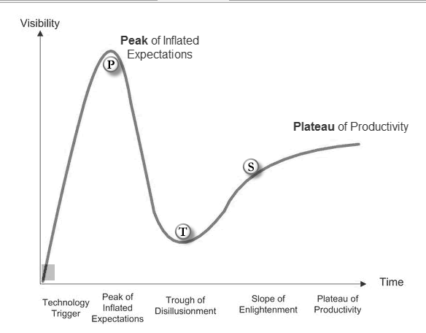
Notes:
What is Gartner Group? Gartner publishes the Hype Cycle for emerging technologies
What is hype cycle?
Peak og expections P (everybody wants it – interest peak, everybody tries to implement)
Through og disillusionment T (most attempts by early movers fail)
Slope of enligthenment S (implementations based on previous experience)
Plateau of productivity P (”off the shelf” technology)

Slide 11
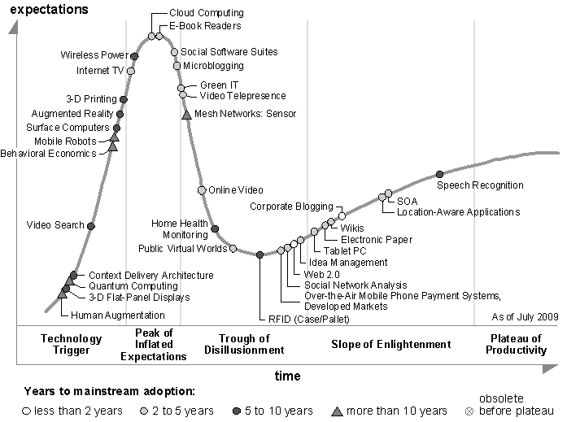
Notes:
Around 2005, after a hype crash, around, SOA was on the slope of enlightenment heading for the plateau.
Example: SOA projects around 2003 was more focused on the technology, and many failed miserably.
After 2009, SOA disappear from Gartners hype cycle: SOA has reached the plateau. Today many SOA principles influence (enterprise) systems architecture.

Slide 12
FIRST
SOA isn’t a technology.
Notes:
Comment about TECHNOLOGY from the cycle on previous slides.
The technology perspective alone lacks the most important reasons to apply SOA.

Slide 13
SECOND
SOA isn’t new.
SOA rests on centuries old principles.
…yes, centuries!
Notes:
Comment about HYPE from the cycle on previous slides.
The principles really revolves around BUSINESS and less around technology.

Slide 14
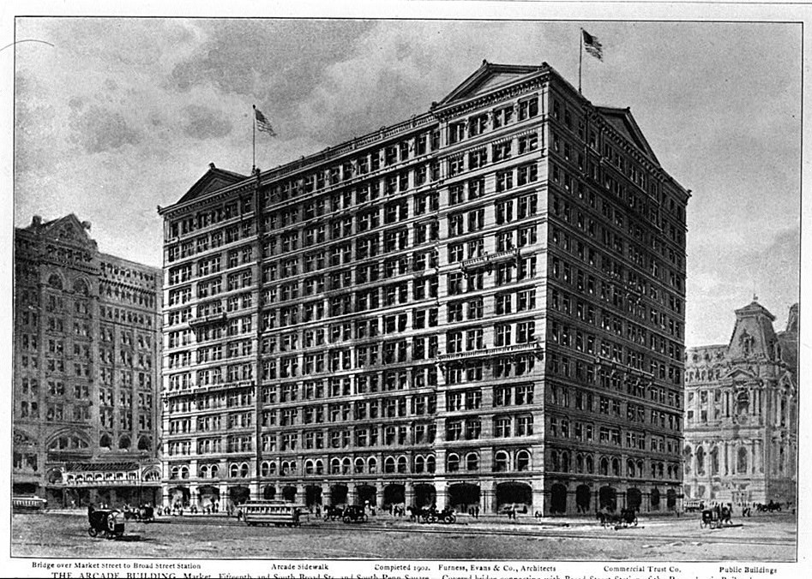
Notes:
Lets try to think of an analogy related to BUSINESS: A large corporation.
How most (if not all) corporations has been structured for decades.

Slide 15
ADMINISTRATION
SALES
ACCOUNTING
ARCHIVE
FINANCE
RECEPTION
Notes:
Principle: DIVIDE AND CONQUEOR
As corporations grow, individual departments (business units) are created to provide business services.
Loose coupling, Contract based cooporation, Autonomy are cornerstones of an effective corporation.

Slide 16
BUSINESS SERVICES
ADMINISTRATION
SALES
ACCOUNTING
ARCHIVE
FINANCE
RECEPTION
Notes:
Removing the building, we are left with the concept of BUSINESS SERVICES (units).
A business can be divided into service areas or units that
Solves well-defined business tasks within that area
Has well-defined processes for providing business services

Slide 17
BUSINESS SERVICES
ADMINISTRATION
SALES
ACCOUNTING
ARCHIVE
RECEPTION
FINANCE
Notes:
In reality, the information flows and processes are not always well-defined or isolated within a business unit.

Slide 18

DEPENDENCIES
SALES
ACCOUNTING
Open Account
Notes:
A unit providing business services often has dependencies on other units.

Slide 19
DEPENDENCIES
ADMINISTRATION
SALES
ACCOUNTING
ARCHIVE
RECEPTION
FINANCE
Notes:
The dependency explosion becomes evident as the company grows.
Each unit define their own interface (biased by their isolated understanding/interest of the business)

Slide 20
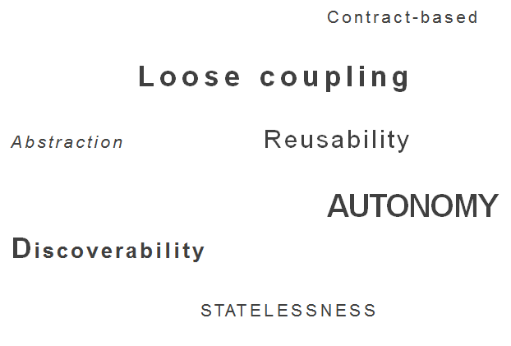
SERVICE DESIGN PRINCIPLES
Notes:
To re-iterate:
When you think about it, these are sound business principles …
TODO: consolidate with next slide- animation ☺

Slide 21
SERVICE DESIGN PRINCIPLES
SOUND BUSINESS PRINCIPLES
Notes:
… that succesfull companies incorporated for many years.

Slide 22
SOA
ADMINISTRATION
SALES
ACCOUNTING
ARCHIVE
RECEPTION
FINANCE
MODEL
Notes:
When implementing SOA, the first step is to build a common model of the business.
This is the cornerstone to reach a common understanding of the business throughout the business.
Business service contracts can then be defined using the shared model.

Slide 23
THIRD
SOA isn’t a dogma
Notes:
Dogma: Endegyldig sandhed, dvs. religiøst princip uden behov for bevis.

Slide 24
THIRD
SOA isn’t a dogma
shouldn’t be
Notes:
During the hype period, some organizations thought that SOA prescribed the silver bullet.
Example:
A company decides that in order to move forward, a full unified model of the busniess are required to implement their SOA strategy.
Four years later, the SOA initiative are put in grave due to lack of results: A unified model could not be agreed upon.

Slide 25
SOA MANIFESTO
”
Service orientation is a PARADIGM that frames what you do.
Service-oriented architecture (SOA) is a
TYPE OF ARCHITECTURE that results from applying service orientation.
”
www.soa-manifesto.org
Notes:
So what is SOA: could look at SOA manifest’s definition of service orientation
Paradigm : a typical example or pattern of something; a pattern or model

Slide 26
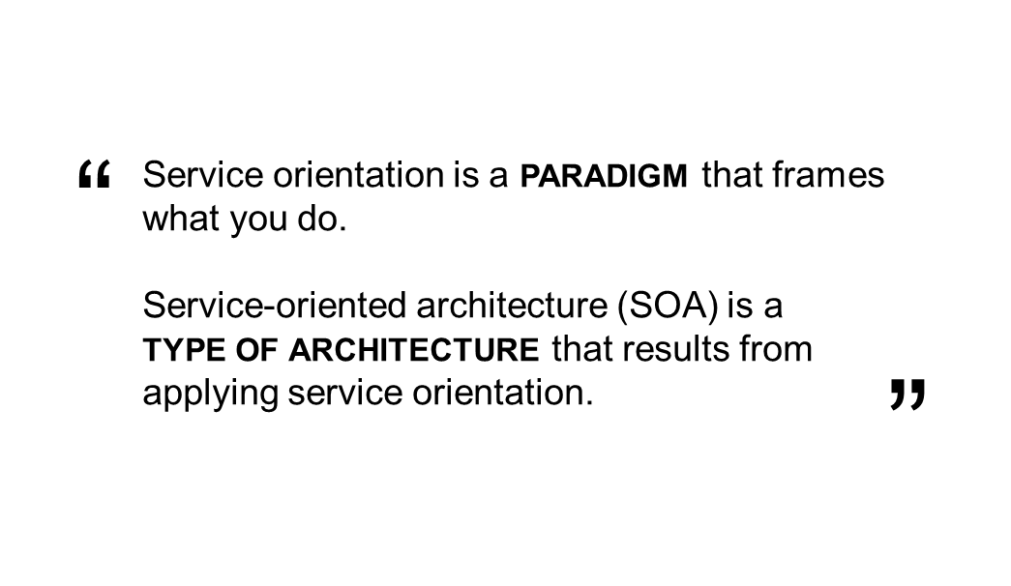
SOA MANIFESTO
DEFINITION
PRIORITIES
Business value over technical strategy
Strategic goals over project-specific benefits
Intrinsic interoperability over custom integration
Shared services over specific-purpose implementations
Flexibility over optimization
Evolutionary refinement over pursuit of initial perfection
GUIDING PRINCIPLES
Respect the social and power structure of the organization. Recognize that SOA ultimately demands change on many levels. The scope of SOA adoption can vary. Keep efforts manageable and within meaningful boundaries. Products and standards alone will neither give you SOA nor apply the service orientation paradigm for you. SOA can be realized through a variety of technologies and standards. Establish a uniform set of enterprise standards and policies …
www.soa-manifesto.org
Notes:
Along the SOA manifesto definition are provided
some priorities and guiding principles
To keep in mind when designing or implementing a Service Oriented Architecture.

Slide 27
2 describing A SERVICE
Notes:
TAN

Slide 28
Design by contract
Definition of contract
“Fully spelled out contract”
Implicit references
Real world
Example of contract
Incomplete information
Resulting code
“Key points”
Aim for adequate specification
Document decisions
Make references explicit
Notes:
What is a contract in general
What is design ny contract
Realise that there is no such as a complete contract.

Slide 29
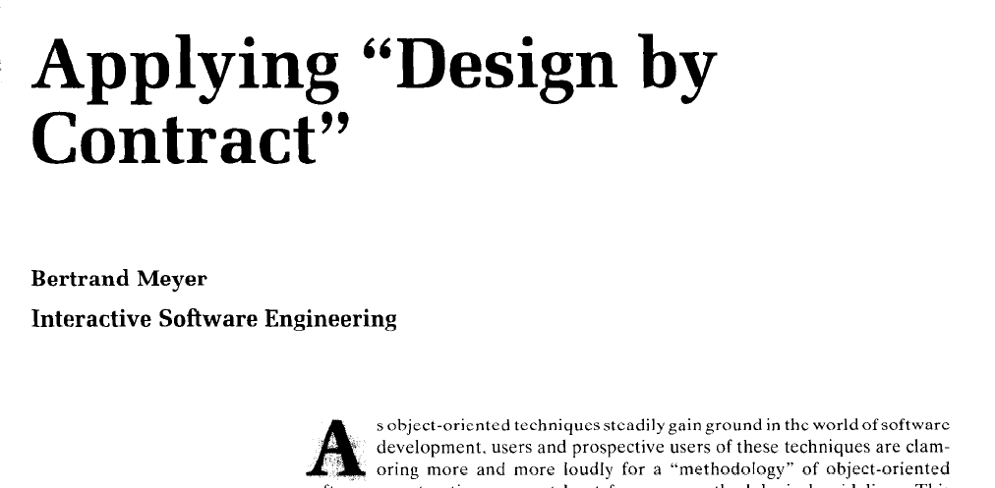
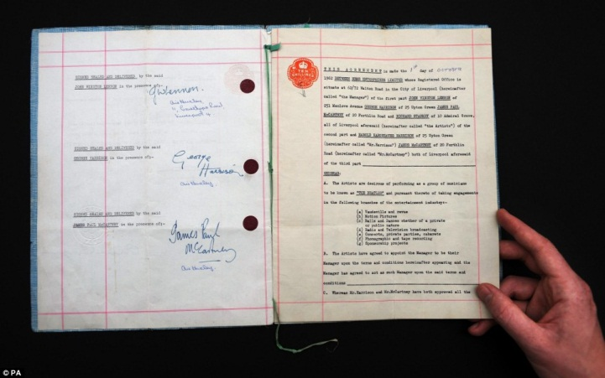
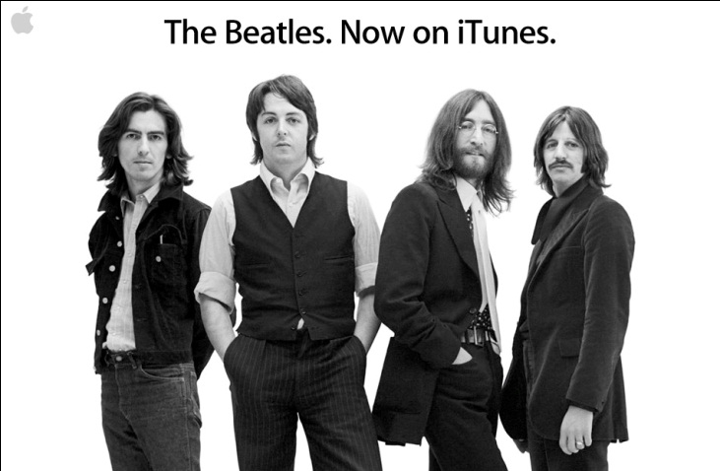
What is a contract?
A contract is a common agreement with benefits for all participants.
The Beatles’ first contract
...a client who satisfies all the constraints listed is entitled to the benefits. This is the No Hidden Clause rule.
The No Hidden Clauses principle does not prevent us from including references, implicit or explicit, to rules not physical part of the contract.
Computer, Vol. 25, No. 10. (1992), pp. 40-51.
A more recent contract
Notes:
In common language a contract is an agreement.
Between two or more parties
Offer some benifit
Obligation
Acceptance by parties
Sometimes the contract is bigger than the parties involved and outlives participants.
In software the term is ”Design by Contract” which is about:
Acceptable and unacceptable input values or types, and their meanings
Return values or types, and their meanings
Error and exception condition values or types that can occur, and their meanings
Side effects
Preconditions
Postconditions
Invariants
(more rarely) Performance guarantees, e.g. for time or space used

Slide 30
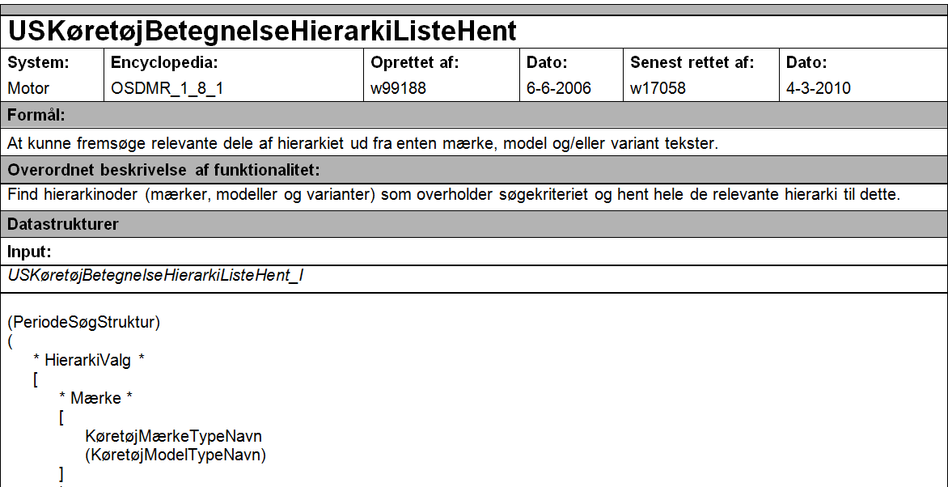
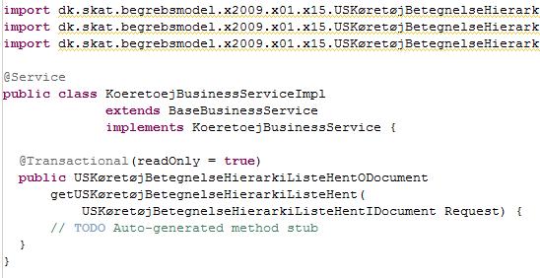
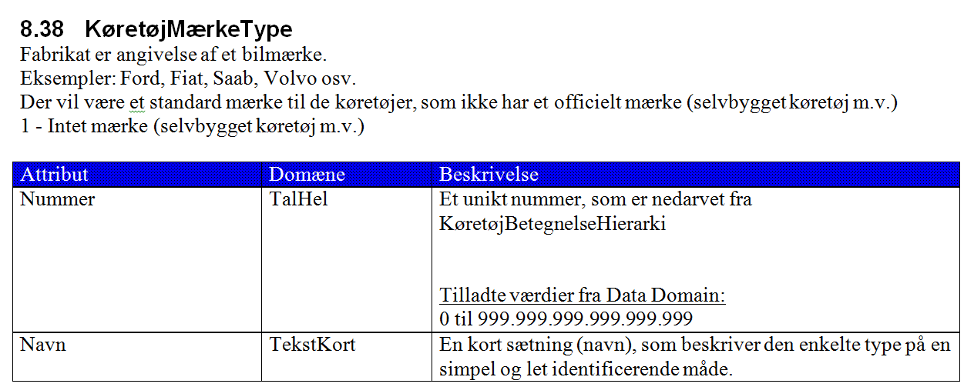
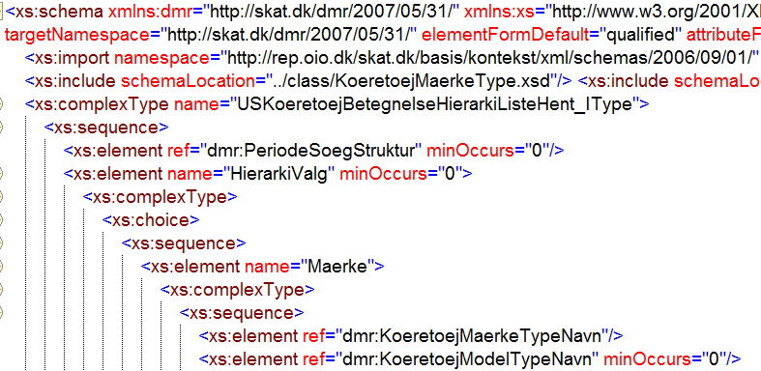
A real world example
Java service implementation stub
Service description from customer
Domain model from customer
XML type definition
Notes:
The purpose is to get from an input document to an output document following the described behavior.
The contract is written in a way that makes the client able to use the service operation to get the information the clients requires.
- How the service is implemented is not relevant for the client! BLACK BOX
The contract is not a complete specification for the developer! The contract defines the interface constrains which the developer has to adhere to.
- This enable the client and service developer to work independently as long as they respect the contract.

Slide 31
Complete vs loose contract
A complete contract
Parts of the contract differ in degree of detail/specificity. From more to less detail:
Security model, infrastructure
Input / output complex types
Simpler xml types
Normal behavior
Restrictions between optional elements
Expected business exceptions
Extreme behavior (e.g. no elements found)
Runtime exceptions (e.g. time out, full disk)
Transactional integrity
Concurrency (even on www)
… is not always a possibility
Therefore, take great care in documenting the decisions made during implementation:
Record changes, and the motivation for these
Beware of other usages of type
Detailed behavior in service description.
Restrictions between optional elements
Reuse exception types across services
Agree on common pattern for services
Wrap in reusable exception types
Part of system architecture not service
Concurrency (even on www)
Notes:
To simplify service contracts some information my be generaliced.
Make general definition across system services like
How to handle exceptions – client might not need the specific cause! And we might not want to give it.
For security reasons exceptions might be generic.
General rules for extreme cases
Is ”No elements found” an exception or an expected result?

Slide 32
Contract vs. Code first
WSDL
Code
Code
Code
Higher detail level
Code independent
Greater Interoperability
Built in governance
Less detailed
Developer oriented
Easy to get started
Easy to break contract
Notes:
When implementing a service as a service provider one has to be aware of that other might depend on the contract!
The service provider has to decide what comes first the “Contract” or the “Code”, both have strengths an weaknesses.
Choose the “Contract” if others outside the project are dependent of the service.
Choose the “Code” if the services are internal.

Slide 33
3
DESIGNING SERVICES
Notes:
TAN

Slide 34
Design deliverables
Systems, Domains and Services
Global Logical Domain Model
Operations and Processes
Physical Document Types
Real world
Internal and external services
Reuse and coupling
CRUD and Process services
“Key points”
Decouple internal and external services on the physical level
Aim for reusable services
Services are different
Notes:
When designing af service, various design elements has to be taken into account.
How is the system structured
How does the different parts of the domain relate to one another
Is the service part of a standard domain : OiO, GML (Geographic Markup Language)? It could be sector og govermental specific.
Are physical documents part of the solution
Internal service and external serviceses are different
Constraints are different
Contract constraints are different

Slide 35
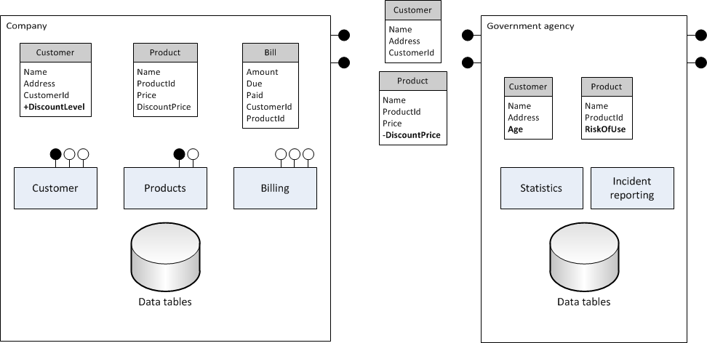
Domain models and services
Do’s
Don'ts
Provide a global logic domain model as part of the contract, but leave external physical communication types flexible.
Be aware that reuse of types between services is strong coupling
Remember that services are used together. Output will be used as input by others.
Model your data tables directly from communication formats
Don’t share physical types between internal and external services. Transformations in one system is easier than changing two systems.
Loose coupling of systems
Notes:
Some of the rules are different for internal services and domain models.

Slide 36
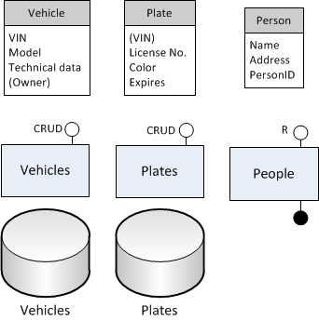
Simple and more complex services
FindVehiclesWithPlateMatching(pattern) {
FindPlates(pattern)
For each plate
result +=ReadVehicle(VIN)
return result;
}
Keeping results in memory is a problem with large result sets. Consider streaming services.
RegisterVechicleToPersonAndAssignPlate(VIN, person) {
UpdateVehicle // ad owner
GetNextAvailablePlate
UpdatePlate // add VIN
}
Issues with concurrency and transactional integrity
Two separate systems for vehicles and license plates and a proxy service for an external system with information about people.
Simple services for Create, Read, Update and Delete, but what about more complex services?
NotifyPoliceAboutExpiredPlates(startDate, endDate) {
GetAllExpiredPlates(startDate, endDate);
Foreach Plate
FindVehicle(VIN)
FindPersion(PersonID)
result += (Vehicle, Plate, Person)
}
“Batch job as service” with join over web service per element and non-domain information (address).
Notes:
No shared transaction -> inconsistent data or compensation services to clean up.

Slide 37
CRUD, Find or Process service?
Not all services are born alike!
Create, Read, Update and Delete
Processes in services
On create, return assigned id
Optional/required might differ in create and read.
Update by sending changes or overwrite whole entity.
Versioning on update can provide optimistic locking
Keep old versions on update and delete operations
Sequences and available data (order of creation)
Avoid joining over services
Consider asynchronous patterns e.g. message queues
Candidates for BPM
Searching for entities via services
Bulk updates
Filtering on fields and values
Avoid joining over services
Behavior for not found and large result sets.
Avoid joining over services
Let update services take a list of elements to update

Slide 38
4
Security
Notes:
KUB

Slide 39
CASE: A PENSION COMPANY
Notes:
Consider a pension company whishing to improve its member services by offering an online Member Portal to their customers .

Slide 40
TRUSTED SUBSYSTEM
IMPERSONATION
Notes:
The traditional choice in security architecture has been between trusted subsystem or impersonation (what identity the backend service sees)

Slide 41
SILO-BASED SECURITY
Notes:
Both trusted subsystem and impersonation models leads to a silo-based security architecture:
Every system defines its own security model.
Example:
You can think of this as if each department in a business applying their own locks and keys. This would make it very hard to navigate and solve tasks dependent on other departments.

Slide 42
SILOS
ARE A
SOA ANTI PATTERN

Slide 43
SILO
CLAIMS-BASED SECURITY
Notes:
Shifting to a claims based security model can help avoid the silo anti pattern.
In a claims based security approach, the security model are shared between the services in the enterprise.

Slide 44
CLAIMS-BASED SECURITY
Notes:
Both the security model and its implementation are shared via an Identity Provider.

Slide 45
CLAIMS-BASED SECURITY
Notes:
FLIS – fødereret login for kommuner
STS (security token service)
Microsoft ADFS 2.0 server: Denne kan modtage både SAML og WS-Federation tokens, validere deres indhold, kryptering og signering og tillige slå ekstra brugerinformation op fra forskellige kilder
Microsoft Universal Access Gateway (UAG): Dette produkt placeres foran SharePoint portalen, og kan konfigureres til at al portal-adgang kræver succesfult login via ADFS serveren. Når en bruger har udført succesfuldt login kan UAG mappe dette login til en lokal AD skyggekonto og danne en kerberos ticket, som den så benytter som login til SharePoint. Herefter foregår al sikkerhed, rollestyring, dataadgang og logning på samme vis som for almindeligt login.
Teknisk set oprettes de lokale AD skyggekonti via den normale brugeradministration i FLIS Portalen, således at UAG allerede har en matchende lokal AD skyggekonto til rådighed når den modtager et ADFS token fra kommunens ADFS Server. Skulle en kommunal bruger, der ikke er oprettet i FLIS, forsøge at logge ind vil vedkommende få en adgangsfejl.

Slide 46
5
MANAGING CHANGE
Notes:
KUB

Slide 47
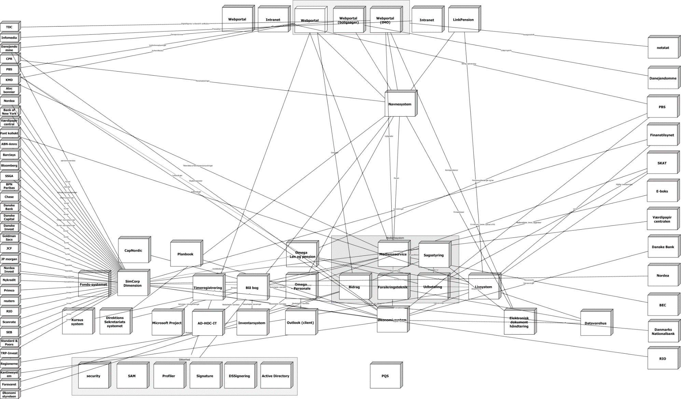
ALL TOO COMMON SYSTEM LANDSCAPE
Notes:
Dependencies, dependencies

Slide 48
…THIS JUST IN:
AS THE BUSINESS CHANGES
SO DOES ITS SERVICES!
Notes:
Why is supporting business requirement changes a challenge? How to manage imposed changes to services?

Slide 49
DEPENDENCIES
”I need an additional field
on the Member object
in three weeks”
”We’re busy for 2 months implementing
that other stuff you wanted!”

Slide 50
VERSIONING
Notes:
KUB
Der er indgået en kontrakt mellem parterne, og parterne er derfor forpligtet til at gøre opmærksom på alle ændringer til kontrakter

Slide 51
6
Governance
Notes:
KUB

Slide 52
GOVERNANCE IS ABOUT
TRANSPARENCY
and
CONTROL

Slide 53
TRANSPARENCY
Understanding your data
Understanding your services and their dependencies
Understanding your business processes
(is prerequisite to)
CONTROL
Enforcing your policies
Managing change
Successfully connecting IT with Business Strategy

Slide 54
TRANSPARENCY:
UNDERSTANDING YOUR DOMAIN
CRM
PENSION
FINANCE

Slide 55
TRANSPARENCY:
UNDERSTANDING YOUR DOMAIN
Member
CRM
PENSION
FINANCE
Notes:
Silo-specifik forståelse af domæner – der er ikke fuld tranparens

Slide 56
ENTERPRISE DATA MODEL

Slide 57
ENTERPRISE DATA MODEL
Notes:
Enterprise data model binder siloerne sammen i en fælles forståelse af forretnings begreber

Slide 58
TRANSPARENCY:
UNDERSTANDING YOUR SERVICES
SERVICE REPOSITORY
PROVIDERS
  Service contracts
CONSUMERS
  Dependencies
Notes:
Der er en fælles repository over services – overblik over services og centralt sted at håndhæve governance / kontrol

Slide 59
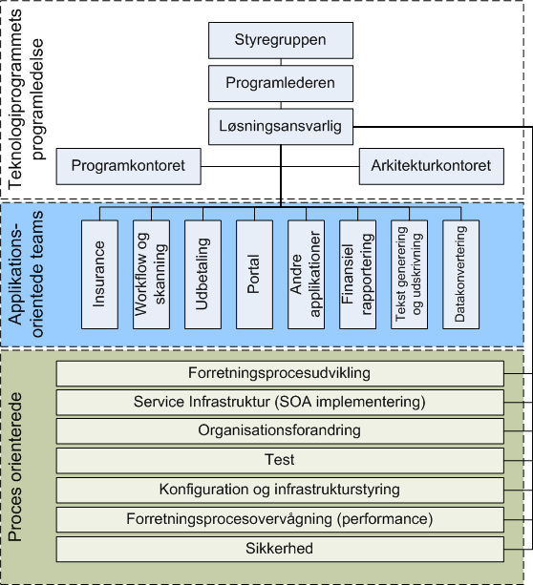
CONTROL
Notes:
Control is implemented via organization structure. In this example technology program organization, teams are divided in application and process orientation.
Thereby establishing SOA as a program-wide effort.

Slide 60
Example: Organization changes
Ad hoc integration
EAI
SOA
Dev Team 1
Database integration
Dev Team 1
EAI integration
Dev Team 1
Review – architecture team
Dev Team 2
Corba integration
Dev Team 2
Integration team
Dev Team 2
SOA - ESB
Notes:
The business organization is often changed according to needs and identified bottlenecks.
Step 1. Teams arbejder autonomt med deres system integrationer. Over tid fører dette til uorden.
Step 2. Integrationsopgaver håndteres af EAI team. Det skaber en flaskehals, idet integrationsteamet er udførende på tværs af projekter.
Step 3. Integrationsopgaver håndteres af teams. Governance proces styres at review team. Mindre flaskehals end step 2.

Slide 61
7
The Enterprise Service Bus
Notes:
TAN

Slide 62
ENTERPRISE SERVICE BUS
ESB
Service Consumer
Consumer
Provider
Service Provider
Transformation
Format A => Format B
Routing
Routing
Format a
Format b
Common ESB functionality
Routing
Addressing
Transformation
Activity monitoring
Policy enforcement
Logging
Notes:
The ESB is the component which binds everything together.
1. The services are published on a ESB and all messages are routed through the ESB.
The ESB knows where to send each message.
Repository of internal service endpoints
Transformation between different message formats
Services often have a standard external format based on governmental defined types or business/organization specific format.
OiO, GML, etc.
2. The ESB usually get some extra responsibilities, like:
Activity monitoring, like who uses which services and how often
Policy enforcement, security, service management, etc.
Logging, service response time, what service is used by whom and how.

Slide 63
ENTERPRISE SERVICE BUS
Notes:
All services published on the ESB
An ESB is a single point of contact for service consumers.

Slide 64
ENTERPRISE SERVICE BUS
Notes:
ESB can be split across domain.
B2B integrations establish trust between the two domian
Single connection between the domains
Trust is specific to the ESB’s.
Model to minimze possible attacks from outside
SAML can be used to federate identity across the domains.

Slide 65
MESSAGE EXCHANGE PATTERNS
SYNCHRONOUS
ASYNCHRONOUS
Request/Response
Request/Response
One-way
Notes:
Synchronous
close coupling
Asynchronous
loose coupling
Response at some point
Flexibility for the client to do other stuff while waiting
Contract is to deliver in parts and at some point.
Easier to scale different parts individually.
2 ways:
Fire and forget; does something just have to be started? If it fails the user can’t help. Then why let him wait.
Spawn multiple requests and join at the end to parallel multiple tasks.

Slide 66
Synchronous = Poor scalability
1
Wait time of 1 is the sum of 2, 3 and 4 plus ESB time.
2
3
4
Notes:
Poor scalability
Client has to wait for Bus which has to wait for each service to finish the Service…
Contract is to deliver all or nothing!
In an asynchronous pattern each service could be called in parallel.

Slide 67
AN EFFECIENT SOA
IS
ASYNCHRONOUS

Slide 68
8
Business process management
Notes:
TAN

Slide 69
Business process
Workflows and queries
Automated processes
Rules
Related services
Real world
An example
Manual process steps
Automated process steps
“Key points”
Aim for reusable services
More business issues than technical issues
KPI’s
Compensation service
Notes:
Business process consists of …

Slide 70
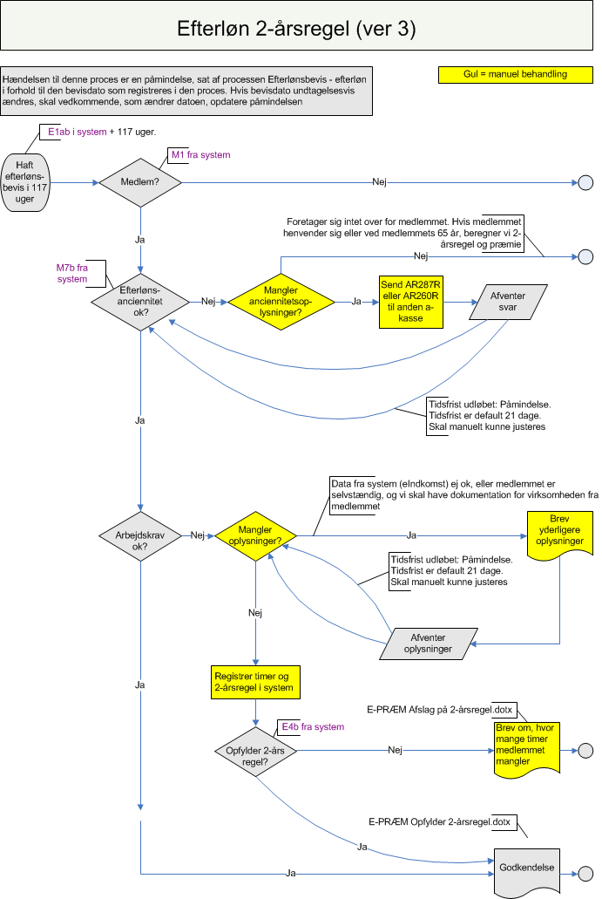
A real world example
The current workflow in the new system
Many activities are given by current laws
Manual activities exist in the system, given complex decisions or necessary individual evaluation
Loose contract of communication formats (phone conversation, letters)
Decisions based on human judgment
Hints about existing bottlenecks
Possible improvements can be identified
The customer wants to
Reduce some manual activities over time
Optimize processes
  => Less waiting time for the members
Simplify the processes
Minimize bottlenecks
Evaluate performance to spot problematic workflows
Notes:
Why?
To enlighten
To measure and optimize?
To harmonize how a specific work process is being executed.
No workflow = people find their own way to solve
KPI’s (Key Performance Indicators) enable the business to get detailed information about the workflow.
Information to make decisions to optimize
A common question; why does it take so long for us to fill an order? To create a customer?
Input to business stakeholders
Remember that there usually are no transaction support across the workflow!
- Compensation if something goes wrong : automatic or manually

Slide 71
Notes:
Customer creation takes to long?
Legislation
Check for signing rights
First manual, now partially automatic, manual when unable to make check
Manual processes
Print and send letter to bank
3 days wait
Backend systems
– batch creation over night

Slide 72
The Future of SOA
Notes:
KUB / TAN

Slide 73
2011-
Common practice!

Slide 74
REST vs SOAP
REpresentational State Transfer
- a client/service pattern
Simple Object Access Protocol
- a protocol for structured data and remote procedure calls
No standard for metadata (WADL to come?)
Operations and processes other than HTTP Verbs tends to be messy
GET /VechicleType/Matching?brand=O*
Security is limited to HTTP/HTTPS. Difficult to encrypt some parts of message only.
Really good for representing public data hierarchies.
GET /VechicleType/Opel/Kadett/?year=1983
Can be very easy to implement, but depends on message format (html/txt, json and xml).
Rich metadata standardization in WSDL
HTTP verbs can be used as operations.
Support for more transports of same operation
Many standardized security policies for authentication, signatures and encryption.
Possible to route messages with partially encrypted content.
More natural in a Business Process context
Can be difficult because of platform specific differences in protocol implementation
REST over SOAP is a possibility…

Slide 75
Cloud Computing
Why Cloud computing?
  Cost-efficient handling of changing resource usage scenarios
  Infrastructure outsourcing
Cloud computing and SOA
  Cloud computing is a natural consequence of the SOA principles
    Vice versa, “SOA will be like electricity for architects looking toward cloud computing” (Gartner)
  Architecture considerations
    Security
    Off-premise vs. on-premise data and services
  Legislation
    Arcane privacy protection laws
  SaaS,
  PaaS

Slide 76
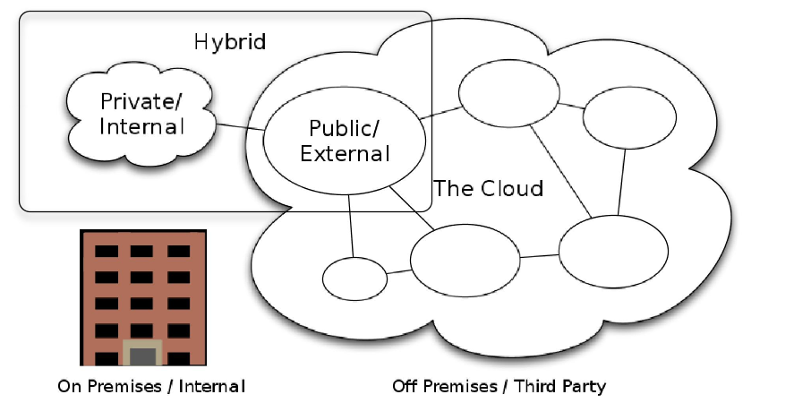
Hybrid Cloud

Slide 77
SOA
IS HERE TO
STAY!

Slide 78
www.netcompany.com

Slide 79
SOA links
http://en.wikipedia.org/wiki/Service_autonomy_principle
http://en.wikipedia.org/wiki/Service_abstraction

