Slide 1
ROUTING TECHNIQUES IN WIRELESS SENSOR NETWORKS: A SURVEY
JAMAL N. AL-KARAKI, AHMED E. KAMAL, 2004
Presented By: Abbas Kazerouni
EE 360 paper presentation, winter 2014,
EE Department, Stanford University

Slide 2
Outline
Challenges in WSNs
Categorization based on Network Structure
Flat-Based Routing
Hierarchical-Based Routing
Location-Based Routing
Categorization based on Protocol Operation
Summary

Slide 3
Challenges in WSNs
No global ID addressing
IP-based protocols do not apply
Stationary nodes
Constraints on energy, storage and processing capacity
High redundancy in different sensors’ data

Slide 4
Network Structure Categorization
Routing Protocols
Flat-Based
Hierarchical-Based
Location-Based

Slide 5
Network Structure Categorization
Routing Protocols
Flat-Based
Hierarchical-Based
Location-Based
All the nodes are treated equally and have the same functionality
5

Slide 6
Flat-Based Routing Protocols
1. Sensor Protocol for Information Negotiation (SPIN):
Sending meta-data to neighboring nodes, instead of data
Requesting for the desired data
Avoid redundant data transmission
Adaptation to remaining energy increase network lifetime
2. Directed Diffusion:
BS continuously sends query to the neighboring nodes
Node with the desired data transmit all the way back to BS
Saving energy by selecting the optimal return path
Not practical for continuous data demand cases

Slide 7
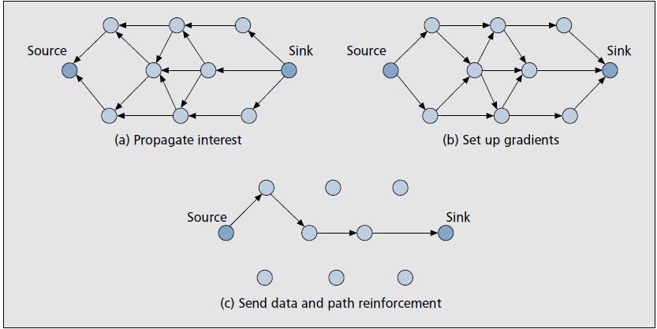
Flat-Based Routing Protocols
3. Rumor Routing:
Variation of Directed Diffusion
Each node has an event table
Event agent flooding instead of query flooding
Significant energy saving
Good for when number of events is less than queries
4. Minimum Cost Forwarding Algorithm (MCFA):
Each node knows the least cost path between itself and BS
Least cost path can be acquired via initialization
Saving energy by selecting the optimal return path
Good for small networks
7

Slide 8
Network Structure Categorization
Routing Protocols
Flat-Based
Hierarchical-Based
Location-Based
Higher energy nodes for transmission, lower energy nodes for sensing
Two layer routing
Increasing the life time
8

Slide 9
Hierarchical Routing
1. Low Energy Adaptive Clustering Hierarchy(LEACH):
Random and variation Cluster Head (CH) selection
Compression and transmission of arriving data at CHs
Constant monitoring applications
Good for small networks
Extra overhead because of clustering
2. Self Organizing Protocol (SOP):
Mobile sensors to probe the environment
Stationary nodes as the routers
LML algorithm for routing
Energy consumption is less than SPIN

Slide 10
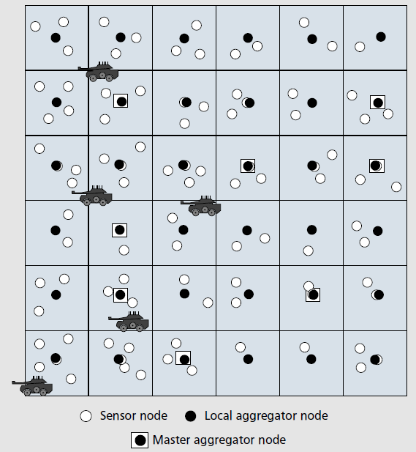
Hierarchical Routing
3. Virtual Grid Architecture
Symmetric, non-overlapping clusters with optimal CH
Local and global data aggregation
NP-hard to find the optimal
global aggregators
4. Hierarchical power-aware routing
Proximate nodes form zones
Routes through the zones which has
maximum minimum residual energy
Dijkstra algorithm can be exploited
10

Slide 11
Network Structure Categorization
Routing Protocols
Flat-Based
Hierarchical-Based
Location-Based
Sensor nodes are addressed based on their location
Location are acquired by GPS or via coordination among nodes
11
11

Slide 12
Location-Based Routing
1. Geographical Adaptive Fidelity (GAF):
Network divided into zones
Only one node is awake in each zone, the rest sleep
Conserves energy by turning off unnecessary nodes
Increases the network life time
2. SPAN:
Some nodes are selected as coordinators based on their positions
Enough coordinators such that network is three-hop reachable
Not energy efficient as the others
12

Slide 13
Routing Protocols based on Protocol Operation
1. Multipath routing
Increases fault tolerance
Sophisticated case: have back up paths
2. Query-based routing
Query transmitted and the date is sent back
3. Negotiation-based routing
High-level data description
Elimination of redundant data transmission
4. QoS-baed routing
Balance between data quality and energy consumption

Slide 14
Summary
WSNs needs have specific characteristics.
WSNs need specific routing algorithm.
Large number of algorithms has been designed, but no optimal one!
Based on the network structure, routing algorithms can be categorized into 3 main groups.
We briefly discussed some examples of each group.

