Slide 1
Sensors
EE 5351
Lecture 7

Slide 2
Sensors Are…
Extremely sensitive to some aspect of the local environment (temp, sound level, motion, etc.)
Extremely insensitive to all other factors
Able to create a linear response to measured changes in that environmental variable
Able to transduce the measurements into a useable signal

Slide 3
A few sensors…
www.societyofrobots.com

Slide 4
Types of Sensors:
Position/Orientation: GPS, Accelerometer, digital compass, Shaft Encoder
Temperature: Bi-metallic, Thermistor, Infra-Red
Sound: Microphone
Object Location: IR, Accoustic (SONAR), Laser Range Finder
Force/Pressure: Piezo-Resistive, Metallic
Magnetic Field: Hall Effect

Slide 5
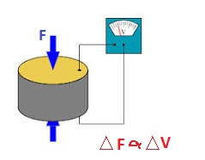
Piezoelectric Effect
In certain Crystals and special ceramics, the crystaline structure deforms under pressure to produce a measurable voltage
Excellent Force
Transducer
Reversible: V→ F or F → V
Wikipedia.org

Slide 6
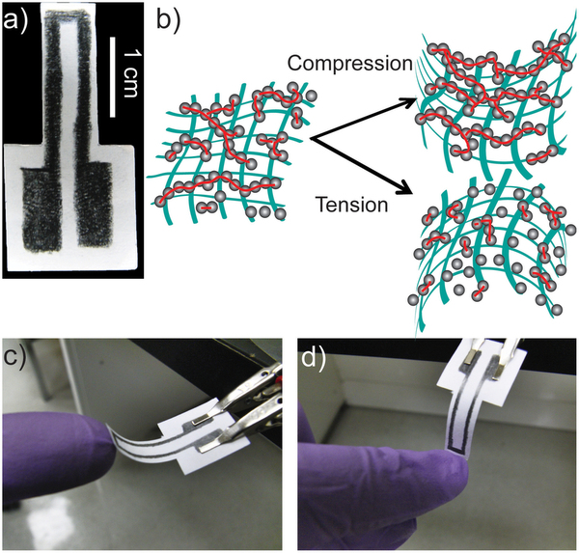
Draw Your Own Strain Gauge!?!?
Paper in NATURE by Cheng-Wei Lin, Zhibo Zhao, Jaemyung Kim & Jiaxing Huang
“Pencil Drawn Strain Gauges and Chemiresistors on Paper”

Slide 7
Hall Effect

Slide 8
Output From Transducers (Sensors)
Analog or Digital
Wired or Wireless
Passive/Active

Slide 9
Analog Signals
0-5 Vdc
-5 to +5 Vdc
4-20 mA Current
Pulsed (Pulse frequency proportional to measured amplitude)

Slide 10
ADC (Analog to Digital Converter)
Periodically sample an Analog Sensor signal and convert it to a digital word
ADC has finite precision, usually +/- ½ bit
Leads to Quantization Error
Accuracy also limited by linearity of measurement process, bandwidth and sampling frequency, aliasing error, etc.
Accuracy usually summarized by Effective Number of Bits (ENOB)

Slide 11
QUANTIZATION:
Quantization is determined by:
- The resolution (R) of the ADC (No. of Bits)
- The full-scale voltage range (span)of the input
Q = Span/(2^{R}-1)
Example: 8-bit ADC with span of -5 to +5 volts: Q = 10/255 = 39.2 mV per bit

Slide 12
Example:
Let’s Look at applying a temperature sensor, AD590 to an ATMEGA328 ADC port:
ATMEGA: 10-Bit resolution, +/- ½ bits, Span = 0-5 Volts
Analog Devices AD 590: Output: 1 uA per Kelvin, terminated by a 10 k-ohm resistor

