Slide 1
Firmware threat
Dhaval Chauhan
MIS 534

Slide 2
What is firmware ???
In electronic systems and computing, firmware is a type of software that provides control, monitoring and data manipulation of engineered products and systems.
Examples :
Traffic lights, consumer appliances, remote controls and digital watches
computer peripherals, mobile phones and digital cameras
Network interface cards, embedded controllers, graphics cards, USB sticks, mice, keyboards ,routers and switches all have firmware.

Slide 3
Why firmware is vulnerable ???
Security and IT managers aren’t paying attention to it.
Security teams focuses more on firewalls, intrusion prevention systems and sandboxes.

Slide 4
Why Hackers attacks firmware ?
Persistence
Malware can be clean up with antivirus software and then remediate with software. Compromised firmware could cause malware to keep coming back even after normal remediation actions.
Stealth
Normal mechanisms for detecting malware do not examine firmware. So compromised firmware can be used to hide malicious behavior for a long time.
Full Access
If malware can control system firmware, it gains full access to the system. By altering firmware, malware can usually bypass existing measures.

Slide 5
Recent incidents
https://www.wired.com/2015/07/hackers-remotely-kill-jeep-highway/
https://www.tripwire.com/state-of-security/incident-detection/dhs-confirms-u-s-public-utilitys-control-system-was-hacked/
https://www.engadget.com/2016/11/03/hackers-hijack-a-philips-hue-lights-with-a-drone/
https://www.youtube.com/watch?v=5GnMj5cus4A

Slide 6
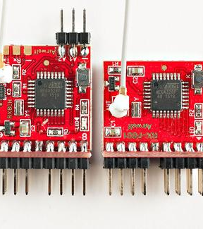
Protecting firmware from attacks
Understand that the threat to firmware is real
Security managers need to know that the risk of an attack in firmware is quite real and that firmware must be updated like any other software.
Routine BIOS updates required, so firmware updates are something security and IT managers need to manage themselves.

Slide 7
Protecting firmware from attacks
Practice security basics
Use solid security principles such as least privilege, in which you only grant access rights to a user for a specific business purpose.
Companies also need to deploy standard defense-in-depth practices for their infrastructure, including firewalls, sandboxes and intrusion protection systems.
IT managers also need to keep web browsers updated and install routine Windows or Mac updates.
Other common practices include not to run applications as root and to disable unnecessary services.

Slide 8
Protecting firmware from attacks
Benchmark your system for security vulnerabilities
Find potential vulnerabilities.
Open source tools such as CHIPSEC give security managers an idea of what specific vulnerabilities are present.
If the system is not configured to protect writes to firmware attackers can simply overwrite it with malware.
If secure boot is not enabled and correctly configured attackers can run their malware before an operating system starts.

Slide 9
Protecting firmware from attacks
Prepare for attacks before they happen
Security managers can take a golden image of each system’s firmware, which then lets them compare what’s changed from the original image in the event of an attack.
Such checks could also be run periodically to monitor any changes when conditions are normal.
While serious, firmware attacks are still rare. If one is suspected, experts from vendors and the local security team may be needed as part of a detailed investigation.

Slide 10
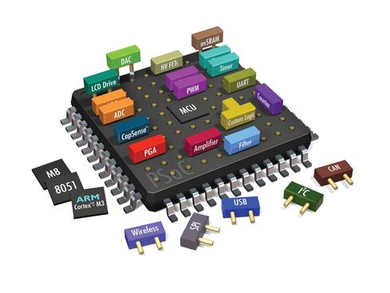
Protecting firmware from attacks
Think about other devices and components
This includes hard drives, network interface cards, graphics cards, baseboard controllers, embedded controllers, and networking gear such as routers and switches.
For the most part, established networking vendors make provisions for automated firmware updates.
Firmware for embedded controllers is usually updated with standard BIOS updates. But for most of the other components, check with the manufacturer to see how they handle firmware updates.

Slide 11
Thank You Prepare for Disaster: Recover Faster

