Slide 1

ECA e-Procurement initiatives and their relevance to the SAR e-Procurement efforts.
South Asia Region Public Procurement Conference
February 20-23, 2017
Sri Lanka
Hunt La Cascia
Senior Procurement Specialist, Governance Global Practice
The World Bank

Slide 2
Contents
1) E-Procurement forums in Vienna and Berlin
2) ECA E-GP Strategy
3) E-Procurement Projects in ECA
4) Rapid e-Procurement Toolkit and Online Learning
Introduction
Notes:
Many thanks for organizing this forum. It represents an incredible initiative to share our experiences and knowledge, not only among countries in SAR, but also across regions. In Europe and Central Asia, several e-Procurement initiatives were launched to help countries move forward and modernize the performance of their public procurement system. I’m going to address the following points in this presentation:
Introduction – Explain the rationale behind encouraging the development of E-Procurement
E-Procurement forums in Vienna and Berlin
ECA E-GP Strategy
E-Procurement Projects in ECA
Rapid e-Procurement Toolkit and Online Learning
For each of these points, I will address how the South Asia Region can implement similar initiative.

Slide 3
Intro – Why encouraging e-Procurement initiatives?
Past
Focus on procurement legal compliance
Institution strengthening and capacity of procurement professionals
Present
Efficient performance of Public Procurement
E-procurement solutions implementation
Missing data
No holistic view
Wide range of data easily collectible
Focus on citizens
Notes:
E-Procurement encourages procurement performance, which is becoming a hot topic in the world of public procurement and results in a shift of priorities:
PAST: procurement systems tended to focus on strict legal compliance, institution strengthening and capacity building of procurement staff. In this way, procurement performance was not the priority, especially since procurement data was missing and most procedures were paper-based.
PRESENT: With the modernization of procurement system and the introduction of e-Procurement solutions, procurement performance is taking more and more importance. E-Procurement data allows for compliance monitoring but also performance measuring. With this approach, the focus is more on citizens since procurement is not an end on itself but rather a bridge to service delivery. As such, procurement performance should not focus only on the bidding process but also on contract implementation.

Slide 4
Procurement Performance and E-Procurement – Reaching the top
Performance
Capacity
Institutions
Legal and Regulatory Framework
Notes:
As described in the previous slide, the following pyramid shows the pathway in constructing an effective public procurement system:
The first step is ensuring a robust legal and regulatory framework in order to regulate the procurement function effectively
The second step is creating institutions to apply the legal and regulatory framework in an efficient and transparent way
The third step is giving the capacity to these institutions to fulfill their mission
The fourth step, once the first three steps are fulfilled, is to measure the performance of the public procurement activity in order to identify bottlenecks, areas of improvement but also achievements. To do so, building a sophisticated e-procurement system is key.

Slide 5
1.
E-Procurement Forums in Berlin and Vienna

Slide 6
2015 E-GP Forum in Vienna
Theme: “Using E-Procurement data to measure the transparency and performance of public spending”
85 participants, 32 countries and 8 international organizations represented
2016 E-GP Forum in Berlin
Theme: “Moving Forward with E-Procurement”
75 participants, 25 countries, and 6 international organizations represented
Meeting with e-Procurement Vendors to discuss their products
Meeting with Donors to discuss financing solutions
Notes:
Organized by the World Bank and co-hosted by the European Bank for Reconstruction and Development, the 2016 “Moving Forward with E-Procurement” Forum was conceived to facilitate the sharing of country experiences in public procurement across the Europe and Central Asia (ECA) region. These forums are the “e-GP oriented” complements to the PRIMO forums, which are broader and are organized every year by ECA SIP.
The Forum was aimed at providing an opportunity to countries to exchange their latest practices in the field.
The Forum also formed a mechanism for country delegates to explore ways and means for regional cooperation in this area and to seek active involvement of international and bilateral donors in the efforts of governments to further improve E-Procurement implementation as well as transparency, economy and efficiency aspects of public expenditure.
These forums are an example of a success story in terms of collaboration and knowledge exchange. It gathered tremendous participation in both years.
Each year on the third day, after countries showcased their presentations, ECA SIP wished to organize something concrete that would help them build their e-Procurement system.
In the first edition, Countries representatives met with more than 20 vendors who showcased their e-Procurement solutions.
In the second edition, countries had the opportunity to sit with donors in order to explore potential financing solutions to improve their e-GP system.

Slide 7
Objectives of the 2015 e-Procurement Forum in Vienna
Sharing countries experiences
Agreeing on a set of indicators
Creating the baseline for all countries against these indicators
Update indictors on an annual basis
Notes:
The 2015 e-Procurement Forum in Vienna/Data and Indicators: The 2016 forum was organized as a follow-up event to last years’ e-procurement forum in Vienna “Enhancing Public Spending Using E-Procurement Data.” The forum was a key conduit for increasing the awareness of the importance of data analytics to improve procurement outcomes, practices, and behaviors which helps Governments maximize the value of public spending.
The Forum highlighted the impact of innovative E-Procurement approaches on enhanced use of public funds. The Forum provided a great opportunity to address the needs of both internal and external clients. It constituted a major achievement in implementing the Bank’s E-Procurement Strategy for the ECA Region and in mainstreaming E-Procurement as a form of transformational engagement within the Global Governance Practice. In this context, the Forum had a strong impact on the development of follow-up business opportunities for the Bank to assist ECA client countries in areas such as E-Procurement, open contracting, data analytics, and citizen engagement.
The objectives of last years’ forum were as follows:
Share country experience in what countries are doing in the area of the theme.
Agree on set of Indicators
Create the baseline for all countries against these indicators (benchmark), using a web based tool for input, visualization and analysis
Update indictors on an annual basis

Slide 8
2015 E-Procurement Indicators: Example of Italy
Category | Indicator | % |  | Availability of Data (Yes/No) | Indicator Value
Efficiency | Success ratio/cancellation | 8.41% | Percentage of procedures without cancellation | Yes | 100%
 | Savings | 8.40% | Percentage of savings from award price vs. cost estimate; Percentage of savings from final price after contract completion vs. award price | Yes | 17% (average award price vs. cost estimate)
Transparency | Open access to procurement information and decisions | 8.41% | Percentage of procurement opportunities advertised on a portal with free access; Percentage of awarded contracts published on a portal with free access | Yes | 100%
Level of Adoption | Procurement value passed through e-platforms | 7.48% | Percentage of procurement value with online transactions | Yes | 100%
 | Professionalization of the PP Officials and Practitioners | 5.61% | Percentage of certified e-Procurement users in contracting authorities | No | Despite the absence of a official certification of the public buyer in Italy, Consip is recognized as a center of excellence in terms of procurement and eProcurement skills
Competitiveness | Level of competition | 7.48% | Average number of bidders | 3.8 | Average number of offers per lot
 |  |  |  | 5.5 | Average number of suppliers offering per lot (including the number of suppliers participating in ”Temporary Consortium of Enterprises”)
 | Open procedures with notice vs. Closed procedures by invitation | 3.74% | Percentage of number of contracts procured competitively | Yes | 96%
Notes:
As stated in the previous slides, an objective of the e-Procurement forum from 2015 was to agree on a set of indicators. The chosen indicators can be seen in this slide. In the third column, you can see the order of the indicators by percentage as they were suggested and selected during last year’s forum. Each country was then asked to provide data for each indicator. The data above is was submitted by Italy and refers to the activities of CONSIP (a participant to the e-Procurement forum 2015) as a CPB (Central Purchasing Body), and, more specifically, to Framework agreements in 2015.

Slide 9
Themes of the 2016 Berlin E-Procurement forum
Institutional Framework for e-Procurement
Moving forward with e-procurement - defining the needs
Costs savings and other economical benefits
Centralized Purchasing
Good Governance through e-Procurement
Notes:
In addition to providing a follow-up on last year’s forum, the WB team asked the countries to present the additional following key points:
Institutional Framework for e-Procurement: What is the institutional framework for managing the e-procurement agenda and operating the e-Procurement system in the country? Are the responsibilities set within the public procurement authority or are they delegated to a third party?
Central Purchasing: The countries were asked to share achievements in the context of using E-Procurement for centralized purchasing including framework agreements, dynamic purchasing systems, e-catalogues, etc.
Costs savings and other economical benefits: The countries were asked to share what kind of costs savings and other benefits did they witness after the implementation of the e-procurement system
Moving forward with e-procurement in your country - defining the needs: The countries were asked to provide specific needs to move forward with e-Procurement, in particular the immediate priorities and the long-term goals

Slide 10
Communities of Practice and Forum Webpages
Forums Webpages:
  2015 E-Procurement Forum in Vienna:
    http://www.worldbank.org/en/events/2015/10/20/e-procurement-forum-enhancing-public-spending
  2016 E-Procurement Forum in Berlin:
    http://www.worldbank.org/en/events/2016/10/31/moving-forward-e-procurement
ECA C4D Communities of Practice:
  E-Procurement Community of Practice
    http://collaboration.worldbank.org/groups/e-procurement
  PRIMO Community of Practice
    https://collaboration.worldbank.org/groups/ppkep
    http://www.worldbank.org/en/events/2016/05/17/12th-procurement-integrity-management-and-openness-forum
Notes:
ECA SIP created two communities of practice on the World Bank’s collaborative platform, “Community 4 Development” or “C4D”. The first one, e-Procurement, allows participants to share their e-procurement experiences and knowledge. The site allows for sharing documents, discussing hot topics and researching e-procurement topics. The second one, Procurement, Integrity, Management and Openness (PRIMO), gives participants the opportunity to discuss issues of critical importance to improving public procurement, and report on recent achievements and future plans in each of their countries, based on the forums held yearly. More information on the forum can be found on these COP. In addition, two webpages are solely dedicated to the forums.

Slide 11
E-Procurement forums in SAR?
Notes:
Slide on SAR -

Slide 12
2.
ECA E-Procurement Strategy

Slide 13
Objective and Scope of Strategy: Governance and Procurement objectives
The ECA e-GP strategy fits within the key objectives of both good governance and public procurement
Governance objectives:
A sustainable public resource management
Effective performance and delivery arrangements
An open an accountable government that supports transparency
Procurement objectives:
Value for Money
Transparency
Economy
Efficiency
Effectiveness
Integrity
Openness

Slide 14
Strategic directions
Enhancement of national adoption plans
Creation of country-tailored performance measurement systems
Use of country e-GP in Bank funded projects
Three Strategic Directions for the Promotion of E-GP in ECA countries
Notes:
ECA SIP developed an e-Procurement strategy to help ECA countries
There are three strategic directions towards which the promotion of e-GP in ECA countries will be made:
Fostering the enhancement of national adoption plans in such way that as many countries as possible get ready to offer their procurement communities the benefit of fully-fledge e-GP systems. It includes the enhancement of stock taking in ECA countries, the reinforcement of capacity through training and promotion of professionalization schemes for procurement, the launch of e-GP dedicated communications and social marketing plans.
Setting up a country tailored performance measurement system with the building of key performance indicators measuring both the adoption of e-GP and the procurement performance itself.
Increasing the use of e-GP in Bank-funded projects for both improving the project management efficiency and quality and showcasing the e-GP use and practice.

Slide 15
Objective and Scope of the ECA e- Procurement Strategy
Developing e-GP capacity and share relevant experience
Strengthening public procurement systems in ECA countries by promoting further adoption of e-GP.
Building capacity in using e-Procurement data to measure public procurement performance
Notes:
The core objectives of the strategy are:
Objective 1: Strengthen public procurement systems in ECA countries by promoting the further adoption of E-GP. The rationale behind this objective derives from a correlation between the introduction and the development of E-GP with relevant, measurable and measured improvements. The recognizable advantages are in terms of transparency, ease of access, competition and economic efficiency of public spending,.
Objective 2: Develop E-GP capacity and share relevant experience. Public procurement capacity will have to be tailored to fill in the structural gaps. The creation of professionalization of the procurement function from both public and private sides of the market is essential.
Objective 3: Build capacity in using e-procurement data to measure public procurement performance to help strengthen public procurement systems to be more strategic. Even in countries and regions that are quite active in undertaking the reform and modernisation of their public procurement systems there is, with few exceptions, some “structural lack of quantitative approach to market information”. Building on the natural ability of E-GP to make the collection and treatment of information a lot easier, this strategy aims at promoting the performance measurement as a key step towards a strategic management of public procurement.

Slide 16
ECA E-Procurement strategy – Indicators and Data
Indicators
E-Procurement Indicators (Adoption, Steps covered etc.)
Procurement performance indicators (Improve efficiency of procurement processes, length of procedures…)
Data
Open Contracting (Categories of data that publishers should seek to collect, manage and publish as part of an open contracting process.)
Governance Filters to detect or prevent fraud, waste and abuse in e-GP systems
Notes:
ECA E-Procurement Strategy is also based on the creation of a set of indicators to assess e-Procurement implementation in ECA Countries and Procurement performance indicators. It also refers to open contracting and governance filters.
1) Indicators
e-Procurement indicators: For example, the value of contracts formed through e-GP (% of total public procurement),
Procurement performance indicators: For example, the average length of pre-award stage (from contract notice to contract award notice), the average % of savings in open procedures
2) Data
Open Contracting:
The different categories of data that publishers should seek to collect, manage and publish as part of an open contracting process. These are divided into three levels:
Basic - these items are commonly held by organizations and provide a basic overview of a contracting process.
Intermediate - these items are important to providing joined-up open contracting data, letting users follow key features of a contracting process over time. They may require publishers to connect up data in their internal systems.
Advanced - these items are important to connecting open contracting data with other data sources (e.g. budget, project), and with real-world impacts (locations, milestones etc.). They may require some publishers to collect and manage additional data.
Governance filters The governance filters in e-Procurement can
Create “proactive” alerts of potentially fraudulent transactions to procurement and oversight personnel. These include alerts of potential collusion and bid rigging at bid submission stage;
Automatically block transactions that do not comply with procurement rules or regulations;
Use collected historic procurement data to generate norms and benchmarks that can be used to create new, tailored and more refined tests;
Create a detailed, comprehensive audit trail for auditors;
Create a useful evidentiary record for investigators.

Slide 17
Example of Adoption of e-GP Key Indicators (Common Indicators for ECA Countries)
STRATEGY DIRECTION | POLICY AREA | POLICY GOAL | SYNTHETIC INDICATORS (country wise) | BASIC INDICATORS (from platforms level) | SOURCE
ADOPTION of e-GP [first direction] | e-GOV | Full adoption of e-GP (engagement) | Value of contracts formed through e-GP (% of total public procurement) | Value of contracts awarded through e-submission Value of goods, services and works contracts awarded through e-submission Value of contracts awarded by a CPB or through a centralised purchasing arrangement | E-GP service provider (platform) + National Statistics
 |  |  | Volume of contracts formed through e-GP (% of total number of contracts) | Number of contracts awarded through e-submission Number of goods, services and works contracts awarded through e-Submission Number of contracts awarded through a centralised versus decentralized way Number of contracts awarded by a CPB or through a centralised purchasing arrangement | E-GP service provider (platform) + National Statistics

Slide 18
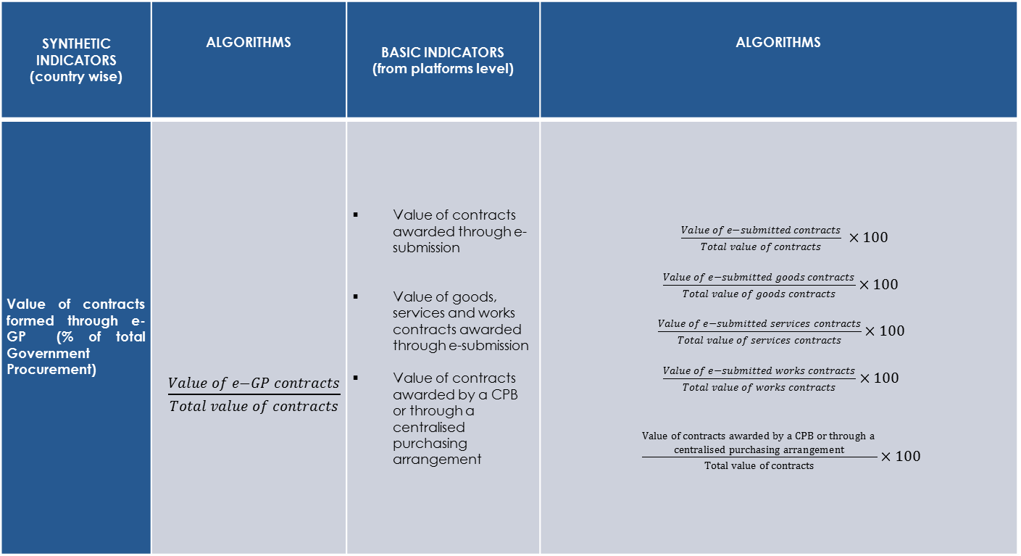
Example of Adoption of e-GP Key Performance Algorithms
SYNTHETIC INDICATORS (country wise) | ALGORITHMS | BASIC INDICATORS (from platforms level) | ALGORITHMS
Value of contracts formed through e-GP (% of total Government Procurement) | $\frac{Value of e−GP contracts}{Total value of contracts}$ | Value of contracts awarded through e-submission Value of goods, services and works contracts awarded through e-submission Value of contracts awarded by a CPB or through a centralised purchasing arrangement | $\frac{Value of e−submitted contracts}{Total value of contracts} ×100$ $\frac{Value of e−submitted goods contracts}{Total value of goods contracts}×100$ $\frac{Value of e−submitted services contracts}{Total value of services contracts}×100$ $\frac{Value of e−submitted works contracts}{Total value of works contracts}×100$ $\frac{\begin{aligned}Value of contracts awarded by a CPB or through a \\ centralised purchasing arrangement\end{aligned}}{Total value of contracts}×100$

Slide 19
Transposing the strategy to the SAR
Notes:
SAR slide

Slide 20
3.
E-Procurement Projects in ECA
Notes:
ECA is undertaking many E-Procurement reform projects that could easily serve as an inspiration for SAR.

Slide 21





What is the World Bank doing in ECA
Support to the implementation of the public procurement strategy in Romania
Strengthening Public Procurement in Serbia
Improving Efficiency and Transparency in Public Procurement Georgia
Enhancing the implementation of Public Procurement in FYR Macedonia
Country Fiduciary and Project Implementation (CFPI) Review in Albania
Notes:
The World Bank is undertaking many projects to assist ECA countries in improving their e-procurement system:
Serbia: ECA SIP is currently implementing a project called “Strengthening Public Procurement in Serbia.” The strategy for development of Public Procurement in Serbia for the period 2014 – 2018 sets as one of its priorities to upgrade the e-Procurement system in Serbia. The project contains three e-procurement related activities:
Analysis of preconditions for further development of e-procurement
Create recommendations and roadway for further development of e-procurement
Preparation of conceptual solution and technical documentation for development of Public Procurement Portal
Georgia: Improving Efficiency and Transparency in Public Procurement in Georgia. The proposed program will assist the Government of Georgia in improving public procurement outcomes by enhancing public procurement procedures, processes, systems and capacity. The activities defined in this program aim to increase the quality and use of data and analytics in the management of procurement, contract management and public finances. The World Bank’s Europe and Central Asia e-procurement Indicators will be applied to establish a systemic profile. These will be supplemented by indicators which have been customized to provide greater insight on the performance of different agencies relating to procurement in capital investment, and the dynamics of small and medium enterprise participation in procurement.
Macedonia: SAFE RETF “Enhancing the implementation of Public Procurement in FYR Macedonia.” One of the three components of the project concerns E-procurement, security & software updates : This component will finance additional ESSP functionalities for (i) publication of procurement notices of international donors, in order to increase transparency given the fact that local economic operators know the e-GP system as a unique place to search for business opportunities with the public sector; (ii) pre-view of the tender documents for Economic Operators without subscribing to the system and (iii) e-payment for the registration subscription for EOs and CAs. Additionally, this component will finance analysis for (iv) the harmonization of e-procurement with e-archive and e-appeal and (v) based on the results of the analysis other innovative tools and functionalities could be added to the e-procurement system.
Romania: In supporting the National Public Procurement Agency of Romania (ANAP) to transform the public procurement policy and practice into a strategic management function with focus on value for money throughout the project cycle, the World Bank is developing a web-based knowledge and learning tool (Guide). As indicated in the public procurement strategy of Romania, the Guide will be a critical tool to shift the paradigm of the public procurement system from a compliance-based to a performance-based culture among contracting authorities and public procurement stakeholders. The Guide will help develop an in-depth understanding of the general public procurement principles of the EU directives.
Albania: The main objectives of the CFPI review is to support the Government of Albania in developing efficient and effective public procurement reform and project implementation strategies. It includes an assessment of the e-procurement system.

Slide 22


E-Procurement Data: Examples Albania and Georgia
Country Fiduciary and Project Implementation (CFPI) Review in Albania
Improving Efficiency and Transparency in Public Procurement Georgia
Notes:
These are two examples of our work related to e-Procurement data analytics.
In Albania, as part of the Country Fiduciary and Project Implementation Review, we received a lot of data from the Albanian e-Procurement system which helped us analyze for example the percentage of goods, works, and services contracts by size or the duration of different procurement stages, such as the duration from public procurement notice to bid submission deadline, bid opening to contract signature date, or contract signature date to contract publication date.
In Georgia, access to the e-Procurement data helped the Bank drill down the percentage of competitively awarded contracts for goods, works, and services as well as the percentage of procurement activities with one, two, three, 4 or more participating bidders.
Analytical data help identify bottlenecks and issues throughout public procurement and contract management as basis for informed decision making in the area of public procurement.

Slide 23
Implementing similar projects in SAR
Notes:
Relevant?? Finding similar projects in SAR that can benefit from our projects?

Slide 24
4.
Rapid e-Procurement Toolkit and Online Learning

Slide 25
Scope and Objectives of the Toolkit and Online course
Rapid E-Procurement Toolkit
Scope: Set of detailed resources for launching their e-Procurement projects in line with international standards
Scope: Online learning material for interested parties to familiarize themselves with e-Procurement and the benefits of e-GP
Objective: Providing detailed information on needs and requirements when embarking on the establishment of e-GP, through a dedicated website
Online Learning
Objective: introducing audience to the concepts and main objectives of e-GP and state-of-the-art e-Procurement systems, through five learning modules, which lead to an e-Procurement certification
Notes:
As a response to the significant inefficiencies observed worldwide in several e-GP implementation initiatives, such as lot of misunderstandings on goals and scope for such initiatives, uncoordinated efforts leading to unproductiveness and duplication of work etc. the WB has taken the initiative to create tools aiming at assisting countries to better understand e-Procurement and modernize their overall e-GP framework:
E-Procurement online learning course:
Online learning material for interested parties to familiarize themselves with e-Procurement and the benefits of e-GP
E-Procurement Toolkit:
A set of detailed resources including a mechanism for interested parties to create template Terms of Reference for launching their national e-Procurement projects in line with international standards
The objectives for each are as follows:
E-Procurement Online learning courses: aimed at introducing audience to the concepts and main objectives of e-GP and state-of-the-art e-Procurement systems, through five learning modules, which lead to an e-Procurement certification:
E-Procurement Preparation
E-Procurement Basics
Advanced e-Procurement
E-Procurement Indicators
Incorporating e-Procurement into Public Financial Management (PFM) reforms
Rapid e-Procurement Toolkit: aimed at providing detailed information on needs and requirements when embarking on the establishment of e-GP, through a dedicated website that offers:
Documentation covering core topics of e-GP and e-Procurement in particular
Mechanism for the creation of template requirements of a state-of-the-art e-Procurement system

Slide 26
E-Procurement online learning course – General
www.eProcurementLearning.org
Consists of five learning modules, following common structure:
  Topics:
  E-Procurement Preparation
  E-Procurement Basics
  Advanced e-Procurement
  E-Procurement Indicators
  Incorporating e-Procurement into Public Financial Management (PFM) reforms
  Common structure:
  Introductory video, outlining the topic to be presented
  Main content, including interactive features, diagrams and inline questions
  Self assessment quiz, prompting the learners to evaluate their understanding
  Summary of the presented learning module
  List of acronyms used throughout the presented module
Leads to an e-Procurement certification
  Upon completion of the five learning modules, learners can take the e-Procurement Certificate examination (20 random questions of topics covered in all five learning Modules)
  Upon successful completion of the examination, learners obtain the “e-Procurement champion” certificate
Implemented within the World Bank Group’s Open Learning Campus (OLC)
  OLC: learning platform providing access to development knowledge across all sectors and region
Notes:
The online learning course covers the majority

Slide 27
E-Procurement online learning course – Topics covered
E-Procurement Basics:
The e-Reverse Auctions system
The Contract Management system
The e-Catalogue system
The Catalogue Management system
The e-Purchasing system
The Vendor Management system
The Business Intelligence Reporting & Dashboard system
E-Preparation module:
What is public procurement
What is e-Government procurement and how to establish
Recommended organizational structure
Indicative action plan
E-Procurement Indicators:
E-Procurement indicators
Strategic directions
Performance management
Calculation of indicators
Incorporating e-Procurement into Public Financial Management (PFM) reforms:
What is Public Financial Management (PFM)
What is Financial Management Information Systems (FMIS)
E-Procurement systems in the context of PFM reforms
The e-Registration system
The Searching system
The e-Procurement Plan system
The e-Publishing/Notification system
The e-Tendering system
The e-Evaluation/e-Awarding system
Non-functional aspects
Advanced e-Procurement:
Notes:
As you can see, the online course covers the whole spectrum of e-Procurement.

Slide 28
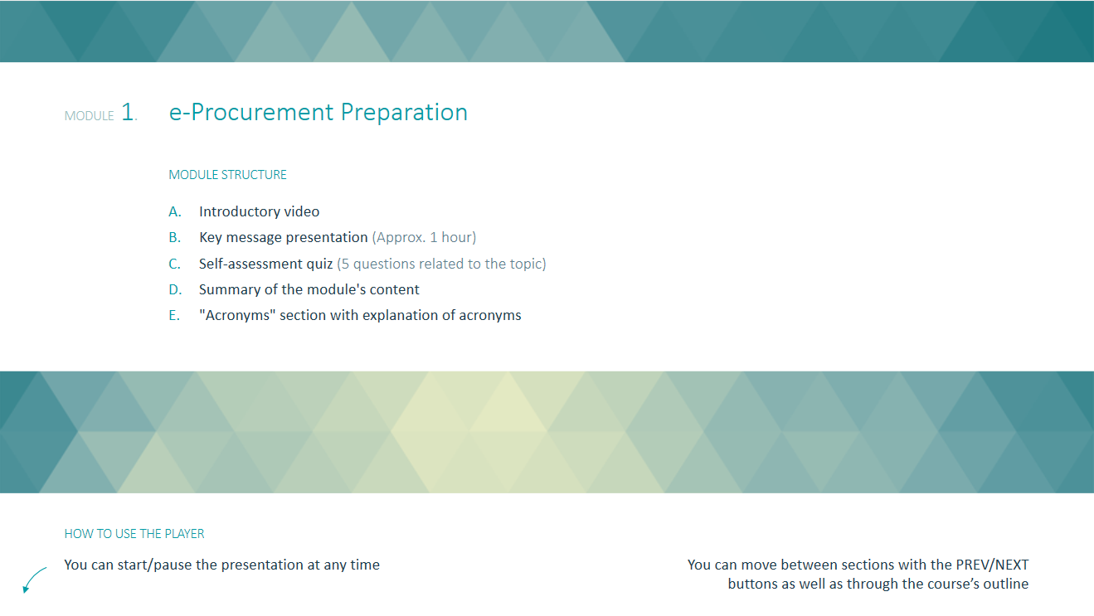
E-Procurement online learning course – Overview
Notes:
Each course module is available on OLC. This slides shows how the course actually looks like as well as its structure.

Slide 29
Rapid e-Procurement Toolkit - Overview
www.eProcurementToolkit.org
Documents section, covering four essential topics of e-GP and e-Procurement:
  E-Procurement Preparation
  Open Contracting Data Standard (OCDS) Implementation Methodology
  Public Procurement Indicators
  Guidelines for Conducting Market Analysis for e-Procurement Systems
Template Requirements functionality, guiding users to quickly formalize their technical requirements for implementing or procuring an e-Procurement system, in terms of:
  E-Procurement modules
  E-Procurement submodules
  E-Procurement requirements
Notes:
The Rapid E-Procurement toolkit offers two different tools for countries in order to either build or enhance their e-GP System:
A documents section covering four essential topics of e-GP and procurement:
E-Procurement Preparation, presenting:
The concept of e-Government Procurement (e-GP)
Why and how to pursue the establishment of an e-GP framework
The benefits that e-GP implementation projects can offer and a model action plan
Open Contracting Data Standard Implementation Methodology, presenting:
The concept of Open Contracting Data Standard (OCDS) and technical overview of the standard
A high-level approach for its implementation in an e-Procurement system
How it can be incorporated in a new or existing e-Procurement system
Public Procurement Indicators, presenting:
The concept of public procurement indicators for assessing countries’ e-GP operation against relevant policy goals
The different categories of public procurement indicators, along with computational method and target per indicator
Guidelines for Conducting Market Analysis for e-Procurement Systems, presenting:
Why market analysis can form a means to better formalize requirements and approach by understanding the ICT market (available e-Procurement vendors / software products)
The core principles of a methodology for conducting market analysis
Template Requirements functionality, guiding users to quickly formalize their technical requirements for implementing or procuring an e-Procurement system:
Users are able to select the desired e-Procurement functionality, in order to obtain a full set of relevant template requirements, i.e.:
Select the required e-Procurement system modules (14 modules in total, such as “Catalogues Management”)
Select the required e-Procurement system submodules based on the module selection (65 submodules in total, such as “Catalogue submission”)
Obtain the e-Procurement system requirements based on the modules/submodules selection
The Toolkit outputs template requirements for an e-Procurement system to support the selected functionality:
Requirements can be viewed on screen
Requirements can be exported in user-friendly XLS format
The template requirements can be used when procuring an e-Procurement system (i.e. form part of the technical requirements in a bidding “Terms of Reference” document) or when defining specifications for an in-house e-Procurement implementation.

Slide 30
Rapid e-Procurement Toolkit - Documentation
E-Procurement Preparation, presenting:
The concept of e-Government Procurement (e-GP)
Why and how to pursue the establishment of an e-GP framework
The benefits that e-GP implementation projects can offer and a model action plan
Open Contracting Data Standard Implementation Methodology, presenting:
The concept of Open Contracting Data Standard (OCDS) and technical overview of the standard
A high-level approach for its implementation in an e-Procurement system
How it can be incorporated in a new or existing e-Procurement system
Public Procurement Indicators, presenting:
The concept of public procurement indicators for assessing countries’ e-GP operation against relevant policy goals
The different categories of public procurement indicators, along with computational method and target per indicator
Guidelines for Conducting Market Analysis for e-Procurement Systems, presenting:
Why market analysis can form a means to better formalize requirements and approach by understanding the ICT market (available e-Procurement vendors / software products)
The core principles of a methodology for conducting market analysis
Notes:
E-Procurement Preparation, presenting:
The concept of e-Government Procurement (e-GP)
Why and how to pursue the establishment of an e-GP framework
The benefits that e-GP implementation projects can offer and a model action plan
Open Contracting Data Standard Implementation Methodology, presenting:
The concept of Open Contracting Data Standard (OCDS) and technical overview of the standard
A high-level approach for its implementation in an e-Procurement system
How it can be incorporated in a new or existing e-Procurement system
Public Procurement Indicators, presenting:
The concept of public procurement indicators for assessing countries’ e-GP operation against relevant policy goals
The different categories of public procurement indicators, along with computational method and target per indicator
Guidelines for Conducting Market Analysis for e-Procurement Systems, presenting:
Why market analysis can form a means to better formalize requirements and approach by understanding the ICT market (available e-Procurement vendors / software products)
The core principles of a methodology for conducting market analysis

Slide 31
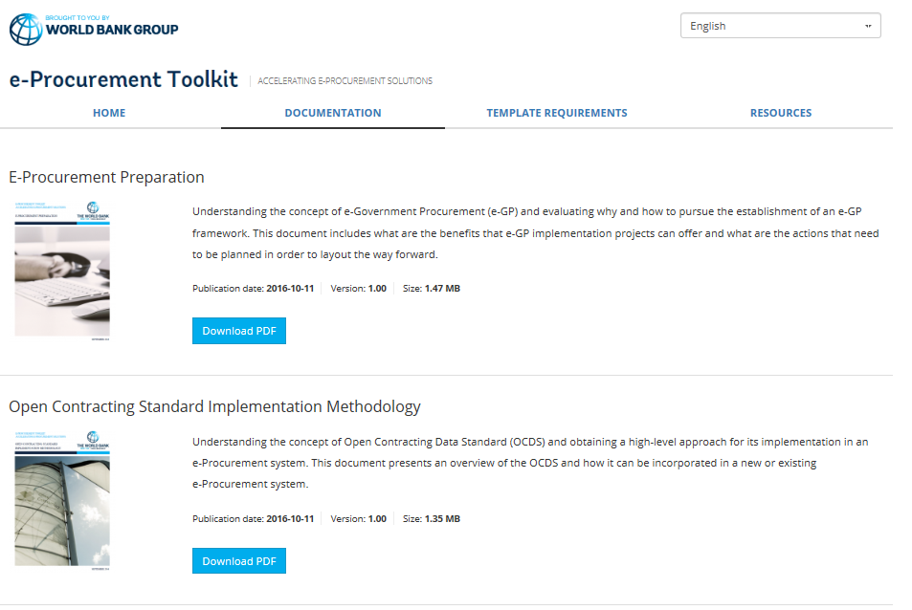
Rapid e-Procurement Toolkit – Documentation Overview
Notes:
Under the tab documentation, all four documents can be found in both English and Russian versions.

Slide 32
Rapid e-Procurement Toolkit – Template requirements
Users are able to select the desired e-Procurement functionality, in order to obtain a full set of relevant template requirements, i.e.:
Select the required e-Procurement system modules
The Toolkit outputs template requirements for an e-Procurement system to support the selected functionality:
Requirements can be viewed on screen
Requirements can be exported in user-friendly XLS format
Select the required e-Procurement system submodules based on the module selection
Obtain the e-Procurement system requirements based on the modules/submodules selection
Notes:
Users are able to select the desired e-Procurement functionality, in order to obtain a full set of relevant template requirements, i.e.:
Select the required e-Procurement system modules (14 modules in total, such as “Catalogues Management”)
Select the required e-Procurement system submodules based on the module selection (65 submodules in total, such as “Catalogue submission”)
Obtain the e-Procurement system requirements based on the modules/submodules selection
The Toolkit outputs template requirements for an e-Procurement system to support the selected functionality:
Requirements can be viewed on screen
Requirements can be exported in user-friendly XLS format
The template requirements can be used when procuring an e-Procurement system (i.e. form part of the technical requirements in a bidding “Terms of Reference” document) or when defining specifications for an in-house e-Procurement implementation.

Slide 33
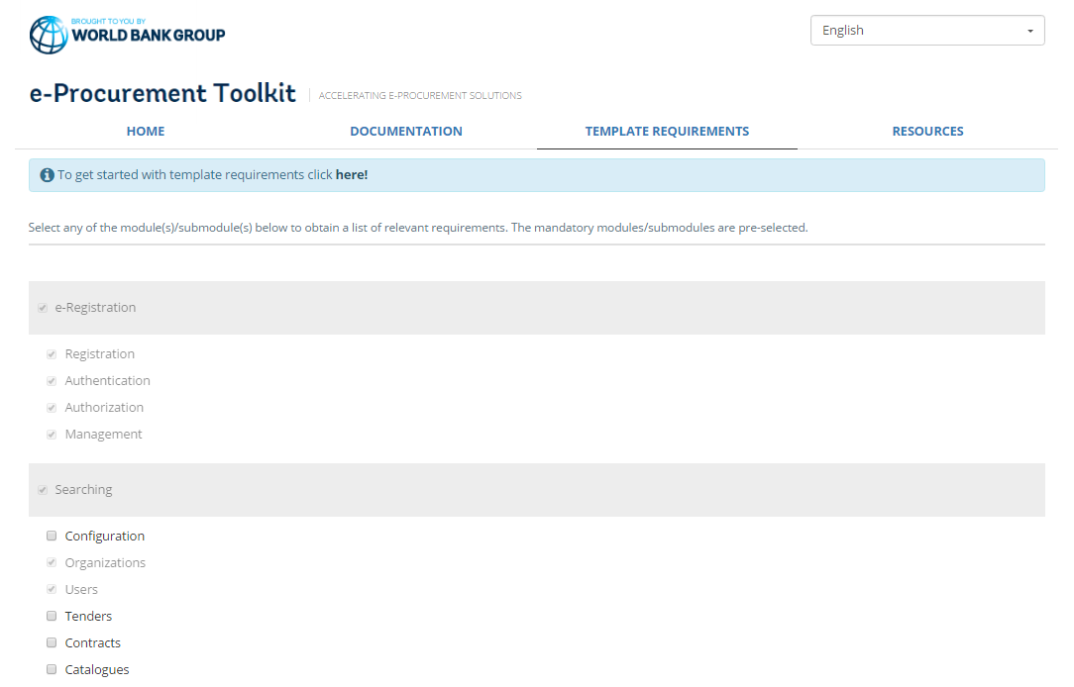
Rapid e-Procurement Toolkit – Template requirements Overview
Notes:
In this slide, you can see the template requirements for the module e-Registration and the sub-module “registration,” and each requirement is described and categorized into “mandatory”, “desirable” or “important”.

Slide 34
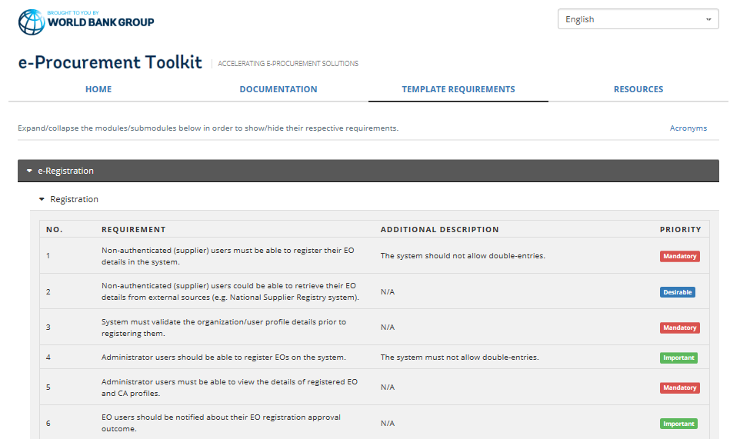
Rapid e-Procurement Toolkit – Template requirements Overview
Notes:
In this slide, you can see the template requirements for the module e-Registration and the sub-module “registration,” and each requirement is described and categorized into “mandatory”, “desirable” or “important”.

Slide 35
Usage of Toolkit by SAR?
Notes:
SAR Slide.

Slide 36
Thank you!

