Slide 1
Use of Bessel Function in Designing Fiber for Fiber Optic Communication
Michael Ghoorchian

Slide 2
Fiber Optic
An optical fiber is a glass or plastic fiber that carries light along its length so it acts as a Wave guide.
Mostly made of Silicon (not Silicone !)
Optical fibers are widely used in fiber-optic communications,

Slide 3
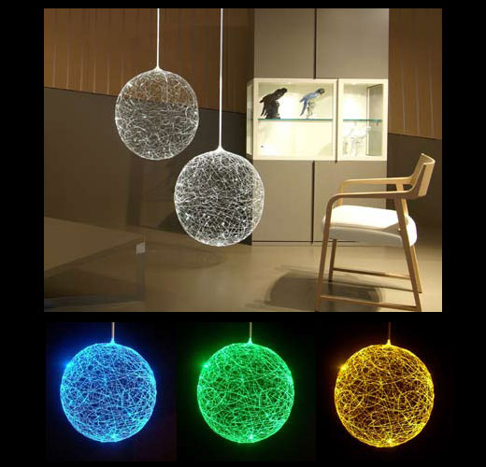
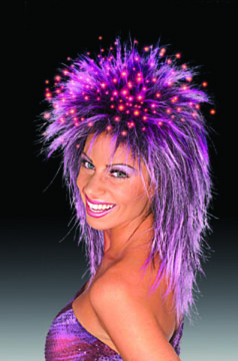
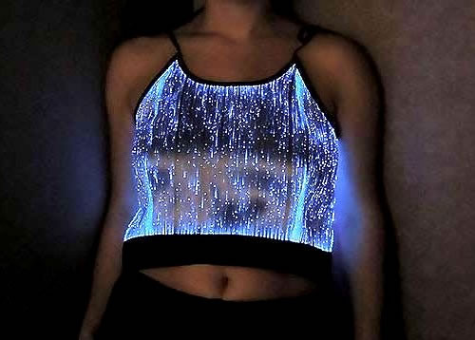
Other use of Fiber Optics !

Slide 4
Fiber Optic Communication
First developed in the 1970s,
Transmitting information from one place to another by sending pulses of light through an optical fiber.
Revolutionized telecommunications industry
Major role in the advent of the Information Age
Advantages over electrical transmission,
Largely replaced copper wire communications in the developed world.

Slide 5
Basic Steps
Creating the optical signal
Transmitting the signal
Relaying the signal along the fiber and ensuring that
signal does not become too distorted or weak,
Receiving the optical signal,
Converting it into an electrical signal.

Slide 6
Benefits of Fiber Optic Communication
Costs
Silicon , eighth most common element in the universe by mass ;
a lot cheaper than copper ;
Long Distance Signal Transmission
The low attenuation (signal loss)
Superior signal integrity in comparison to metallic-based systems. (e.g. : single-line, copper systems longer than 1.2 miles require in-line signal repeaters ; this is 62 miles for optical systems.
Emerging technologies promise even greater distances in the future.

Slide 7
Benefits of Fiber Optic Communication
Large Bandwidth, Light Weight, and Small Diameter
Solution to today's applications requiring an increase in bandwidth
Easy installation due to small diameter & light weight
Non-Conductivity
Dielectric in nature ; no metallic components ;
can be installed in areas with electromagnetic interference (EMI), including radio frequency interference (RFI). Areas with high EMI include utility lines, power-carrying lines, and railroad tracks.
Ideal for areas of high lightning -strike incidence.

Slide 8
Benefits of Fiber Optic communication
Security
Unlike metallic-based systems, the dielectric nature of optical fiber makes it impossible to remotely detect the signal being transmitted within the cable.
The only way to do so is by actually accessing the optical fiber itself which requires intervention that is easily detectable by security surveillance.
These circumstances make fiber extremely attractive to governmental bodies, banks, and others with major security concerns.

Slide 9
Fiber Structure

Slide 10
Fiber Propagation Modes :

Slide 11
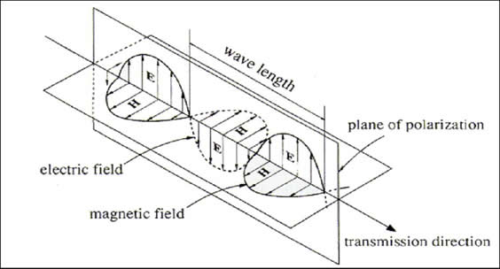
Light Wave Propagation Model
Light wave propagation in fiber follows by Maxwell’s equation for Electromagnetic Wave :
∇×Ε = −∂Β/∂t
∇×H = ∂D/∂t
∇⋅ D = 0
∇⋅ B = 0
E & H are Electric and Magnetic Fields
D & B are their relative flux densities

Slide 12
Light Wave Equation
Using Maxwell Eq. and Cylindrical symmetry of fiber along Z axis:
Where n is the refractive index of the core.
Using method of separation of variables & rewriting the equation :
Resulting in 3 equations :

Slide 13
Solution to the first and second equation are simple :
Z = exp(iβz) & Φ = exp (imϕ)
The last equations seems to be complex but it is in fact Bessel function of the form
with general solution of
where A, A`,C & C` are constants & J_{m} , Y_{m}, K_{m} & I_{m} are different kinds of Bessel function.

Slide 14
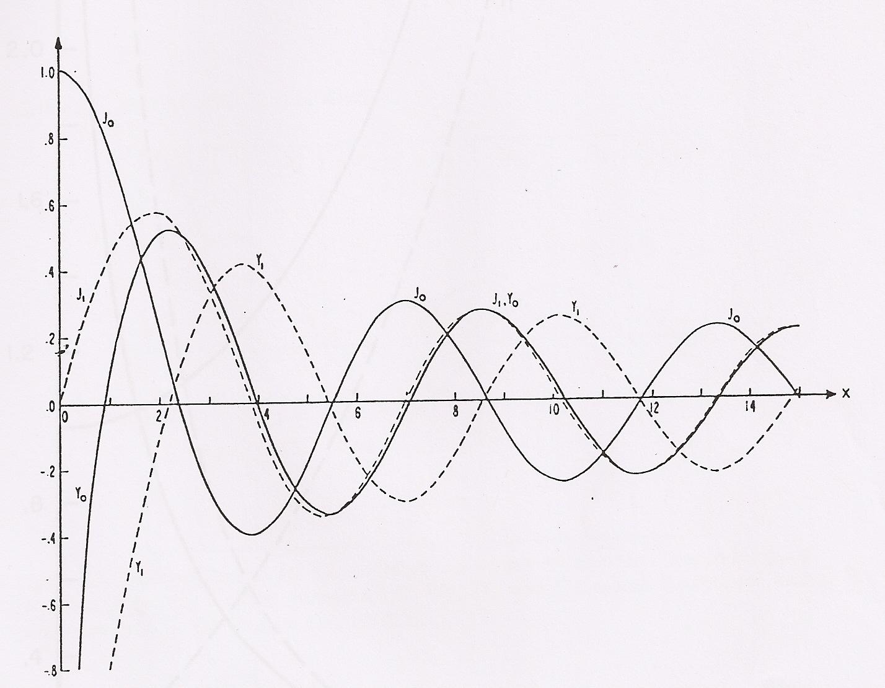
Values obtained from Bessel function show fiber modes .
2.405

Slide 15
How these numbers are used in designing fiber optics ?
Bessel’s first zeros are used to calculate the diameter of fiber core using formula :
“Wave length cutoff” < “root of Bessel function”
(2πα/λ) Sqrt. (n₁²- n₂²) < (2.405 for SMF)
Example :
wave length λ = 1310 nm transmitting through single-mode silicon fiber
with refractive index of core n₁= 1.47
refractive index of cladding n₂= 1.45
The radius is about 2.93 micron.

Slide 16
Resources :
Fiber Optic Communication System ; 3rd ed. ; by G.V. Agrawal ; Uni of Rochester, NY
Field and Wave Electromagnetic ; 2nd ed. ; by Cheng ;
http://en.wikipedia.org/wiki/Fiber-optic_communication
Bell Lab internal class handouts by Prof. Daniel Rode.
Pictures used from following WebPages :
Technabob.com
Paigeelectric.com
Sz-wholesale.com
Ehow.com
Neatorama.com
Fashion-fiber.com

Slide 17
Questions ?

