Slide 1
Image Compression-JPEG
Speaker: Ying Wun, Huang
Adviser: Jian Jiun, Ding
Date2011/10/14

Slide 2
Outline
Flowchart of JPEG (Joint Photographic Experts Group)
Correlation between pixels
Color space transformation-RGB to YCbCr & Downsampling
KL Transform & DCT Transform
Quantization
Zigzag Scan
Entropy Coding & Huffman Coding
MSE & PSNR
Conclusion
Reference

Slide 3
Flowchart of JPEG(Joint Photographic Experts Group)

Slide 4

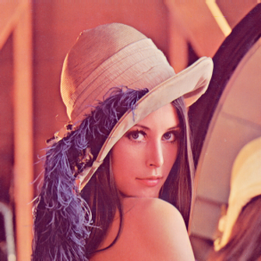


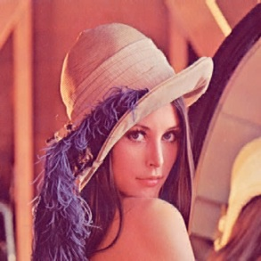




Correlation between pixels
Correlation:
  High Low
Compression ratio:
  High Low
Original
Image
769KB
Original
Image
769KB
Original
Image
769KB
Compressed
Image
9KB
Compressed
Image
50KB
Compressed
Image
410KB
$$\frac{9KB}{769KB}≅1.17\%$$
$$\frac{50KB}{769KB}≅6.50\%$$
$$\frac{410KB}{769KB}≅53.32\%$$

Slide 5
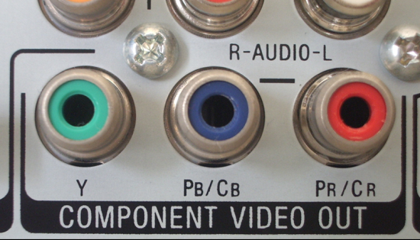
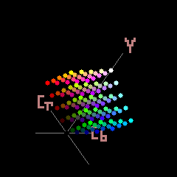

Color space transformation-RGB to YCbCr
&
Downsampling
Since luminance is more sensitive than chrominance to the human eyes, we transfer the color space from RGB to YCbCr and use downsampling(4:2:2 or 4:2:0 : downsampling; 4:4:4 : no downsampling) to reduce the information recorded in the jpeg file.
Sensitivity for human eyes:
  Red(R) > Green(G) > Blue(B)
  Luminance(Y) > Chromance(Cb, Cr)
  $Y =+0.299×R+0.587×G+0.114×B$
  $C_{b}=−0.169×R−0.331×G+0.500×B$
  $C_{r}=+0.500×R−0.419×G−0.081×B$

Slide 6
Color space transformation-RGB to YCbCr
&
Downsampling
4:4:4 (No downsampling)
4:2:2 (Downsampling every 2 pixels in vertical or horizontal direction.)
4:2:0(Downsampling every 2 pixels in both vertical and horizontal direction.)
Y
Cb
Cr
Y
Cb
Cr
Y
Cb
Cr
or
Y
Cb
Cr

Slide 7
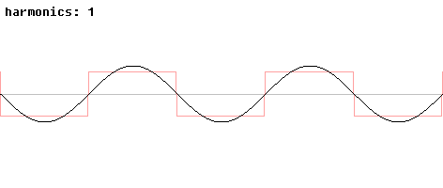
KL Transform & DCT Transform
Fourier Transform & Fourier Series (1-Dimension):
A signal can be expressed as a combination of sines and cosines.
KL Transform & DCT Transform (2-Dimension):
  A complex pattern can be expressed as a combination of many kinds of simple pattern (i.e. bases).

Slide 8
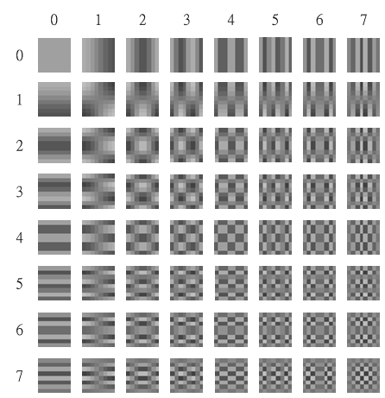
KLT & DCT
Karhunen-Loeve Transform (KLT):
Every image has its own bases (i.e. different image has different bases), we need to find and save the bases information during the process of compression.
  Advantage:
  Minimums the Mean Square Error(MSE).
  Disadvantage:
    Computationally expensive.
Discrete Cosine Transform (DCT):
  Compress different image by the same bases.
  Advantage:
  Computationally efficient.
  Disadvantage:
    The performance of MSE is not as well as KL Transform, but it’s good enough.
8x8 DCT bases

Slide 9

KLT & DCT
Formulas of DCT:
  DCT
  $$F\left(u,v\right)=\frac{2C\left(u\right)C\left(v\right)}{N}\sum_{i=0}^{N−1}{\sum_{j=0}^{N−1}{f\left(i,j\right)}}\cos\left(\frac{\left(2i+1\right)uπ}{2N}\right)\cos\left(\frac{\left(2j+1\right)vπ}{2N}\right)$$
  Inverse-DCT
  $$f\left(i,j\right)=\frac{2}{N}\sum_{i=0}^{N−1}{\sum_{j=0}^{N−1}{C\left(u\right)C\left(v\right)F\left(u,v\right)}}\cos\left(\frac{\left(2i+1\right)uπ}{2N}\right)\cos\left(\frac{\left(2j+1\right)vπ}{2N}\right)$$
  Where $0≤i,j,u,v≤N−1$, $C\left(n\right)=\left\{\begin{aligned}1/{\sqrt{2}} \left(n=0\right) \\ 1 \left(n≠0\right)\end{aligned}\right.$

Slide 10
KLT & DCT
Example of DCT:
Before DCT:
-76, -73, -67, -62, -58, -67, -64, -55,
-65, -69, -73, -38, -19, -43, -59, -56,
-66, -69, -60, -15, 16, -24, -62, -55,
-65, -70, -57, -6, 26, -22, -58, -59,
-61, -67, -60, -24, -2, -40, -60, -58,
-49, -63, -68, -58, -51, -60, -70, -53,
-43, -57, -64, -69, -73, -67, -63, -45,
-41, -49, -59, -60, -63, -52, -50, -34
AC terms:
Small coefficient
After DCT:
-415.37, -30.19, -61.20, 27.24, 56.13, -20.10, -2.39, 0.46,
4.47, -21.86, -60.76, 10.25, 13.15, -7.09, -8.54, 4.88,
-46.83, 7.37, 77.13, -24.56, -28.91, 9.93, 5.42, -5.65,
-48.53, 12.07, 34.10, -14.76, -10.24, 6.30, 1.83, 1.95,
12.13, -6.55, -13.20, -3.95, -1.88, 1.75, -2.79, 3.14,
-7.73, 2.91, 2.38, -5.94, -2.38, 0.94, 4.30, 1.85,
-1.03, 0.18, 0.42, -2.42, -0.88, -3.02, 4.12, -0.66,
-0.17, 0.14, -1.07, -4.19, -1.17, -0.10, 0.50, 1.68,
DC terms:
Large coefficient

Slide 11
Quantization
We divide the DCT coefficients by Quantization Table to downgrade the value recorded in the jpeg file because it is hard for the human eyes to distinguish the strength of high frequency components.
Quantization Table:
16 | 11 | 10 | 16 | 24 | 40 | 51 | 61
12 | 12 | 14 | 19 | 26 | 58 | 60 | 55
14 | 13 | 16 | 24 | 40 | 57 | 69 | 56
14 | 17 | 22 | 29 | 51 | 87 | 80 | 62
18 | 22 | 37 | 56 | 68 | 109 | 103 | 77
24 | 35 | 55 | 64 | 81 | 104 | 113 | 92
49 | 64 | 78 | 87 | 106 | 121 | 120 | 101
72 | 92 | 95 | 98 | 112 | 100 | 103 | 99
17 | 18 | 24 | 47 | 99 | 99 | 99 | 99
18 | 21 | 26 | 66 | 99 | 99 | 99 | 99
24 | 26 | 56 | 99 | 99 | 99 | 99 | 99
47 | 66 | 99 | 99 | 99 | 99 | 99 | 99
99 | 99 | 99 | 99 | 99 | 99 | 99 | 99
99 | 99 | 99 | 99 | 99 | 99 | 99 | 99
99 | 99 | 99 | 99 | 99 | 99 | 99 | 99
99 | 99 | 99 | 99 | 99 | 99 | 99 | 99
Luminance quantization table
Chrominance quantization table

Slide 12
Quantization
Example of Quantization:
  Before Quantization
  After Quantization
-415.37, -30.19, -61.20, 27.24, 56.13, -20.10, -2.39, 0.46,
4.47, -21.86, -60.76, 10.25, 13.15, -7.09, -8.54, 4.88,
-46.83, 7.37, 77.13, -24.56, -28.91, 9.93, 5.42, -5.65,
-48.53, 12.07, 34.10, -14.76, -10.24, 6.30, 1.83, 1.95,
12.13, -6.55, -13.20, -3.95, -1.88, 1.75, -2.79, 3.14,
-7.73, 2.91, 2.38, -5.94, -2.38, 0.94, 4.30, 1.85,
-1.03, 0.18, 0.42, -2.42, -0.88, -3.02, 4.12, -0.66,
-0.17, 0.14, -1.07, -4.19, -1.17, -0.10, 0.50, 1.68,
Quantize by
lumunance quantization table
-26, -3, -6, 2, 2, -1, 0, 0,
0, -2, -4, 1, 1, 0, 0, 0,
-3, 1, 5, -1, -1, 0, 0, 0,
-3, 1, 2, -1, 0, 0, 0, 0,
1, 0, 0, 0, 0, 0, 0, 0,
0, 0, 0, 0, 0, 0, 0, 0,
0, 0, 0, 0, 0, 0, 0, 0,
0, 0, 0, 0, 0, 0, 0, 0,
We Get Many Zeros!

Slide 13
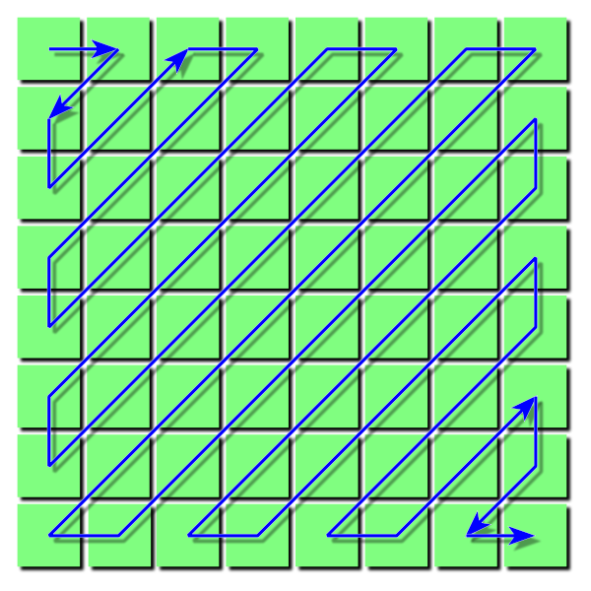
Zigzag Scan
Low
Frequency
-26 | -3 | -6 | 2 | 2 | -1 | 0 | 0
0 | -2 | -4 | 1 | 1 | 0 | 0 | 0
-3 | 1 | 5 | -1 | -1 | 0 | 0 | 0
-3 | 1 | 2 | -1 | 0 | 0 | 0 | 0
1 | 0 | 0 | 0 | 0 | 0 | 0 | 0
0 | 0 | 0 | 0 | 0 | 0 | 0 | 0
0 | 0 | 0 | 0 | 0 | 0 | 0 | 0
0 | 0 | 0 | 0 | 0 | 0 | 0 | 0
Zigzag
Scan
High Frequency
We get a sequence after the zigzag process:
−26, −3, 0, −3, −3, −6, 2, −4, 1 −4, 1, 1, 5, 1, 2, −1, 1, −1, 2, 0, 0, 0, 0, 0, −1, −1, 0, ……,0.
The sequence can be expressed as:
(0:-26),(0:-3),(1:-3),…,(0:2),(5:-1),(0:-1),EOB
The remnants are Zeros!
Run-Length Encoding

Slide 14
Entropy Coding & Huffman Coding
Key points:
  Encode the high/low probability symbols with short/long code length.
Symbol | Binary Code
0 | 00
1 | 010
2 | 011
3 | 100
4 | 101
… | …
8 | 111110
9 | 1111110
10 | 11111110
11 | 111111110
Symbol |  | Binary Code
Run | Size
0 | 1 | 00
… | … | …
0 | 10 | 1111111110000011
… | … | …
6 | 1 | 11110110
… | … | …
15 | 10 | 1111111111111110
EOB |  | 1010
ZRL |  | 1111
DC luminance
Huffman Table
AC luminance
Huffman Table

Slide 15

MSE & PSNR
Mean Square Error (MSE):
  $$MSE=\sqrt{\frac{\sum_{x=0}^{W−1}{\sum_{y=0}^{H−1}{{\left(f\left(x,y\right)−f′\left(x,y\right)\right)}^{2}}}}{WH}}$$
  f(x,y): original image f’(x,y): decoded image
  H: height of image W: width of image
Peak signal-to-noise ratio (PSNR):
$PSNR=10\log_{10}{\frac{{{MAX}_{f}}_{}^{2}}{MSE}}$=$20\log_{10}{\frac{{MAX}_{f}}{\sqrt{MSE}}}$
${MAX}_{f}$:the maximum possible pixel value of the image

Slide 16
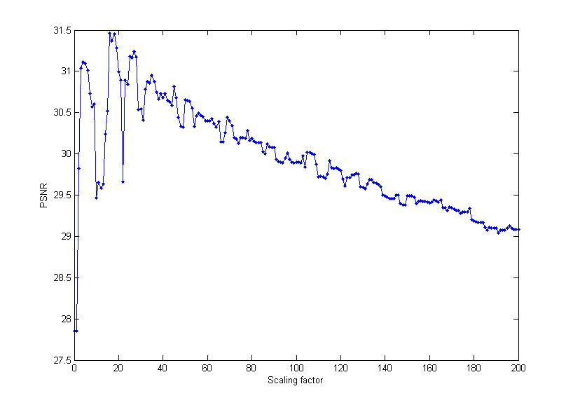
MSE & PSNR

Slide 17


MSE & PSNR
Blind spot of MSE & PSNR:
PSNR still looks fine even though we can easily find a obvious error on the right image, why?
It is due to the fact that PSNR is calculated from MSE, where MSE is the “MEAN” square error.
Correct Image
PSNR = 30.4
Error Image
PSNR = 32.6

Slide 18
Conclusion
As a conclusion, to compress a image, first we have to reduce the correlation between pixels, then quantize the image to reduce the high frequency components, finally encode the image by entropy coding to minimize code length to get a low data rate image.

Slide 19
Reference
[1] 酒井善則、吉田俊之 共著，白執善 編譯， 影像壓縮技術 映像情報符号化，全華科技圖書股份有限公司, Oct. 2004
[2] WIKIPEDIA, “JPEG”, http://en.wikipedia.org/wiki/JPEG
[3] WIKIPEDIA, “PSNR”, http://en.wikipedia.org/wiki/PSNR

Slide 20
The End

