Slide 1
Data Processing
As a science major, you will all eventually have to deal with data.
All data has noise
Devices do not give useful measurements; must convert data
The better you can handle data, the more employable you will be

Slide 2
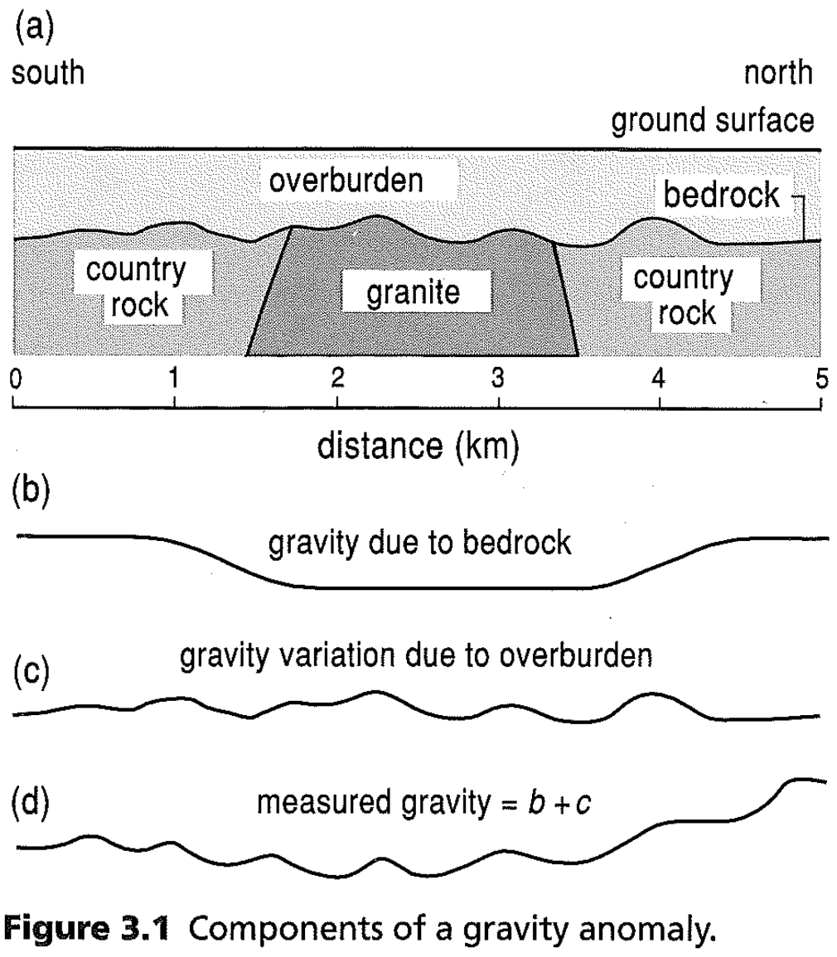
Wavelength and Fourier Analysis
A Simple Example…
The granite produces a negative gravity anomaly
Variations in the sediment cover cause noise in the data
The noise and the anomaly have different wavelength scales
Fourier analysis
Separates signals by wavelength

Slide 3
General Wave Terms
a
0.5a
Amplitude
0
0.5 λ
λ
1.5 λ
2 λ
Wavelength (λ)
0.5a
-a
Amplitude (a) =
Wavelength (λ) =
Frequency =
Period =

Slide 4
Harmonic Analysis
1st 5 harmonics
1
0.5
0
0.2 L
0.4 L
0.6 L
0.8 L
L
0.5
-1
Harmonics: multiples of a signal’s half wavelength, L
Why use harmonics?
Found in nature and music
Like a guitar!
Any wiggly line can be mathematically reproduced by adding together a series of waves
Exact match requires ∞ waves

Slide 5
Fourier Analysis
A type of harmonic analysis where wiggly data are separated into various harmonics of differing amplitude
Adjusts the amplitudes of each harmonic
Can isolate dominant frequencies/wavelengths in data and remove unwanted ones
Sum of ∞ harmonics reproduces data exactly
Data Separated by Wavelength
Sum of same harmonics, but with different amplitudes

Slide 6
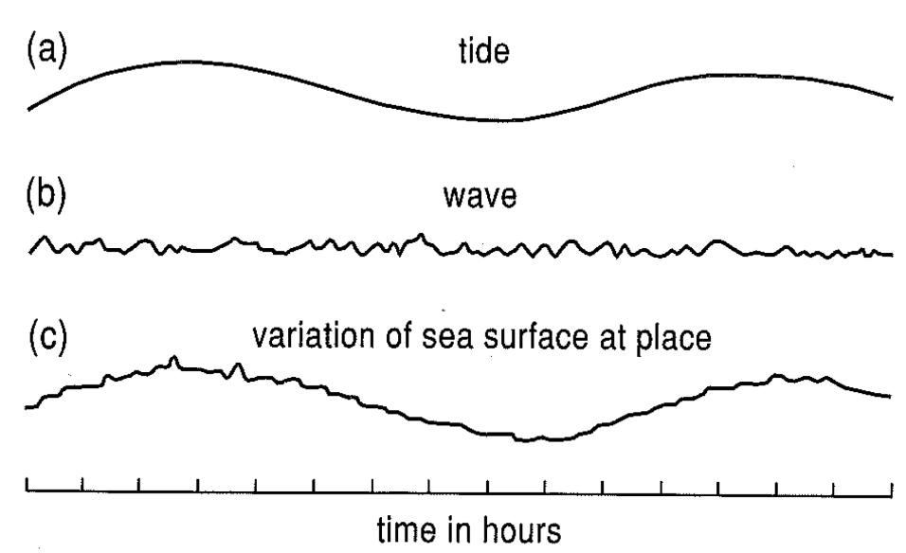
What to Remove?
In this tide data, what type of wavelengths (short or long) should we remove?
What causes each?

Slide 7
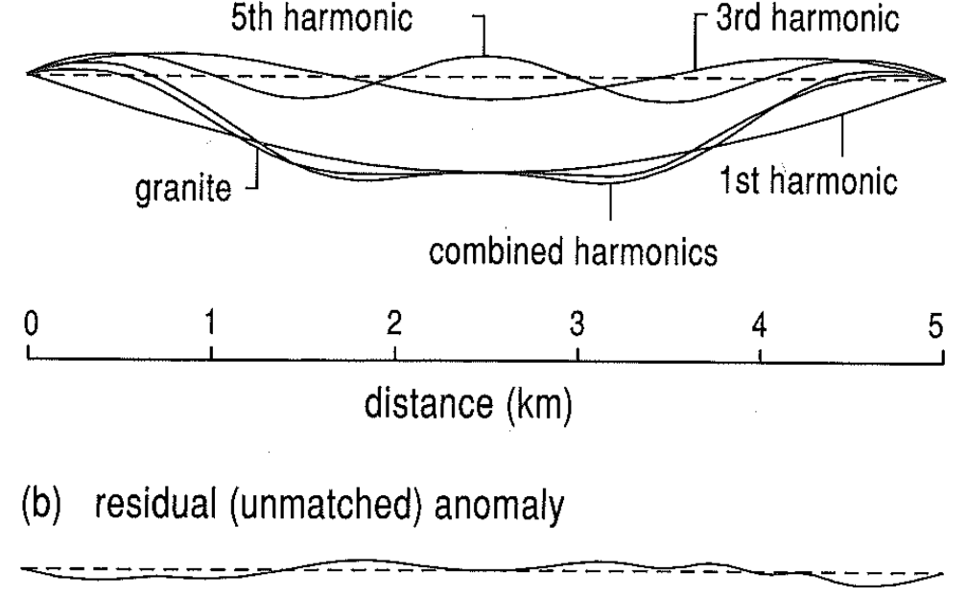
Caveats of Fourier Analysis
Requires a complete signal
Starts and ends at same value
Only analyzes wavelengths that are multiples of the signal length
Geologic targets likely have multiple wavelengths and may share some wavelengths with noise.

Slide 8
Digital Filtering
An alternative way to remove unwanted wavelengths/frequencies: Filtering
Usually applied to regularly space data
If data not regular, interpolation can be used
E.g. A simple 3-point filter :: 1/3 (y_{n-1} + y_{n} + y_{n+1})
Also called
3-point running average
3-point moving window
Time or Distance
1 2 3 4 5 6 7 8 9 10
Value
1 0 5 4 9 4 2 3 1 5
Filtered Value
X
2
3
6
There are also 5-point, 7-point, and n-point filters.
Some are weighted to remove certain wavelengths

Slide 9
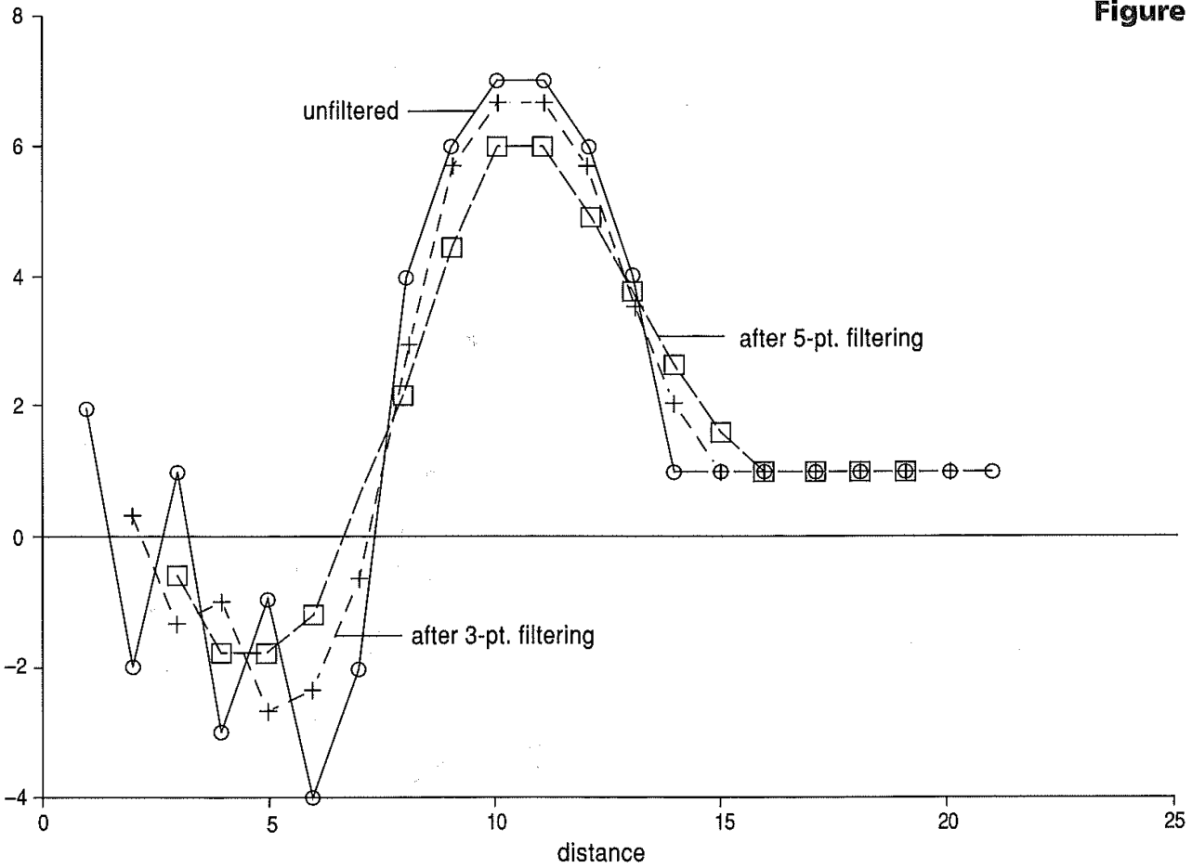
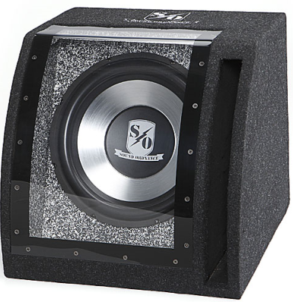
Effects of Digital Filters
Low-pass filter
Also called
Smoothing filter
Allows low freq
to “pass through”
High-pass filter
Allows high freq
To “pass through”
Band-pass filter
Constructed to only let certain “bands” or frequencies through
A subwoofer in a bandpass box

Slide 10
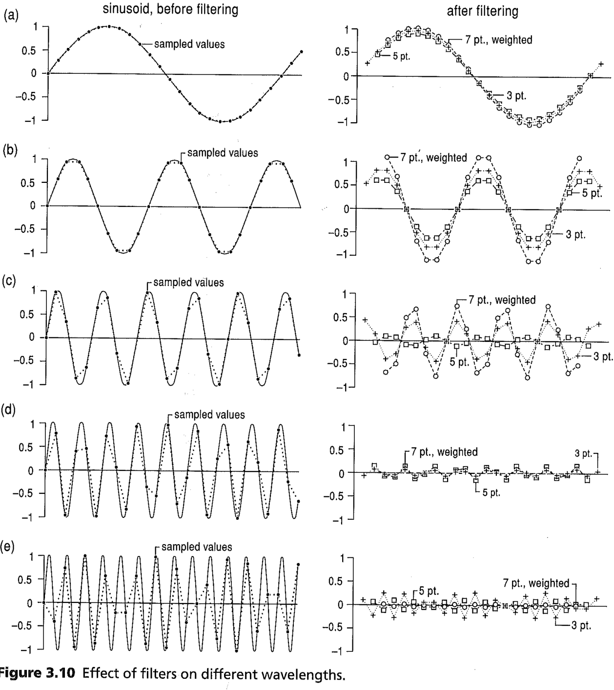
Effects of Digital Filters
A given filter may have a very different effect on data depending on:
Wavelength
Sampling Rate / Resolution
A filter can completely decimate a signal

Slide 11
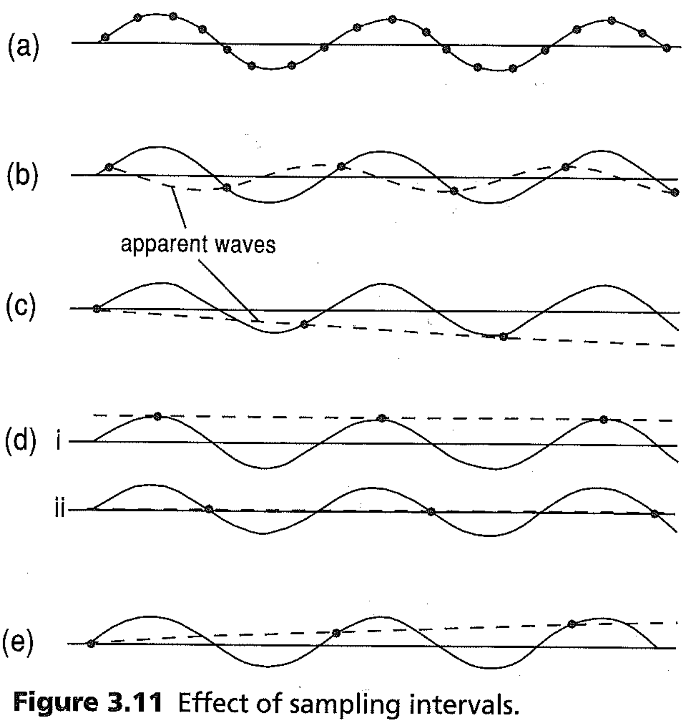
Aliasing
If sampling rate (resolution) approaches wavelength of signal
May see false patterns
If sampling rate is less than signal’s wavelength
May see false long wavelength signals
Aliasing: Discrete (non-continuous) data can suggest patterns that are not real
Nyquist wavelength = half the signal’s wavelength.
This is the minimum sampling rate to avoid aliasing

Slide 12
Gridded Data Processing
All of the data processing techniques discussed here can also be applied to gridded or even three-dimensional data
Can filter directional noise
Highlights directional features
Geologists should pay attention in multivariable calculus class! ☺
E.g. MAT 2130 - CALCUL ANALY GEOM III
Do not rely on black box computer programs
E.g. Arc GIS

Slide 13
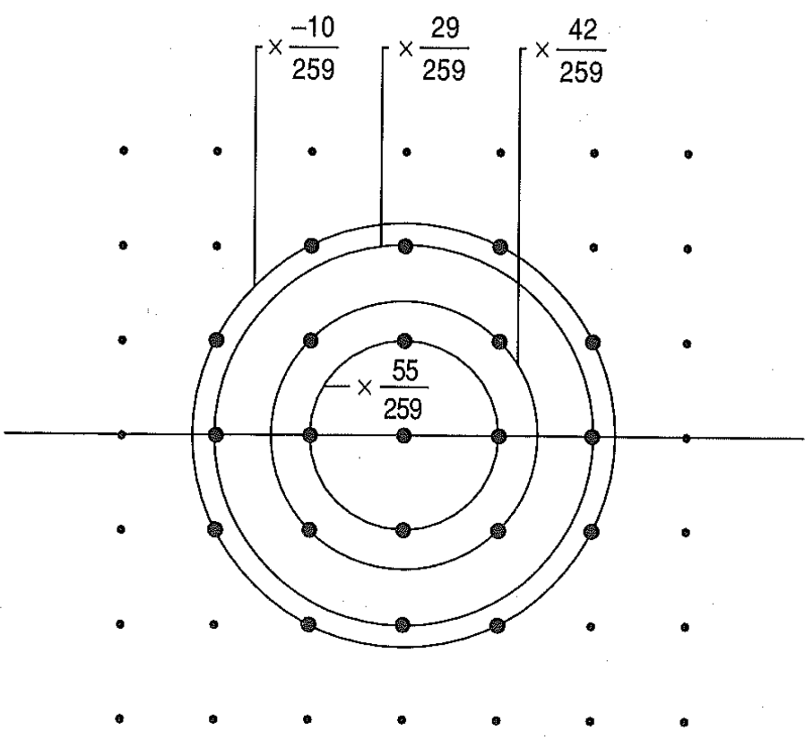
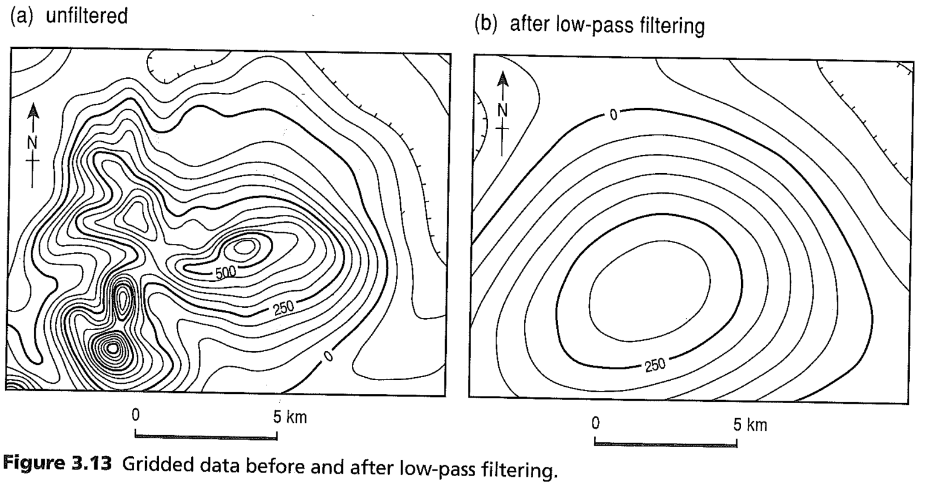
Filtering in 2D :: Gridded Data
Filters can be created to filter all types of data
No technique is perfect
Great care must be given when creating a filter or processing data in general

