Slide 1
SeaFET Data Processing
Temperature & Salinity Correction
Geoff MacIntyre
May 15, 2014

Slide 2
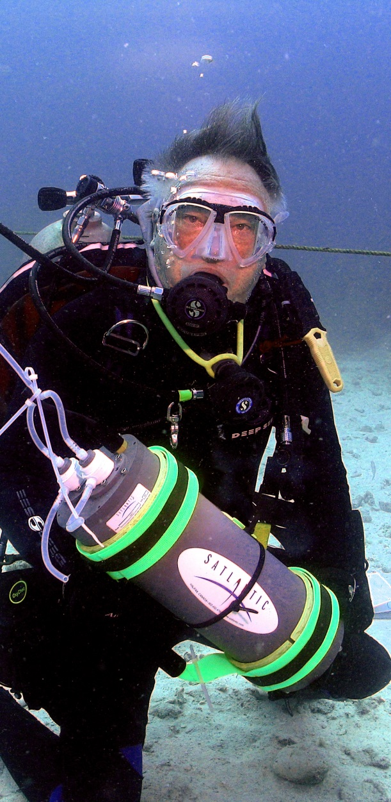
Outline
SeaFET technology overview
SeaFETCom introduction
Temperature & salinity sensitivity
Data processing and analysis

Slide 3
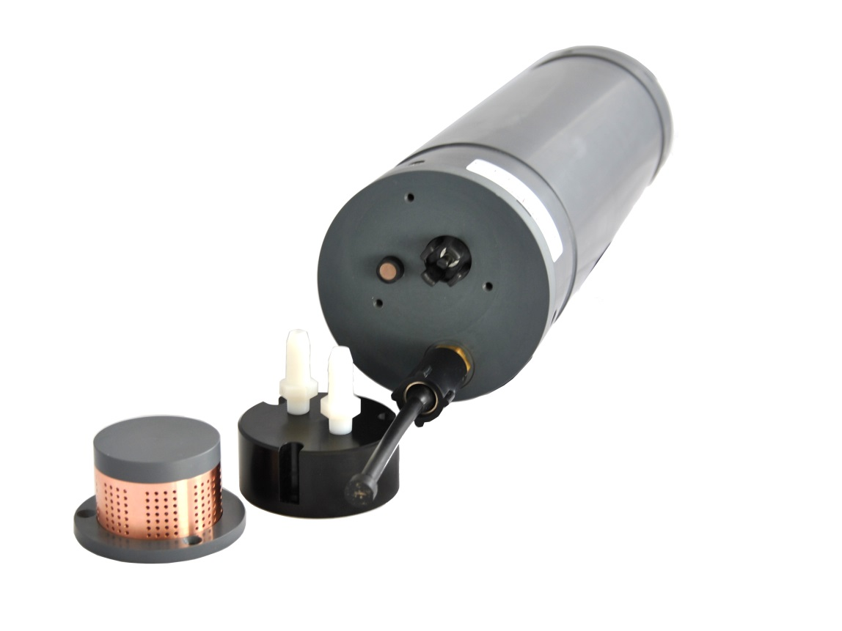
SeaFET overview
Developed by Dr. Ken Johnson (MBARI) and Dr. Todd Martz (Scripps)
Uses ISFET technology (ion-sensitive field effect transistor)
stable and precise in seawater
External reference electrode
ISFET
Bio-fouling guard
Flow through adapter

Slide 4
Principle of operation
SeaFET has two potentiometric cells
an internal cell
an external cell
The internal cell consists of an Ag/AgCl electrode bathed in a saturated KCl solution/gel
its electrical potential is proportional to the concentration of Cl in the KCl gel
the reference electrode is somewhat isolated from the sensed medium
the internal cell has a liquid junction at the seawater/KCl gel interface
The potential of the external reference electrode varies with the chloride concentration of the sensed medium
the external reference electrode has been incorporated into the design because it does not have a liquid junction potential, which offers advantages
if we also measure salinity, the chloride concentration can be determined very accurately
Notes:
The internal reference electrode is bathed in a saturated KCl solution/gel so that the chloride concentration that the electrode ‘sees’ remains relatively constant. Note that Ag/AgCl electrodes exhibit primary sensitivity to chloride ions. The solution is in a compartment within the instrument; the connection to the sensed medium is through an annular frit which encircles the post. So again, ‘internal’ refers to the fact that the reference electrode is somewhat isolated from the sensed medium; its electrical potential is proportional to the concentration of chloride of the KCl gel, which is not expected to vary considerably. One wants a reference electrode to be stable with respect to its electrical potential by design. Note that the internal cell has a liquid junction at the seawater/KCl gel interface.
The external cell also consists of the ISFET as the working electrode. The potential of the external reference electrode is expected to vary with the chloride concentration of the sensed medium. In this sense, it is sometimes termed a pseudo-reference electrode . Ordinarily this would not be a good approach for measuring pH because the signal exhibited by the overall cell potential will be the sum of a chloride signal and a hydrogen/hydroxide ion signal (ISFET sensitive to H + /OH - ). If, however, one measures salinity, one can reasonably approximate the chloride concentration and can then retrieve the hydrogen/hydroxide ion signal, which is what we’re after! The external reference electrode has been incorporated into the design because it does not have a liquid junction potential, which offers advantages.

Slide 5
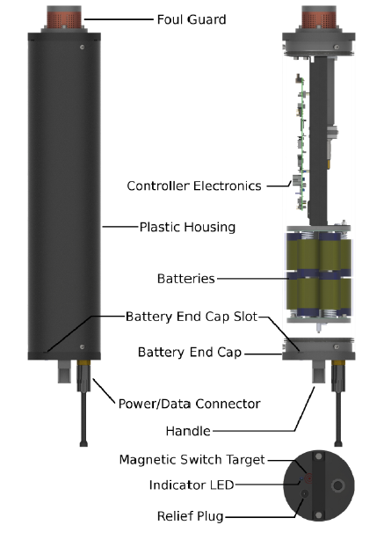
Major components

Slide 6
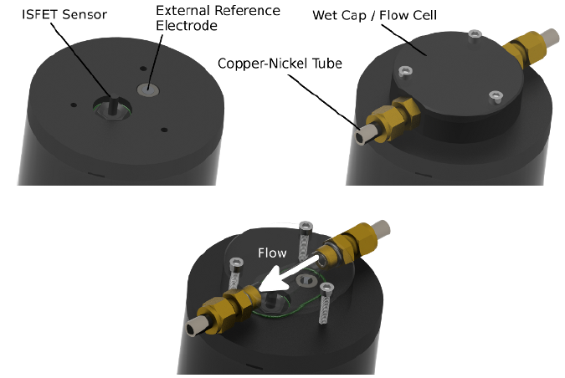
Flow cell

Slide 7
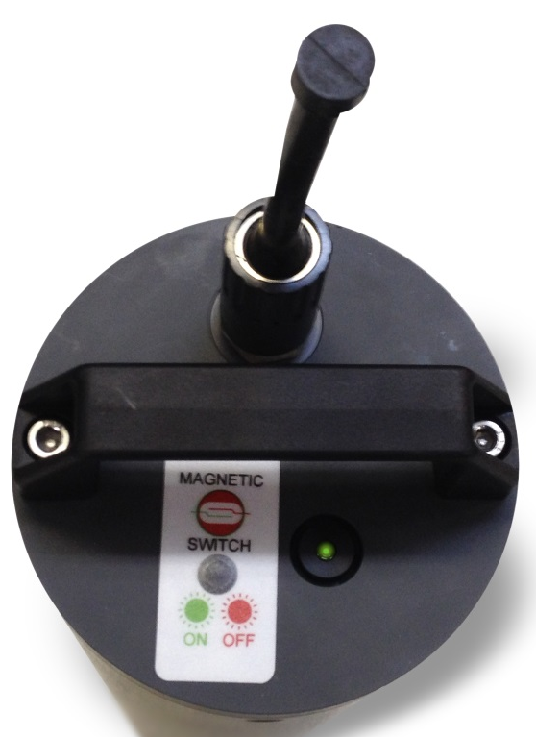
Power
Internal batteries
12 Alkaline D-cell batteries
Split internally into 2 separate packs
Main pack 12 V
Isolated pack 6 V
Magnetic on/off switch
Magnet provided in driver
Swipe over indicated area
LED color and flashing pattern indicates state
Flashing Pattern |  | Meaning
Green short blink | . . . . . | Starting continuous sampling mode / Sampling
Green long blink | - - - - - | Starting periodic mode
Green long and short blink | -. - . -. -. -. | Starting polled mode
Red long blink | - - - | Deactivating internal batteries
Notes:
The 'Main battery pack' is used to power the instrument control electronics when the instrument is in active mode while the 'Isolated battery pack' is used to power the sensing element when the instrument is in low power standby mode.
A distinctive characteristic of the SeaFET is that it requires an uninterrupted and isolated source of power to keep the sensing element conditioned. Note that re-conditioning of the sensing element due to loss of power could take up to 24 hours, hence the need for keeping it permanently powered during deployment. This power source also needs to be isolated from the system ground in order to achieve the desired noise performance. As explained before, this uninterrupted and isolated power is derived from the internal batteries. For this reason batteries must be installed and activated before deployment. The internal batteries can be activated from the SeaFETCom dashboard or by using the magnetic switch.

Slide 8
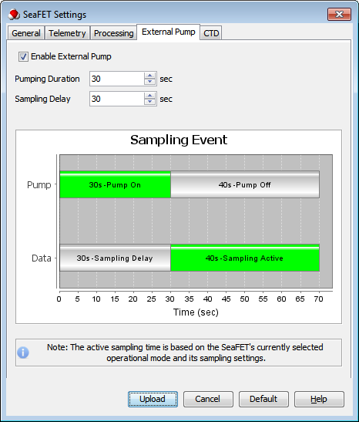
External Pump
Enable External Pump setting enables or disables use of an external pump by the SeaFET
Pumping Duration is the time in seconds that the external pump is on.
Sampling Delay is the time in seconds between when an acquisition event starts and when data sampling starts. By setting the sampling delay greater than the pump duration SeaFET will pump, wait, and then sample with the pump off.
The Sampling Event graph the has two horizontal bars:
Pump to show when the external pump is turned on and off for each sampling event
Data to show when data sampling starts and stops for each sampling event
Notes:
Note: When the external pump is setup to be on during sampling it will remain on until sampling has completed.

Slide 9
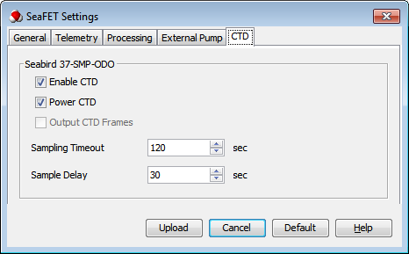
CTD Settings
Seabird 37-SMP-ODO Settings
Enable CTD setting enables or disables use of the CTD by the SeaFET
Power CTD setting enables or disables supplying power to the CTD by the SeaFET.
Output CTD Frames setting enables or disables transmission of data frames from the CTD by the SeaFET.
Sampling Timeout is the maximum time (seconds) that the SeaFET will wait to receive a data frame requested from the CTD.
Sample Delay is the time (seconds) that the SeaFET delays ISFET parameters sampling (pH, ISFET T, etc.) after a sampling event begins. This feature can be used to allow for the measurements to stabilize after the CTD pumps a fresh volume of water and before the SeaFET starts data recording and streaming. Note: This setting is ignored in Continuous mode and when use of an External Pump is enabled.

Slide 10
Cautions
SeaFET has sensitive components that can be damaged by improper storage and handling
SEAWATER ONLY! When the SeaFET is not in service, the wet cap must be in place and filled with clean seawater - immersing the sensing elements in fresh water can lead to sensor instability and damage
Do not allow the DuraFET KCl gel or the wet cap filling solution to freeze during shipping or deployment
Never let the sensing elements dry out - if the SeaFET is to not to be redeployed immediately, put the wet cap in place and fill it with artificial sea water
The ISFET is light sensitive and will produce a voltage offset if illuminated - if the SeaFET is deployed with the flow cell, the flow cell should be shaded (e.g. using tape)
Always rinse SeaFET with sterile artificial sea water prior to storage
Do not leave SeaFET in direct sunlight on deck when it is not being used. Direct sunlight can damage SeaFET by overheating it

Slide 11
How to videos
www.Satlantic.com/SeaFET

Slide 12
SeaFETCom
SeaFETCom is an interactive graphic software application that can be used to:
Review and modify SeaFET operational settings
Schedule SeaFET data collection activity
Manage and retrieve logged SeaFET data
View SeaFET data in real time
Reprocess SeaFET data and graph results

Slide 13
SeaFETCom
Menu bar
Instrument info
Main commands
Setup window
Data viewing area
Output area

Slide 14
Data processing
Menu bar → Data → SeaFET Data Processing
Load data file(s)
Calibration file
cal coefficients on instrument
applied to on-board calculations
cal coefficients included in data file header
SeaFETCom applies coefficients from data file header
If data logged with external data logger, header info might not exist
create cal file with specific format

Slide 15
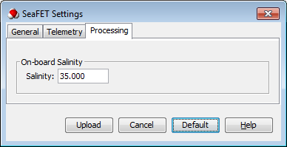
Temperature salinity
pH calculation is dependent on temperature and salinity
Onboard processing uses:
salinity value: user-defined constant
temperature value: obtained from internal thermistor
Menu bar → Sensor → SeaFET Settings → Processing

Slide 16
Sensitivity
Accuracy can be improved by providing external TS data from a Sea-Bird CTD
pH sensitivity to salinity ~ 0.013 pH / psu
pH sensitivity to temperature ~ 0.015 pH / °C

Slide 17
TS data options
TS data from an external file
Data taken from either .cnv or .csv file
TS data from SeaFET data frames
Data that was used during onboard processing

Slide 18
Specify TS data
Select ‘Specify Temperature Salinity Data’ option
Load external TS data file
Select
Select

Slide 19
TS file format
SeaFETCom accepts time-correlated TS data in two supported file formats:
Generic CSV (comma separated values) text file
Sea-Bird .cnv (converted) CTD data format
The CSV file should be in the following format:
YYYY-MM-DD hh:mm:ss, <temperature>, <salinity><cr><lf>
example…
2014-04-25 15:22:48,10.8326,34.8974
2014-04-25 15:22:54,10.8547,34.895
2014-04-25 15:23:00,10.8517,34.9032
2014-04-25 15:23:06,10.867,34.9007
2014-04-25 15:23:12,10.8889,34.8926

Slide 20
Converting data with Excel
To use MicroSoft Excel to convert data to the format required by SeaFETCom:
Import data into Excel
Convert date/time to a single 'YYYY-MM-DD hh:mm:ss' text field
Remove all columns except date/time, temperature, and salinity
Re-order columns to match the <date/time>, <temperature>, <salinity> ordering required
Save as a comma-delimited text file

Slide 21
Sea-Bird CTD file
SeaFETCom can also ingest temperature and salinity measurements from a file in a specific .cnv (converted) format as generated by the SBE Data Processing
To convert your Sea-Bird CTD data to a compatible format for SeaFETCom:
Copy your .hex and .xmlcon CTD files to the SBE Data Processing input directory
From the SBE Data Processing main menu select Run → Data Conversion
In the File Setup tab, select your .hex and .xmlcon input files
In the Data Setup tab, press Select Output Variables
In the Select Output Variables dialog, add these fields in order:
Time, Instrument [seconds]
Temperature [ITS-90, degC]
Salinity, Practical [PSU]
Press the Start Process button to create a .cnv file

Slide 22
Sea-Bird CTD .cnv file
The data section (following the header meta-data) in the resulting .cnv file should look like the following:
388682568 | 10.8326 | 34.8974 | 0.000e+00
388682574 | 10.8547 | 34.8950 | 0.000e+00
388682580 | 10.8517 | 34.9032 | 0.000e+00
388682586 | 10.8670 | 34.9007 | 0.000e+00
388682592 | 10.8889 | 34.8926 | 0.000e+00
To minimize steps on subsequent conversions, use the Program setup file panel to save your SeaFET-specific conversion configuration as a new .psa file
A sample .psa file for converting SBE37 data to SeaFET format is available at:
http://satlantic.com/DatCnv-SBE37-SeaFETCom-1.0.0.psa

Slide 23
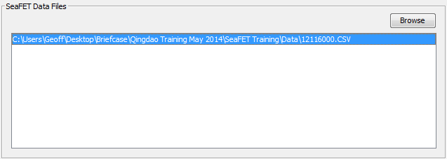
Process
Highlight data file(s) to be reprocessed
TS data selected
Select output directory
Select process

Slide 24
Graph results

Slide 25
pH (INT)

Slide 26
pH INT vs EXT

Slide 27
pH (EXT)

Slide 28
Common problems
TS data file must follow defined format
Saved as .CSV file
Time stamp has to be in the following format
YYYY-MM-DD hh:mm:ss
Time stamps in both files must overlap
If the clocks were offset, inset time offset
No additional formatting info associated with file
Manipulating file with some programs adds formatting information that may not be visible
Difficult to detect

Slide 29
Questions
Danke!

