Slide 1
Concurrency Control Mechanism

Slide 2
What is Concurrency Control?
Process of managing simultaneous execution of transactions in a shared database, to ensure the serializability of transactions, is known as concurrency control.

Slide 3
Why we need Concurrency Control?
Simultaneous execution of transactions over a shared database can create several data integrity and consistency problems:
Lost Updates.
Uncommitted Data.
Inconsistent retrievals.

Slide 4
When we need Concurrency Control?
Concurrent access to data is desirable when:
The amount of data is sufficiently great that at any given time only fraction of the data can be in primary memory & rest should be swapped from secondary memory as needed.
Even if the entire database can be present in primary memory, there may be multiple processes.

Slide 5
Concurrency Control Techniques
Pessimistic concurrency control
– Locking
Optimistic concurrency control

Slide 6
Pessimistic Concurrency Control
Pessimistic Concurrency Control assumes that conflicts will happen
Pessimistic Concurrency Control techniques detect conflicts as soon as they occur and resolve them using blocking.

Slide 7
Optimistic Concurrency Control
Optimistic Concurrency Control assumes that conflicts between transactions are rare.
Does not require locking
Transaction executed without restrictions
Check for conflicts just before commit

Slide 8
Lock-Based Protocols
A lock is a mechanism to control concurrent access to a data item
Data items can be locked in two modes :
Exclusive lock
Shared lock

Slide 9
Lock-Based Protocols
Exclusive (X) mode. Data item can be both read as well as written.
X-lock is requested using lock-X instruction.
Shared (S) mode. Data item can only be read. S-lock is requested using lock-S instruction

Slide 10
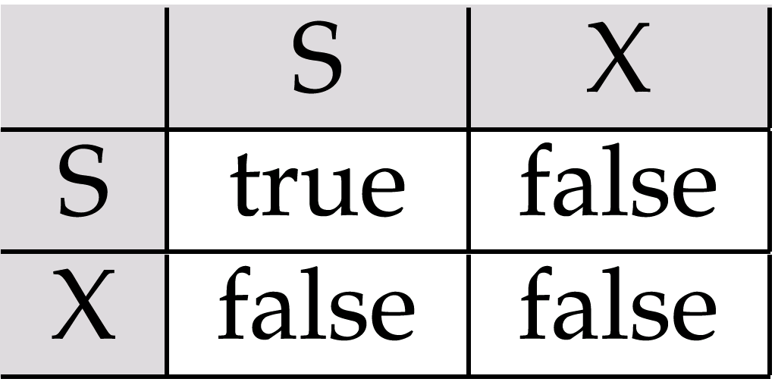
Lock-Based Protocols
Lock-compatibility matrix

Slide 11
Lock-Based Protocols
A transaction may be granted a lock on an item if the requested lock is compatible with locks already held on the item by other transactions
Any number of transactions can hold shared locks on an item, but if any transaction holds an exclusive on the item no other transaction may hold any lock on the item.
If a lock cannot be granted, the requesting transaction is made to wait till all incompatible locks held by other transactions have been released. The lock is then granted

Slide 12
Lock-Based Protocols
Example of a transaction performing locking:
T₂: lock-S(A);
read (A);
unlock(A);
lock-S(B);
read (B);
unlock(B);
display(A+B)

Slide 13
Lock-Based Protocols
A locking protocol is a set of rules followed by all transactions while requesting and releasing locks. Locking protocols restrict the set of possible schedules.

Slide 14
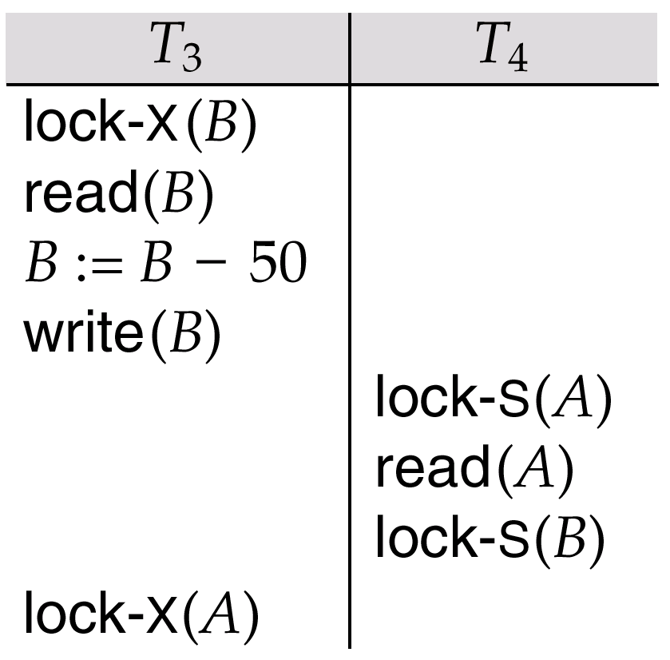
Pitfalls of Lock-Based Protocols
Consider the partial schedule

Slide 15
Pitfalls of Lock-Based Protocols
Neither T₃ nor T₄ can make progress — executing lock-S(B) causes T₄ to wait for T₃ to release its lock on B, while executing lock-X(A) causes T₃ to wait for T₄ to release its lock on A.
Such a situation is called a deadlock.
To handle a deadlock one of T₃ or T₄ must be rolled back and its locks released.

Slide 16
Pitfalls of Lock-Based Protocols
The potential for deadlock exists in most locking protocols. Deadlocks are a necessary evil.
Starvation is also possible if concurrency control manager is badly designed. For example:
A transaction may be waiting for an X-lock on an item, while a sequence of other transactions request and are granted an S-lock on the same item.
The same transaction is repeatedly rolled back due to deadlocks.
Concurrency control manager can be designed to prevent starvation.

Slide 17
The Two-Phase Locking Protocol
This is a protocol which ensures conflict-serializable schedules.
Phase 1: Growing Phase
transaction may obtain locks
transaction may not release locks
Phase 2: Shrinking Phase
transaction may release locks
transaction may not obtain locks
The protocol assures serializability. It can be proved that the transactions can be serialized in the order of their lock points.

Slide 18
The Two-Phase Locking Protocol
Two-phase locking does not ensure freedom from deadlocks
Cascading roll-back is possible under two-phase locking. To avoid this, follow a modified protocol called strict two-phase locking. Here a transaction must hold all its exclusive locks till it commits/aborts.
Rigorous two-phase locking is even stricter: here all locks are held till commit/abort. In this protocol transactions can be serialized in the order in which they commit.

Slide 19
Lock Conversions
Two-phase locking with lock conversions:
– First Phase:
can acquire a lock-S on item
can acquire a lock-X on item
can convert a lock-S to a lock-X (upgrade)
– Second Phase:
can release a lock-S
can release a lock-X
can convert a lock-X to a lock-S (downgrade)
This protocol assures serializability. But still relies on the programmer to insert the various locking instructions.

Slide 20
Automatic Acquisition of Locks
A transaction T_{i} issues the standard read/write instruction, without explicit locking calls.
The operation read(D) is processed as:
if T_{i} has a lock on D
then
read(D)
else
begin
if necessary wait until no other
transaction has a lock-X on D
grant T_{i} a lock-S on D;
read(D)
end

Slide 21
Automatic Acquisition of Locks
write(D) is processed as:
if T_{i} has a lock-X on D
then
write(D)
else
begin
if necessary wait until no other trans. has any lock on D,
if T_{i} has a lock-S on D
then
upgrade lock on D to lock-X
else
grant T_{i} a lock-X on D
write(D)
end;
All locks are released after commit or abort

Slide 22
Implementation of Locking
A Lock manager can be implemented as a separate process to which transactions send lock and unlock requests
The lock manager replies to a lock request by sending a lock grant messages (or a message asking the transaction to roll back, in case of a deadlock)
The requesting transaction waits until its request is answered

Slide 23
Implementation of Locking
The lock manager maintains a data structure called a lock table to record granted locks and pending requests
The lock table is usually implemented as an in-memory hash table indexed on the name of the data item being locked

Slide 24
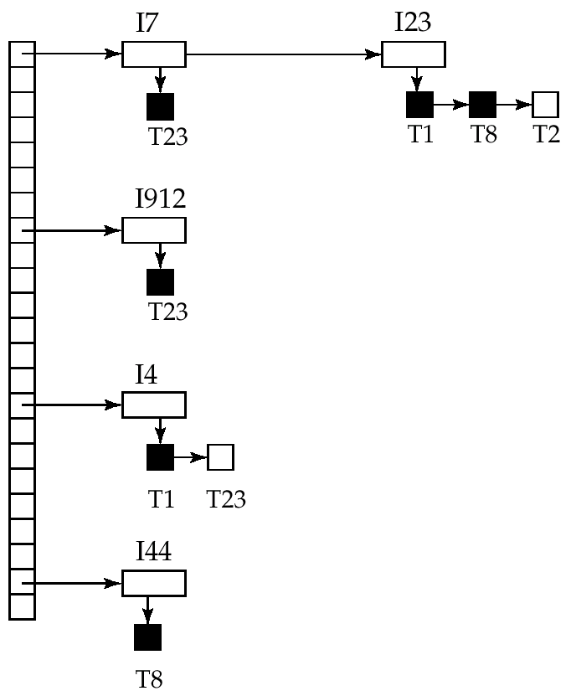
Lock Table
Black rectangles indicate granted locks, white ones indicate waiting requests
Lock table also records the type of lock granted or requested
New request is added to the end of the queue of requests for the data item, and granted if it is compatible with all earlier locks
Unlock requests result in the request being deleted, and later requests are checked to see if they can now be granted
If transaction aborts, all waiting or granted requests of the transaction are deleted
lock manager may keep a list of locks held by each transaction, to implement this efficiently

