Slide 1
Petri net modeling of biological networks
Claudine Chaouiya

Slide 2
Challenges in Biological networks
How complex interaction networks control the cell behaviour
…

Slide 3
Contents
Introduction
Petri Net Basics and relevant extensions
biological networks using PN
Metabolic networks
Signaling networks
Genetic networks
Conclusion

Slide 4
Introduction
Formal methods to model biological networks.
Dynamical modeling helps to understand the dynamical properties of the system.
Two main classes of dynamical models defined in this papers are:
Quantitative model
Qualitative model

Slide 5
Introduction
Quantitative model:
Based on systems of ordinary differential equations (ODEs);
Representing the system in a detailed way, producing quantitative results;
Require accurate data, which are often lacking.
Because of the size of the models, most of the results are obtained by numerical integration methods, that makes difficult to prove general properties of the models.

Slide 6
Introduction
Qualitative model:
defined through discrete formalisms or piecewise linear differential systems;
more suitable to induce dynamical properties of complex systems, specially when few data are accessible.

Slide 7
Introduction
Petri nets (PNs) is a graphical and mathematical formalism, suitable for the modeling and the analysis of concurrent, asynchronous, distributed systems.
PNs allow the definition of both qualitative and quantitative models.
PNs are a convenient mathematical formalism allowing an intuitive representation of biochemical networks.

Slide 8
Petri Net Basics
A PN is a bidirectional graph with two different types of nodes:
Places : shows resources of the system.
A place is an input of the transition if the occurrence of the transition is conditioned by the state of the place.
Transitions: shows events that can change the state of the resources.
a transition is output of a place if the occurrence of the event has some consequence on the state of the resource.

Slide 9
Petri Net Basics
Places hold 0 or a positive number of tokens.
Marking: a state of system is represented by allocation of tokens over the places.
The definition of a PN includes:
initial marking,
Enabling a transition: input places contain the required numbers of tokens.
firing an enabled transition: consume input tokens and produce output tokens.

Slide 10
Petri Net Basics
Extended arcs:
Test arc (place to transition): enables a transition but it is not modified by the transition.
Inhibitor arc (place to transition): an empty place enables transition (if the place has a token t is not fired).

Slide 11
Petri Net Basics
M0 is initial marking giving the number of tokens allocated to each place, enabling the firing of transition t1.
Pre, denoting preconditions on the required
marking of input places.
Post, denoting the produced numbers of tokens into output places
Incidence matrix gives, for each transition, the balance of its firing onto each place (number of tokens produced minus number of tokens consumed.

Slide 12
Petri Net Basics
State equation defines the resulting marking after a firing sequence (using a Parikh vector encompassing, for each transition of the net, its number of occurrences).
Marking graph: describes the dynamical behaviour.

Slide 13
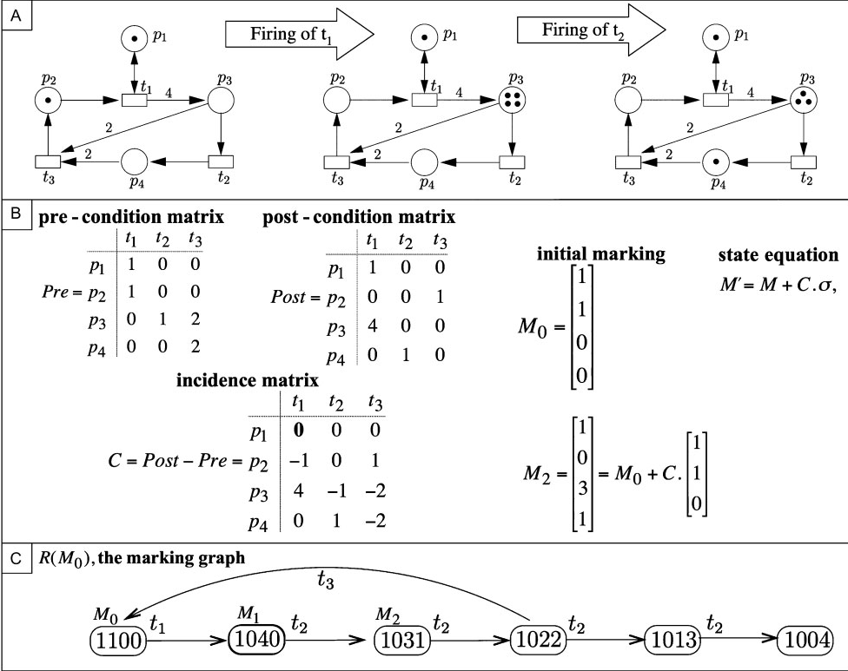

Slide 14
Petri Net Basics
Standard PN models are discrete and nontemporized (time is implicit).
Typical properties and their interpretations in the context of biological networks:
Boundedness: The number of tokens in each place is bounded. For metabolic networks, it means that no product can accumulate;
P-invariants: Sets of places which the sum of tokens is a constant. In metabolic networks, these sets correspond to conservation relations;

Slide 15
Petri Net Basics
T-invariants are firing sequences, which reproduce a marking. In biological terms, T-invariants may represent cyclical behaviours and correspond to the elementary modes of the Metabolic Control Theory;
Reachability of a marking M: there is a sequence
of firings from the initial marking to the marking M. (existence of a trajectory leading an initial state to a desired state in biological system);
Liveness guarantees that an event (a reaction
for example) can eventually occur.

Slide 16
Petri Net Basics
Extensions of the PN increases its expressiveness however makes them more difficult to analyze.
Useful extensions for the modelling of biological networks are:
Coloured Petri Nets (CPNs) : assign data values to the tokens (defining colour sets), and expressions are attached to the arcs. CPNs can also encompass timed transitions.
Stochastic Petri Nets (SPNs): enabled transitions fire with exponentially distributed time delays.

Slide 17
Petri Net Basics
Hybrid Petri Nets (HPNs) : allow the coexistence of both discrete places (marked with tokens) and continuous places associated with real variables. Discrete transitions fire after a determined delay, while enabled continuous transitions
fire continuously at a given rate.
Hybrid Functional Petri Nets (HFPNs): increase the modelling power of HPNs. Continuous transition firing rates can depend on the values of the input places and the weights of arcs can be defined as a function of the markings of the
connected places.

Slide 18
Contents
Introduction
Petri Net Basics and relevant extensions
biological networks using PN
Metabolic networks
Signaling networks
Genetic networks
Conclusion

Slide 19
biological networks using PN
Biochemical networks
Standard PNs allow the representation of the essential components in biochemical pathways, and a qualitative analysis.
Metabolic pathways are generally seen as interconnected networks of enzymatic reactions, where the product of one reaction is a reactant of (or an enzyme that catalyses) a subsequent reaction. The arc weights correspond to the stoichiometric coefficients of the reactions.

Slide 20
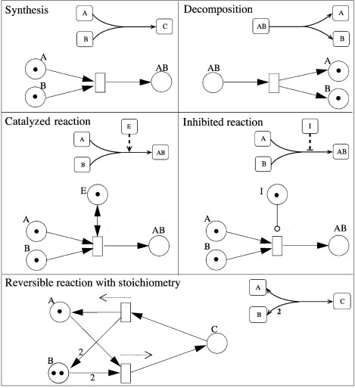

Slide 21
biological networks using PN
Biochemical networks
PN theory can be used for the structural validation of metabolic networks through qualitative analysis. For example, the sucrose breakdown metabolism in the potato tuber.
CPNs can use to simulate enzymatic reaction Chains. The colour associated to a place is a pair encompassing the name and the concentration of the related substrate.
Functional PNs, defined as self-modified PNs, allow the flow relations between places and transitions to depend on the marking.

Slide 22
biological networks using PN
Genetic networks
In the case of the regulation of gene expression,
particular regulatory product activates a gene (or a set of genes).
Regulatory interactions differ semantically from metabolic reactions. In a chemical reaction the reactants are consumed. During the regulatory process the expression levels of regulators do not change.
Regulatory interactions are not so easily modelled.
One successful method to qualitatively model
regulatory networks is the logical approach.

Slide 23
biological networks using PN
Genetic networks
In a logical regulatory graph, the nodes represent
genes, which are associated with discrete levels of
expression, and arcs represent interactions between genes.
Each interaction is associated with an expression that shows source of the interaction, has an effect onto the targeted gene.
For each gene, a discrete logical function indicates to which qualitative level the gene tends when submitted to a given combination of interactions.
It is possible to derive a standardPN model from a Boolean regulatory network (where genes are ON/OFF)

Slide 24
biological networks using PN
Genetic networks
Complementing the qualitative analysis tools, model checking can be used to check dynamical properties. CPNs are amenable to model checking.
HPNs provide a way to represent protein concentration dynamics being coupled with discrete switches. A detailed modelling of gene regulatory networks would require the representation of several stages including DNA modification, transcription, translation, post-transcriptional and translational modifications. Since the data on these mechanisms are lacking, it is difficult to conceive kinetic models of these mechanisms, which are therefore abstracted as a single process.

Slide 25
biological networks using PN
Signaling networks
Signal transduction, like genetic regulation, encompasses
response to rather than product transformation.
Using standard PNs, this signal transduction network is qualitatively modelled and validated.

Slide 26
Conclusion
This paper shows the effectiveness of PNs for the modelling, analysis and simulation of molecular networks.
PN-based models for biological networks can be explained by their underlying graphical representation, their suitability to model concurrent distributed systems, their well-founded mathematical theory and the availability of dedicated tools.
Several PN extensions have been introduced to increase the expressiveness of the primary formalism.

Slide 27
Conclusion
PNs are not meant to represent spatial properties. However, molecular transportation or diffusion can be modelled.
Hierarchical is a valuable issue. Hierarchical modelling can also be applied to large networks, often composed of interconnected functional modules. In order to allow model composition, PN units or modules might be defined as building blocks of biological network models.
Finally, bridges might be defined between other modelling formalisms and PNs.

