Slide 1
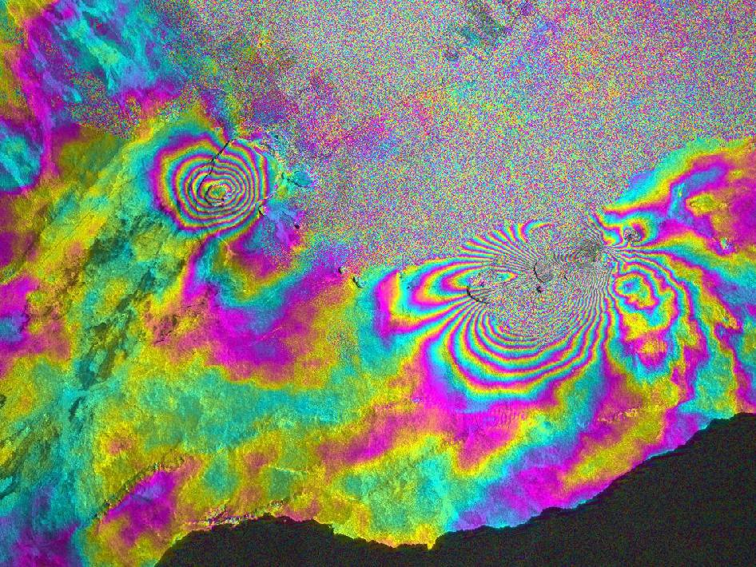
RAdio Detection and Ranging (RADAR)
PTYS 551 Lecture 6
Kilauea Volcano, Hawaii

Slide 2
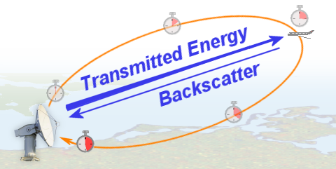
RADAR
What is Radar?
RADAR is an acronym for RAdio Detection And Ranging.
RADAR is an object detection system that uses electromagnetic waves
to identify the range, altitude, direction or speed of both moving and
fixed objects such as aircrafts, ships, motor vehicles, weather
formations and terrain.
Reflection of electromagnetic waves
Measurement of running time of transmitted pulses

Slide 3
RADAR
Radar Classification
1. Continuous Wave Radar or Doppler Radar
Continuous Wave (CW) radars utilize Continuous waveforms, which may be considered to be a pure sine wave. Spectra of the radar echo from stationary targets and clutter will be concentrated at the center frequency for the echoes from moving targets will be shifted by the Doppler frequency. Thus by measuring this frequency difference CW radars can very accurately extract target relative velocity.
2. Pulsed Radar:
More useful than CW radar. Here the transmitter emits a train of narrow rectangular shaped pulses modulating a sine wave carrier. The range to the target is determined by measuring the time taken by the pulse to travel to the target and return to the radar station.

Slide 4
RADAR
Radar Equation
The power P_{r} returning to the receiving antenna is given by the
radar equation:
where
P_{t} = transmitter power
G_{t} = gain of the transmitting antenna
A_{r} = effective aperture (area) of the receiving antenna
σ = radar cross section, or scattering coefficient of the target
F = pattern propagation factor
R_{t} = distance from the transmitter to the target
R_{r} = distance from the target to the receiver.

Slide 5
RADAR
Radar Noise and Clutter
Signal noise is an internal source of random variations in the signal, which is
generated by all electronic components. Noise typically appears as random variations
superimposed on the desired echo signal received in the radar receiver. The lower the
power of the desired signal, the more difficult it is to discern it from the noise.
Noise is also generated by external sources, most importantly the natural thermal
radiation of the background scene surrounding the target of interest.
There will be also flicker noise due to electrons transit, but depending on 1/f, will
be much lower than thermal noise when the frequency is high.
Clutter refers to radio frequency (RF) echoes returned from targets which are
uninteresting to the radar operators. Such targets include natural objects such as
ground, sea, precipitation (such as rain, snow or hail), sand storms, animals
(especially birds), atmospheric turbulence, and other atmospheric effects, such as
ionosphere reflections, meteor trails, and three body scatter spike. Clutter may also
be returned from man-made objects such as buildings and, intentionally, by radar
countermeasures such as chaff.
Clutter may also originate from multipath echoes from valid targets due to ground
reflection, atmospheric ducting or ionospheric reflection/refraction.

Slide 6
RADAR
Radar Noise and Clutter
The basic types of clutter can be summarized as follows:
1) Surface Clutter – Ground or sea returns are typical surface clutter. Returns from
geographical land masses are generally stationary, however, the effect of wind
on trees etc means that the target can introduce a Doppler Shift to the radar
return. This Doppler shift is an important method of removing unwanted
signals in the signal processing part of a radar system. Clutter returned from the
sea generally also has movement associated with the waves.
2)
Volume Clutter – Weather or chaff are typical volume clutter. In the air, the most
significant problem is weather clutter. This can be produced from rain or snow
and can have a significant Doppler content.
3) Point Clutter – Birds, windmills and individual tall buildings are typical point
clutter and are not extended in nature. Moving point clutter is sometimes
described as angels. Birds and insects produce clutter, which can be very
difficult to remove because the characteristics are very much like aircraft.

Slide 7
RADAR
Radar Jamming
Radar jamming refers to radio frequency signals originating from
sources outside the radar, transmitting in the radar's frequency and
thereby masking targets of interest. Jamming may be intentional, as
with an electronic warfare (EW) tactic, or unintentional, as with
friendly forces operating equipment that transmits using the same
frequency range. Jamming is considered an active interference
source, since it is initiated by elements outside the radar and in
general unrelated to the radar signals.

Slide 8
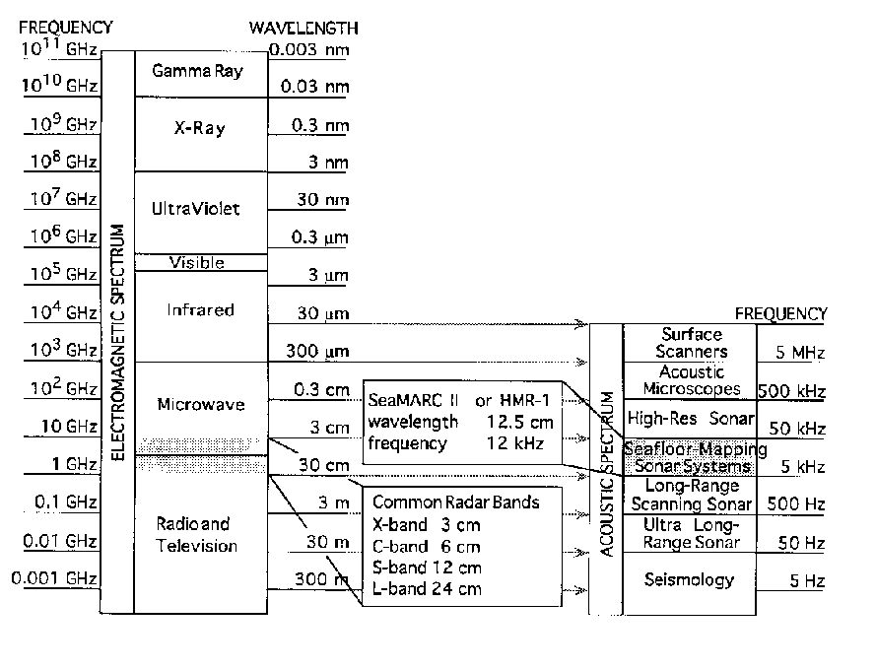
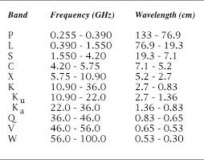
RADAR
Radar Frequency Bands

Slide 9
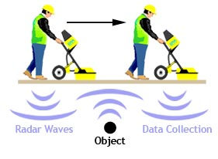
RADAR
Ground Penetrating Radar (GPR)

Slide 10
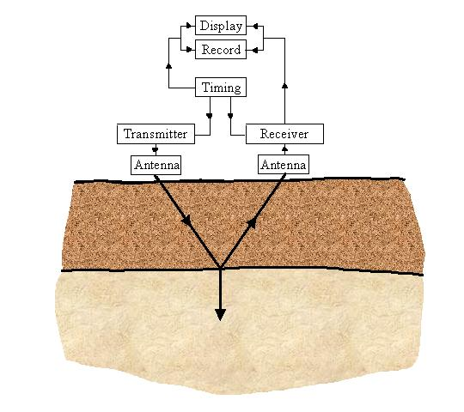
RADAR
Ground Penetrating Radar (GPR)
An EM pulse is sent through an antenna, penetrating into the surveyed material.
A portion of the energy is reflected back to the antenna when an interface between materials of dissimilar dielectric constant is encountered.

Slide 11
RADAR
Ground Penetrating Radar (GPR)
Reflected Signal
The amount of reflected energy at an interface is governed by:
where ρ_{1,2} is the reflection coefficient and ε_{r1} and ε_{r2} are the dielectric constants.
Typical Dielectric Constants:
Material | Relative permittivity
Air | 1
Asphalt: dry | 2-4
Clay | 2-40
Dry sand | 3-5
Concrete: dry | 4-10
Fresh water | 80
Metals | ∞

Slide 12
RADAR
Ground Penetrating Radar (GPR)
GPR: Depth Determination
The reflected signal has information on:
how quickly the signal traveled
how much was attenuated
These quantities depend on spatial configuration and materials.
The depth of a layer is given by:
D = (5.9t)/sqrt. of(Er)
D = depth of target
t = wave travel time (nanosecond)
5.9 = a constant incorporating speed of light and unit conversions
Er = dielectric constant of subsurface material

Slide 13
RADAR
Ground Penetrating Radar (GPR)
GPR: Depth Determination
It depend upon two condition:
The type of soil or rock in the GPR survey area.
The frequency of the antenna used.
Low frequency systems are more penetrating but data resolution is lower.
High frequency systems have limited penetration but offer a much higher resolution.
Antenna Frequency | Maximum Penetration Depth | Appropriate Application
1500 MHz | 0.5 m | Rebar mapping and concrete evaluation.
900 MHz | 1 m | Pipe and void detection or assessing concrete thickness.
400 MHz | 4 m | Utility surveys, pavement evaluation, storage tank detection and assessing structural integrity
270 MHz | 6m | Utility surveys, geology and archaeology
SHARAD operates at 15 MHz to 25 MHz and can penetrate up to 1 km

Slide 14
RADAR
Ground Penetrating Radar (GPR)

Slide 15
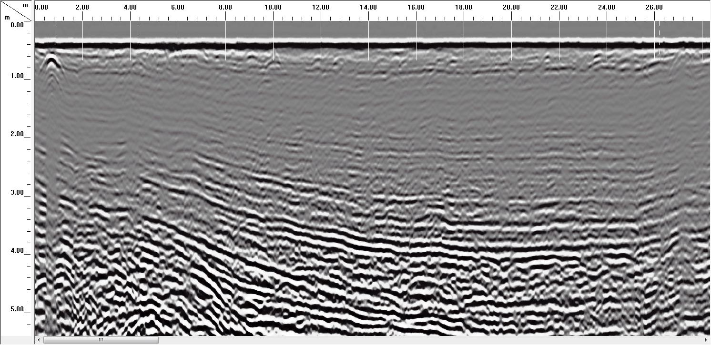
RADAR
Ground Penetrating Radar (GPR)
Sandhill Cone 400 MHz

Slide 16
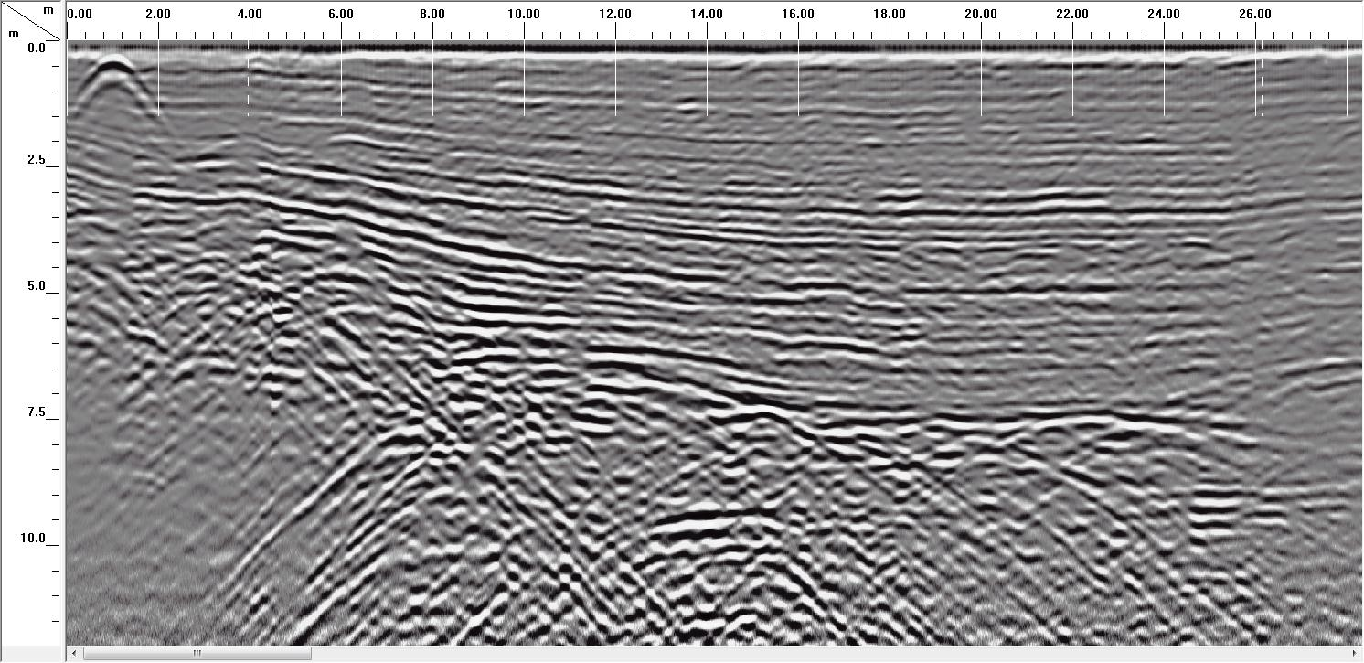
RADAR
Ground Penetrating Radar (GPR)
Sandhill Cone 200 MHz

Slide 17
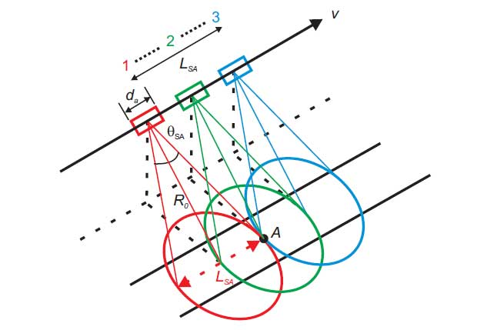
RADAR
RADAR
Synthetic Aperture Radar (SAR)
PTYS 551 Lecture 6
Kilauea Volcano, Hawaii

Slide 18
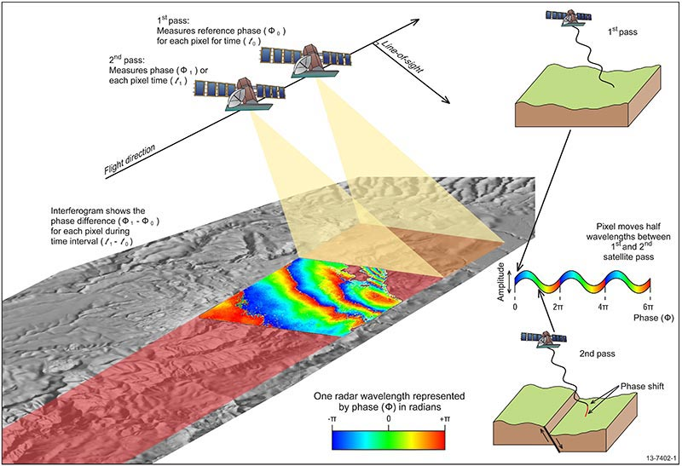
RADAR
InSAR
Interferometric Synthetic Aperture Radar
PTYS 551 Lecture 6
Kilauea Volcano, Hawaii

Slide 19
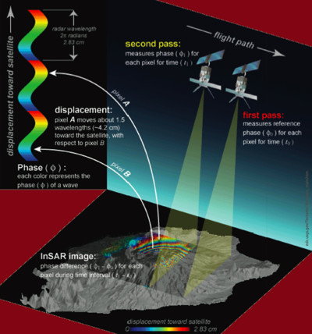
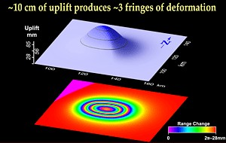
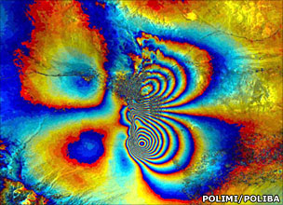
RADAR
InSAR
Interferometric Synthetic Aperture Radar
PTYS 551 Lecture 6
Kilauea Volcano, Hawaii

Slide 20
RADAR
On March 5, 2011, a large fissure eruption began on the east rift zone of Hawaii's Kilauea volcano. This satellite InSAR image, from the Italian Space Agency's (ASI) constellation of COSMO-SkyMed radar satellites, depicts the relative deformation of Earth's surface at Kilauea between Feb. 11, 2011 and March 7, 2011 two days following the start of the recent eruption. Surface displacements are seen as contours (or 'fringes'), where each color cycle represents 1.5 centimeters of surface motion. The circular pattern of concentric fringes toward the left represent deflation of the magma source beneath Kilauea caldera. The complex pattern toward the right represents the deformation caused by the volcanic dike intrusion and subsequent fissure eruption taking place along the east rift zone.
PTYS 551 Lecture 6
Kilauea Volcano, Hawaii

Slide 21
Lecture Summary
RADAR is an acronym for RAdio Detection And Ranging.
RADAR types include: (1) continuous (Doppler) and (2) pulsed.
Pulsed RADAR is generally more useful and its utility is greatly enhanced
using a Synthetic Aperture Radar (SAR) configuration effective aperture
(area) of the receiving antenna (see RADAR equation).
Commonly used RADAR wavelengths include X-Band (3 cm), C-Band
(6 cm), S-Band (12 cm), and L-Band (24 cm).
In addition to backscatter RADAR, Ground Penetrating Radar (GPR) can
be used to identify subsurface reflections.
Inferferometric SAR (InSAR) provides a powerful tool for change
detection and quantification of surface deformation.

