Slide 1
Text Analytics
Prof Sunil Wattal

Slide 2
How happy is the world today?

Slide 3
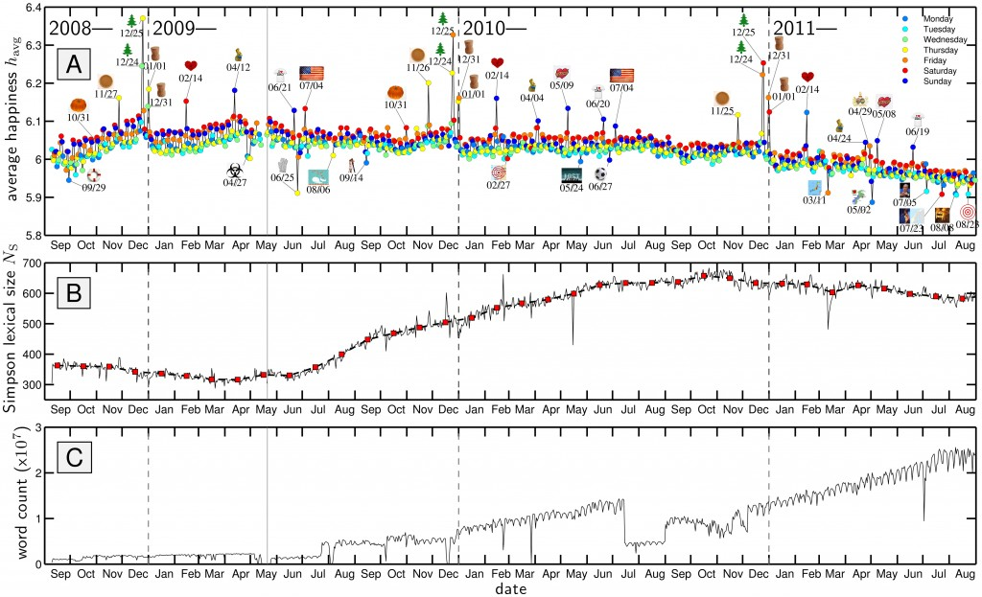

Slide 4
Text Mining
automatically extracting information from unstructured textual resources
Textual sources:
Web pages
Medical records
Customer surveys
Email filtering (spam)
DNA sequences
Incident reports
Drug interaction reports
News stories (e.g. predict stock movement)

Slide 5
Other sources
Email
Insurance claims
News articles
Patent portfolios
Customer complaint letters
Contracts
Transcripts of phone calls with customers
Technical documents

Slide 6
Sentiment Analysis: Example
Good, but a little outdated. I bought the ACME Z37 as my first digital compact P&S camera. I had it for a couple of weeks, until mine had a 'lens error' that basically made the camera inoperable (it was stuck open). It might've been due to batteries running low, but I tried another set (which I now think was also low).
The picture quality from the Z37 was very good, a bit of barrel distortion was noticed in the wide angle and shooting tall skyscrapers (noticed by the curve along the side of the frame where the buildings are supposed to be straight).Another gripe I had with the camera was how slow the auto-focus was. It would basically go through the whole range of focus every time I pressed the shutter half-way and then some. This became more annoying the more I used it.
Eventually a lot of my pictures came out blurry, including outdoor overcast days with 3x optical zoom. Basically anytime there's zoom & less than ideal lighting, I would have to have rock steady hands to get non-blurry pictures. Overall it is a good camera if you can overlook the issues I mentioned.
Camera review with positive and negative comments
Notes:
This example is from the Teragram training related to SAS Sentiment Analysis.

Slide 7
Sentiment Analysis: Brand Management
Notes:
Sentiment Analysis permits visualizing sentiment about features of a product. In the above example related to a compact digital camera, red is bad and green is good. Overall, the sentiment is favorable to the camera.

Slide 8
Motivation for Text Mining
Approximately 90% of the world’s data is held in unstructured formats (source: Oracle Corporation)
Information intensive business processes demand that we transcend from simple document retrieval to “knowledge” discovery.
Structured Numerical or Coded
Information
10%
Unstructured or Semi-structured
Information
90%
Notes:
The justification for the interest in text mining is the same as for the interest in knowledge retrieval (search and categorization).
The shear amount of unstructured data (mostly textual) out there calls for more than just document retrieval. Tools and techniques exist to mine this data and realize value in the same way that data mining taps structured data for business intelligence and knowledge discovery.

Slide 9
Text mining is the process of discovering and extracting meaningful patterns and relationships from text collections.
Text Mining
Natural Language Processing
=
Data Mining
+
Notes:
This slide is employed in SAS marketing material. It is too simplistic, but it provides a general view of text mining.

Slide 10
Text Mining
Text mining has the following characteristics:
operates with respect to a corpus of documents
employs a dictionary or vocabulary to identify relevant terms
accommodates a variety of metrics to quantify the contents of a document within the corpus
derives a structured vector of measurements for each document relative to the corpus
employs analytical methods applied to the structured vector of measurements based on the goals of the analysis, for example, groups documents into segments
Notes:
Rather than attempt to justify the formal definition of text mining, instead describe how text mining operates. The course notes discuss dictionary, vocabulary, and relate these concepts to the start list.

Slide 11
Challenges in Text Mining
Data collection is “free text”
Data is not well-organized
Semi-structured or unstructured
Natural language text contains ambiguities on many levels
Lexical, syntactic, semantic, and pragmatic

Slide 12
Challenges of Text Mining
Very high number of possible “dimensions”
All possible word and phrase types in the language!!
Unlike data mining:
records (= docs) are not structurally identical
records are not statistically independent
Complex and subtle relationships between concepts in text
“AOL merges with Time-Warner”
“Time-Warner is bought by AOL”
Ambiguity and context sensitivity
automobile = car = vehicle = Toyota
Apple (the company) or apple (the fruit)
Notes:
Why aren’t there more products that do text mining?
Because it’s hard!!!
First, there are many possible dimensions of text. Consider just the classes of nouns that might be represented in a text collection. Then, add to that noun phrases (nouns plus adjectives or multi-word concepts).
Second, different documents can look quite different. Never mind issues like formatting differences.
Third, the relationships between words and concepts in text is subtle. Figuring out that a relationship exists is easy, providing the information about the nature of the relationship is tricky.
Finally, the same word can have many meanings (e.g. “interest”), or many words can have the same meaning.

Slide 13
“Search” versus “Discover”
Search
(goal-oriented)
Discover
(opportunistic)
Structured
Data
Data
Retrieval
Data
Mining
Unstructured
Data (Text)
Knowledge
Discovery
Text
Mining

Slide 14
Knowledge Discovery
Typically falls into one of two categories
Analysis of text: I have a bunch of text I am interested in, tell me something about it
E.g. sentiment analysis, “buzz” searches
Retrieval: There is a large corpus of text documents, and I want the one closest to a specified query
E.g. web search, library catalogs, legal and medical precedent studies
Demo : Trackur Tool

Slide 15
Information Distillation
Pattern Discovery (Unsupervised Learning)
Prediction (Supervised Learning)
These are the same general abstract goals of data mining.
Notes:
Text mining applications are dominated by the goal of pattern discovery.

Slide 16
Text Mining Application Areas
Document categorization
Do the documents fall into different categories? (Pattern discovery)
Can you assign a new document to a subject matter category? (Prediction)
Information retrieval
Which documents are most relevant for a given information request? (Pattern discovery and prediction)
Forensic linguistics
Can you identify the author of a manifesto? (Prediction)
This application area applies stylometry to crime investigation, and is related to anomaly detection for crime prevention.
Anomaly detection
Are there any unusual documents in the collection? (Pattern discovery and prediction)
What makes a document unusual? (Pattern discovery)
Notes:
Relate the major application areas to the two abstract goals.

Slide 17
Text Mining Application Examples
Auto warranty
Cost $35bn annually
Input from service technicians is underutilized
How can text mining help?
Healthcare
Costs can be reduced by preventive medicine
Credit card industry
which features are resonating with customers
Notes:
Anomaly detection includes examining internet traffic looking for terrorist sources. The course notes discuss how text mining references present general application areas in different ways.

Slide 18
In class exercise
Data Analytics Challenge

