Slide 1
Hierarchical clustering approaches for high-throughput data
Colin Dewey
BMI/CS 576
www.biostat.wisc.edu/bmi576
colin.dewey@wisc.edu
Fall 2016

Slide 2
The clustering landscape
There are many different clustering algorithms
They differ with respect to several properties
  hierarchical vs. flat
  hard (no uncertainty about which profiles belong to a cluster) vs. soft clusters
  overlapping (a profile can belong to multiple clusters) vs. non-overlapping
  deterministic (same clusters produced every time for a given data set) vs. stochastic
  distance (similarity) measure used

Slide 3
Hierarchical vs. Flat clustering
Flat clustering (e.g., K-means and Gaussian Mixture Models)
  Number of clusters, K, is pre-specified
  Each object is assigned to one of these clusters
Hierarchical clustering
  Hierarchical relationships established between all objects
  A threshold on the maximum dissimilarity can be used to convert a hierarchical clustering into a flat clustering
    Multiple flat clusterings can be produced by varying the threshold

Slide 4
Hierarchical clustering
height of bar indicates
degree of distance
within cluster
distance scale
0
leaves represent objects to be clustered (e.g. genes or samples)

Slide 5
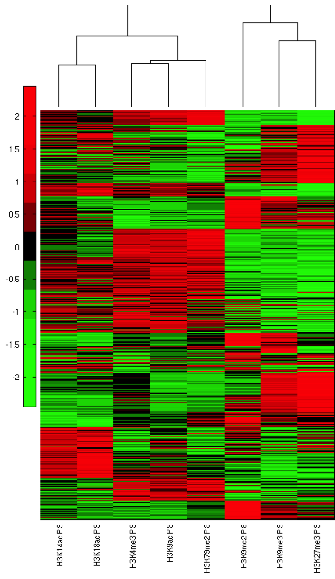
Hierarchical clustering example
clustering of chromatin marks measured near genes in a particular cell type (induced pluripotent cell (iPS))
  Columns correspond to chromatin marks
  Eight marks
    Five activating
      H3K14
      H3K18
      H3K4me3
      H3K9ac
      H3K79me2
    Three repressive
      H3K9me2
      H3K9me3
      H3K27me3
Data from Sridharan et al.

Slide 6
Hierarchical clustering
Input: a set X={x₁,.. x_{n}} of data points, where each x_{i} is a p-dimensional vector
Output: a rooted tree with the data points at the leaves of the tree
Two major strategies
  top-down (divisive)
  bottom-up (agglomerative)
Both strategies iteratively build a tree by splitting (to-down) or merging (bottom-up) subsets of data points
We will focus on bottom-up clustering

Slide 7
Top-down clustering
Basic idea: use a flat clustering method to recursively split a set, X, of data points into K (usually K=2) disjoint subsets
topdown_cluster(X):
  if X has only one element x:
    return a tree with a single leaf node labeled by x
  else:
  X1, X2 = flat_cluster(X, K=2)
  T1 = topdown_cluster(X1)
  T2 = topdown_cluster(X2)
  return a tree with children T1 and T2

Slide 8
Bottom-up hierarchical clustering
// each instance is initially its own cluster, and a leaf in tree
// find least distant pair in C
// create a new cluster for pair
// Add new cluster to list of clusters to be joined in the tree

Slide 9
Distance between two clusters
The distance between two clusters c_{u} and c_{v} can be determined in several ways
  single link: distance of two most similar profiles
  complete link: distance of two least similar profiles
  average link: average distance between profiles

Slide 10
Haven’t We Already Seen This?
Hierarchical clustering is very similar to distance-based phylogenetic methods
Average link hierarchical clustering is equivalent to UPGMA for phylogenetics

Slide 11
Differences between general clustering and phylogenetic inference
what a tree represents
  phylogenetic inference: tree represents hypothesized sequence of evolutionary events; internal nodes represent hypothetical ancestors
  clustering: inferred tree represents similarity of instances; internal nodes don’t represent ancestors
form of tree
  UPGMA: rooted tree
  neighbor joining: unrooted
  hierarchical clustering: rooted tree
how distances among clusters are calculated
  UPGMA: average link
  neighbor joining: based on additivity
  hierarchical clustering: various

Slide 12
Complete-link vs. single-link distances
complete link
single link

Slide 13
Updating distances efficiently
If we just merged and into , we can determine distance to each other cluster as follows
  single link:
  complete link:
  average link:

Slide 14
Effect of different linkage methods
Single linkage
Complete linkage
Single linkage might result in a “chaining” effect
Average linkage

Slide 15
Flat clustering from a hierarchical clustering
We can always generate a flat clustering from a hierarchical clustering by “cutting” the tree at some distance threshold
cutting here results
in 2 clusters
cutting here results
in 4 clusters

Slide 16
Naïve computational complexity
The naïve implementation of hierarchical clustering has time complexity, where n is the number of objects
  computing the initial distance matrix takes time
  there are merging steps
  on each step, we have to update the distance matrix and select the next pair of clusters to merge

Slide 17
Computational Complexity
for single-link clustering, we can update and pick the next pair in time, resulting in an algorithm
for complete-link and average-link we can do these steps in time resulting in an method

Slide 18
How to pick the right clustering algorithm?
If you have a sense of what the right number of clusters are, K-means or Gaussian mixture models might be good
If you want to control for the extent of dissimilarity you should use hierarchical
Hierarchical clustering is deterministic
  Always gives the same solution with the same distance metric
K-means and Gaussian mixture model are non-deterministic
We have talked about clustering of gene expression profiles
  However clustering could be used to find groupings among more complex objects
  All we need is to define the right distance metric

Slide 19
Summary of clustering
Many different methods for clustering
  Flat clustering
  Hierarchical clustering
  Dissimilarity metrics among objects can influence clustering results a lot
Picking the number of clusters is difficult but there are some ways to do this
Evaluation of clusters is often difficult
  Comparison with other sources of information can help assess cluster quality

