Slide 1
Online Contextual Face Recognition: Towards Large Scale Photo Tagging for Sharing
Gang Hua
Microsoft Corporate
ganghua@microsoft.com
Notes:
Good afternoon everyone. It is my pleasure to present my work here. The title of my presentation today is “Contextual face recognition”.

Slide 2
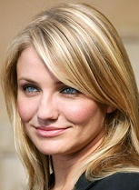
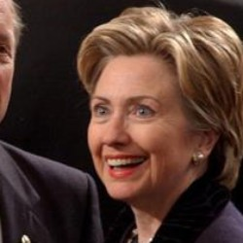
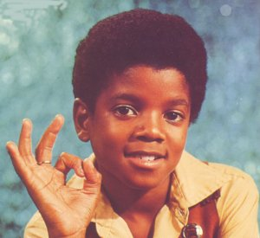
Photos->People->Tags->Social
Photo sharing has become a main online social activity
FaceBook receives 850 million photo uploads/month
Users care about who are in which photos
Tagging faces is common in Picasa, iPhoto, WLPG, FaceBook.
Face recognition in real life photos is challenging
FRGC (controlled): >99.99% accuracy with FAR<0.01%
LFW [Huang et al. 2007]: ~75% recognition accuracy
Notes:
Why is this problem interesting? Let’s firstly briefly review some of the facts in the online space. First, photo sharing has become a main online social activity. As a matter of fact, FaceBook receives 850 million photo uploads every month and has become the number 1 photo sharing sites. In this context, users care about who are in which photos. That is why tagging faces has become a standard feature for different photo management systems. It is obvious that face detection/recognition can help automate the tagging tasks here. On the research side, face recognition in controlled environment can more or less be regarded as solved problem. For example, according the FRGC2006, the research community has pushed the recognition accuracy to be higher than 99.99% with false acceptance rate less than 0.01%. On the other hand, the research on face recognition in uncontrolled real life photos is not quite there yet.

Slide 3
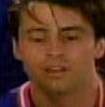
Challenges
Gallery faces
?
… …
… …
… …
Poses, lighting, facial expression, and partial occlusions, etc.
Recognizing large number of subjects is still challenging
Recognition accuracy drops with increasing number of subjects
Efficiently matching against large gallery dataset is nontrivial
Memory storage of gallery faces is limited

Slide 4
Contextual face recognition
Design robust face similarity metric
Leverage local feature context to deal with visual variations
Power large-scale face recognition tasks
Design efficient matching metric
Employ image level context and active learning
Utilize social level context to scope recognition
Design social network priors to improve recognition

Slide 5
Syllabus
Face recognition: an elastic and partial matching metric
Feature: dense local image descriptors, i.e., feature context
Robust elastic and partial matching metric
Scalability issues in large scale face recognition
Gallery face selection by active learning
A discriminative model incorporating image context
Leverage social network context
Scope the face recognition task
Leverage social network priors
Conclusion and future work

Slide 6
Part I: [Hua & Akbarzadeh, ICCV09]
A robust elastic and partial matching metric for face recognition

Slide 7
A face recognition pipeline
Reducing pose variation
Reducing lighting variation
Face Detection
Face part detection
Face pose alignment
Face photometric rectification
Pre-processing unit
Face recognizer
Face feature extraction
& Face representation
Face recognition tasks: face verification, face matching, and face tagging, etc..
Similarity metric
Each step in the preprocessing is not perfect
The feature extraction and metric need to be robust
Elastic and partial matching is required

Slide 8
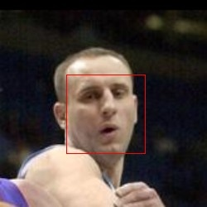
Preprocessing
Input to our algorithm
Face Detection
Boosted cascade
Eye Detection
Neural network
Face alignment
Similarity transform to canonical frame
Illumination
normalization
[Viola-Jones ‘01]

Slide 9
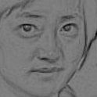
An elastic and partial matching metric
f₁₁
f_{ij}
Geometric Rectification
Photometric Rectification
match each feature within region
Dense Overlapping
Partitioning
r
f_{KK}
each min distance
d₁₁ d₁₂ … d_{ij} … d_{KK}
sort distances
Descriptor Extraction
A variant of the T2S2 in [Winder &Brown, CVPR’07]
Face Representation
d₇₃ d₈₂ … d₁₁ … d₃₄
α -th percentile as final distance

Slide 10
Evaluation method
We have several manually tagged data sets
Eg. ~280 persons (900 faces), ~600 persons (2500 faces), ~1200 persons (5000 faces)
For each person split up in red and blue group:
Store all blue in DB, do lookup for each red
Store all red in DB, do lookup for each blue

Slide 11
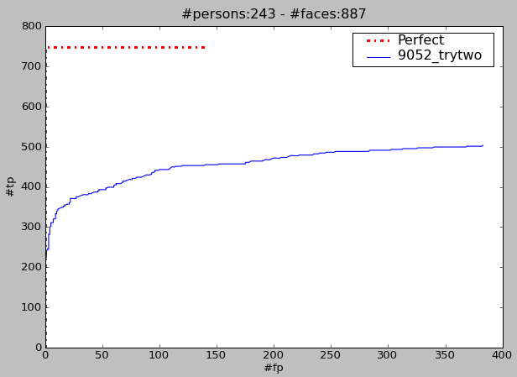
Evaluation method - continued
For each lookup we compute:
Matching candidate and confidence in match
Sort all lookup results by confidence:
0.97, 0.92, 0.86, 0.73, 0.65 … 0.06, 0.02, 0.01
TP TP FA TP FA … FA FA FA
We plot ROC curve:

Slide 12
Some important setting and parameters
f₁₁
f_{ij}
Geometric Rectification
Photometric Rectification
match each feature within region
Dense Overlapping
Partitioning
r
f_{KK}
each min distance
d₁₁ d₁₂ … d_{ij} … d_{KK}
sort distances
Descriptor Extraction
Face Representation
d₇₃ d₈₂ … d₁₁ … d₃₄
α -th percentile as final distance

Slide 13
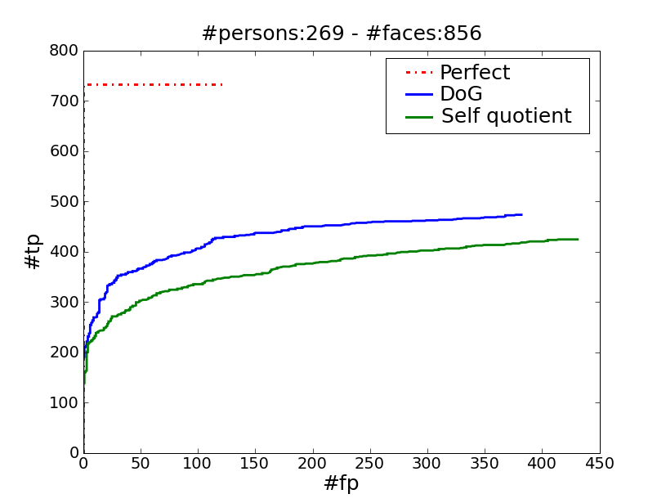
Photometric rectification

Slide 14
Some important parameters
f₁₁
f_{ij}
Geometric Rectification
Photometric Rectification
match each feature within region
Dense Overlapping
Partitioning
r
f_{KK}
each min distance
d₁₁ d₁₂ … d_{ij} … d_{KK}
sort distances
Descriptor Extraction
Face Representation
d₇₃ d₈₂ … d₁₁ … d₃₄
α -th percentile as final distance

Slide 15
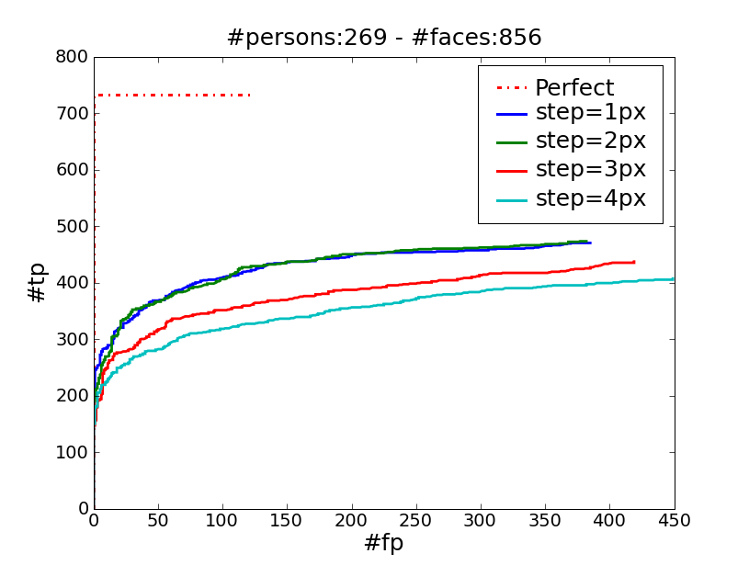
Step parameter in dense partitioning

Slide 16
Some important parameters
f₁₁
f_{ij}
Geometric Rectification
Photometric Rectification
match each feature within region
Dense Overlapping
Partitioning
r
f_{KK}
each min distance
d₁₁ d₁₂ … d_{ij} … d_{KK}
sort distances
Descriptor Extraction
Face Representation
d₇₃ d₈₂ … d₁₁ … d₃₄
α -th percentile as final distance

Slide 17
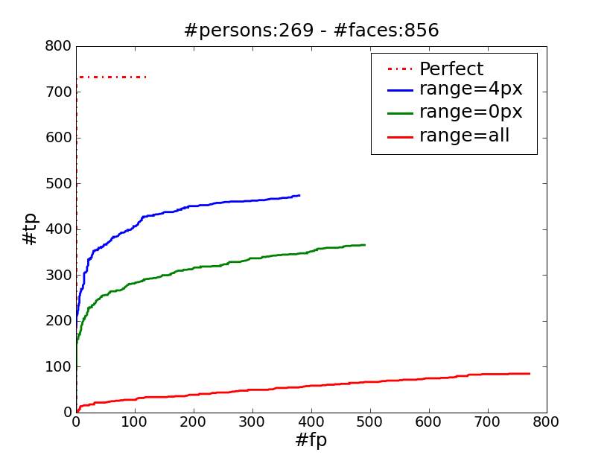
Range parameter

Slide 18
Some important parameters
f₁₁
f_{ij}
Geometric Rectification
Photometric Rectification
match each feature within region
Dense Overlapping
Partitioning
r
f_{KK}
each min distance
d₁₁ d₁₂ … d_{ij} … d_{KK}
sort distances
Descriptor Extraction
Face Representation
d₇₃ d₈₂ … d₁₁ … d₃₄
α -th percentile as final distance

Slide 19
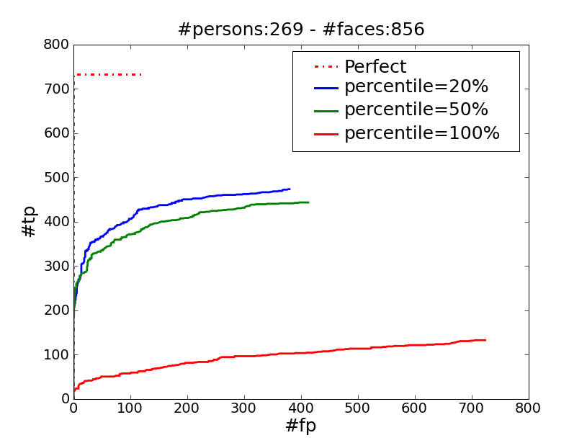
Percentile parameter

Slide 20
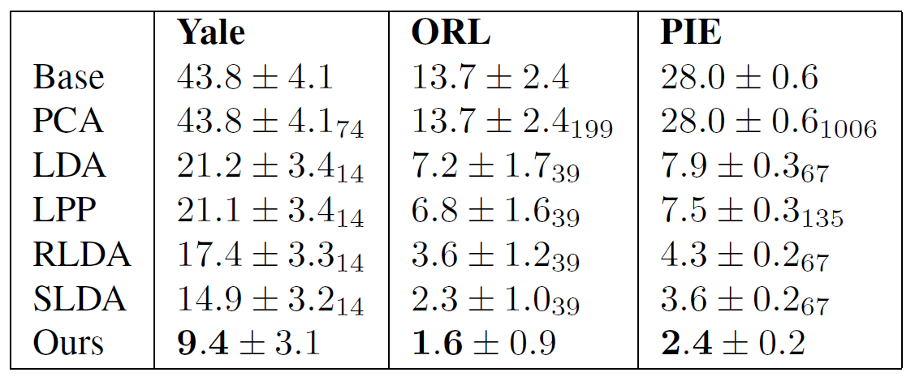
Comparisons on academic benchmarks
Low resolution face image (32x32)
Yale: 11 faces/subject x 15 subjects = 165 faces. 5 faces from each subject are selected as gallery faces.
ORL: 10 faces/subject x 40 subjects = 400 faces. 5 faces from each subject are selected as gallery faces.
PIE: 170 faces/subject x 68 subjects = 11560 faces. 30 faces from each subject are selected as gallery faces.

Slide 21
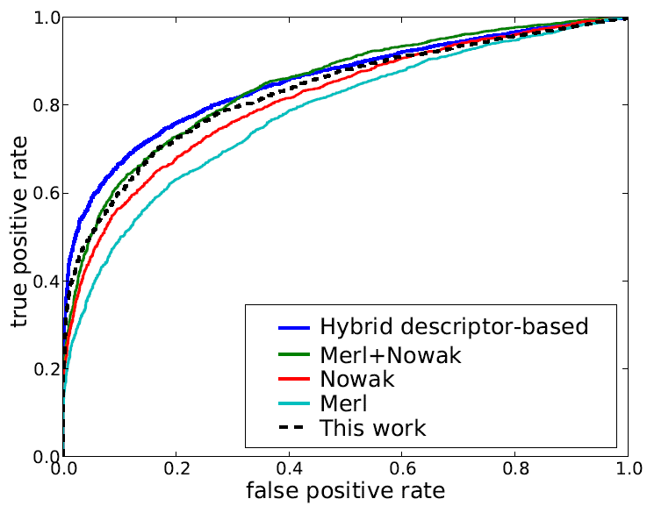
More comparisons and qualitative results
Some qualitative matching results
Comparison on LFW

Slide 22
Percentile parameter

Slide 23
Part II [Kapoor & Hua & Akbarzadeh & Baker, ICCV09]
Scalability issues in large scale face recognition applications

Slide 24
Scalability challenges
How to build the gallery face dataset to achieve the best recognition accuracy?
How to handle the problem of recognizing large number of subjects in a social network?

Slide 25
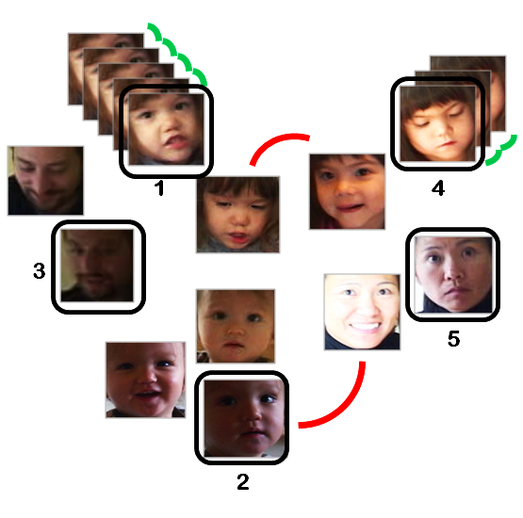
Space scalability
Given N labeled faces, how to choose a maximum M out of the N to form the gallery faces such that the recognition accuracy is maximized?

Slide 26
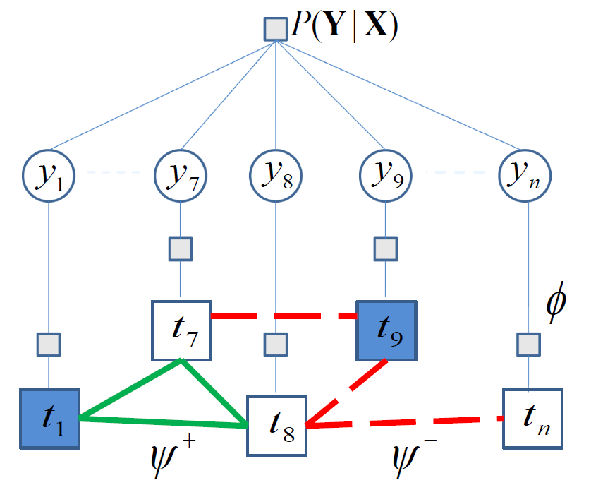
An active learning framework
Variational message passing
A discriminative model (GP+MRF)
Active learning:

Slide 27
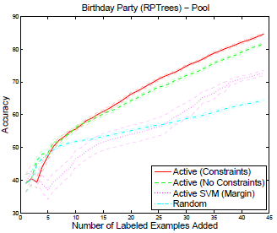
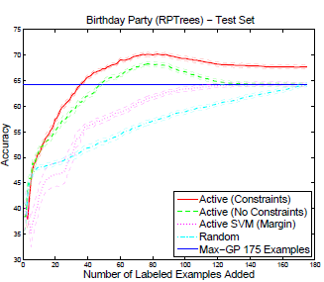
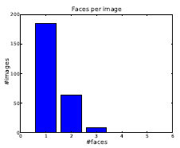
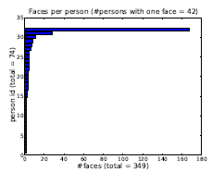
Experiments (1)
74 people
349 faces
1 person appeared ~170 times
42 persons appeared only once

Slide 28
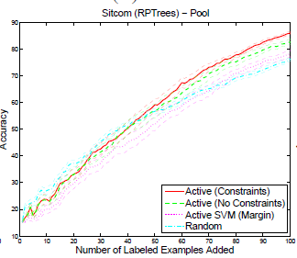
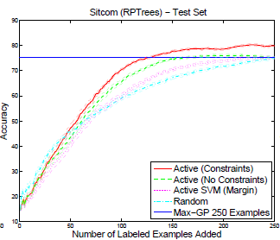
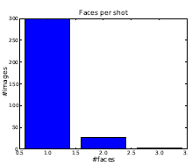
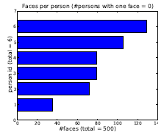
Experiments (2)
80 minutes “friends” video
6 characters
1282 tracks, 16720 faces
500 samples are used for testing

Slide 29
Social network scope and priors
Scope the recognition by social network
Build the prior probability of whom Rachel would like to tag

Slide 30
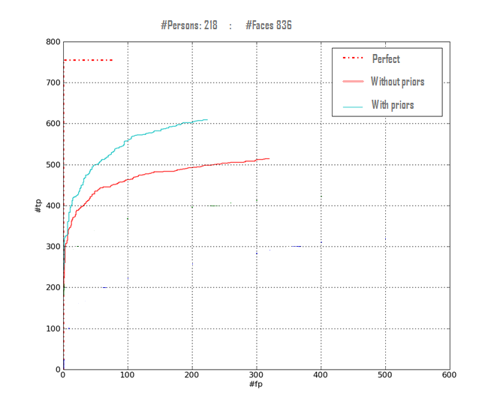
Effects of social priors
Perfect recognition
Recognition w/ Priors
Recognition w/o Priors

Slide 31
Conclusion and future work
Leverage three levels of context for face recognition
A robust face recognition algorithm
Feature context: matching with local image descriptors
Image context: active learning with constraints
Social context: scope task and induce priors
Future work
Further explore different UI/UX for visual tagging tasks

Slide 32
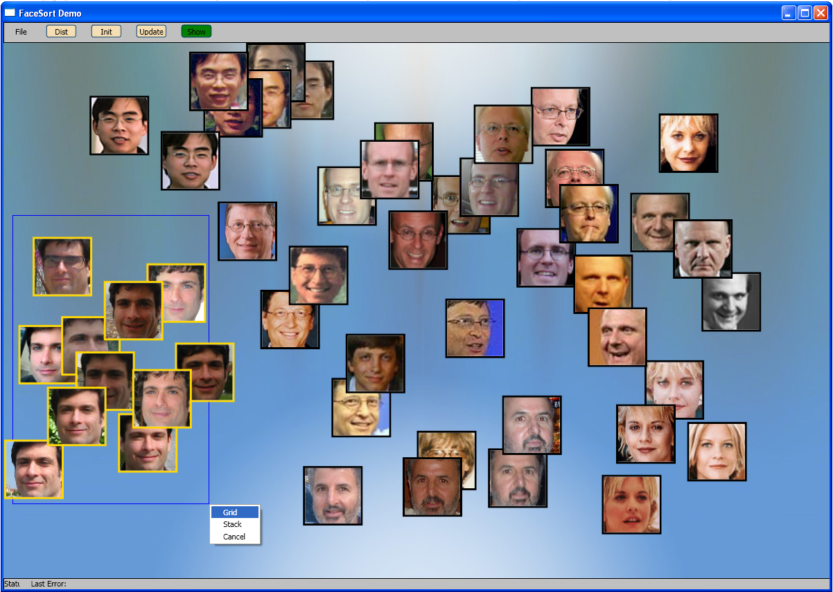
FaceSort

Slide 33
Q & A
John Wright and Gang Hua, “Implicit Elastic Matching for Pose Variant Face Recognition”, CVPR’09 (Oral session on Tuesday)
Simon Winder, Gang Hua, and Matthew Brown, “Picking the best Daisy”, CVPR’09
Thank you for your attention!

