Slide 1

Building a Strong Foundation: Communications
SECURE, INTEGRATE, TRANSFORM
Tom Mazzone
Principal Solution Architect

Slide 2
Telecom Intelligent Network & Technology Evolution
2010+ - Convergence
Voice/Data – Wireless Broadband (LTE/WiMAX/WiFi)
IT & Communications – Ethernet & Home Networks
Fixed/Mobile – Seamless Integration
Communications and Media/Entertainment
Communications and Electric Power Utility
2000 - 3G Wireless
Digital Wireless Voice Communications
Wireless Data Transmission
Mass Market Broadband
SMB & Enterprise Data Growth
1990s – Internet, IP, Broadband, Wireless
Telecommunications Act of 1996 - Deregulation and Competition
Rise of the Internet
Rapid Expansion of Wireless Voice Communications
Increasing Intelligence, Complexity, Value
1980s – Fiber Optics, Digital Networks and Data Transmission
  1984 - US Gov’t breakup of AT&T
  Intelligent Network – 800 Services, Custom Calling Features, Alternative Billing
  Customized Voice Services and Service Creation Platform
1970s - Primarily Analog, Copper-based Networks for Voice Services
Late 1960s - Software Controlled Switches
Late 1800s - First Electromechanical Switch
In the Beginning: A Manually Connected Network (via local operator)

Slide 3
Power Utility Smart Grid Evolution
2010+ - Industry on Steeper Change Curve
Operations Mechanization Happening
Intelligent edge devices evolving quickly
Data explosion
Communications options abound
Security Awareness & Hardening
Convergence of Communications and Electric Power Utility
Secure Efficient Communications Operations is the Intersecting Critical Success Factor
2000 – Industry Energized
Regulatory changes
Intelligence becomes a significant force
Increasing Intelligence, Complexity, Value
1990s – Business as Usual - Almost
IT Growth
Alternative Awareness
1970s -1980s – Modernization & Mechanization
Oil Crises & Efficiency Consciousness
Predictable modernization models
SCADA mechanization
1960 – Rural growth
1940s - 1950s – Growth and interconnectivity
Early 1900s – Local & Regional deployments set stage for industry models
In the Beginning: Edison vs. Westinghouse

Slide 4



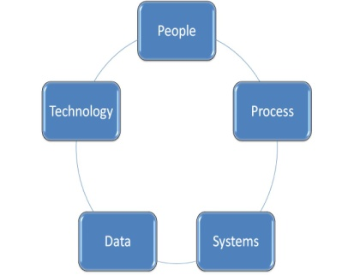

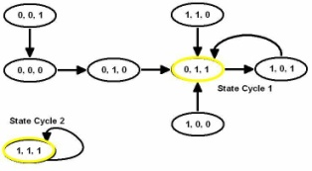
Communications Operations is a Intersecting Critical Success Factor What are we learning?
Secure it
  Now!
  All of it
  Maintain the momentum
Integrate it
  Data, data, everywhere!
  What can it telling us?
  What can we do with it?
  Communications will become a Critical Success Factor
  Holistic interoperable operations approach to optimization
  Leads to mechanization & savings
Transform it
  On-going evolution
  Changing financial models & limiting economics
  Value of legacy support systems
  Value of emerging technologies
  Value of transformation flexibility
Holistic Operations Transformation Methodology

Slide 5
Strong Smart Grid Security Approach
Smart Grid is an opportunity to plan top-down security approach
Need to factor in vendor security architecture (or lack thereof)
Business factors, availability of standards, and technology maturity will also alter your approach

Slide 6
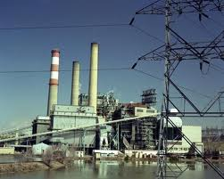

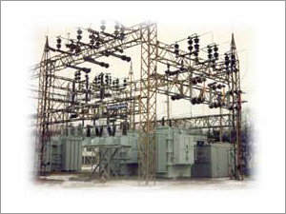


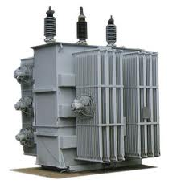


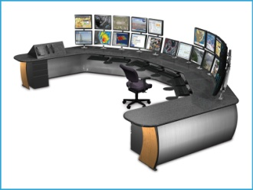
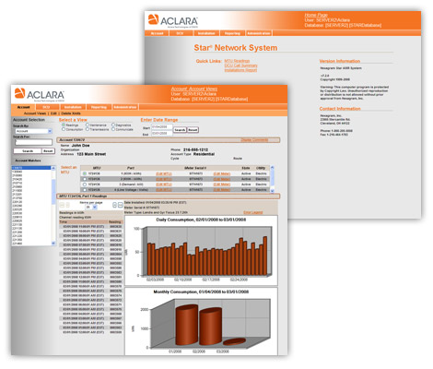
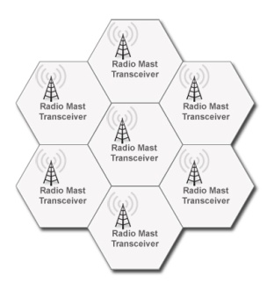
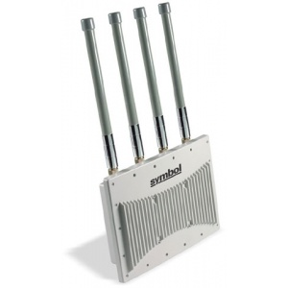
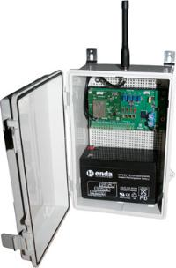




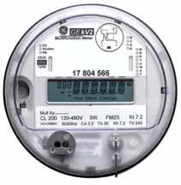

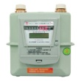
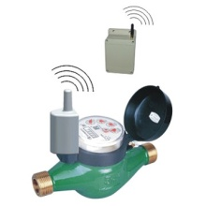
Example - AMI Wireless Security Model Integrating with T&D
Other Enterprises
Wireless & Wireline Networks
AMI APs
Operations Center
Rest of the Enterprise
AMI Management Network
Proprietary Wireless
Public Wireless
AMI Relays
Interoperability
Robust Security
Common Data Model
Standard & Requirements
Integrated Operations Processes
Mesh Networks
AMI Home Area Network
Field Service

Slide 7
Potential Vulnerabilities
Loss of Control of Secure Functions (e.g., Remote Disconnect)
Steal, Alter, Swap Smart Meter Credentials
Compromise Mesh Wireless Network
Remotely alter meters
Take Management Control over Access Points
Penetrate Back-end Networks from Field Components (also gain Internet access)
New Ways to Commit Fraud
Loss of Privacy (visibility into electric usage)
Immature and Vulnerable Software Release Management
Compromise of AMI Management Systems
Supply Chain Attacks
Create a Meter BOT network
And integration with the rest of the business is accelerating

Slide 8
Efficient Operations & IT Frameworks
Integrating the Best of Converging Models
Service Design – holistic foundation from ideation to definition
  Standards
  Requirements – Functional & Security
  Interoperability – functionality, Interfaces, Internal & External
  Enterprise Data Management, Common Data Models,
  Processes & Work Centers
  Operations Support Systems & Customer Information Systems (Account & Billing)
Service Transition – deploy it holistically
  Procurement
  Training – Technology, Security,
Service Operations – allows interoperability
  Network Engineering, Design & Construction
  Network Configuration and Inventory Management
  Enterprise Data Management
  IP Security and Configuration Management
Continuous Service Improvement
  Metrics – Individual components, Holistic – Enterprise, Security built-in
Holistic Operations Transformation Methodology

Slide 9
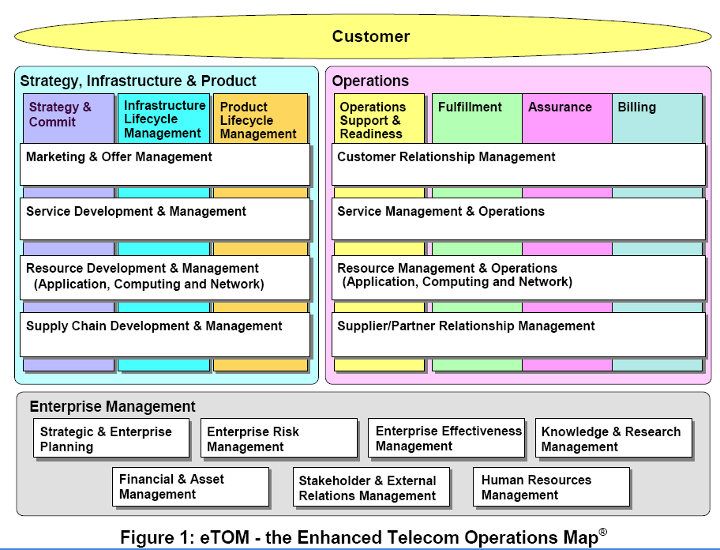
Telecom’s Operational Efficiency Framework
Years of Trial & Error, what can we learn from it?
eTOM is being interleaved with ITIL

Slide 10


Commonly Deployed Operations Model for a Strong Foundation
Real-Time, Policy Based Billing
ERP/Asset
Management
CRM
SAP - Master
Data Management
Workforce
Automation
Common Language
(Locations, Equipment)
Holistic Operational
Visibility
Building Strong Foundation - Communications
AMI, Smart Grid & IP Security – integrate with T&D
Smart Grid Equipment Testing
Network Operations / NOC Processes
Communications Network & Technology Planning, Design & Integration
Centralized
Network
Inventory
Management
IP Security & Configuration Management
Fault Mgmt
Perf Mgmt
Fault Management
Performance Management
SCADA
DMS
OMS
NMS
AMI
...
Network
Commissioning
Network
Discovery &
Reconciliation
Smart Grid – Tx, Dx & Communications Network

Slide 11
An Example of Efficient Foundation
Integrated Inventory Management
Bridges view of inside and outside plant, physical and logical facilities
Single federated view of resource status, capacity utilization, and customers/services
Provides 'as-designed' and 'as-built' views of networks to provisioning
Automated data reconciliation between network and inventory
Automated equipment connect/disconnect
Network Engineering
Network Inventory

Slide 12
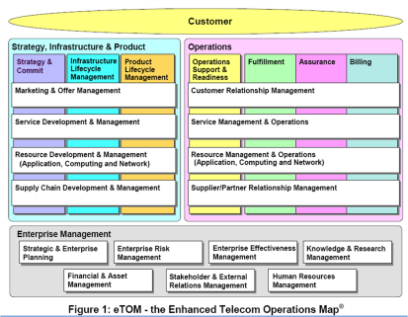
Building a Strong Transmission & Distribution Foundation - Summary
Communications Network Operations:
Secure it
Integrate it
Transform it
Holistic Operations Transformation Methodology

