Slide 1
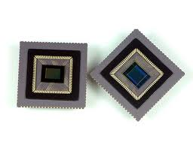
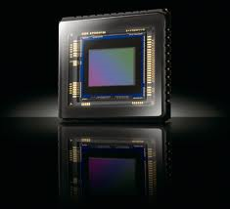
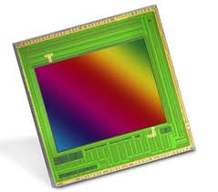
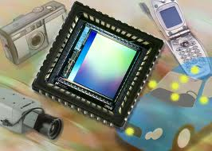
CMOS image sensors
Presenter: Alireza eyvazzadeh

Slide 2
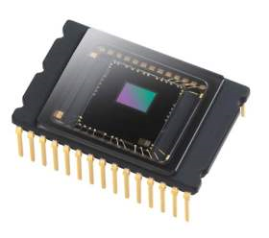
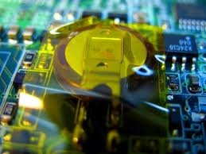
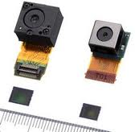
Complementary metal–oxide–semiconductor
a technology for constructing integrated circuits
CMOS technology is used in
Microprocessors
Microcontrollers
static RAM
other digital logic circuits
CMOS technology is also used for several analog circuits such as
image sensors
data converters

Slide 3
CMOS image sensors
Two most common types of sensors used in digital cameras:
CCD - Charge Coupled Device
CMOS - Complementary Metal Oxide Semiconductor
All CCD and CMOS image sensors operate by exploiting the photoelectric effect to convert light into electricity
With the CMOS imager both the 'Photon-to-Electron' conversion and the 'Electron-to-Voltage' conversion is done within the pixel

Slide 4
Some drawbacks of CCDs
complex clocking requirements
high power consumption
difficulty of on-chip integration of circuitry
limited frame rate
CMOS image sensors address these drawbacks by using the same technology as microprocessors and memory chips

Slide 5
Advantages and drawbacks of the CMOS image sensors
Low Power Consumption
one-third to more than 100 times less than that of CCDs
Lower cost compared to CCD’s technology
On chip functionality
A sensor can integrate various signal and image processing blocks such as ampliﬁers, ADCs, circuits for color processing and data compression, etc. on the same chip
Miniaturization
High-speed imaging
Random access of image data
Selective read-out mechanism
Also they are still too noisy and less sensitive than CCDs

Slide 6
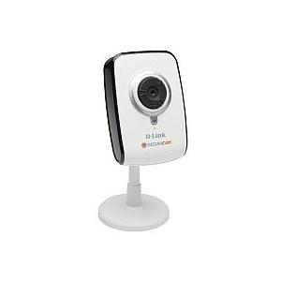
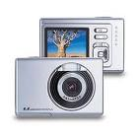
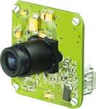
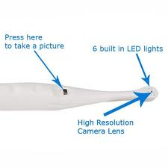
present applications of CMOS image sensors
internet camera
digital still camera
machine vision
Automotive
children’s toy
medicine and dentistry
fingerprint ID
surveillance
aerospace
motion analysis
industrial inspection
quality control
process control
target tracking
spectroscopy

Slide 7
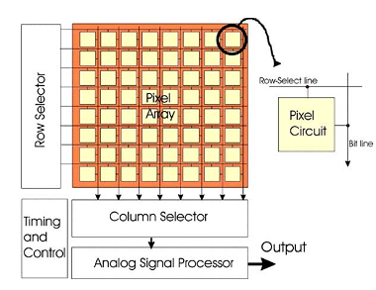
Overall architecture
CMOS imagers architecture can be divided into four main blocks:
1. Pixel Array
2. Analog Signal Processors
3. Row and Column Selector
4. Timing and Control

Slide 8
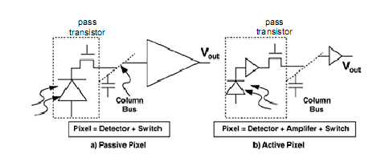
Basic pixel structures
Each pixel contains a photodetector and some transistors. This area is the heart of an image sensor and the imaging quality is largely determined by the performance of this area.
active pixels (APS)
passive pixels (PPS)
Pixel circuits
An APS has three transistors in a pixel, while a PPS has only one transistor. To achieve further improvement, an advanced APS that has four transistors in a pixel, the so-called 4T-APS, has been developed.
APS are sensors that implement a buffer per pixel. Currently, APS are the predominant devices, although in some cases PPS are also used.
The in-pixel amplifier in APS enables non-destructive read of the photodiode charge at a faster speed and a generally higher signal-to-noise ratio (SNR) than PPS

Slide 9
Operation of a photodetector comprises:
generation of free electron-hole pairs due to impinging light
separation and collection of electrons and holes
(c) production of an output signal through interaction with other components
Several popular silicon-based photosensing devices are
Photoconductors
PN and PIN photodiodes
Phototransistors
photogates

Slide 10
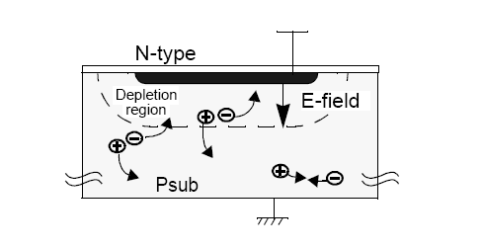
PN junction photodiode
an important sensor for digital imaging
The potential voltage decreases when electrons accumulate. By measuring the voltage drop, the total amount of light power can be obtained.

Slide 11
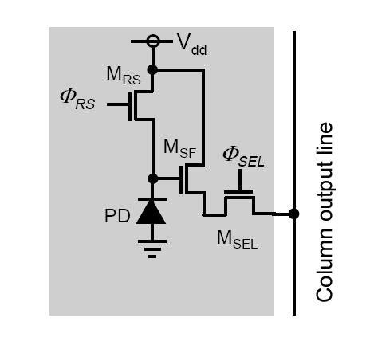
Active pixel sensor, 3T-APS
First, the reset transistor M_{RS} is turned on
PD is reset to the value V_{dd} −V_{th}
V_{th} is the threshold voltage of transistor M_{RS}
M_{RS} is turned off and the PD is electrically floated
The accumulated charge changes the potential in the PD; the voltage of the PD,V_{PD} ,decreases according to the input light intensity
After an accumulation time, the select transistor M_{SEL} is turned on and the output signal in the pixel is read out in the vertical output line.
When the read-out process is finished M_{SEL} is turned off and M_{RS} is again turned on to repeat the above process.

Slide 12
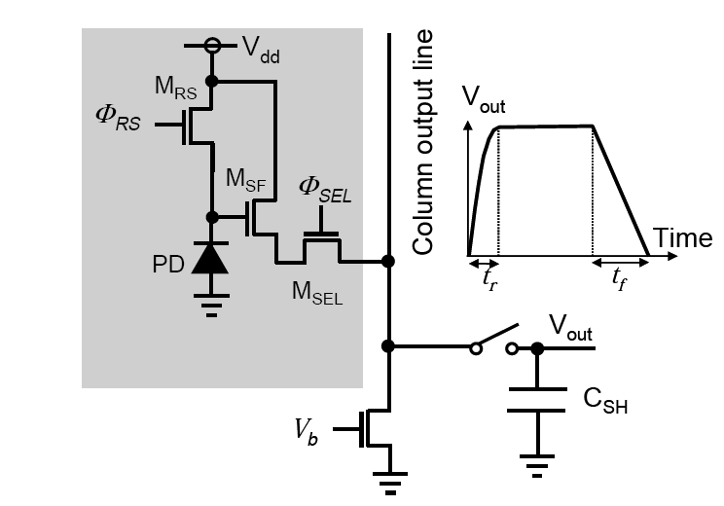
Sensor peripherals
Addressing
In CMOS image sensors, to address each pixel, a scanner or a decoder is used
Readout circuits
The voltage of a PD is read with a source follower (SF)
a follower transistor M_{SF} is placed in a pixel and a current load M_{b} is placed in each column

Slide 13
Thanks for your attention

