Slide 1
Reactors in ChemCAD
Joshua Condon, Richard Graver, Joseph Saah, Shekhar Shah

Slide 2
Different Types of Reactor Models
Several options are given in ChemCAD for reactor unit ops
Each type plays a specific role
Engineer’s prerogative/responsibility to choose the correct one for the job
Types
Stoichiometric, Equilibrium, Kinetic, and Gibbs

Slide 3
Stoichiometric Reactor
The simplest reactor model in ChemCAD
Used only for single reactions
Great for a preliminary model of a process
Normally want a better reactor model for later process flow diagrams
Basics
Specify stoichiometry of reaction, thermal mode, key component, and fraction conversion

Slide 4
Stoichiometric Example
Suppose we are adiabatically forming water from oxygen in the following reaction:
H₂ + ½ O₂ -> H₂O
Basis: 1 mole Oxygen and complete reaction

Slide 5
Process Flow Diagram for Example

Slide 6
Stoichiometric Reactor
Great for initial observations and calculations
However, may not give physical results
Better to use one of the other reactors when accuracy is needed

Slide 7
Equilibrium Reactor
Simulates multiple reactions at once
Requires equilibrium data or conversion for each reaction
Uses ChemCAD component thermodynamic data
More complex version of the stoichiometric reactor
Assumes reaction is run to close to equilibrium
Approximates a reactor with a high residence time
Estimates final conversion based on component equilibrium data and reaction stoichiometry

Slide 8
Equilibrium Reactor Example
Steam reformer in methane to syngas process
Reaction 1: CH4 + H2O ←→ 3 H2 + CO
Reaction 2: CO + H2O ←→ CO2 + H2
Specify 2 reactions
Select thermal mode
Adiabatic, isothermal, or specify heat duty

Slide 9
Equilibrium Reactor Example
Select reactor type (standard, methanation, shift)
Methanation reactor provides all necessary stoichiometry and equilibrium data specifically for example reactions 1 and 2
Select conversion mode
Reaction conversion ignores equilibrium data and uses a specified percent conversion
Approach delta T calculates equilibrium conversion at a certain temperature above or below reactor T
Approach fraction estimates conversion of reaction that does not completely reach equilibrium

Slide 10
Equilibrium Reactor Example
Select base component (for example, CH₄)
Select conversion
Enter stoichiometric coefficients for reaction 1
Repeat for reaction 2
Not used in methanation or shift presets

Slide 11
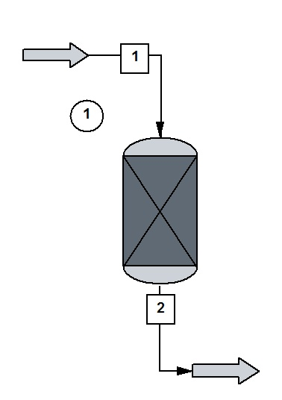
Kinetic Reactor Module Basics
Can be used to calculate the volume of a PFR or CSTR, given the fractional conversion of one component, or vise-versa.
Up to 300 simultaneous reactions can be input
Liquid, Vapor, or mixtures are allowed, but the reaction is only allowed to take place in one phase

Slide 12
Included Assumptions
CSTR Assumptions
PFR Assumptions
Perfect mixing
Uniform temperature, pressure, and composition throughout
Rate of reaction is constant
If thermal mode adiabatic, or a heat duty is specified, temperature is calculated
If temperature is specified, heat duty is calculated
No axial mixing or axial heat transfer occurs
Transit times for all fluid elements from inlet to outlet are of equal duration
Can be operated in the five thermal modes of isothermal, adiabatic, specified temperature profile, and specified utility conditions

Slide 13
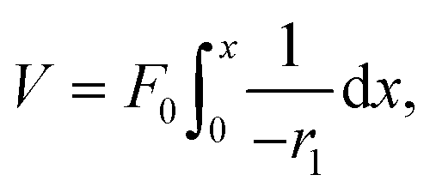
Kinetic Reactor Design Equations
For a CSTR, the design equation is
For a PFR, the design equation is
ChemCAD solves the CSTR equation directly, and solves the PFR equation using numerical integration if the volume is specified

Slide 14
Rate Expression
CHEMCAD’s kinetic reactor is programmed with a rate expression of the form:

Slide 15
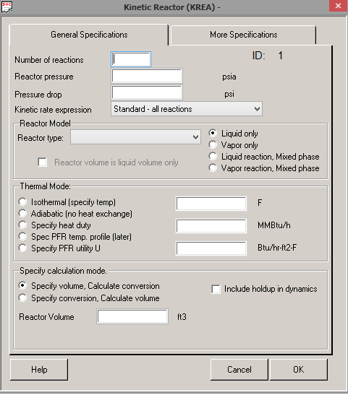
Kinetic Reactor Interface 1

Slide 16
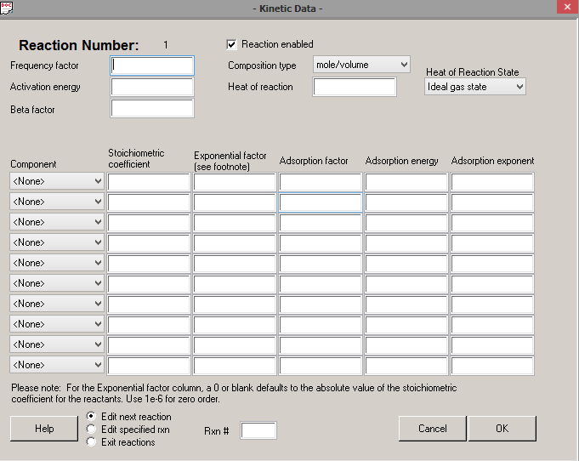
Kinetic Reactor Interface 2

Slide 17
Gibbs Reactor
After setting up the Gibbs reactor, input the following operating conditions and reactor specifications:
Temperature
Pressure
Inlet flow rates
Thermal mode
Reaction phase

Slide 18
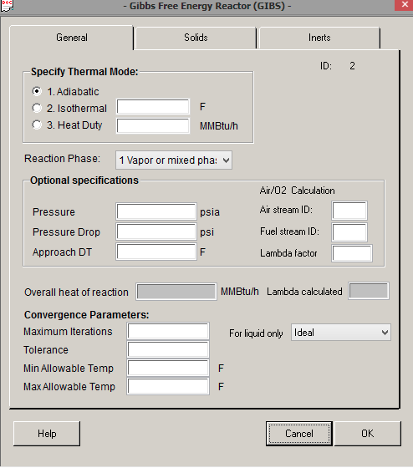
Gibbs Reactor Interface

Slide 19
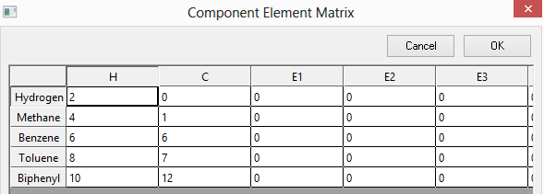
Gibbs Reactor Matrix

Slide 20
Gibbs Reactor Outputs
ChemCAD outputs:
Temperature
Pressure
Composition
Heat of Reaction (inerts that take up heat can be taken into account)

Slide 21
Advantages vs. Disadvantages
Advantages
Disadvantages
Allows all potential reaction to happen by employing an element matrix (ChemCAD generated) and then minimizes the Gibbs free energy of the products to obtain output compositions and conditions
Relies heavily on the specified thermal mode and thermodynamic model, but it is not clear how close the actual reaction comes to equilibrium

