Slide 1
Metamaterials

Slide 2
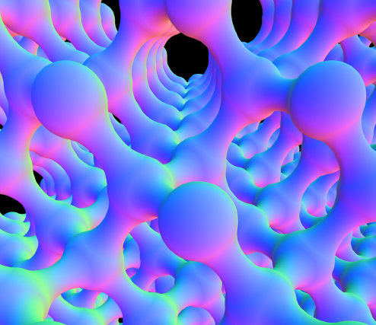
Metamaterials
Have a periodic material that has photonic or phononic properties.
*Taken From 3.042 handout & Physics Worlds 2005 “Sound Ideas”

Slide 3
Interference Lithography
Create photoresist film
Expose photoresist
Develop photoresist to create periodic structure

Slide 4
Project Outline
Thick 1D structures (50-100 microns)
Variety of 2D structures (2-20 microns)
Phase mask creation
Thick 3D structures (50-100 microns) via phase mask interference lithography
Sol gel process to create 3D structures from other materials
Testing of photonic and mechanical properties

Slide 5
Recent Progress
Gained access to lithography laboratory
Become certified in SEM and lithography
Getting a working cost collector I.D.

Slide 6
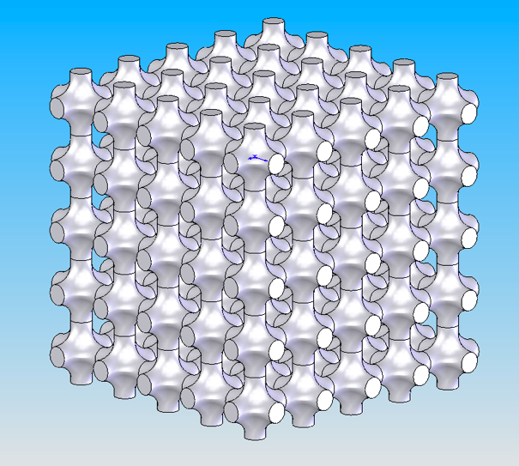
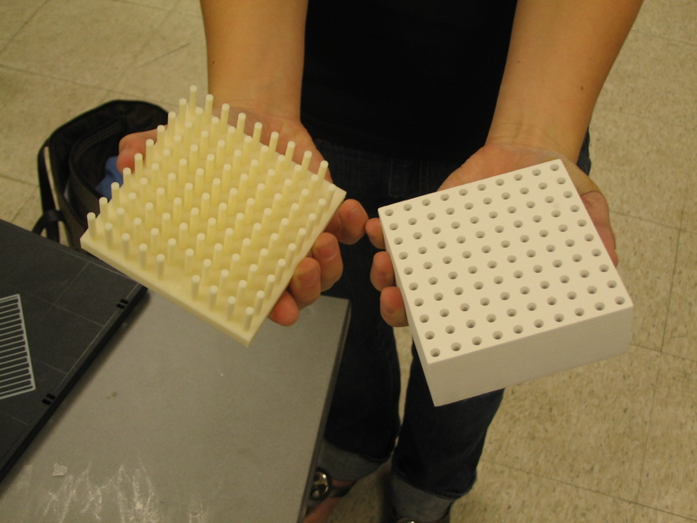
Recent Progress
Created a 3D CAD model of a proposed periodic metamaterial
Created a plastic 2D representation of a phase mask

