Slide 1
Hybrid Switched Reluctance Motor Applied in Electric Vehicles
Harbin Institute of Technology
Science Park of Harbin Institute of Technology
Email:zhan_gianfan@hit.edu.cn
指導老師:王明賢
班級:控晶四乙
學號:4A02C084
姓名:郭仲紋

Slide 2
INTRODUCTION
Motor is one of key parts in EV. It is the only propulsion system in battery EV, and the key part of the dynamical assembly in HEV, which is the kernel to realize all kinds of strategy. Induction motor, PM synchronous motor, brushless DC motor, switched reluctant motor and DC motor are all used in EV. Traction motors for EV are different from motors applied in industry. Load features are constant torque in low speed and constant power in high speed. Characteristics such as high maximum torque and maximum speed, high ratio of maximum speed to base speed usually larger than 4, and high efficiency over whole work area are demanded. Moreover, motor is usually installed on the chassis on which the environmental features are vibrative, dusty and moist.

Slide 3
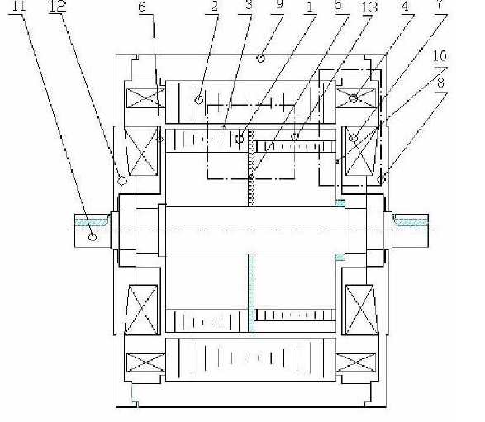
ARCHITECTURE AND PRINCIPLE
Hybrid switched reluctance motor is developed from Hybrid Stepper Motor. In the motor, there are axial excitation coils on both sides of end cover, which is different from HB stepper motor. These coils produce axial flux which is controlled to compensate and adjust PM flux.

Slide 4
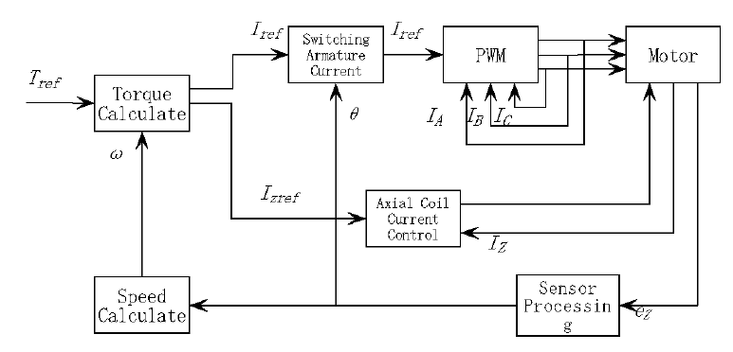
MOTOR DRIVES
Simple armature current commuting and axial coil flux adjusting control are developed to achieve large torque and high speed. The control block diagram is shown in fig.3.
Fig.3 Block diagram of motor drive control

Slide 5
CONCLUSION
電動馬達是在部分電動的車輛包括混合動力電動汽車，燃料電池電動車輛和電池電動車輛。寬扭矩-速度範圍和高可靠性是需要的的電動機施加在電動輛。新穎的混合開關磁阻電機顯影。它結合了強大的功能，如開關磁阻電機永磁高效和電機。通量加強和削弱控制權給予最大扭矩和高轉速電機驅動器。它們通過簡單地控制在一個額外的線圈的電流的大小和方向來實現馬達。轉子位置是通過從在固定線圈的信號中檢測到電動機和轉子速度來計算，根據該信號。要測試的特性馬達驅動器，一個試驗台顯影。它是容易測試四個象限轉矩-速度和動態特性馬達驅動器。整個測試系統是節能。

Slide 6
References
http://ieeexplore.ieee.org/xpl/articleDetails.jsp?tp=&arnumber=4544152&queryText%3DHybrid+Switched+Reluctance+Motor+Applied+in+Electric+Vehicles
http://ieeexplore.ieee.org/xpl/abstractReferences.jsp?tp=&arnumber=4544152&queryText%3DHybrid+Switched+Reluctance+Motor+Applied+in+Electric+Vehicles

