Slide 1
Robust control
Saba Rezvanian
Fall-Winter 88

Slide 2
Robust control
A control system is robust if it is insensitive to differences between the actual system and the model of the system which was used to design the controller.

Slide 3
Robust control
Uncertainty
Noise
Disturbances

Slide 4
Representing Uncertainty
Uncertainty in the plant model may have several origins:
There are always parameters in the linear model which are only known approximately or are simply in error.
2. The parameters in the linear model may vary due to nonlinearities or changes in the operating conditions.
3. Measurement devices have imperfections.

Slide 5
Representing Uncertainty
4. At high frequencies even the structure and the model order is unknown.
5. Even when a very detailed model is available we may choose to work with a simpler (low-order) nominal model and represent the neglected dynamics as “uncertainty”.
6. Finally, the controller implemented may differ from the one obtained by solving the synthesis problem. In this case one may include uncertainty to allow for controller order reduction and implementation inaccuracies.

Slide 6
Representing Uncertainty
Parametric uncertainty. Here the structure of the model (including the order) is known, but some of the parameters are uncertain.
2. Neglected and unmodelled dynamics uncertainty (Unstructed uncertainty). Here the model is in error because of missing dynamics, usually at high frequencies, either through deliberate neglect or because of a lack of understanding of the physical process. Any model of a real system will contain this source of uncertainty.

Slide 7
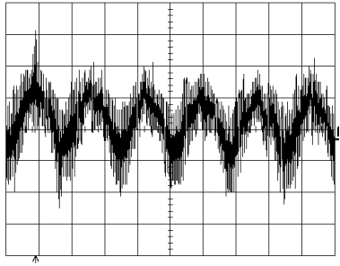
Noise
High Frequency
Low amplitude

Slide 8
Disturbance
Low Frequency
High amplitude

Slide 9
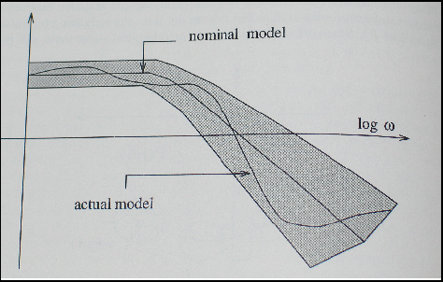
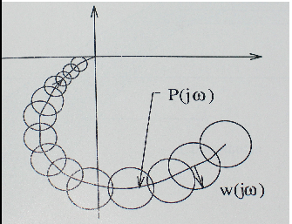

Slide 10
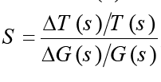
Sensitivity function

Slide 11
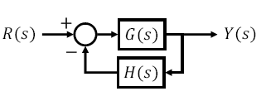
Sensitivity & feedback

Slide 12
High Gain
Saturation
Noise effect
Stability

Slide 13
Loop shaping

Slide 14
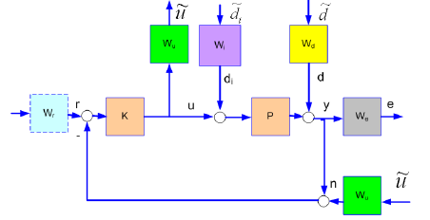
Loop Shaping

Slide 15
Signal & System Norm

Slide 16
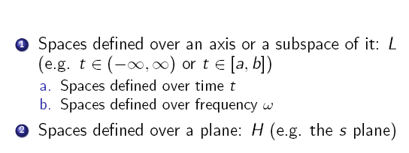
Functional Spaces

Slide 17
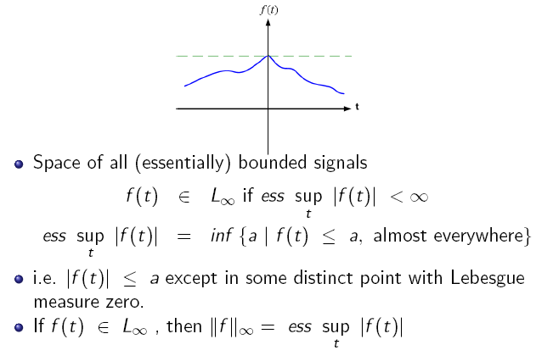

Slide 24
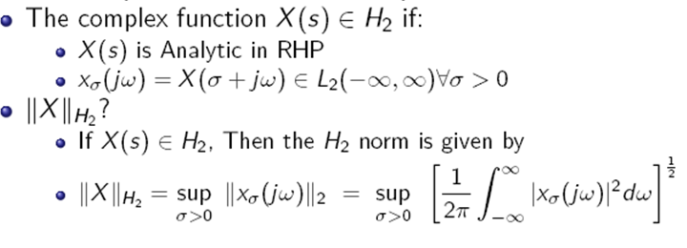

Slide 29
Unstructured Uncertainty Models

Slide 30
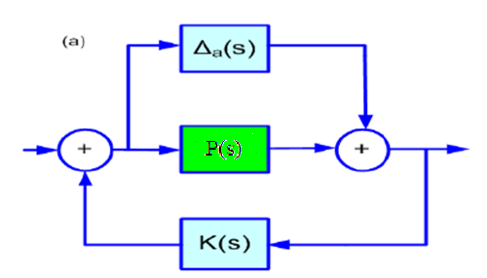
Additive Uncertainty
Additive plant errors
Neglected HF dynamics
Uncertain zeros

Slide 31
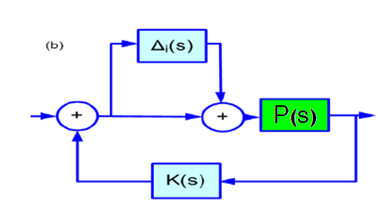
Input Multiplicative Uncertainty
Input (actuators) errors
Neglected HF dynamics
Uncertain zeros

Slide 32
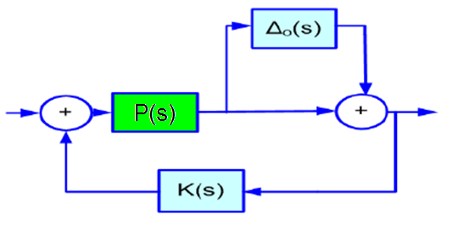
Output Multiplicative Uncertainty
Output (sensors) errors
Neglected HF dynamics
Uncertain zeros

Slide 33
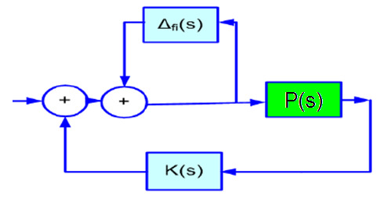
Input Feedback Uncertainty
LF parameter errors
Uncertain poles

Slide 34
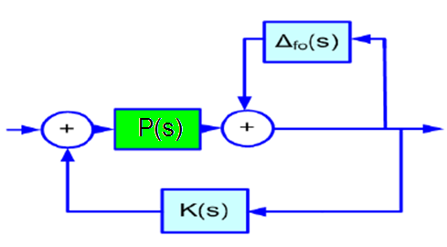
Output Feedback Uncertainty
LF parameter errors
Uncertain poles

Slide 35
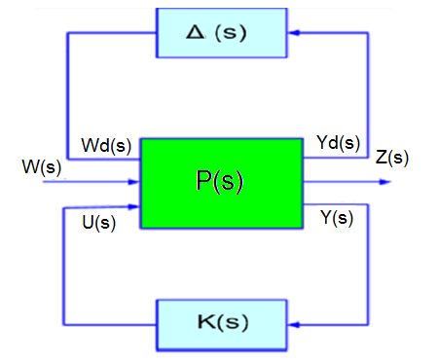

Slide 40
Linear-Quadratic-Gaussian (LQG)
The LQG controller is simply the combination of a Kalman Filter i.e. a Linear-Quadratic Estimator (LQE) with a Linear Quadratic Regulator (LQR).

Slide 41
For example
Nominal model:
Perturbed model:

Slide 42
For example

Slide 43
Notice
LQG optimality does not automatically ensure good robustness properties. The robust stability of the closed loop system must be checked separately after the LQG controller has been designed.

