Slide 1
Development of a novel growth strategy for propagation and bacteriocin production from selected strains of Lactobacilli
Dr. Myrto P. Zacharof ¹
Dr. Robert W. Lovitt ²
¹ Multidisciplinary Nanotechnology Centre, Swansea University, Swansea, SA2 8PP, UK
² College of Engineering, Multidisciplinary Nanotechnology Centre, Swansea University, Swansea, SA2 8PP, UK

Slide 2
Project Summary
Optimisation of physicochemical conditions of in vitro media for growth and bacteriocin production from Lactobacilli.
Development of a low molecular weight medium (LMWM) to support simultaneously bacterial growth, bacteriocin production and facilitation of bacteriocin extraction.
Development of a dose-response model for quantifying the bacteriocin by Lactobacilli amount produced based on the effect of Nisin (LAB commercially available bacteriocin) on the target strain.

Slide 3
Project Summary
Development of an extraction-concentration strategy of the bacteriocins majorly based on membrane filtration.
Comparative study of the bacteriocins produced on the developed media in relation to its effect on the target strain.

Slide 4
Introduction
Lactobacilli: Rod shaped bacteria widely used in the food industry nowadays.
They are mostly used in dairy industry due to their ability to ferment sugars especially glucose and galactose so to produce lactic acid .
Research though suggests that they produce antimicrobial activity metabolites active against other bacteria of the same genre that could be used as natural antimicrobials on their own or synergistically with other factors.

Slide 5
Introduction
Their production mechanism has been widely studied as well as their antimicrobial activity spectrum.
Their antimicrobial nature is rather bacteriostatic than bactericidal as they mostly affect the cellular membrane of the target strains inactivating their reproduction mechanism.
Nisin is the only commercially available bacteriocin. This emerges the need to further exploit these metabolites.
The use of nisin as a natural additive to food, has been approved worldwide.

Slide 6
Introduction
Their production has several implications :
They were growth related metabolites so they are influenced from factors that negatively affect growth (end product inhibition due to lactate excess, glucose exhaustion due to fastidious growth, microbial contamination).
They are extracellular metabolites of peptide nature so they are sensitive to conditions that may denaturise their peptide nature.
Their extraction becomes difficult as they may form micelles or clumps with the nitrogen sources already in the production medium.

Slide 7
Aims and Objectives
In this project, the previously referred problems were taken into consideration and a suitable strategy was developed.
Three known bacteriocin producing strains were selected.
A common optimised growth medium was be developed including optimum physicochemical conditions.
Based on the optimised medium a low molecular weight medium (LMWM) was be developed to facilitate their extraction.

Slide 8
Aims and Objectives
As extraction method ultra0filtration was selected.
A quantification method was developed based on the antimicrobial effect nisin had on the target strain.
The quantification method included a carefully selected target strain and a growth medium that ensured optimum growth of the target strain was developed.

Slide 9
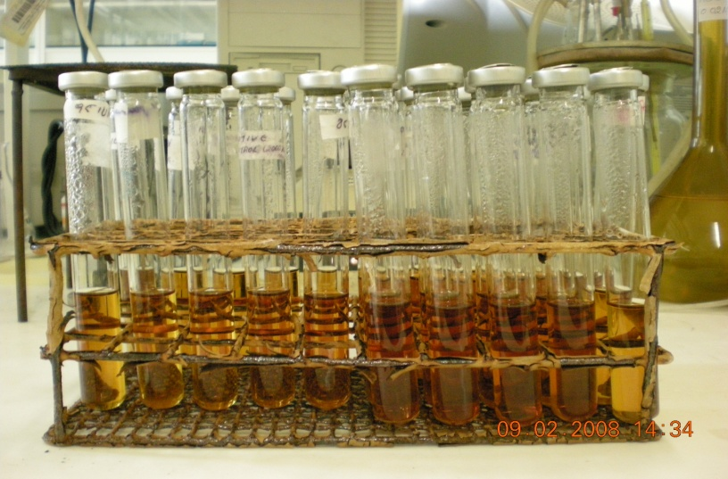
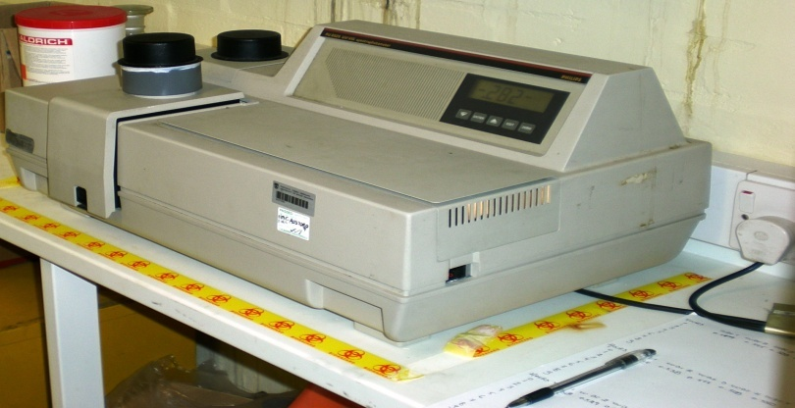
Materials and Methods
Chemicals supplied by Sigma Aldrich UK, Fischer UK, Fluka UK.
Lactobacillus casei NCIMB 11970 Lactobacillus plantarum NCIMB 8014, Lactobacillus lactis NCIMB 8586 and the target strain Lactobacillus delbruckii subsp.lactis 8117 were provided in a lyophilised form by National Collection of Food and Marine bacteria (NCIMB) , Ferguson Building, Craibstone Estate, Aberdeen , Scotland, AB21 QYA.
Pyrex glass tubes sealed with butyl rubber stoppers and alumina seals were used to measure the growth rate. The microbial growth was measured on UV/Vis Spectrometer Philips 8250 and the numerical results are calculated on MS Excel software 2003.
Fig 1. Test tubes containing growth medium
Fig 2.UV/Vis Philips 8250 Spectrophotometer

Slide 10
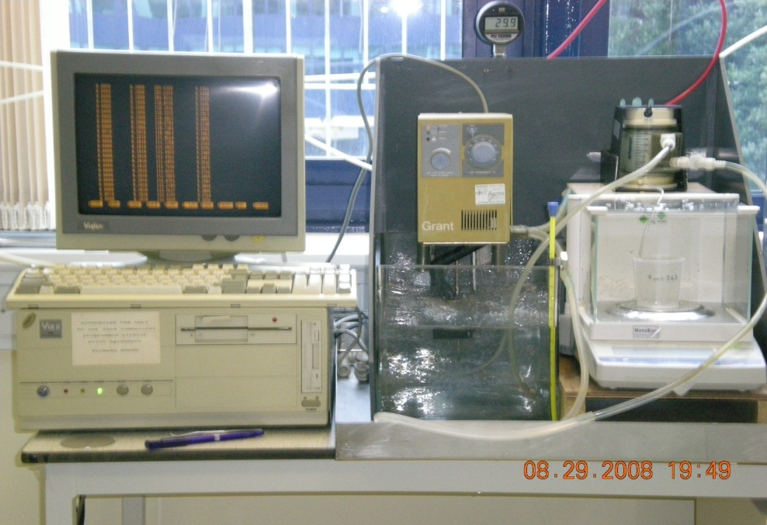
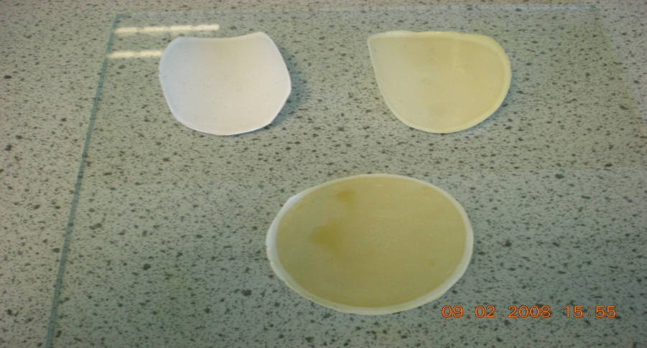
Materials and Methods
To develop a LMWM and to extract the bacteriocins from the broth membrane filters were used of 30 kDa (Cellulose acetate) , 4kDa and 1kDa (Polysulfone) MWCO. The filters were purchased by Millipore, Microdyn-Nadir and Osmonics and fitted in Amicon cell 8200 unit reactor .
The amount of bacteriocins produced was measured by analysing the The protein content using the Lowry method.
The glucose demand was analysed by using a GOD enzymatic method in a UV/Vis 300 Unicam spectrophotometer operated via Vision 32 software.
Bacteriocins were sized using Dynamic Light Scattering technology.
Fig 3. Amicon Cell Unit Reactor 8200 System
Fig 4. Ultrafiltration membrane filters (30kDa, 4kDa, 1kDa counter clockwise)

Slide 11
Results
Growth Media Development and Optimisation
Table 1: MRS Modified Medium (Basal Medium for growth)
Table 2: Optimised Medium for Growth

Slide 12
Results
Growth Media Development and Optimisation
Table 3: Comparative table of performance Optimised Medium and MRS modified medium

Slide 13
Results Development of Low Molecular Weight Media (LMWM)
LMWM were developed through serial filtration of the optimised medium by a 30 kDa, 4 kDa and1 kDa MWCO membrane filters.
The media of 4kDa and 1kDa nitrogen sources were initially proven insufficient for growth due to the lack of metal ions that were rejected during filtration.
Metal ions of magnesium and manganese were introduced in the media and they could support equally to the optimised medium Lactobacilli growth.

Slide 14
Results Comparative study Between LMWM & Optimised Unfiltered Media
5
6
8
9
7
10

Slide 15
Results Development of a Quantification Assay of the Produced Bacteriocins
The assay was developed based on the growth rates of the target strain L.delbruckii occurring under different concentrations of nisin induced in the medium.
The assay had a limit value of 200 IU/ml of nisin or of nisin-like activity antimicrobial compound . Beyond this value no growth occurs
The Lactobacilli were tested for bacteriocin production both through measurement of protein content and through testing the supernatant for antimicrobial activity.
Fig 11. Standard curve of quantification of nisin assay

Slide 16
Results Bacteriocin production by the selected Lactobacilli on different media
Lactobacilli | Nutrient Media
 | Unfiltered Medium |  |  | LMW medium (4kDa) |  |  | LMW medium (1 kDa)
 | Growth rate(h-1) | Doubling Time(h) | Amount of Bacteriocin Produced (IU/ml) | Growth rate(h-1) | Doubling Time (h) | Amount of Bacteriocin Produced (IU/ml) | Growth rate(h-1) | Doubling Time (h) | Amount of Bacteriocin Produced (IU/ml)
L.casei | 0.16 | 4.31 | 95 | 0.16 | 4.31 | 95 | 0.16 | 4.31 | 95
L.plantarum | 0.16 | 4.31 | 95 | 0.16 | 4.31 | 95 | 0.13 | 5.30 | 110
L.lactis | 0.14 | 4.92 | 105 | 0.14 | 4.92 | 105 | 0.12 | 5.75 | 115
Table 4. Comparative table on bacteriocin production deriving from Lactobacilli grown on LMWM and Unfiltered media

Slide 17
Conclusions and Future Recommendations
Conclusions
A novel growth strategy for their in vitro production was developed.
A novel quantification method of their amount was developed
Lactobacilli do indeed produce antimicrobial activity on LMW media
Future work
A cost effective, easy to implement and handle separation, concentration and purification method has been developed.
A mathematical model could be developed forecasting the production of bacteriocins.
The bacteriocins could be tested in a wider area of target strains.
Several other nutrient sources could be tested.

Slide 18
Aknowledgments
Dr. Paul Williams
Dr. Ilseon Jung
Dr. Marion Jones
Dr.Karnika Ratanapongleka

