Slide 1
Discovery and development of antibiotics

Slide 2
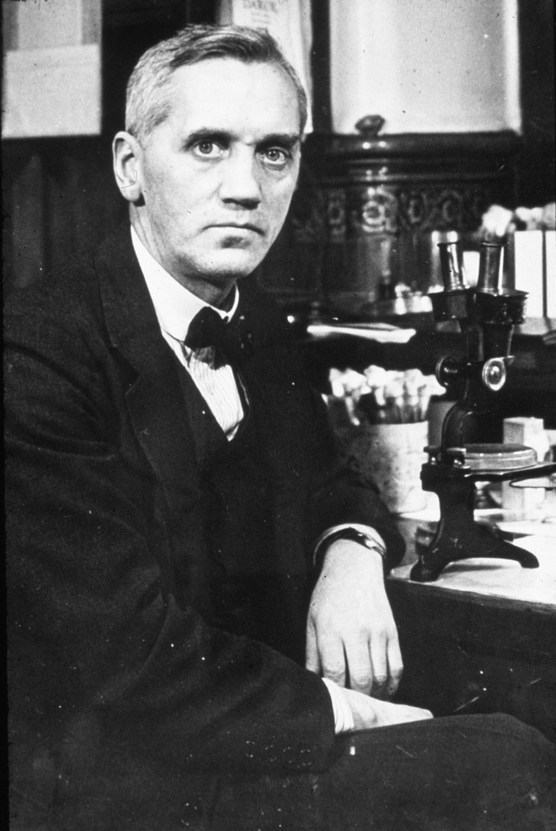
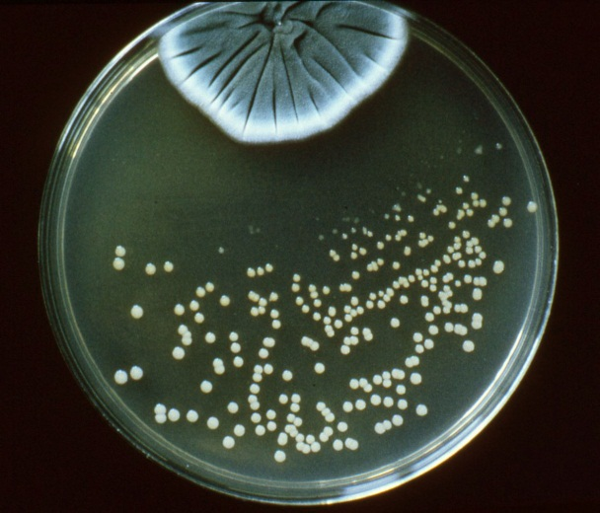
Penicillin - the first antibiotic
Penicillin was the first antibiotic to be discovered.
It was discovered in 1928 by Alexander Fleming, a Scottish scientist working in St Mary's Hospital London.
Fleming discovered that mould from a Penicillium fungus had antibacterial properties. The antibiotic was named penicillin after the fungus.

Slide 3
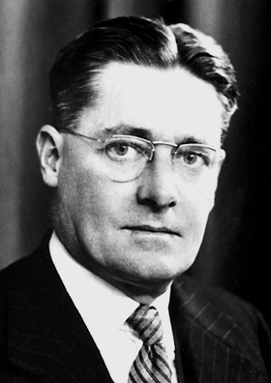
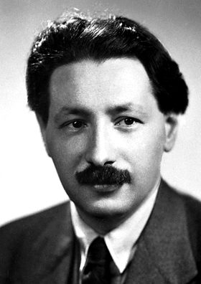
Penicillin - the first antibiotic
Fleming could not extract enough penicillin from the mould to use for the treatment of patients
In 1938, Howard Florey (an Australian microbiologist), Ernst Chain (a German chemist) and others at Oxford University pioneered the production of penicillin for human treatment. But they had to depend on pharmaceutical companies in the United States to produce penicillin on a large scale.
Penicillin was first released for widespread use in the early 1940’s and it saved many lives during World War II.
Howard Florey
Ernst Chain

Slide 4
Production of antibiotics
Penicillins and cephalosporins are antibiotics derived from fungi
Antibiotics can also be derived from other bacteria. These include aminoglycosides and carbapenems
Newer antibiotics are synthetically made, usually by modifying the chemical structure of naturally occurring antibiotics
Chemically synthesised antibiotics include quinolones and sulfonamides

Slide 5
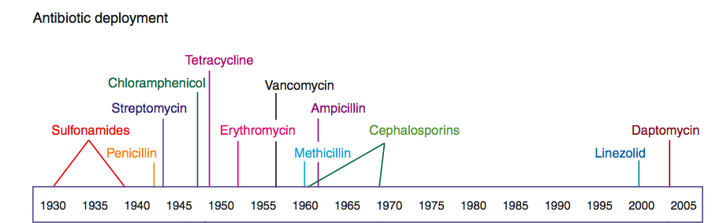
Timeline of antibiotic discovery and development
The period from 1950 to 1960 is often called the golden age of antibiotic discovery. Since then, antibiotic discovery, development and release for widespread use has been in decline.

Slide 6
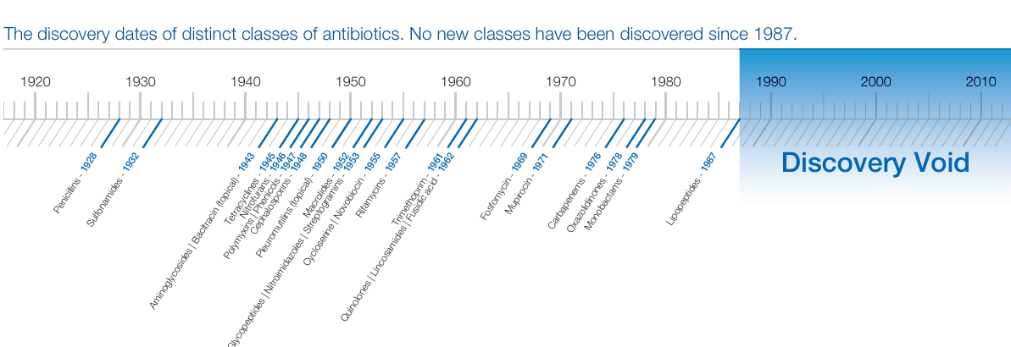
Discovery of new antibiotics
No new classes of antibiotics have been developed since 1987.
Since this time, a few new antibiotics have been introduced, but these are modifications and adaptations to existing antibiotics.
Notes:
Why might no Pharma company be developing antibiotics?

Slide 7
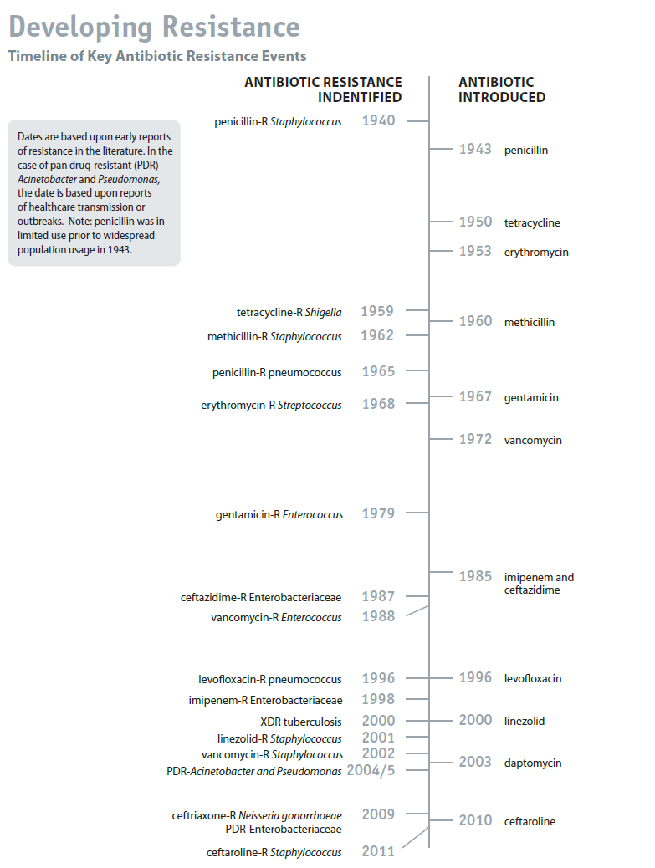
Antibiotic resistance was first identified in the 1940’s.
Resistance can develop within a short space of time.
The first Meticillin-Resistant Staphylococcus Aureus bacterium was identified only 2 years after meticillin was introduced.
In the case of penicillin, resistance was identified even before the antibiotic was released for widespread use, although this was not a problem until antibiotics began to be used intensively.

Slide 8
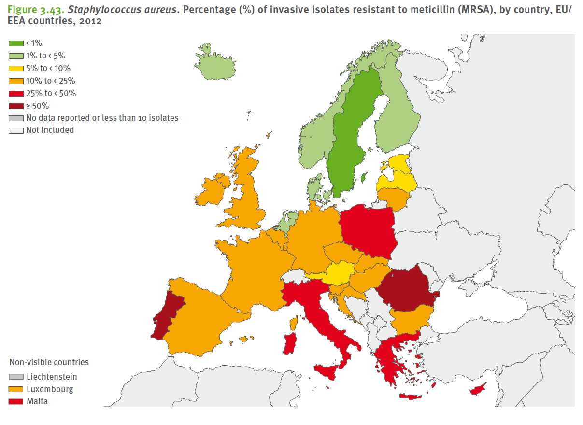
Resistance rates in Europe
Antimicrobial resistance rates vary across Europe.
This figure shows the percentage of invasive Staphylococcus aureus isolates resistance to meticillin (MRSA), by country in 2012

