Slide 1
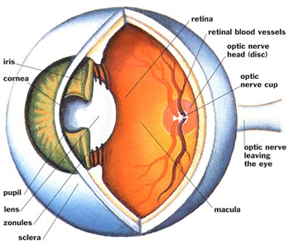
Ophthalmology as a Career Choice?
Thomas J. Whittaker, J.D., M.D.
University of Kansas Department of Ophthalmology

Slide 2
Ophthalmology as a career choice?
Advantages:
  Surgical specialty
    Immediate gratification
  Happy patients
  Increasing patient population (aging baby-boomers)
  Multiple sub-specialties:
    Retina (medical and surgical), plastics/orbit, glaucoma, pediatrics, cornea/refractive, pathology, neuro, uveitis
  Internship plus 3 year residency (and fellowship, if desired)
  Good compensation, although decreasing.

Slide 3
Ophthalmology as a career choice
Disadvantages
  Very Competitive to match
    Average USMLE Step I score for matched applicants 2012= 238
    Historically—85-90% US Med School Seniors match in Ophth
    117 programs with 475 residents in the nation
  Very Competitive to practice
    Optometry scope of practice expanding politically

Slide 4
Ophthalmology as a career choice
Resources
  American Academy of Ophthalmology
    www.aao.org
  SF Match
    www.sfmatch.org/residency/ophthalmology/index.htm
  ACGME
    www.acgme.org
  KU Eye
    We interview KU applicants!
    We give advice to KU students!
    We do rotations/shadow!

Slide 5
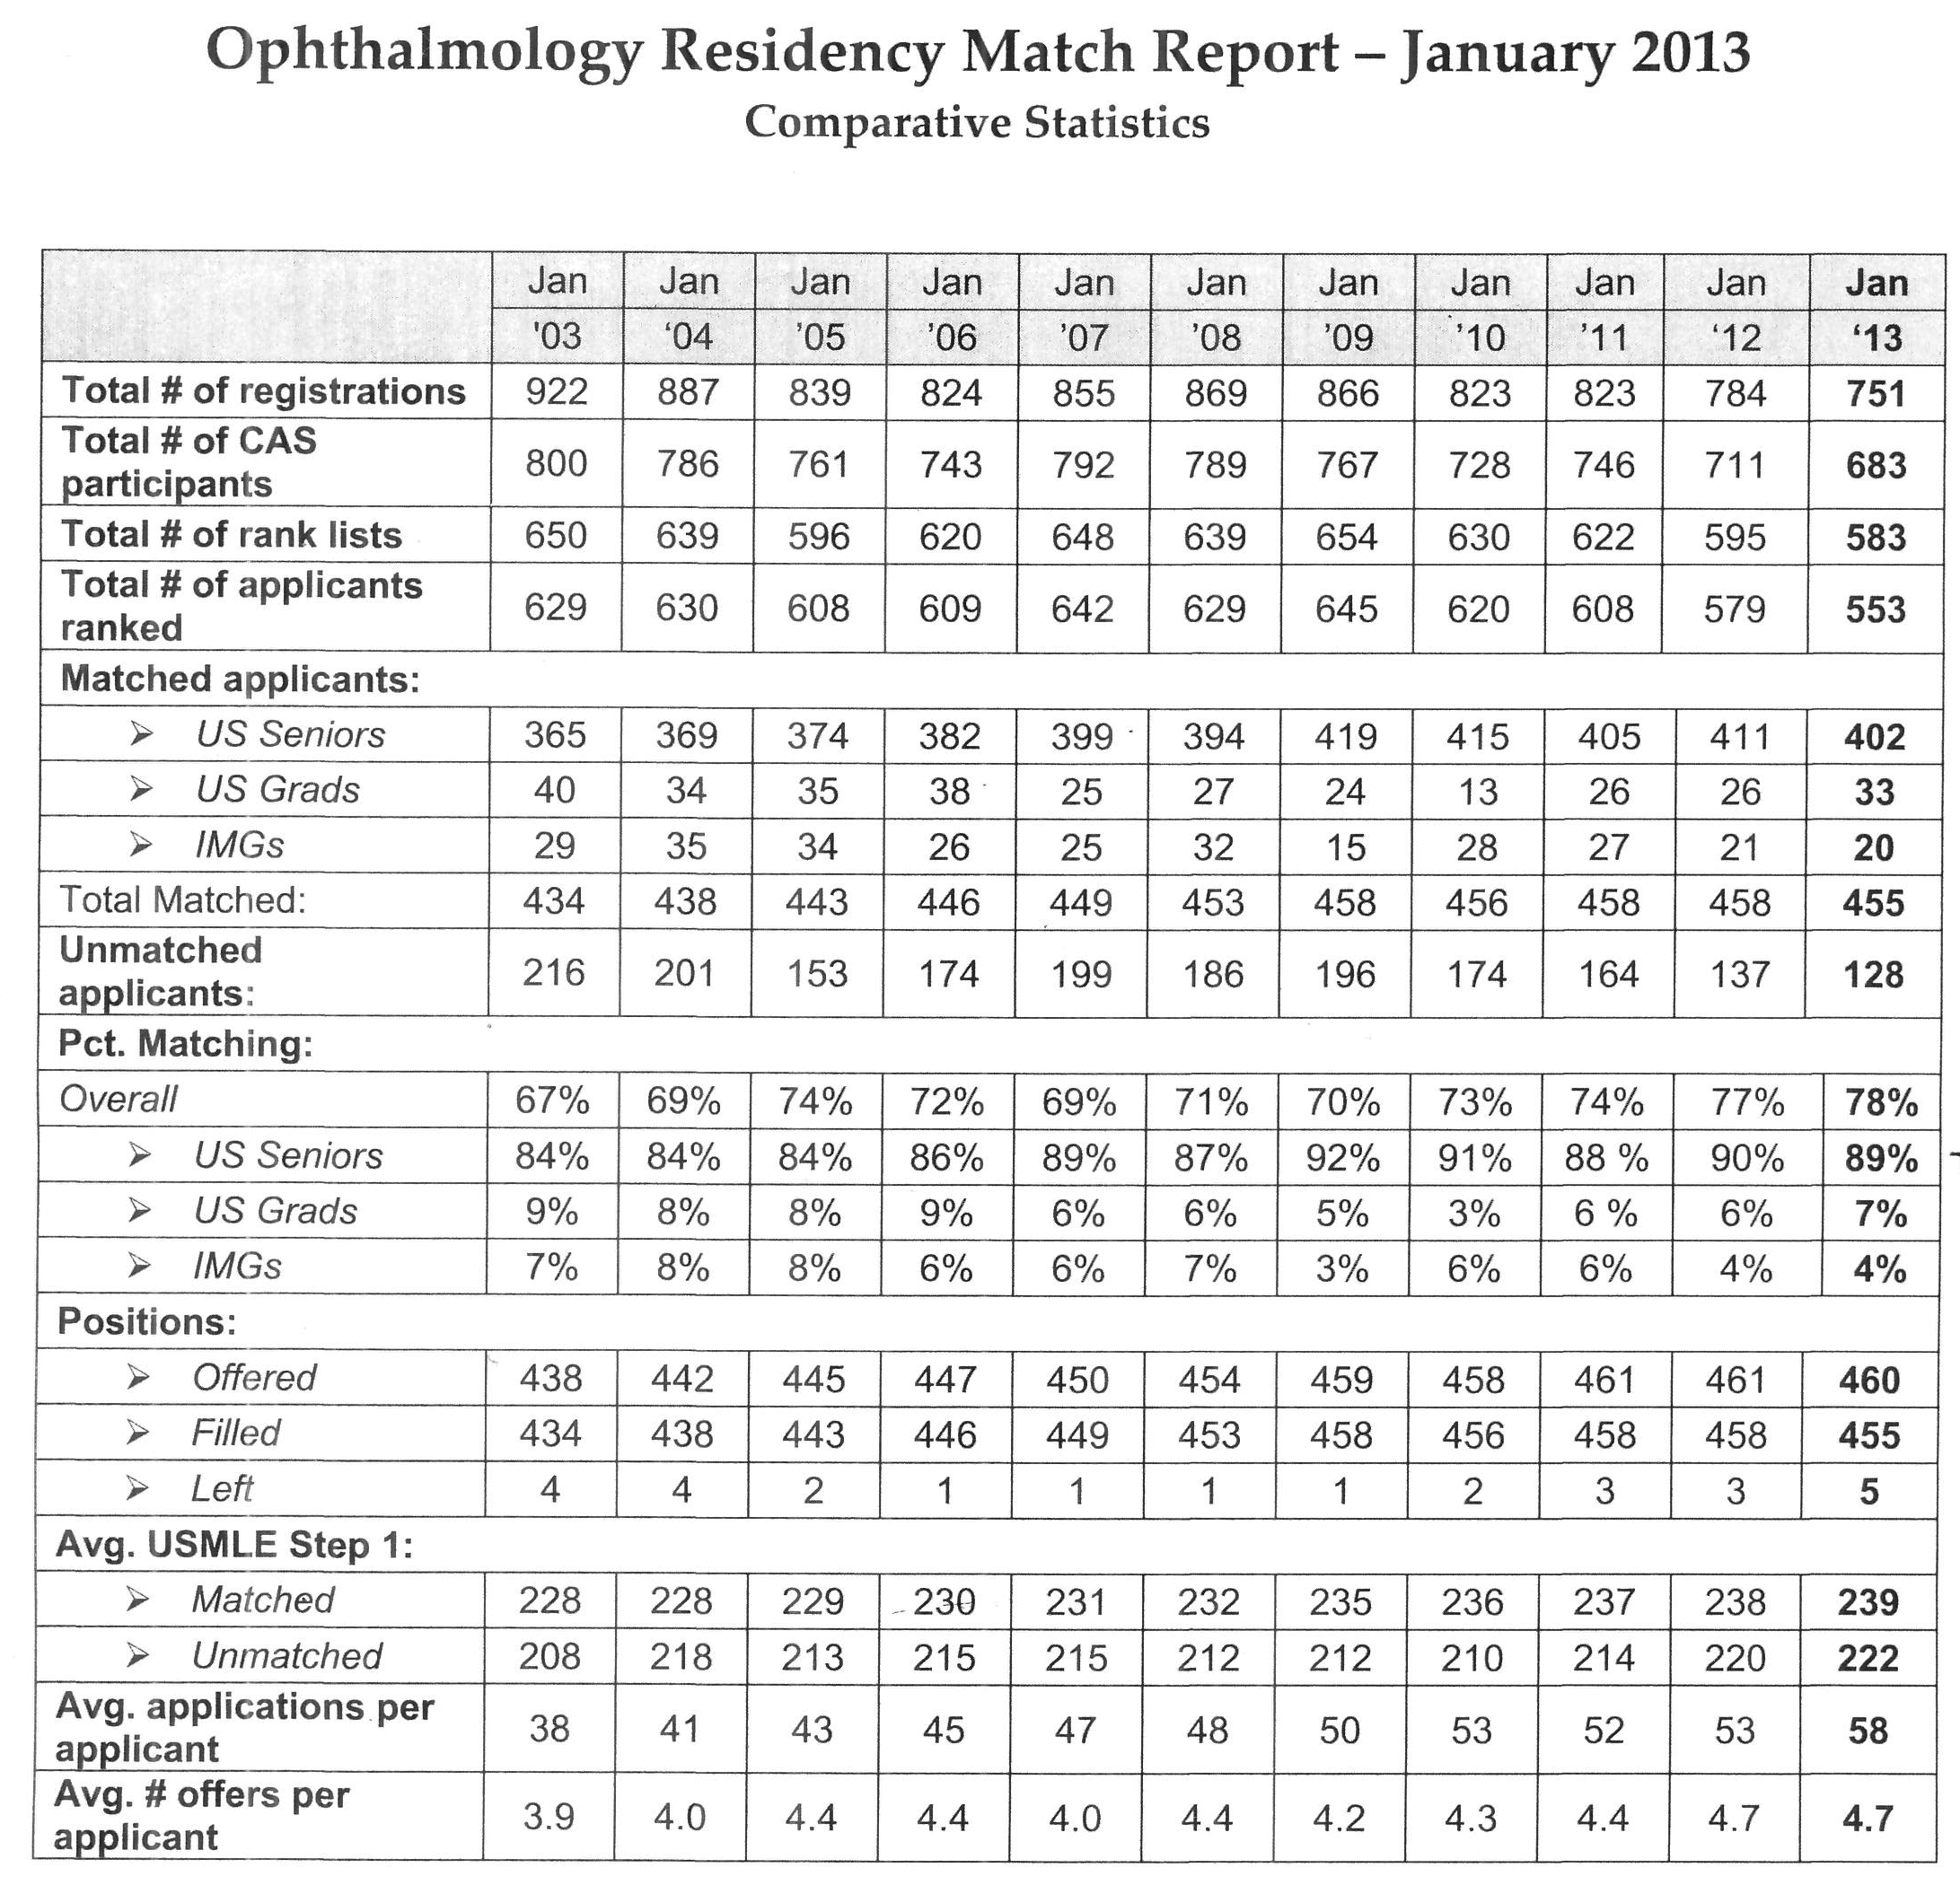

Slide 6
Ophthalmology at KU
KU Ophthalmology:
  John Sutphin, MD -- Chair
  Thomas Whittaker, JD MD -- Program Director
Small residency program: 3 positions/year; ACGME accredited;
  KU Eye: multi-specialty practice at 7400 State Line, Prairie Village KS
  Children’s Mercy Hospital: pediatric ophthalmology
  KC VAMC: primary care ophthalmology with sub-specialty coverage by KU Eye
Busy surgical caseload—see slide from ACGME

Slide 8
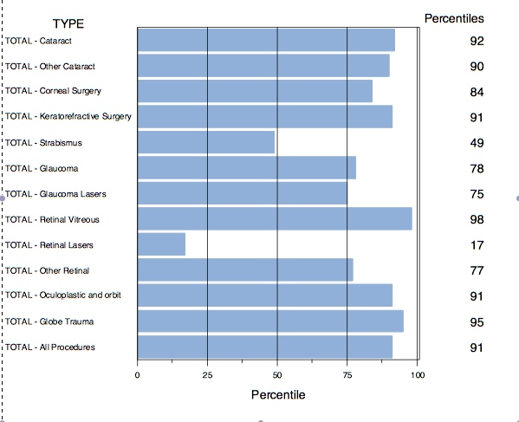

Slide 9
Questions?
Call/email: Dr. Sutphin, Dr. Whittaker
Talk with our residents
Get involved—
  Ophthalmology Interest Group
  JayDoc eye nights
  Research opportunities
  Rotations
  Shadow faculty both at KU and in the community

