Slide 2
CONTENTS
Helicobacter pylori
Urea Breath Test
Heliprobe® System
Clinical advantages
How it works
System components
Vs. other methods/tests
References
Summary

Slide 3
Helicobacter pylori

Slide 4
Over 50% of the world’s population infected
Global health problem
Driven by sanitary situation
High prevalence in emerging markets
Source: Helicobacter Foundation

Slide 5
Sites and type of infection
Pyloric antrum: duodenal ulcer
Corpus: gastric ulcer and cancer

Slide 6
Life-threatening gastrointestinal diseases
Around 25% of those with H. pylori will experience significant health problems
* Correa, P: A human model of gastric carcinogensis. Cancer Res 1988; 48: 3554 – 60
* IARC Working Group on the Evaluation Carcinogenic Risks to Humans: Schistosomes, liver flukes and Helicobacter pylori. 1994; 61: 1-241.

Slide 7
Effective treatment available
Chronic gastritis and gastric or peptic ulcers due to H. pylori now treatable
Treatment focuses on killing the bacteria that cause the disorder
Regimens include acid reducers, antibiotics and stomach protectors
Cure rates approach 90% in some cases
Treatment requires an effective test for H. pylori

Slide 8
The latest Guidelines for managing the Helicobachter pylori infection.
The test and treat strategy is indicated for patients <50 years without alarm symptoms such as weight loss, dysphagia, diagnosis of gastrointestinal bleeding and iron-deficiency anaemia.
Ref: Gut 2012;61:646-664.

Slide 9
Rapid and reliable test for H. pylori Kibion Heliprobe® System
Highly reliable on-site test
Easy, painless administration
Accurate results less than 20 minutes
Based on Urea Breath Test (UBT)

Slide 10
Urea Breath Test (UBT)
The gold standard test for H. pylori

Slide 11
The most convenient and cost-effective method
Holmes et al. BMC Health Services Research 2010 10:344 doi: 10.1186/1472-6963-10-344, Kibion Internal Evaluation

Slide 12
UBT test principle
Patient swallows a labeled C13/14 urea tablet. Dissolves to release ¹⁴C-urea.
If present, H. pylori metabolizes ¹⁴C-urea to labeled carbon dioxide (¹⁴CO₂) and ammonia via the enzyme urease.
¹⁴CO₂ is transported in the blood to the lungs.
Patient exhales. ¹⁴CO₂ is captured for analysis.
H₂N(^{13/14}CO)NH₂ + H₂0 →
urease → 2NH₃ + ^{13/14}CO₂
(If H. pylori is absent, the ¹⁴C-urea is simply absorbed and subsequently voided)

Slide 13
Heliprobe® System
Over 2,200 units installed world-wide

Slide 14
Many clinical advantages
Convenience
Near-patient testing
Easy to use (simple breath card and device)
No need to send sample for analysis
Speed
Only 10 minutes from swallowing tablet to sample for analysis
Test result available in 5 minutes
System Reliability & Precision
Reliable results with high precision
Robust with low maintenance needs

Slide 15
Many clinical advantages
Convenience
Near-patient testing
Easy to use (simple breath card and device)
No need to send sample for analysis
Speed
Only 10 minutes from swallowing tablet to sample for analysis
Test result available in 5 minutes
System Reliability & Precision
Reliable results with high precision
Robust with low maintenance needs

Slide 16
Many clinical advantages
Convenience
Near-patient testing
Easy to use (simple breath card and device)
No need to send sample for analysis
Speed
Only 10 minutes from swallowing tablet to sample for analysis
Test result available in 5 minutes
System Reliability & Precision
Reliable results with high precision
Robust with low maintenance needs

Slide 17
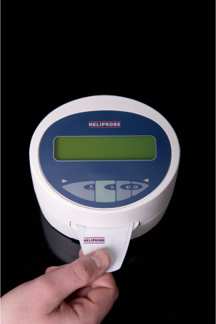
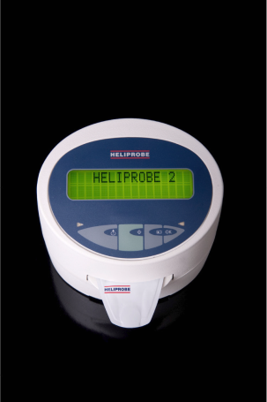
How Heliprobe® System works Simply swallow, breathe and analyze
Swallow HeliCap™
Wait 10 minutes. Breathe into BreathCard®
Insert BreathCard® into Heliprobe® Analyzer
Read the result after just 5 minutes

Slide 18
Heliprobe® System Film

Slide 19
Heliprobe® System – three simple components HeliCapTM
Blue Gelatin capsule, hard
One capsule contains 1 μCi ¹⁴C-urea
Very low effective radioactive dose
Ten capsules per pack
Max storage temperature 25°C
Two-year shelf-life

Slide 20
Heliprobe® System – three simple components BreathCard®
Capture device for exhaled ¹⁴CO₂
Single use
Indicator changes from orange to yellow
Five cards per pack
Ten packs per box

Slide 21
Heliprobe® System – three simple components Heliprobe® Analyzer
Small desktop GM-counter
Detects ¹⁴C radioactivity on BreathCard®
Measures background radioactivity
Low maintenance
Shelf-life over ten years
Can connect to printer

Slide 22
Heliprobe® System vs. other methods

Slide 23
Heliprobe® System vs. other tests
Conclusion: Heliprobe® System is the simplest and most effective test for identifying the presence of Helicobacter pylori.

Slide 24
Heliprobe® System well documented Selected publications
Hegedus, et al.: Validated accuracy of a novel urea breath test for rapid Helicobacter pylori detection and in-office analysis. Eur. J. Gastroenterology 2002; 14: 1-8
Öztürk, et al.: A new practical, low-dose 14C-urea breath test for the diagnosis of Helicobacter pylori infection: clinical validation and comparison with the standard method. Eur. J. Nuclear Med. and Mol. Imag. 2003; 30:1457-1462
Özdemir et al.: Could the simplified 14C urea breath test be a new standard in noninvasive diagnosis of Helicobacter pylori infection? Ann Nucl Med (2008) 22:611-616
Fennerty: Helicobacter pylori: Why it still matters in 2005. Cleveland Clinic Journal of Medicine, Vol 72, Suppl 2, May 2005
Peter Malfertheiner et al.: Management of Helicobacter pylori infection – the Maastricht IV/ Florence Consensus Report Gut 2012;61:646-664

Slide 25
Heliprobe® System SUMMARY
Reliable → Measures active infection. Sensitivity 95%, specificity 100%
Fast → Short test time
Ease of use → No preparation needed
Patient friendly → Painless
Cost effective → Good average cost / correct diagnosis

