Slide 1
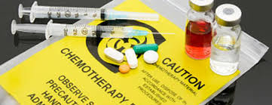
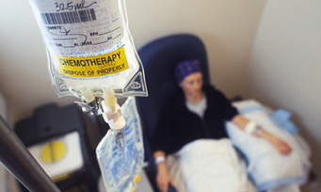
Administration of Chemotherapy
Prepared by:
Dr. Irene Roco
Asst. Professor

Slide 2
Outline
Definition
Goals
Mechanism of Action
Stages of Administration
Routes of Administration
Chemotherapy Treatment and Practice
Extravasation
References

Slide 3
Definition of Chemotherapy
Antineoplastic agents (Cytotoxic ) are used in an attempt to destroy tumor cells by interfering with cellular functions and reproduction.
primarily to treat systemic disease rather than lesions that are localized and amenable to surgery or radiation.
Chemotherapy may also include the use of antibiotics or other medications to treat any illness or infection.
Chemotherapy can help other therapies (Combination therapy) , such as radiotherapy or surgery have more effective results.

Slide 4
Goals of Chemotherapy
Cure (Total remission) - to cure the patient completely. In some cases chemotherapy alone can get rid of the cancer completely.
Control ( Delay/Prevent recurrence; Slow down cancer progression) – to prevent the return of a cancer, is most often used after a tumor is removed surgically. ; used mainly when the cancer is in its advanced stages and a cure is unlikely.
Palliation - To relieve symptoms; also more frequently used for patients with advanced cancer.

Slide 5
Mechanism of action of chemotherapeutic drugs
Chemotherapy (chemo) drugs interfere with (mitosis) a cancer cell's ability to divide and reproduce (Cytotoxic drugs.)
It targets cancer cell's food source, enzymes and hormones they require in order to grow.
Stops the growth of new blood vessels that supply a tumor
Triggers suicide of cancer cells (apoptosis.)

Slide 6
Chemotherapy may be given at different stages
Neo-adjuvant therapy – shrinks the large tumor before surgery. This may involve some pre-operative chemotherapy and/or radiotherapy.
Adjuvant therapy - chemotherapy given after surgery.
Chemoradiation therapy - the chemotherapy is given in combination with radiotherapy.

Slide 7
Adjuvant chemotherapy
therapy after surgery has removed all visible cancer; may last 4-6 months, up to a year.
If the disease disappears completely, chemotherapy may continue for 1-2 cycles beyond this observation to maximize the chance of having attacked all microscopic disease.
If the disease shrinks but does not disappear, chemotherapy will continue as long as it is tolerated and the disease does not grow.
If the disease grows, the chemotherapy will be stopped. Depending on the health and wishes of the patient, either different drugs will be given to try to kill the cancer, or chemotherapy will be stopped and the goal changed to focus on patient comfort.

Slide 8
Administration of Chemotherapeutic Agents
Chemotherapeutic agents may be administered in the hospital, clinic, or home setting by topical, oral, intravenous, intramuscular, subcutaneous, arterial, intracavitary, and intrathecal routes.
The administration route usually depends on the type of agent, the required dose, and the type, location, and extent of tumor being treated.
Patient education is essential to maximize safety if chemotherapy is administered in the patient’s home

Slide 9
Preparing for administration:
Disinfection:
At the beginning of each day disinfect the safety workbench with a disinfectant.
The vial should be disinfected before puncturing.
Administration:
Do not do two jobs at the same time
Only people that are involved in the preparation of the administration of cytotoxic medication

Slide 10
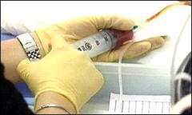
Routes of administration
IV - Directly into the blood stream as an injection or through a drip (intravenously), often using an infusion pump
Oral / sublingual -
Oral chemotherapy have a protective coating that is dissolved by the digestive juices present in the stomach.
Sublingual Chemotherapy agents - Certain medications such as anti-nausea drugs are especially effective when taken this way since they will not be lost in case the patient vomits.

Slide 11
Routes of administration
Intramuscular – contraindicated to patients with low platelets because bleeding inside the muscle can lead to complications.
subcutaneous - If the patient’s blood counts are below normal, subcutaneous injections are less likely to result in bleeding in comparison to intra-muscular injections
intra arterial
Intrathecally –
chemotherapy is given directly into the cerebrospinal fluid to reach cancer cells in the central nervous system.
done via a lumbar puncture or through a special reservoir that is placed into the skull with access to the ventricles, (spaces inside the brain filled with cerebrospinal fluid.)

Slide 12
Routes of administration
7. Intracavitary (bladder, chest cavity, or abdominal cavity) The drug is retained in the cavity for several hours and then drained.
8. Intrapleurally- A chest tube is inserted into the pleural space,
chemotherapy is inserted into the chest tube.
9. intralesional or intratumoral - directly into the tumor
10. Topical - chemotherapy in a cream

Slide 13
Chemotherapy Treatment
Chemotherapy is given in cycles. This allows the cancer cells to be attacked at their most vulnerable times, and allows the body's normal cells time to recover from the damage.
Duration of the cycle: given on a single day, several consecutive days, or continuously as an outpatient or as an inpatient. Treatment could last minutes, hours, or days, depending on the specific protocol.
Frequency of the cycle: repeated weekly, bi-weekly, or monthly.
The number of cycles: In most cases, the number of cycles - or the length of chemotherapy from start to finish

Slide 14
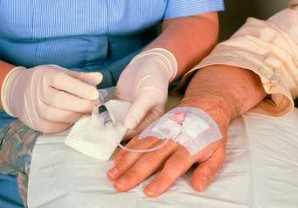
Chemotherapy Practice
CRUCIAL MOMENTS:
Preparation of cytotoxic medication
Cleaning
Administration of cytotoxic medication
Patient care and handling of excretion
GENERAL PREPARATION
Hand washing and disinfection
Changing procedures
Wash hands again if necessary
Use gloves
Risk period of cytotoxic medication : After administration 1 to 7 days

Slide 15
Before the use of gloves:
Wash your hands
Inspect the gloves for use on discoloration, holes and cracks.
After each activity, damage or visible contamination, change your gloves.
After the activity , immediately take off the gloves to avoid contamination of the environment.
Wash hands

Slide 16
Contamination of People
In case of contamination of people, quick action is necessary:
Clothing or gloves: are taken off (laundry bag / special hospital waste container/ household cleaning)
Skin: Rinse with water, wash with soap, if necessary shower. If the skin is damaged treat the wound as extravasation
Eyes: Rinse for 15 minutes with eyewash

Slide 17
Contamination of the area
Most risks occur when the contamination is improperly cleaned. Keep committed to the following:
Take time to clean the contaminated area. Stay calm and controlled
Ensure that the contaminated area stays so small as possible and keep the number of people to a minimum (usually 2 people)
If the contamination is not more than a splash, it can be cleaned with gloves and a tissue
If the contamination is larger, clean the area according to protocol. Use the necessary materials and personal protective equipment from the emergency kit
Provide management of the protocol and the content of the emergency kit

Slide 18
SPECIAL PROBLEM: Extravasation
severe tissue damage if cytotoxic drug infiltrates into local tissues.
an IV needle or catheter delivers the drug into tissues rather than into the bloodstream
Irritants – drugs that cause local cellular damage.
Vesicants - causes severe tissue damage requiring skin grafting.
To avoid infiltration with vesicant drugs, the larger veins of the arm are used for IV administration.
Drugs that are classified as vesicants include cisplatin, dactinomycin, daunorubicin, doxorubicin, idarubicin , mechlorethamine, mitomycin-C, mitoxantrone, paclitaxel, vinblastine, vincristine, vindesine, vinorelbine, and 5-fluorouracil. In some instances, locally applied antidotes may help minimize the effects of infiltration.

Slide 19
TOXICITY ASSOCIATED WITH CHEMOTHERAPY
Gastrointestinal System - Nausea and vomiting are the most common side effects of chemotherapy and may persist for up to 24 hours after its administration.
Hematopoietic System.- myelosuppression (depression of bone marrow function), resulting in decreased production of blood cells increasing the risk for infection and bleeding.
Renal System - can damage the kidneys because of their direct effects during excretion and the accumulation of end products after cell lysis.
Cardiopulmonary System. Antitumor antibiotics (daunorubicin and doxorubicin) are known to cause irreversible cumulative cardiac toxicities, especially when total dosage reaches 550 mg/m2.

Slide 20
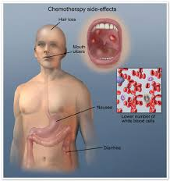
TOXICITY ASSOCIATED WITH CHEMOTHERAPY
Reproductive System. Testicular and ovarian function can be affected, resulting in possible sterility.
Neurologic System. (with repeated doses) Peripheral neuropathies, hearing loss, loss of deep tendon reﬂexes, and paralytic ileus may occur. - usually reversible and disappear after completion of chemotherapy.
Miscellaneous. Fatigue - can be debilitating and last for months after treatment

Slide 21
Right or wrong?
When a drop of contaminated urine gets on your glove, you don’t have to change the gloves because it is a limited quantity.
After an activity with cytotoxic medication (or with contaminated excretion), you immediately take the gloves of to avoid contamination of the environment.
A & B are right
A & B are wrong
Only A is right
Only B is right

Slide 22
After chemotherapy, not only the urine and feces of patients are contaminated with cytotoxic medication. Also the sweat can be contaminated. This has consequences for the washing of patients, and picking up contaminated bedding.

Slide 23
Suggested Video to watch
https://www.youtube.com/watch?v=fTXle_DDglg
References
https://www.ebmt.org/Contents/Resources/Library/Slidebank/EBMT2012SlideBank/Documents/Nurses%20Group/N1235.pdf
http://www.cancerresearchuk.org
http://www.medicalnewstoday.com/articles/158401.php
http://www.rnceus.com/chem/admin.html
http://chemocare.com/chemotherapy

