Slide 1
Surfactants
Kausar Ahmad
http://staff.iium.edu.my/akausar
akausar@iium.edu.my

Slide 2
Contents
Role of surfactants
Types of surfactants
Non-ionic surfactants
HLB concept
Effect of structure
Stability of polyoxyethylene chain
Natural surfactants

Slide 3
POP QUIZ!
Name ONE surfactant

Slide 4
ROLE OF SURFACTANTS IN DRUG DELIVERY
Enhance effective drug solubility
Increase therapeutic efficiency
Control of drug release
Facilitate control of drug uptake
Minimise drug degradation
Contribute to reduced drug toxicity

Slide 5
WHAT ARE SURFACTANTS?
Emulsifier, Dispersant, Wetting agent, Stabiliser
Common application:
Surfactants in industry:
cleaning dirty clothes and kitchenware, writing on paper with a pen, greasing of cooking surfaces
emulsion polymerisation, paper coating food, pharmaceuticals, cosmetics

Slide 6
PROPERTIES OF SURFACTANTS
Adsorb at miscellaneous interfaces
Changes interfacial tension
wettability, foaming property, dispersibility
Sufficient effect can be seen at 0.05% - 0.5% w/w or up to the c.m.c. in water
depending on the surfactant system
Notes:
Compare with lyophobic and lyophilic
Refer transparency of o/w emulsion with various
surfactant concentrations
types of surfactants i.e. different hydrophobic groups
Surfactant solution models: below & above c.m.c.
Foaming and Anti-foaming Agents
Foam generation by introduction of air
anionic > nonionic due to bulky hydrophilic groups and temperature dependent
Foam boosters e.g. water soluble polymers: gelatine increase viscosity
Anti-foaming: foam breakers & foam inhibitors
Foam breakers are water-insoluble fatty alcohols, fatty acid esters and silicone oil emulsion
Foam inhibitors are fatty acid amide, metallic soap

Slide 7
Example: EFFECT OF SURFACTANT CONCENTRATION ON O/W EMULSION
Particle size decreases
Stability increases
Less creaming
Less coalescence

Slide 8
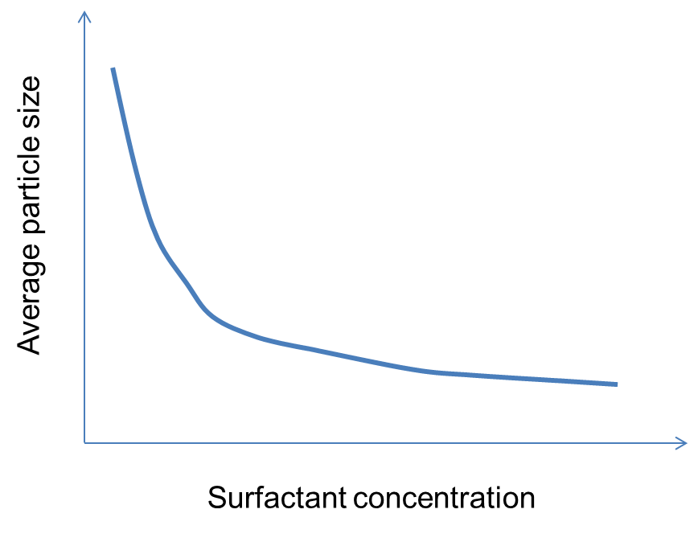
Example: EFFECT OF SURFACTANT CONCENTRATION ON DISPERSION
Particle size decreases
Stability increases
Less sedimentation
Less caking
Less coagulation/aggregation

Slide 9
TYPES OF SURFACTANTS
Molecule consists of a hydrophobic group and a hydrophilic group; MW >200
hydrophilic groups: anionic cationic amphoteric nonionic
Notes:
In aqueous system, surfactants align at the interface due to thermodynamics reason. Thus surface active.

Slide 10
TYPICAL HYDROPHILIC GROUPS
Anionic carboxylates: -COO⁻ sulfonates: -SO₃⁻ sulfates: -OSO₃⁻ phosphates: -OPO₃²⁻
Cationic quarternary ammonium salts N⁺(CH₃)₃Cl⁻
Amphoteric
betaine: -N⁺(CH₃)₂CH₂COO⁻
Nonionic polyoxyethylene group
Notes:
Determine type of surfactant for the following:
Shampoo
Hair conditioner
Laundry detergent
Laundry softener
2 in 1 laundry liquid
Lipstick
Hand and body lotion
Foam bath

Slide 11
POP QUIZ
What is the problem with ionic surfactants?
Notes:
A hot shower accompanied by shampooing with SDS as an ingredient may affect permeability of the blood-brain barrier…..
Ref: A. Saija et al, Change in the permeability of the blood-brain barrier following SDS administration in rat. Exp. Brain Res. 115(3): 54-551(1997)

Slide 12
Typical hydrophobic groups
Hydrocarbon
Fluorocarbon
Organosilicone
Most popular group contains 8 to 22 carbon atoms 1) oils & fats: triglycerides, fatty acid, fatty alcohol 2) petroleum & petrochemicals: n-paraffin, alkylbenzene, synthetic alcohol
fluorated fatty acid and alcohol
polysiloxanes

Slide 13
Structure of hydrophobic groups
Linear
Branched
Aromatic
Cyclic

Slide 14
Cationic surfactant
e.g. Bactericides
benzalkonium chloride
Medicine | Dosage | Bactericide | Base
Skin disease | 0.20 mg | benzalkonium | 1 g
Eye lotion | 0.05 mg | benzalkonium | 1 g
Nasal congestion | 1 mg | benzalkonium | 1 ml
Wounds | 10 mg | benzetonium | 10 g
Oral hygiene | 40 mg | benzetonium | 1 ml
+
R2
R1
N
R3
X⁻
R4
Notes:
Strongest bactericidal effect exhibited by quarternary ammonium salt
Bactericidal effect is enhanced if a long alkyl chain is compounded to the nitrogen atom
R₁ – R₄ is a long chained alkyl group, X represents anionic counter ion e.g. Cl and Br
Medical
Surgery
Gynaecology
Dermatology
Urinology
Sterilisation of medical instruments
Public health
Restaurants
Home
Public places
Industrial hygiene
Food processing
Poultry farming sterilisation of eggs
Stockbreeding disinfection of cattle, sheds sterilisation of drinking water
Veterinary disinfection at operations on cattle

Slide 15
HYDROPHILE-LIPOPHILE BALANCE The HLB is an important criterion for the selection of an emulsifier in determining oil-in-water (O/W) or water-in-oil (W/O) emulsion
Oil Phase | Required HLB Number
 | W/O | O/W
Kerosene | 6-9 | 12.5
Palm oil | ? | 7-9
Camphor oil | ? | 14-16
Lanolin | 8 | 15

Slide 16
Required HLB in Products
Application | HLB | Surfactant (%)
Emulsion paint | 14 - 16 | 1 - 2
Ointment for penicillin | 8 | 10
Suppository | 10 | 90
Ointment containing sulfur | 5 | 0.25
Household detergent | 13 | 15
Shampoo | 14 - 15 | 2 - 10
Notes:
HLB method:
A function of weight percent of hydrophilic groups for nonionic surfactants
Ratio of molecular weight of hydrophilic and hydrophobic groups
Content of polyoxyethylene groups

Slide 17
Phase Inversion Temperature (PIT)
Temperature
at which
O/W emulsion changes to
W/O emulsion
Possible because of changes in the solubility of nonionic surfactant as a function of temperature
Hydration power of hydrophilic group decreases as temperature increases
Destroying ether linkage
Entropy consideration
Free movement of water molecules

Slide 18
NATURAL SURFACTANTS
Eggs
Proteins
e.g. milk casein
Lanolin
w/o emulsifier
Plant extracts: leaves, seeds, stems
E.g. Entana spiralis (locally known as beluru/sintok)

Slide 19
REFERENCES
Martin Malmsten, Surfactants and Polymers in Drug Delivery, Marcel Dekker (2002) Chapter 1
F Nielloud & G Marti-Mestres, Pharmaceutical Emulsions and Suspensions, Marcel Dekker, New York (2000) Chapter 1
ME Aulton, Pharmaceutics: The Science of Dosage Form Design, Churchill Livingstone (1988) Chapter 4
DM Collett & ME Aulton, Pharmaceutical Practice, Churchill Livingstine (1990) Chapter 13
Protein-based surfactants, Marcel Dekker, New York (2001)

