Slide 1
Proteins
By Jennifer Turley and Joan Thompson
© 2016 Cengage

Slide 2
Overview
Amino Acids in Proteins
Amino Acid & Protein Categories
Complementation
Functions of Proteins
Dietary Recommendation

Slide 3
Amino Acid Structure
Amino acids are the “building blocks” of proteins
Amino acids and thus proteins contain nitrogen, carbon, oxygen & hydrogen. A few contain sulfur.
Proteins are organic compounds
Each of the 20 amino acids has a different variable side chain
Amino acids combine together to make a protein

Slide 4
Amino Acids
There are 20 known amino acids that make biological proteins.
Amino Acids are categorized as essential or nonessential.

Slide 5
Categories of Amino Acids
9 Essential: The body cannot make.
Histidine
Isoleucine
Leucine
Lysine
Methionine
Phenylalanine
Threonine
Tryptophan
Valine
11 Nonessential: The body can make from nitrogen & carbohydrate intermediates.
Alanine
Arginine
Asparagine
Aspartic acid
Cysteine
Glycine
Glutamic acid
Glutamine
Proline
Serine
Tyrosine
See your textbook appendix for chemical structures

Slide 6
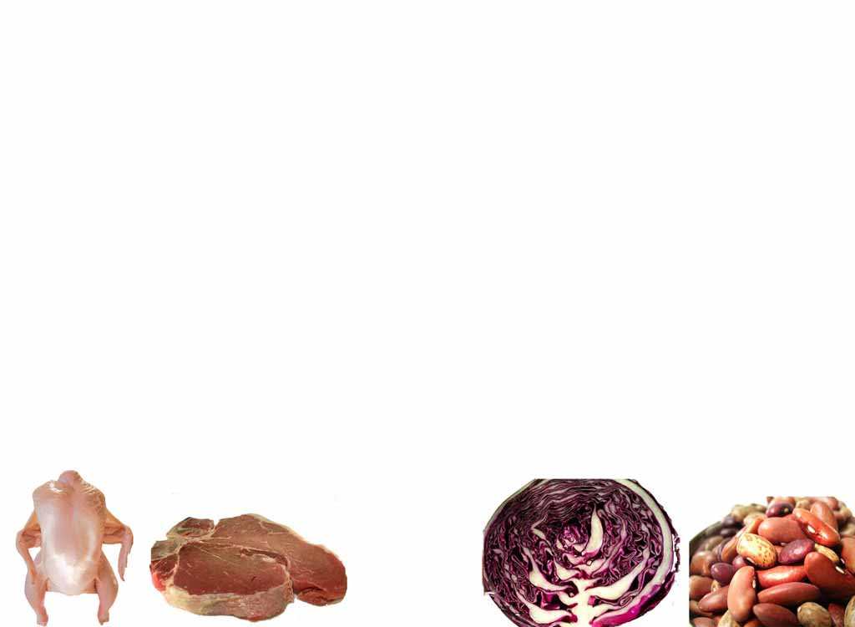
Protein Categories
Complete
High Biological Value
High Quality
Incomplete
Low Biological Value
Low Quality

Slide 7
Protein Classification
The protein quality classification is based on the proportions and the amounts of the essential amino acids present in the protein.

Slide 8
Protein Quality
High Quality Proteins: Contain all the essential amino acids, and are high biological value proteins or complete proteins.
Complete Proteins come from animal sources such as: milk, yogurt, meats, eggs, and cheese.
Low Quality Proteins: Lack one or more essential amino acids, and are low biological value proteins or incomplete proteins.
Incomplete Proteins are plant sources of proteins such as: vegetables, legumes (dried beans), nuts, seeds, tofu, and grains.

Slide 9
Protein Complementation, Part 1
Complementary Proteins:
Low quality protein sources can be combined in such a way that the essential amino acids that are limiting in one protein are supplied by another protein.
The combined proteins can provide all of the essential amino acids of a high quality protein source.

Slide 10
Protein Complementation, Part 2

Slide 11
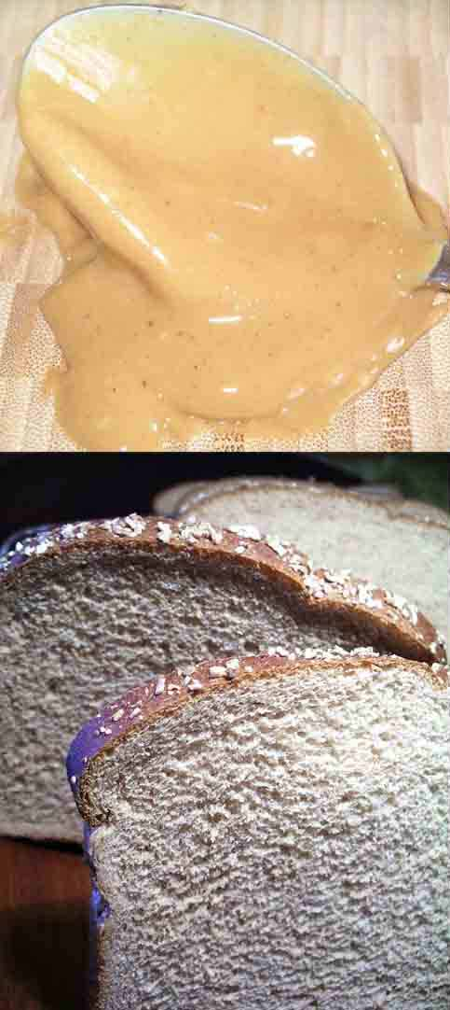
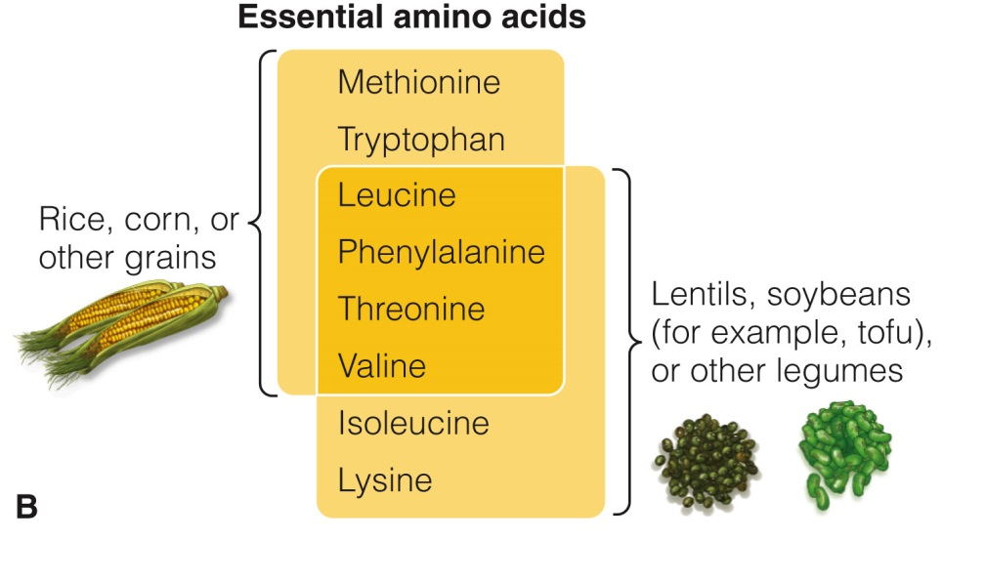
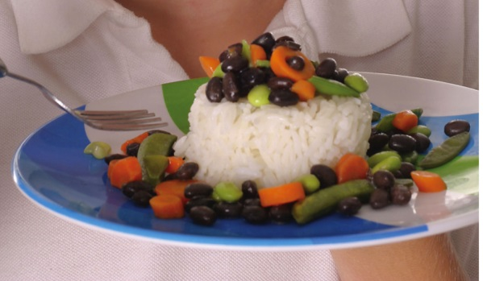
Protein Complementation, Part 3

Slide 12
Protein Complementation, Part 4
Food Combinations
Combine any 2 food groups for complementation
Grains | Legumes | Nuts and Seeds | Vegetables
Wheat | Lentils | Walnuts | Broccoli
Barley | Peanuts | Pecans | Carrots
Rye | Soybeans | Cashews | Leafy greens
Oats | Pinto beans | Other tree nuts | Green beans
Rice | Kidney beans | Sesame seeds | Squash
Quinoa | Lima beans | Sunflower seeds | Tomato
Other Grains | Other died beans | Other seeds | Other vegetables
Notes:
Table Description: Examples of foods within the specified groups of grains, legumes, nuts and seeds, and vegetables.

Slide 13
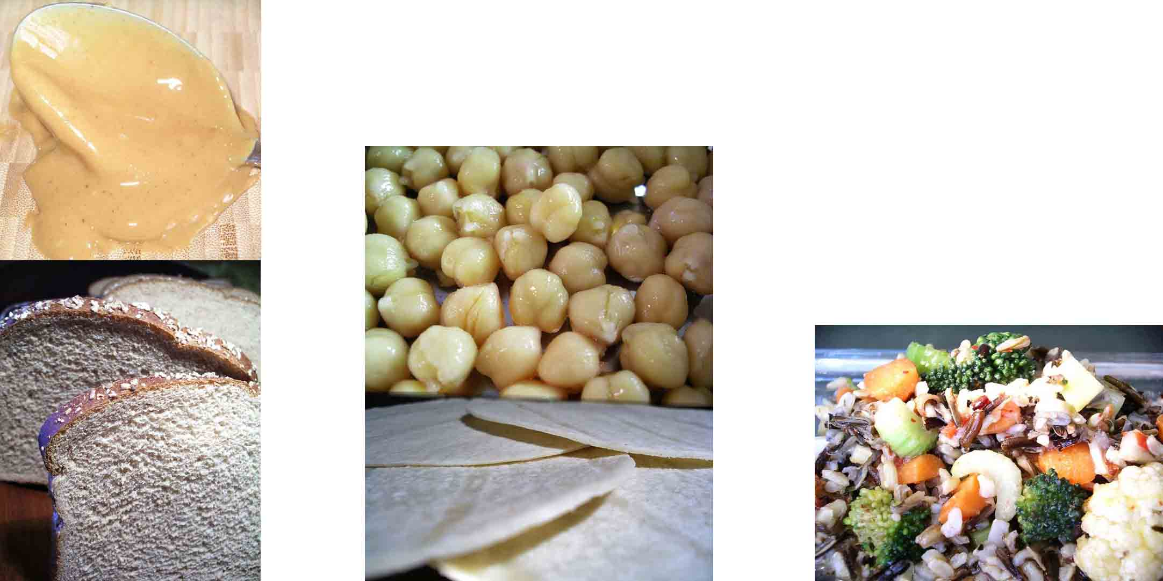
Protein Complementation, Part 5
Bread and Peanut Butter
Tortillas and Beans
Rice and Vegetables

Slide 14
Functions of Proteins
1st used for tissue repair & maintenance
Then used for energy, 4 Cals/gram

Slide 15
Protein: Dietary Recommendations
Is based on body weight.
The adult DRI for protein is 0.8 grams of high quality dietary protein per kilogram body weight per day.
10-35% of Calories should come from protein (this is the AMDR).

Slide 16
Some Summary Points, Part 1
Proteins are made of 20 amino acids categorized as essential & nonessential.
Proteins are categorized as complete & incomplete.
Complete proteins are animal proteins.
Incomplete proteins are plant proteins.

Slide 17
Some Summary Points, Part 2
Combining plant proteins so that all the essential amino acids are present is complementation.
The primary function of protein is tissue repair & maintenance.
When used for energy, proteins provide 4 Cal/gm.
Adults need 0.8 g/Kg body weight protein/day. Adults may consume 10-35% of Calorie from proteins.
References for this presentation are the same as those for this topic found in module 1 of the textbook

