Slide 1
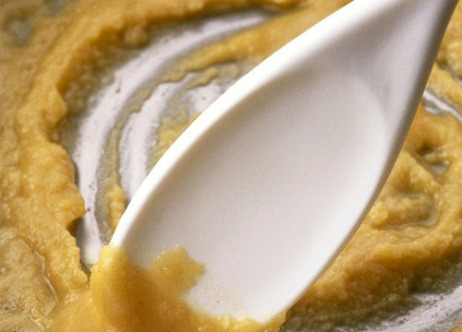
Gelatinization of Starch
Learning Targets:
Thicken foods
using gelatinization
of starch.
Define gelatinization and tell how it occurs.

Slide 2
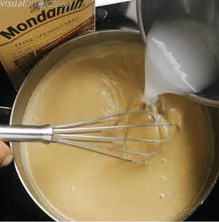
I. What is gelatinization and how does it work?

Slide 3
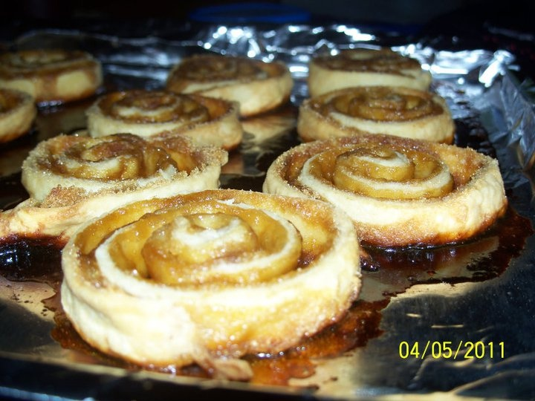
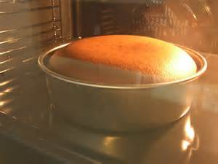
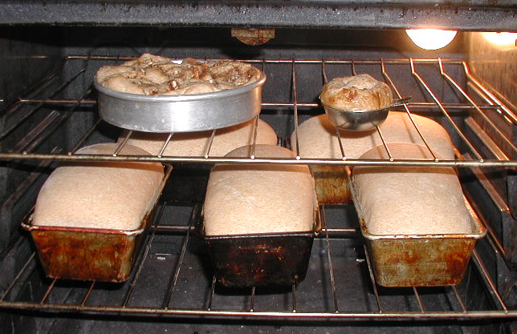
What makes bakery foods set as they cook…

Slide 4
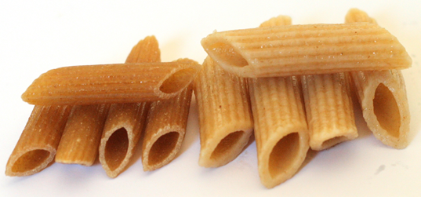
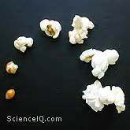
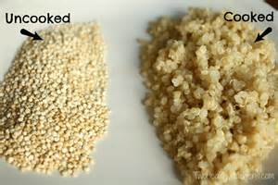
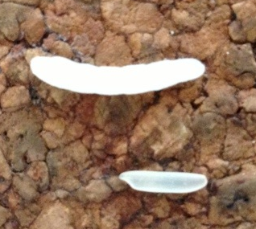
…makes pasta, rice, and other grains swell as they cook…

Slide 5
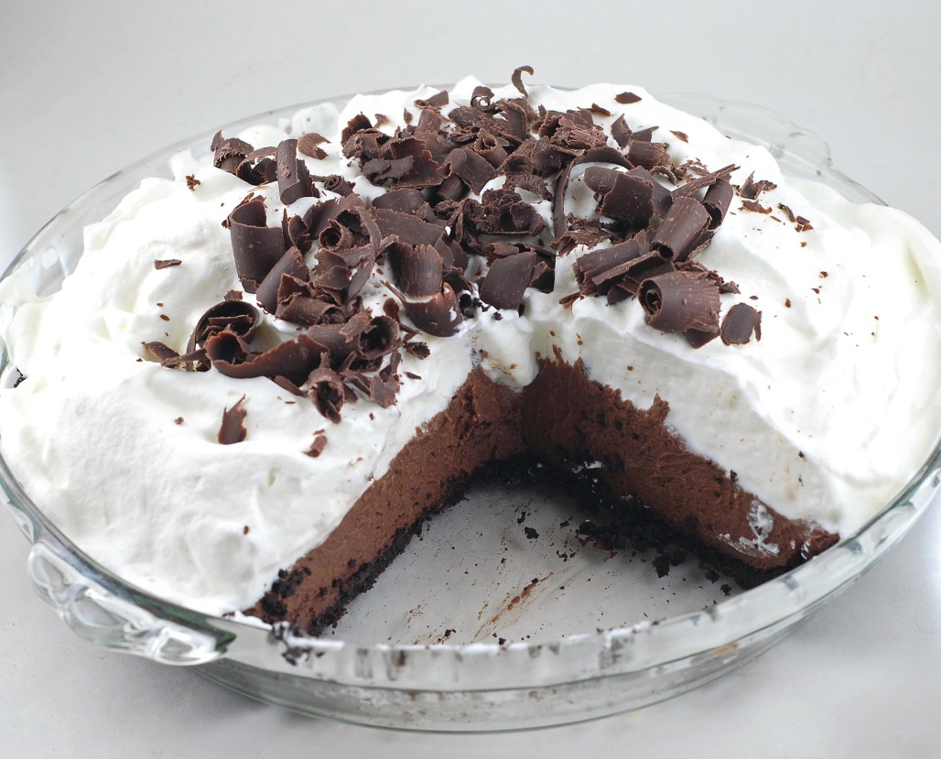
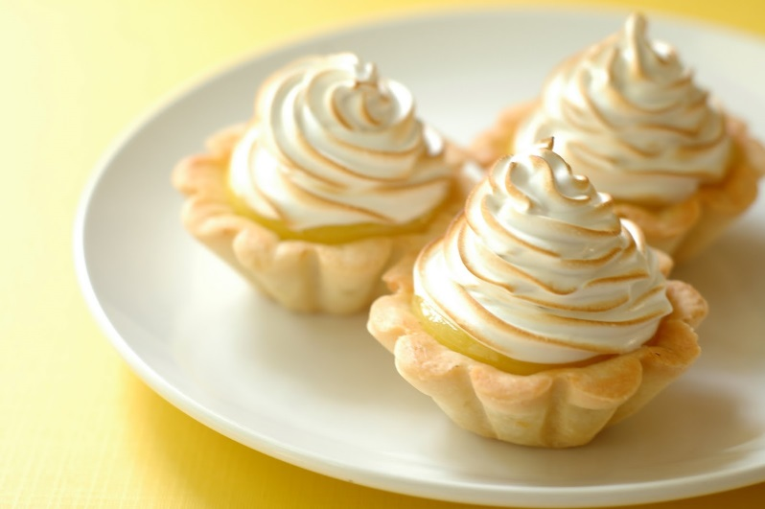
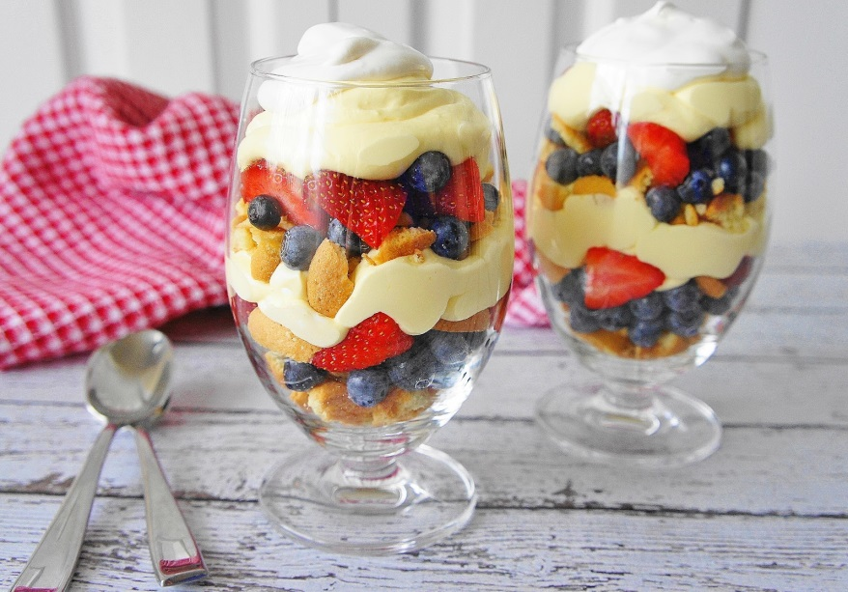
…helps pudding and cream pies set…

Slide 6
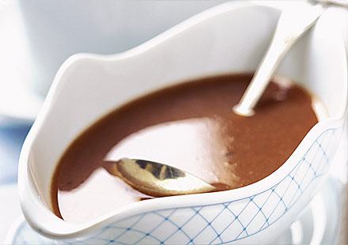
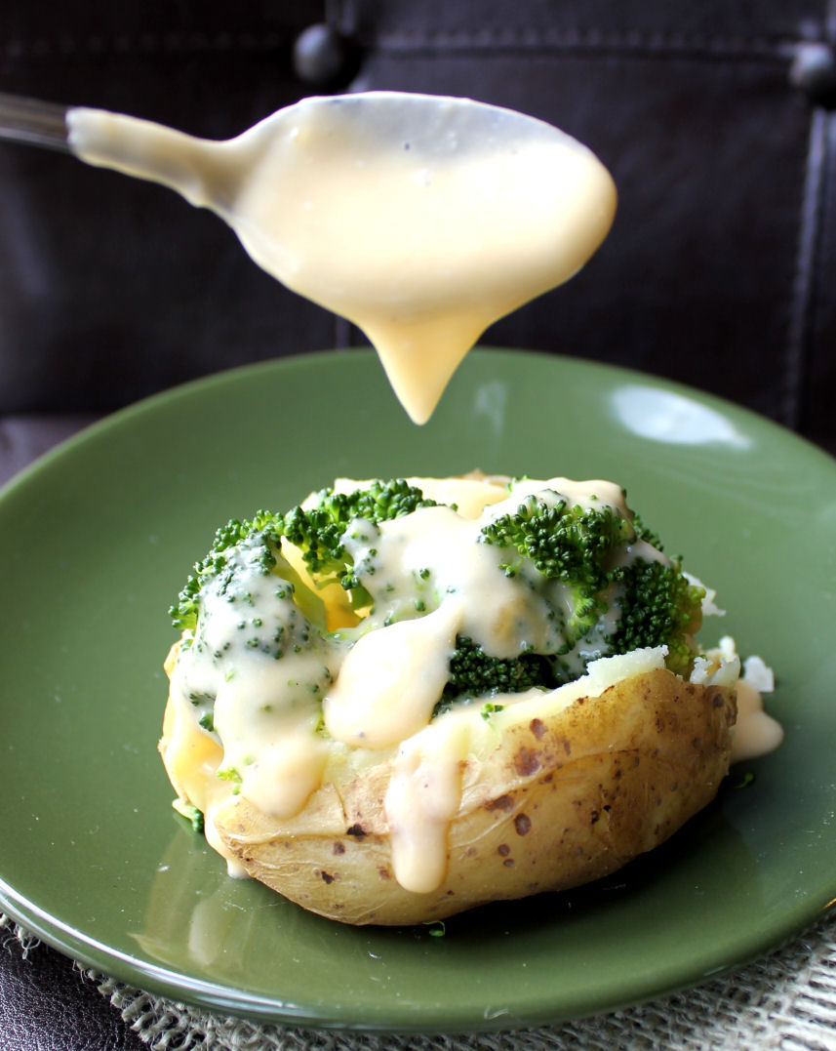
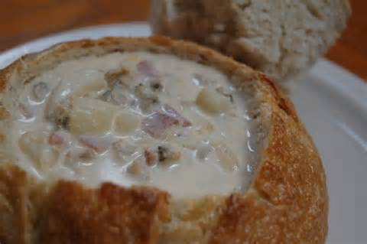
…and thickens gravy, sauces and soups?

Slide 7
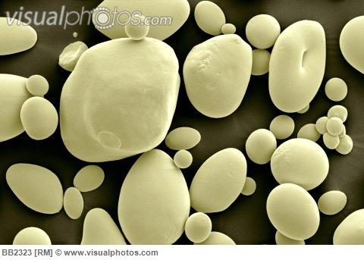
It’s a process called gelatinization
that makes starch swell up and absorb water.

Slide 8
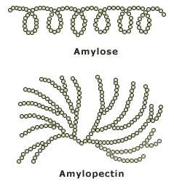
Starch granules are built of strands of starch called amylose and amylopectin.
Amylose is a long linear molecule, often wrapped into a helix.
Amylopectin is a branched molecule.

Slide 9
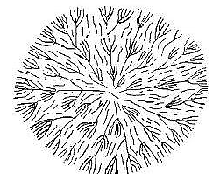
The starch molecules are arranged in a starburst pattern, with hydrogen bonds holding the molecules in place.
Amylose is a long linear molecule, often wrapped into a helix.
Amylopectin is a branched molecule.

Slide 10
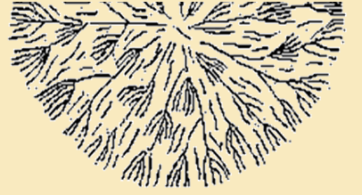
If you add cold water to starch, the granules swell a little, but remain mostly unchanged.

Slide 11
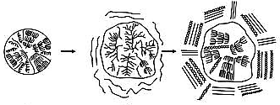
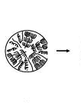
But if you have water and HEAT, important changes begin to occur.
Hot water breaks hydrogen bonds and increases swelling.
As more and more water enters, the molecules spread apart and swell until the granule bursts.
Amylose leaks out and thickens the surrounding liquid.

Slide 12
Video of starch cells gelatinizing to thicken liquid: https://www.youtube.com/watch?v=L6vYxYE1jOg

Slide 13
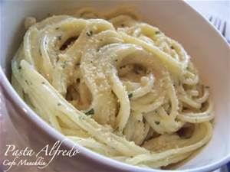
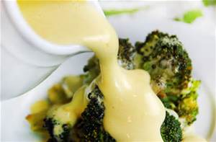
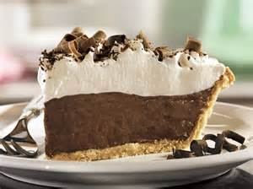
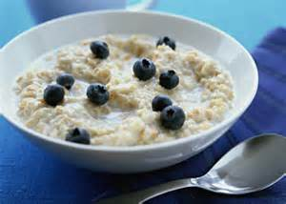
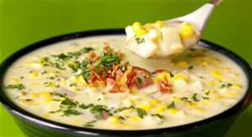
This thickening is important in preparing many foods.

Slide 14
With your partner, discuss:
What is gelatinization?
What happens to starch when it gelatinizes?
What are some of the foods that use gelatinization of starch in their preparation?

Slide 15
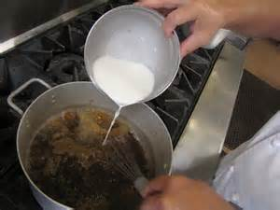
II. HOW DO YOU USE GELATINIZATION TO THICKEN FOODS?

Slide 16
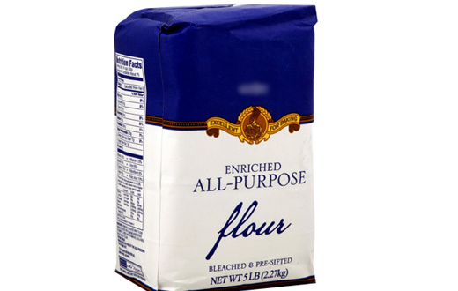
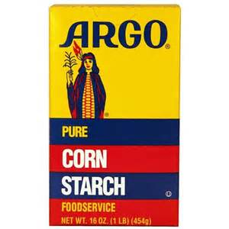
Flour and cornstarch are the thickeners most often used in the United States, but other starches also work.

Slide 17
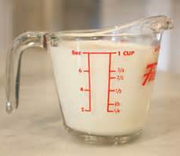
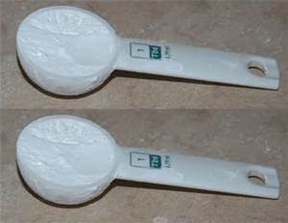
If you use flour as your thickener, you get a bland flavor and opaque color.
Thicken with this much flour:
Thin sauce—1 T.
Med. Sauce—2 T.
Thick sauce—3 T.
For each cup
of liquid:

Slide 18
If you are using a recipe, follow that to see how much thickener to use.

Slide 19
Cornstarch is a stronger thickener. Use only half as much cornstarch as flour. Cornstarch cooks transparent, and since you use less, it has less affect on flavor,.

Slide 20
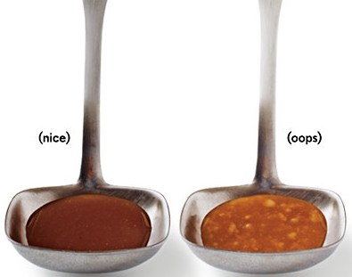
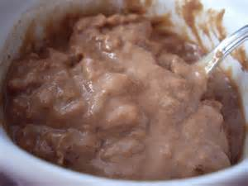
But be careful! Flour or cornstarch added to hot liquid can leave you with a lot of lumps!

Slide 21
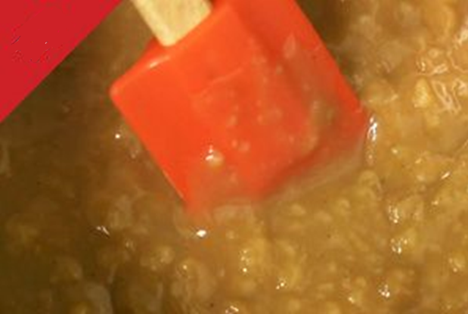
If hot water touches clumps of starch, it can gelatinize the outside of the clump, setting the starch into lumps.
AVOID
LUMPS

Slide 22
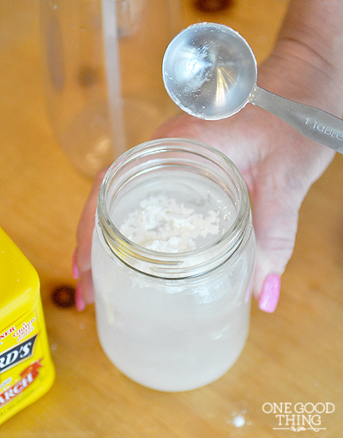
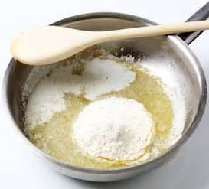
There are 2 main ways to thicken liquids without lumps:
Method 1: Make a slurry.
Method 2: Make a roux.

Slide 23
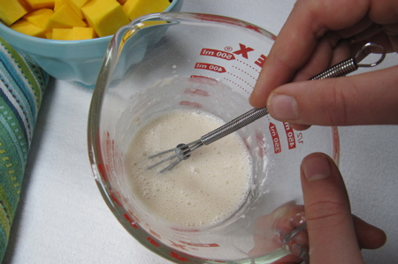
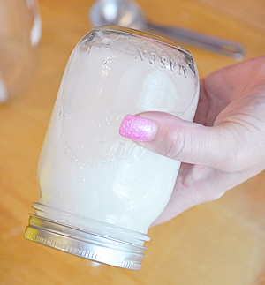
Dilute starch in COLD liquid Stir OR shake your thickener into COLD liquid.
METHOD 1: Make a slurry

Slide 24
Once you have the starch dissolved, you can add it to hot liquids, or heat it up. Stir well as you add it, to prevent lumps.
Remember:
to avoid lumps,
slowly add
COLD slurry to
HOT liquids.

Slide 25
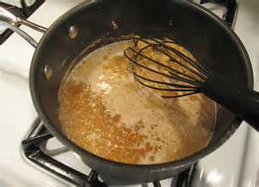
Stir and boil your starch/liquid mixture for a couple minutes (or as long as indicated on the recipe) to gelatinize the starch.

Slide 26
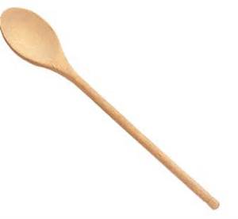
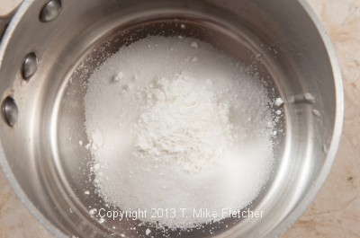
If your recipe calls for sugar, such as for pudding or pie, it will usually tell you to stir the starch into the sugar BEFORE you add the liquid. That also helps avoid starch clumps/lumps.

Slide 27
Video: Make a slurry https://www.youtube.com/watch?v=4uOpKvlSMlc (Turn off after slurry directions—just chat after that.)

Slide 28
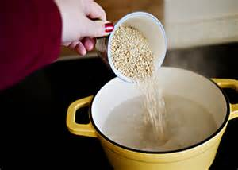
When making oatmeal, you add the oatmeal to boiling water. Since you don’t have a chance to dilute the starch first, sprinkle the oatmeal in, to separate the pieces and help prevent lumps.

Slide 29
Method II Make a roux.
A roux (“roo”) is a cooked mixture of equal amounts fat and starch. The fat surrounds the starch granules, to prevent lumps. The fat also gives it a richness and flavor, but adds calories as well.

Slide 30
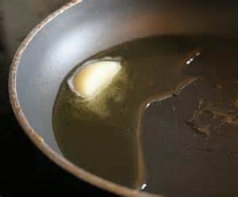
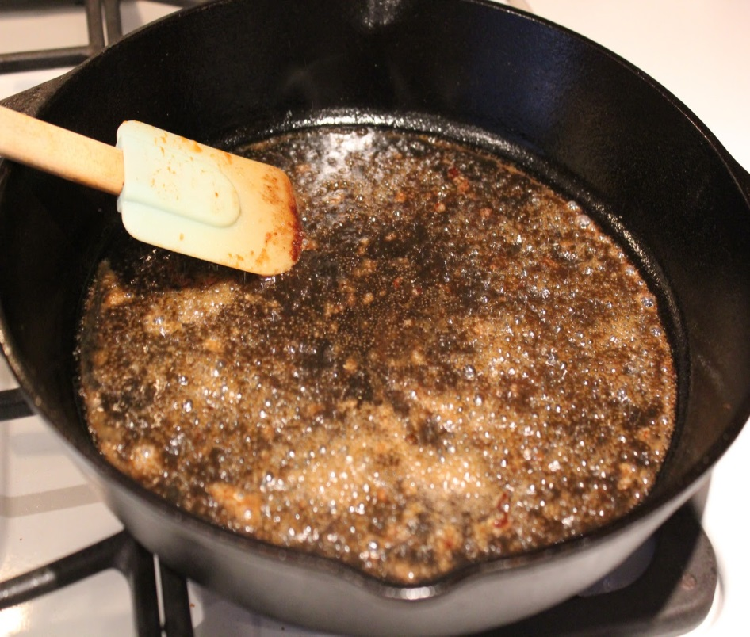
Step 1 in making a roux: Melt your fat.
Since butter adds such a nice flavor, it is the fat most often used in making a roux. Oil also works.
When making gravy, the drippings from the meat usually provide the fat.

Slide 31
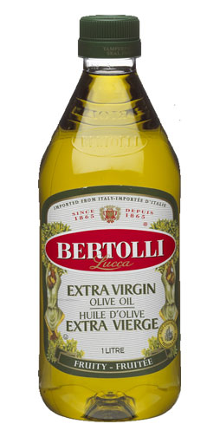
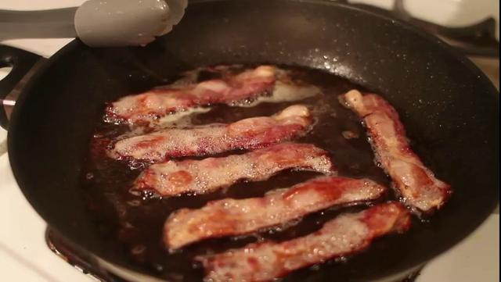
Other fats, including olive oil or bacon fat could also be used. Check your recipe or think about the flavor you want.

Slide 32
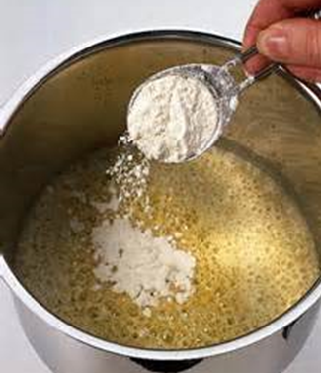
Step 2 for roux: Stir in an amount of flour equal to the amount of fat you used.
Continue to stir and cook until your mixture has formed a thick paste.

Slide 33
The longer you stir and cook your roux, the darker the color and stronger the flavor.
“White” roux is cooked only a few minutes, until the raw flour taste is gone. The roux is pale yellow.
“Brown” roux is cooked longer (20-30 min+). Use a low heat so it doesn’t burn.
“Blonde” roux is cooked a minute or two longer.

Slide 34
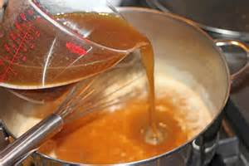
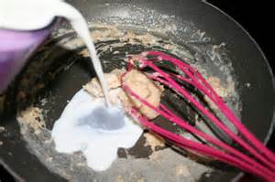
Once you have your roux, you can combine it with the liquid you want to thicken. Simmer the liquid to thicken. (It will take a few minutes; don’t add too much roux before you give it a chance to thicken the liquid.)

Slide 35
Videos: How to make a roux
https://www.youtube.com/watch?v=pL1kcZuT_48

Slide 36
Here are more tips on roux, from another chef:
https://www.youtube.com/watch?v=FgMnUUuuHn4

Slide 37
Tell how to use flour or cornstarch to thicken liquids.
Tell how to make a roux.

Slide 38
Did you meet our
learning targets:
Define gelatinization and tell how it occurs.
Tell how to do 2 methods of thickening sauces.

Slide 39
What if disaster strikes, and your sauce/gravy is lumpy or thin? Here are some emergency fixes:
http://thanksgiving.wonderhowto.com/how-to/saving-thanksgiving-dinner-fix-lumpy-too-thin-gravy-0149468/

