Slide 1
Multiple Sclerosis
Overview for Mental Health Professionals

Slide 2
What does MS look like?
Julia—a 35yo white married mother of 3 who is exhausted all the time and can’t drive because of vision problems and numbness in her feet
Jackson—a 25yo African-American man who stopped working because he can’t control his bladder or remember what he read in the morning paper
Maria—a 10yo Hispanic girl who falls down a lot and whose parents just told her she has MS
Loretta—a 47yo white single woman who moved into a nursing home because she can no longer care for herself
Notes:
There are many different faces of MS. The disease is so variable from one person to another that no two people experience it in exactly the same way.

Slide 3
What else does MS look like?
Sam—a 45yo divorced white man who has looked and felt fine since he was diagnosed seven years ago
Karen—a 24yo single white woman who is severely depressed and worried about losing her job because of her diagnosis of MS
Sandra—a 30yo single mother of two who experiences severe burning pain in her legs and feet
Richard—who was found on autopsy at age 76 to have MS but never knew it
Jeannette—whose tremors are so severe that she cannot feed herself

Slide 4

1396: Earliest Recorded Case of MS
Notes:
Sister Lidwina van Schiedam is thought by many to be the earliest recorded case of MS. She was healthy and active as a child and teenager, but fell while ice skating in 1396 and subsequently developed numerous symptoms characteristic of MS.

Slide 5
From Sister Lidwina to the present…
1868—Jean-Martin Charcot describes the disease and finds MS plaques (scars) on autopsy.
1878—Louis Ranvier describes the myelin sheath (the primary target of MS in the central nervous system).
“Multiple sclerosis is often one of the most difficult problems in clinical medicine.” (Charcot, 1894)
“When more is known of the causes and…pathology of the disease… more rational methods may brighten the therapeutic prospect.” (Gowers, 1898)
1981—1st MRI image of MS is published.
Notes:
In many ways, MS remains as challenging today as it was for physicians in the 19th century. Our knowledge about MS has greatly increased, and our management strategies have become more sophisticated, but patients and families are still confronted with a disease that has no cure and significantly impacts their quality of life.

Slide 6
From Sister Lidwina to the present, cont’d
1993—The first disease-modifying agent for MS—Betaseron—is approved in the U.S.
1998—Bruce Trapp confirms that the nerve fibers themselves are irreversibly damaged early in the disease course (probably accounting for the permanent disability that can occur).
2016—Today, there are several medications approved in the U.S. for the treatment of MS and more in the pipeline.
Today there are 2.3 million people worldwide
Notes:
MS treatment changed radically in the early 90’s with the approval of the first disease-modifying therapy.

Slide 7
What MS Is:
MS is considered an immune-mediated disease—perhaps autoimmune.
The immune system attacks the myelin coating around the nerves in the central nervous system (CNS—brain, spinal cord, and optic nerves) and the nerve fibers themselves.
Its name comes from the scarring caused by inflammatory attacks at multiple sites in the central nervous system.
Notes:
The primary site of the attack in MS is the myelin coating that surrounds the nerve fibers in the central nervous system.
The expert consensus is that MS is an immune-mediated disease; whether MS is autoimmune is the subject of much scientific debate at this time.

Slide 8
What MS Is Not:
MS is not:
  Contagious
  Directly inherited
  Always severely disabling
  Fatal—except in fairly rare instances
Being diagnosed with MS is not a reason to:
  Stop working
  Stop doing things that one enjoys
  Not have children
Notes:
People with MS have very close to a normal life expectancy. There are some individuals in whom a very rapid and severe disease course leads to death, and there are some in whom the complications of the disease become so debilitating that death eventually results. In addition, the suicide rate in people with MS is significantly higher than in the general population, with depression being the single greatest risk factor. Death certificate-based reviews indicate that suicide may be the cause of death for MS clinic attendees in as many as 15% of all cases (Sadovnick et al 1991).
While people with MS used to be encouraged to give up most of their work and family dreams, they are now encouraged to keep their lives as full, productive, and busy as they are able and interested in having them be.

Slide 9
Answering the Big Question:
“Why did I get MS?”
We do not know why one person gets MS and another does not.
We do not know of anything:
  The person did to cause MS
  The person could have done to prevent it
There is no way to predict who will get it and who will not.
Notes:
While people often try to identify some stressful life event that may have precipitated their MS, the relationship between stress and either the onset or worsening of MS remains unclear. We still do not know what causes MS or why it becomes active at any given time.

Slide 10
What Causes MS?
Genetic
Predisposition
Environmental
Trigger
Immune Attack
Loss of myelin
& nerve fiber
Notes:
This diagram illustrates that when a person who is genetically susceptible encounters the (as yet unknown) environmental trigger, the immune-mediated response is initiated, causing damage in the central nervous system.

Slide 11
What is the genetic factor?
The risk of getting MS is approximately:
  1/750 for the general population (0.1%)
  1/40 for person with a close relative with MS (3%)
  1/4 for an identical twin (25%)
20% of people with MS have a blood relative with MS
The risk is higher in any family in which there are several family members with the disease (aka multiplex families)
Notes:
MS is not directly inherited like hair or eye color. If heredity were the only factor, the risk for an identical twin would be 1/1 instead of 1/4.
A close – or first degree – relative is a parent, child, or sibling.

Slide 12
What happens in MS?
“Activated” immune cells...
...cross the blood-brain barrier…
…launch attack on myelin & nerve fibers...
…to obstruct nerve signals
myelinated nerve fiber
myelinated nerve fiber
Notes:
Although scientists are still working out the details of the immune attack in MS, the basic steps involved appear to be as follows:
Misguided immune cells—called T cells—cross the blood-brain barrier (BBB) into the CNS.
The BBB, which is thought to consist of walls of capillaries in the CNS, usually prevents or slows the passage of undesirable substances (e.g., disease-causing organisms) from the blood into the CNS.
These T cells release chemicals that rally other immune system forces that attack the myelin coating around the nerve cells, as well as the cells that manufacture myelin.
This attack causes inflammation and then destruction. The nerve fibers themselves also come under attack.
Once the myelin and nerve fibers have been damaged, nerve signals are slowed or stopped.
MS lesions (damaged areas as seen on MRI) form, with hardened scars or plaques that may impair normal myelin repair processes.

Slide 13




What happens to the myelin and nerve fibers?
Notes:
This drawing shows the steps involved in the damage to the myelin and axons.
The yellow segments represent the myelin coating.
One area of myelin has been damaged.
The immune attack becomes directed toward the axon itself.
The axon is severed.
Myelin has some ability to repair itself, and the potential of myelin repair is an area of intensive research at this time. Once the axons are damaged, however, they cannot be repaired. Because axonal damage can occur even in the earliest stages of the disease, early treatment with a disease-modifying medication should be considered by anyone with a confirmed diagnosis of MS.

Slide 14
What are possible symptoms?
MS symptoms vary between individuals and are unpredictable
Fatigue (most common)
Visual problems
Bladder and/or bowel dysfunction
Sexual dysfunction
Emotional disturbances (depression, mood swings)
Cognitive difficulties (memory, attention, processing)
Sensory changes (tingling, numbness)
Pain (neurogenic; musculoskeletal)
Spasticity
Gait, balance, and coordination problems
Speech/swallowing problems
Tremor
Notes:
Any or all of these symptoms are possible in MS, depending on where in the CNS the lesions form.
Only the symptoms that appear in orange are readily visible—which means that what you see when you look at a person with MS is probably only the “tip of the iceberg.”
Some people develop only one or two of these symptoms over the course of the disease, while other people may develop several.

Slide 15
How is MS diagnosed?
MS is a clinical diagnosis:
  Signs and symptoms
  Medical history
  Laboratory tests
Requires dissemination in time and space:
  Space: Evidence of scarring (plaques) in at least two separate areas of the CNS
  Time: Evidence that the plaques occurred at different points in time
There must be no other explanation
Notes:
There is no single test that can determine if a person has MS.
The current criteria for the diagnosis of MS require evidence of plaques that occurred in different places in the CNS at different points in time. This is why it can sometimes take months or even years to confirm the diagnosis. Until evidence of a second attack can be found, the current criteria for the diagnosis of MS have not been met.

Slide 16
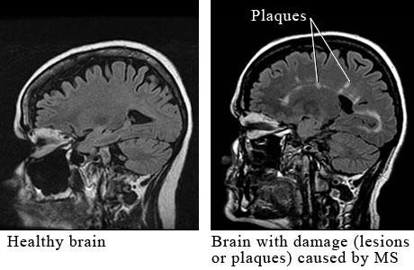
What tests may be used to help confirm the diagnosis?
Magnetic resonance imaging (MRI)
Visual evoked potentials (VEP)
Lumbar puncture
Notes:
MRI makes it possible to visualize and count lesions in the white matter of the brain and spinal cord.
Evoked potentials are recordings of the nervous system’s electrical responses to the stimulation of specific sensory pathways. Since damage to myelin results in a slowing of response times, EPs can identify areas of damage along specific nerve pathways whether or not the person is experiencing any symptoms. VEPs are considered the most useful for diagnostic purposes.
Lumbar puncture is used to examine CSF for changes that are characteristic of MS.

Slide 17
What is the prognosis?
One hallmark of MS is its unpredictability.
  Approximately 1/3 will have a very mild course
  Approximately 1/3 will have a moderate course
  Approximately 1/3 will become more disabled
Certain characteristics predict a better outcome:
  Female
  Onset before age 35
  Sensory symptoms
  Monofocal rather than multifocal episodes
  Complete recovery following a relapse
Notes:
It’s important to remember that the majority of people with MS do not become severely physically disabled. Most will remain able to walk, although they may need an assistive device—such as a cane or walker—to do so. That being said, people who remain fully ambulatory may still be unable to work or function comfortably at home because of cognitive changes or other symptoms that interfere with everyday activities.
Studies indicate that African-Americans tend to have a more rapidly progressing course than Caucasians.
Some people have a “benign” course of MS that remains mild throughout their lifetime. The challenge is that it is impossible to determine at the outset who will do fine and who will experience disabling symptoms 5, 10, or 20 years down the road. Therefore, most MS specialists recommend early treatment, as we’ll talk about in a few minutes.

Slide 18
Disease Types
Clinically isolated syndrome (CIS)
Relapsing-remitting MS (RRMS)
  About 85% of people are diagnosed with RRMS
Primary progressive MS (PPMS)
  About 15% of people experience this course
Secondary progressive
  Most people diagnosed with RRMS will eventually transition to SPMS
Lublin et al, 2014

Slide 19

Clinically Isolated Syndrome (CIS)
A first neurologic event suggestive of demyelination
Individuals with CIS are at high risk for developing clinically definite MS if the neurologic event is accompanied by multiple, clinically silent (asymptomatic) lesions on MRI typical of MS
Notes:
19
CIS has received increasing attention recently, with several of the FDA-approved disease modifying therapies also approved for use in CIS to delay the diagnosis of definite MS.

Slide 20
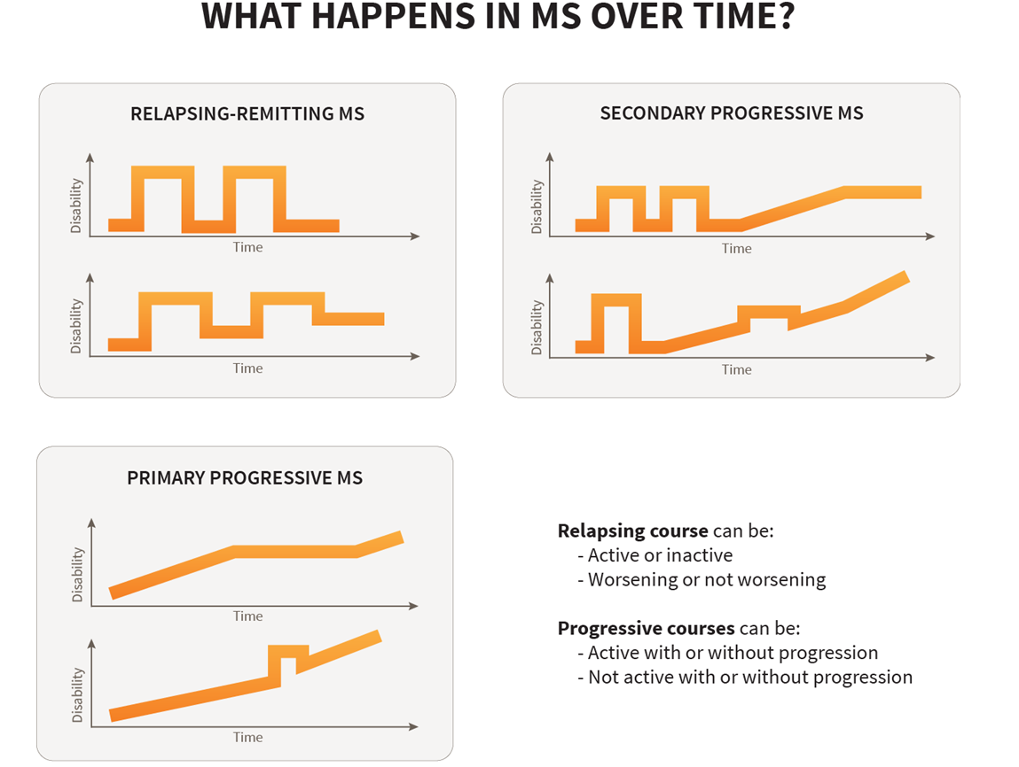
Lublin et al, 2014

Slide 21
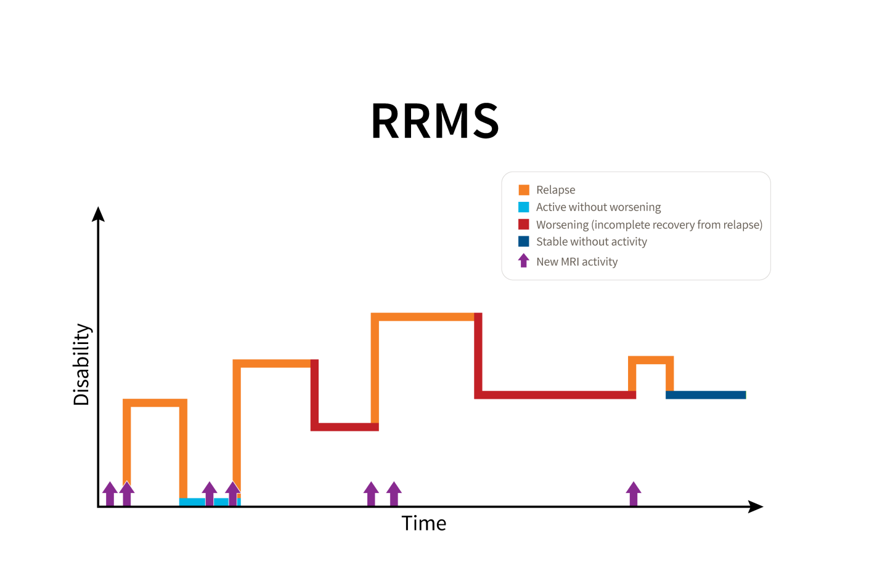
Lublin et al, 2014
Notes:
The purple arrows indicate new lesion activity on MRI. MRI activity can occur very early in the disease course, even before a person is aware of any symptoms.
Over time, RRMS can be Active, with new MRI activity (light blue) and/or relapses (orange). Worsening can occur when symptoms do not fully resolve following a relapse (dark red), resulting in an accumulation of disability. Periods of stability can also occur, when no new MRI activity or relapses occur (dark blue).

Slide 22
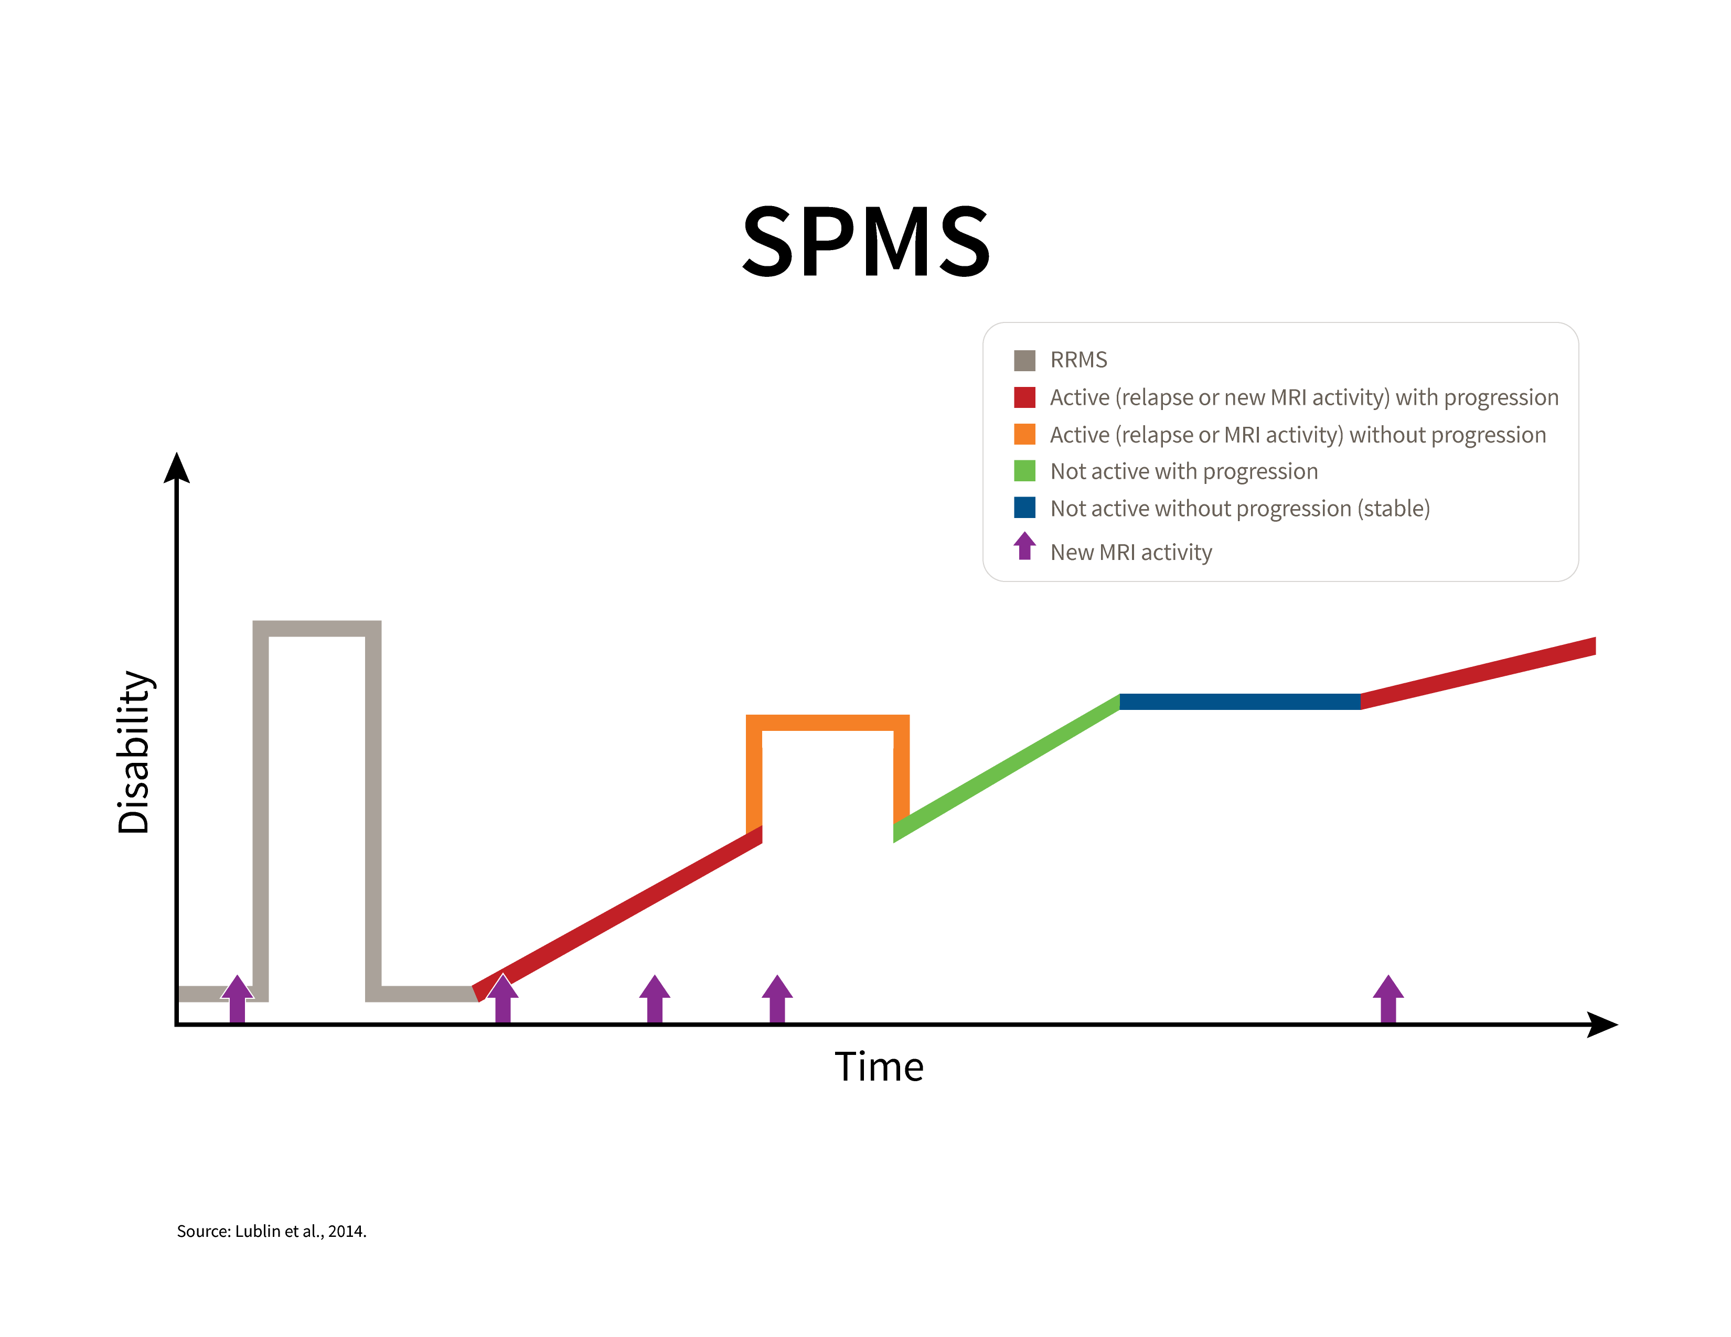
Lublin et al, 2014
Notes:
This graphic shows that secondary progressive MS follows after relapsing-remitting MS. SPMS can be Active, with new relapses or MRI activity, and Progressing (dark red) and it can also be Active without any progression occurring (orange). In SPMS, the disease sometimes progresses without any new MRI lesions or relapses (green). Periods of stability (dark blue) can also occur, when there are no relapses or new MRI activity.

Slide 23
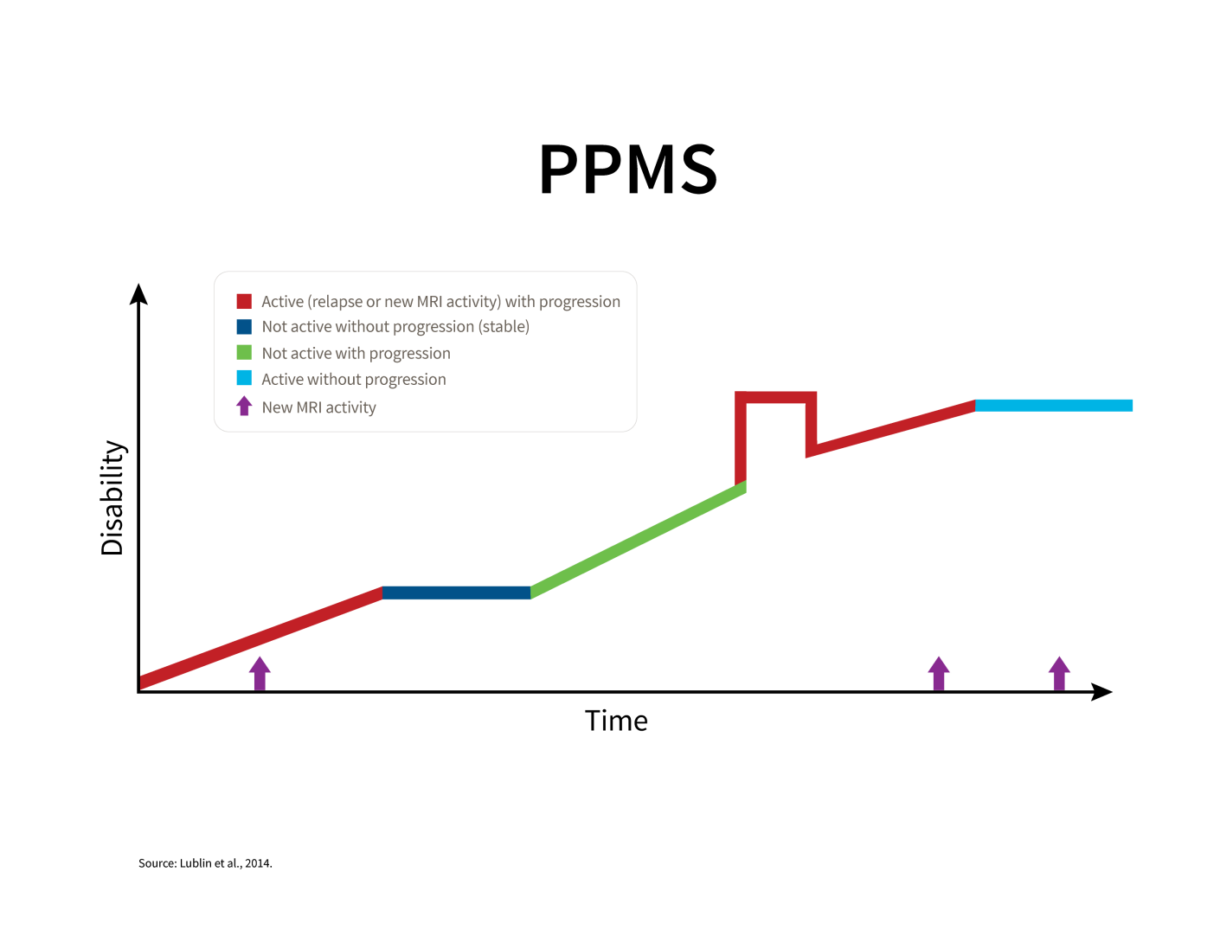
Lublin et al, 2014
Notes:
Primary progressive MS is characterized by progression of disability from the onset of symptoms, without any early relapses. PPMS can have periods when it is Active, with evidence of new MRI activity or a relapse and Progression of disability (dark red) or Active without any progression of disability (light blue). Progression of disability can also occur in PPMS without new MRI activity or relapses (green). Occasional periods of stability, without any MRI activity or relapses (dark blue).
Individuals who were previously diagnosed with Progressive relapsing MS would now be considered to have PPMS that is Active.

Slide 24
An Overview of Treatment Strategies

Slide 25
Who is on the MS “Treatment Team”?
Neurologist
Urologist
Nurse
Physiatrist
Physical therapist
Occupational therapist
Speech/language pathologist
Psychiatrist
Psychotherapist
Neuropsychologist
Social worker/Care manager
Pharmacist
Primary care physician
Notes:
No single practitioner can address all of the problems potentially created by MS. The ideal treatment team, whether located in a single center, or spread out in the community, should include a variety of specialties. While most people with MS are treated by a neurologist, most do not have ready access to this kind of comprehensive care team. A major challenge for patients and families in today’s healthcare system is coordinating the care provided by these specialists.
Rehabilitation is a core component of MS care, and rehab professionals are essential to comprehensive care of the MS patient.

Slide 26
What are the treatment strategies?
Gone are the “Diagnose and Adios” days of MS care
Management of MS falls into five general categories:
  Treatment of relapses (aka exacerbations, flare-ups, attacks—that last at least 24 hours)
  Symptom management
  Disease modification
  Rehabilitation (to maintain/improve function)
  Psychosocial support
Notes:
The days of “diagnose and adios” in MS care (so labeled by Dr. Labe Scheinberg whom many consider to be the father of the comprehensive care model in MS) are long gone. While we do not have a cure for MS, we have a variety of treatment and management strategies to minimize the impact of MS on everyday life.
The rest of this presentation will describe these components of MS treatment, highlighting the role of rehabilitation specialists. Although these components are listed separately, the key to effective, comprehensive care of the MS patient lies in their coordination and integration.

Slide 27
How are relapses treated?
Not all relapses require treatment
  Mild, sensory sx are allowed to resolve on their own.
  Sx that interfere with function (e.g., visual or walking problems) are usually treated
3-5 day course of IV methylprednisolone—with/without an oral taper of prednisone
  High-dose oral steroids used by some neurologists
Rehabilitation to restore lost function
Psychosocial support
Notes:
While corticosteroids reduce inflammation, they are not thought to have any long-term effect on the disease. They are used primarily in exacerbations that are significantly impacting a person’s ability to function.
Steroids can cause significant emotional upheaval in some people—including feelings of being “high” or manic while on the medication, followed by strong feelings of let-down or depression when coming off the medication. Some people may require a medication such as Depakote® to handle these severe swings.
People may react differently to the medication at different times.
The rehabilitation team plays a key role in helping people regain functions that have been impacted by the attack—e.g., strength, balance, gait, coordination—and in teaching the safe and appropriate use of mobility aids and other forms of assistive technology at home and at work.

Slide 28
How is the disease course treated?
Thirteen disease-modifying therapies are FDA-approved for relapsing forms of MS:
  glatiramer acetate (Copaxone®; Glatopa™ - generic equivalent) [inj.]
  interferon beta-1a (Avonex®, Plegridy™, Rebif®) [inj.]
  interferon beta-1b (Betaseron® and Extavia®) [inj.]
  dimethyl fumarate (Tecfidera®) [oral]
  fingolimod (Gileny®) [oral]
  teriflunomide (Aubagio®) [oral]
  alemtuzumab (Lemtrada®) [inf]
  mitoxantrone [inf]
  natalizumab (Tysabri®) [inf]
Notes:
These medications differ somewhat in their mode of action, dosage levels, route of delivery, frequency of injection/infusion, and side effect profile.
The injectable medications (in orange) are given on a schedule ranging from once per week to QD. Avonex is given IM; the others are SQ. Many people self-inject; others need someone else to assist them.
All of the injectable medications are approved as first-line therapies.
The oral medications are in blue. Although these are approved by the FDA as first-line treatments, physicians differ in their willingness to use them as first-line medications because of their more significant side effects.
The infused medications are in gray; they are generally reserved for those patients who have not received sufficient benefit from one or more of the first-line medications. Mitoxantrone is the only FDA-approved medication for secondary-progressive MS.
Patients work with their neurologist to determine which medication would be most suitable. Taking both the disease course and the patient’s lifestyle into account will enhance the likelihood of treatment adherence.
Not all insurance formularies include all of these (expensive) medications; each of the pharmaceutical companies does have a patient assistance program to help people obtain their medication.
Tysabri is for people with relapsing forms of MS. It is approved as a monotherapy and is generally recommended for those people who have not gotten sufficient benefit from the injectables or can’t tolerate the side effects. Associated risk of PML, a serious infection that is generally fatal. Tysabri may be used as a first-line therapy for someone with very active disease.
Novantrone is also reserved for those patients in whom the disease is progressing in spite of treatment with the disease-modifying medications. Associated cardiac risk as well as increased incidence of leukemia.

Slide 29
What do the disease-modifying drugs do?
All reduce attack frequency and severity, reduce scarring on MRI, and probably slow disease progression.
These medications do not:
  Cure the disease
  Make people feel better
  Alleviate symptoms
Notes:
These disease-modifying medications are designed for long-term use.
These medications will not cure MS or make it feel better.
They are designed to reduce the number and severity of attacks and alter the course of the disease.
It is virtually impossible for a person to know if the drug is “working” at any given time.
The “feeling better” part of MS care results from symptom management strategies, including medication and rehabilitation interventions.

Slide 30
How important is early treatment?
The Society’s National Medical Advisory Committee recommends that treatment be considered as soon as a dx of relapsing MS has been confirmed.
  Irreversible damage to axons occurs even in the earliest stages of the illness.
  Tx is most effective during early, inflammatory phase
  Tx is least effective during later, neurodegenerative phase
No treatment has been approved for primary-progressive MS.
Approximately 60% of PwMS are on Tx
Notes:
The MS Coalition’s Consensus Statement on The Use of Disease-Modifying Therapies in Multiple Sclerosis (2015) is available on the Society’s website.
Since irreversible axonal damage can occur very early in the disease course, a major goal of early treatment is to try and prevent that from happening.

Slide 31
How are MS symptoms managed?
Symptom management continues throughout the disease course
Effective symptom management involves a combination of medication, rehabilitation strategies, emotional support—and good coordination of care
Virtually every medication used to treat MS symptoms is used off-label

Slide 32
Treatment Adherence Issues
Patient readiness is key
Factors affecting adherence include:
  Lack of knowledge about MS
  Unrealistic expectations
  Denial of illness
  Side effects
  Cultural factors
  Lack of support (medical team, family)
  Distrust of medical community
Notes:
People differ in their readiness to begin treatment. Our role is to help people think through the information their doctor has given them and make the decision that feels right for them.
Unrealistic expectations are the main reason that people stop taking their medication. It’s difficult to continue injecting oneself with a medication that doesn’t make you feel better—and may even make you feel worse.

Slide 33
What can people do to feel their best?
Balance activity with rest.
Talk with their doctor about the right type/amount of exercise for them.
Eat a balanced low-fat, high-fiber diet.
Avoid heat if they are heat-sensitive.
Drink plenty of fluids to maintain bladder health and avoid constipation.
Follow the standard preventive health measures recommended for their age group
Notes:
NMSS chapters can provide educational materials about health and wellness.
Because of the demands of their MS, people may have a tendency to ignore their general healthcare needs.
Patients may need to be reminded to see their internist or family doctor in addition to their neurologist and obtain the recommended screenings for their age group. Research has shown that people who see only an MS specialist for their medical care are less healthy than those who are also followed by a general medical doctor.

Slide 34
What else can people do to feel their best?
Reach out to their support system; no one needs to be alone in coping with MS.
Stay connected with others; avoid isolation.
Become an educated consumer.
Make thoughtful decisions regarding:
  Disclosure
  Choice of physician
  Employment choices
  Financial planning
Be aware of common emotional reactions.
Notes:
People with MS are bombarded by advertisements on the Internet and by suggestions from well-meaning friends.
People need to choose a neurologist who is knowledgeable about MS and with whom they feel comfortable. Referrals are available from the National MS Society chapter, but insurance plans may limit options.
They need to become educated consumers who can carefully evaluate the information they receive. They can contact the National MS Society with questions about treatments and “cures” they hear about from others.
A major role of mental health professionals is to assist people in the process of making thoughtful, informed decisions on their own behalf. Too often, decisions are made at points of crisis.

Slide 35
How can people work effectively with their healthcare team?
A working partnership requires open communication, mutual respect, and trust.
  Provide HCP with a complete list of all medications (prescription and non-prescription)
  Come to appointments with a list of questions.
  Bring an “extra pair of ears”
  Report any symptoms experienced since the last visit.
Notes:
Patients tend to be very anxious during office visits, with the result that they have difficulty hearing and processing the information the doctor is giving them. Bringing along another person to be “an extra pair of ears,” a tape recorder, or simply a pad to jot down some notes can be very helpful.
Some patients are worried about “disappointing the doctor” or being considered a “bad” or “difficult” patient, so they don’t want to complain or tell the doctor the truth about their symptoms.
Some patients withhold information about the alternative therapies they are using because they don’t want the doctor to be angry or tell them to stop.
Some patients are very dependent, strictly adhering to the medical model; others are much more active participants in their own care.

Slide 36
So what do we know about MS?
MS is a chronic, unpredictable disease.
The cause of MS is still unknown
MS affects each person differently; symptoms vary widely.
MS is not fatal, contagious, directly inherited, or always disabling.
Early diagnosis and treatment are important:
  Significant, irreversible damage can occur early on
  Available treatments reduce the number of relapses and may slow progression
Treatment includes: attack management, symptom management, disease modification, rehab, emotional support.

Slide 37
Something to Think About
You’ve just heard a lot about MS and the ways it can impact a person.
It may be helpful to think about your personal reactions, attitudes—even prejudices—about illness and disability.
As in other areas, self-awareness can enhance your effectiveness as a therapist.

Slide 38
Society Resources for People with MS
Nationwide network of chapters around the country
Web site (www.nationalMSsociety.org)
Access to information, referrals, support (1-800-344-4867)
Educational programs (in-person, online)
Support programs (self-help groups, peer and professional counseling, friendly visitors)
Consultation (legal, employment, insurance, long-term care)
Financial assistance

Slide 39
Society Resources for Healthcare Professionals
Professional Resource Center Website: www.nationalMSsociety.org/PRC
Email: healthprof_info@nmss.org
  Clinical consultations with MS specialists
  Literature search services
  Professional publications
  Quarterly e-newsletter for professionals
  Professional education programs (medical, rehab, nursing, mental health)
  Consultation on insurance and long-term care issues
  Free app for your smartphone

