Slide 1
Traditional Medicine in Nicaragua
Angela, Hana, Dave
LACS 20

Slide 2
Overview

Slide 3
Ethnic Groups
3 Indigenous Tribes out of 6 present groups
Spanish- Speaking Mestizo
English- Speaking Creoles
Miskitu / Miskito
Mayangna / Sumu / Sumo
Rama
Garifuna
Notes:
In order of population size
The bolded are indigenous
**Important to remember: Modern-day groupings are also done by either Spanish or British Colonizers, Sandonistas or Somoza, not based on actual historical tribes
-Different spelling of names- Sometimes hyphenated sumo-mayangna
You might see… Issue with ordering of this slide? Although based on population… there is a hierarchy present.
Take a look at geographic distribution.

Slide 4
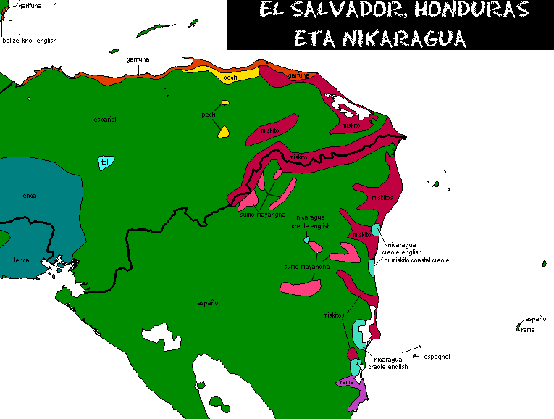
Ethnic Distribution
http://www.muturzikin.com/cartesamerique/imagesamerique/3.png
Notes:
There aren’t really any clear maps to be found. Many info not sure if accurate - plan of future, a past territory spread, or a present day snapshot. So linguistic map.
Spanish- Speaking Mestizo - Green: Recent (1960-70s) eastward migration (Somoza and other landowner takeovers)
English- Speaking Creoles - Turquoise: African and English heritage. Historical claims to leadership (British Protectorate until 1860). Rivalry with Mestizos. Wealthier, but more traditional health behaviours
Miskitu / Miskito - wine red: Eastern Coast, ~100-120,000. RAAN and RAAS coast, highest edu in 3-5, but most likely to use indigenous med
Mayangna / Sumu / Sumo - Lighter pink: Many dialects, Sumu dialects (Twahka and Ulwa) as well as Miskitu and/or Creole English and/or Spanish. ~6,000, RAAN & Jinotega (border Honduras)
Rama - purple: RAAS Creole English ~1,500, Rama Cay (small island), poorest and least educated, least likely to use traditional healer - acculturation?
Garifuna - Speak Creole English (Orinoco), arrived <100 ya, roots in Africa & Carribean, contemporary population in Velize & Honduras. Nicaragua=~1,000, wealthiest of rural ethnic groups
But in terms of language, muddy. Also in terms of traditional medicinal behaviour

Slide 5
Complicated History
Somoza to Sandinista
Contra War
Nowadays - Miskitu
Mayangna vs. Miskitu
17th Century firearms
Mayangna Community/Churches
Contra War- Promises broken
Sumo
Rama?
Notes:
Somoza exploited resources and land, but largely ignored indigenous people - self gov’t
Sandinistas envisioned a single Spanish-speaking country - Contra war
Complicated because some mayangna and miskitu also stayed south with Sandinistas, and were tortured or imprisoned due to their affiliation with others of same tribe.
Early 17th Century: Miskitu acquired firearms, view selves in opposition to inland neighbors
Mayangna retreat from central/interior Nicaragua that continued even after the British gave up the Atlantic Coast in 1860
possible pre-contact total of over 30,000 to around 5–6000
exacerbated by conflicts between the different Mayangna tribes and a series of disastrous epidemics
Miskitu had positions of power within Mayangna communities and churches
increased the tendency of Mayangna individuals to try to shed their original identity either by marrying out of the group or by abandoning their original language in order to move up the Coastal ethnic hierarchy, in which the Miskitu had a higher position
Many Mayangna joined the contra war due to Miskitu persuasion, but were used as cannon fodder. And nowadays Miskitu are still the representative voice of Nicaraguan indigenous peoples, and many Mayangna needs are ignored- feel cheated, died for a war that didn’t benefit them
The name “sumo” - accurate? (seems to be sub-branch). Wikipedia- derogatory Miskitu term. We will be using Mayangna
Rama- all we know is comparatively poorer and less educated, mostly speaking creole english
Even now, many of the articles that I could find were about Miskitu medicine, not much Mayangna. I’ve seen some articles mention Mayangna positively in their knowledge of the local ecology, but paired with an environmentalist agenda.
Many western researchers further exacerbate these problematic dynamics. Thus much of our research is on the Miskitu medicine and methods. However, we thought it important to be aware of these complicated relationships, and that there exist different perspectives outside of the Miskitu culture.

Slide 6
Miskitu Traditional Medicine
Notes:
Curanderos (healers)
Passed down through oral tradition, through generations

Slide 7
Causes of Disease
Biological
Western medicine
Spirits
muertos or isingni (spirits of deceased persons)
liwa mairin or sirena (a spirit related to water/reproductive system)
duende (gnome, spirit related to hunting and wild animals)
prahaku (spirit of the wind) & aubia (forest spirit)
Sorcery
Grisi Siknis: http://fusion.net/story/17330/nicaraguan-indigenous-village-ravaged-by-crazy-sickness/
Conflict with Biomedicine
Notes:
An overview:
These spirit entities may provoke both mental and physical problems, often by means of, or in relation to, the environment.
The duende, for example, protects the wild animals of the forest. if they have hunted too many deer, punish hunters with illness and madness
The spirits may also be used by a sorcerer to send an illness, or other misfortunes, upon someone. By using divination and by dreaming about the client, an experienced healer will determine if the problem is caused by the spirit directly or if a sorcerer is involved, although the symptoms themselves will also give an indication.
The sorcerer could also strike back on someone performing a healing ritual and might, for example, send an illness to the healer or her/his relatives. For this reason, many healers are reluctant to take on a case believed to have been caused by sorcery
symptoms of a spiritual illness may be similar to, or even the same as, an illness recognized by Western medicine, but biomedical treatment is said to be ineffective, and sometimes fatal.
Which, as you can probably guess, would cause some problems with public health clinics that mainly use Western medicine/treatments
Grisi Siknis is an interesting disease in that its symptoms start with:
feel anxiety and irritation, followed by headache and dizziness.
severe convulsions and a hysterical reaction, when they may rip their clothes and hair, try to bite or hurt others, and finally grab a knife or machete and begin to run around with other afflicted people
Feel sever pain even if there is no physiological symptoms
Recent years- pandemic
Western doctors are helpless. Can’t find cause, can’t treat.
it has been difficult as MINSA has not recognised grisi siknis as an illness because it does not have a biological origin.
The doctors have studied five years at the university and many curanderos cannot read or write.
Grisi siknis also brings to the fore biomedicine’s powerlessness and inability to respond to ailments that fall outside the biomedical model, with its view of the body as a natural, bounded and material entity separated from the self and the social world
More specifically Hana and Dave will examine the role of traditional medicine on women and children, respectively

Slide 8
Traditional Approaches to Women’s Health in Nicaragua

Slide 9
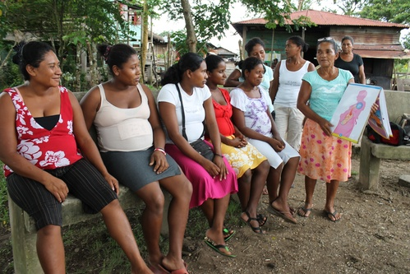
Importance of Midwives (Apa, Parteras)
Provide care, treatments, guidance
Non-interventionist
Home-birth rate is ~50%
Cheaper option
Santa Elena Figueroa Martínez is one of the Miskito community midwives of the RAAN. Here, she is giving HIV counseling to pregnant women in her community (UNICEF).

Slide 10
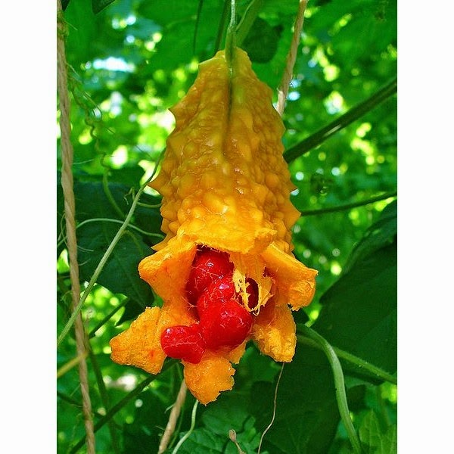
Specific Natural Remedies
- “Hot” foods
- “Blood tonics” for pregnant women: wood of monkey ladder (Bauhinia guianensis Aubl.), the bark of naked man, the bark of laulau, chainey root, the leaves and roots of broom weed, the leaves of baasley, the leaves of sorosi, and the leaves and roots of piss-a-bed
- Kasuu bark , leaves of trompit, sorosi for menstrual flow
Sorosi

Slide 11
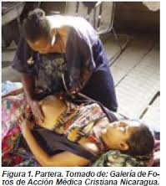
Efficacy of Traditional Methods
Pros:
Good overall health despite living conditions
Many remedies have scientific support
Cons:
Maternal mortality represents almost 4% of all the causes of death in
Nicaragua (Ministerio de Salud de Nicaragua (MINSA), 2005
Lack of training among parteras

Slide 12
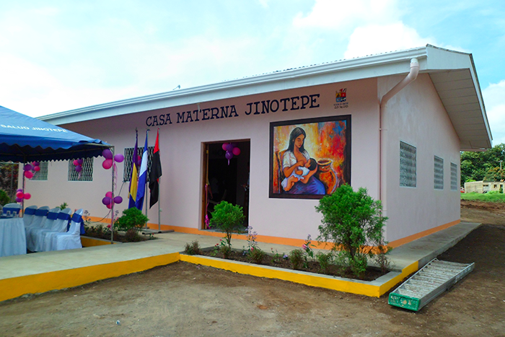
Homebirth Alternative: Casas Maternas
Low-cost lodging services co-managed by civil society organizations
Facilitate access to professional services
Daily medical visits

Slide 13
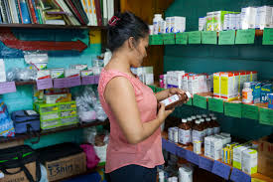
Barriers to Institutionalized Resources
Machismo culture and expectations of women
Social stigmas
Expectations of “good child
deliverers”
Discomfort with male doctors
Financial barriers
Ignorance among healthcare workers

Slide 14
Childcare

Slide 15
Health Statistics for Children(Country)
d
“Infant mortality remains high in the poorest regions and is associated with respiratory diseases, neonatal sepsis, congenital malformations, diarrhea, malnutrition, and meningitis.”¹
“Deaths of children under 1 year of age constituted 28.7% and 30.8% of all deaths in 1988 and 1990, respectively”.²
“The trend has been downward, and for 1996 it is estimated that the proportion decreased to about 21%”.²
“The percentage of children in rural areas suffering from some degree of malnutrition was 32%, compared with 19% in urban areas”. ²
“Other risks that threaten the well-being of Nicaragua's children and youth are teenage pregnancy and early marriages, child trafficking and sexual exploitation, gang involvement and HIV and AIDS.”³

Slide 16
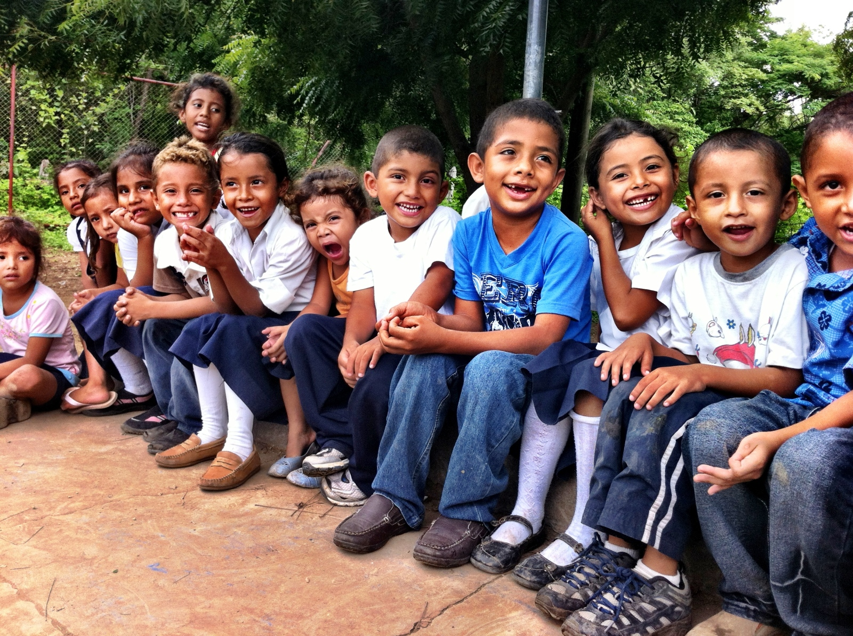
Knowledge and practice regarding general hygiene and parasites(Mestizo)*Survey of mothers with school-aged
children in ten rural communities around San Juan del Sur.
“Local healers for the Mestizo are called “Curandero” and about 77% of the population believes in them”⁴.
“About 40% said they have seen a parasite in their yard”⁴.
“About 15% believe that cutting a child’s nails causes sickness”⁴.
“About 86% believe that a cold shower after a hot day causes illness”⁴.
“About 92% believe that everyone always has parasites”⁴.
“About 51% of children were reported to be barefoot all the time”⁴.
“About 88% used well water to cook food”⁴.

Slide 17
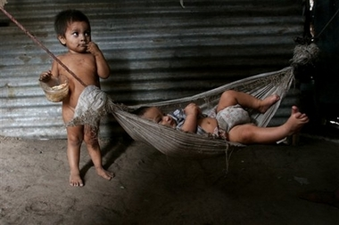
Health Issue: How Mothers/Healers Treat Children with different types of Diarrhoeas.(Mestizo)*Villa Carlos Fonseca, 30 kilometers from Managua
“Sol de Cielo(pujo de sol)-Treatment consists of bath salts with alcohol, herbs, wood and not oil, or very cold water. Diarrhoea is believed considered part of normal development”⁵.
“Fallen fontanelle-Treatments mentioned were pushing the roof of the mouth upwards with the thumb, applying massage, holding baby upside down and hitting it from the bottom of its feet. Diarrhoea believed to be caused by falls, head falling back suddenly, blows to the head, violent coughing, drinking from a bottle with a nipple that was to hard”⁵.
“Dysentery-Majority(90%) of women/healers believe that a doctor was best treatment. Mothers could not identify cause. Many believed it was bad hygiene”⁵.

Slide 18
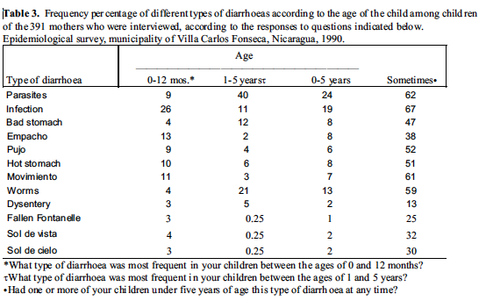
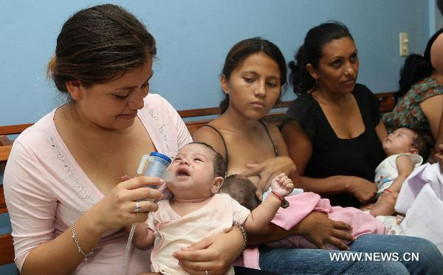
*Empacho-food or beverage sticks onto the wall of the stomach and rots. It can present a danger to the child's life.
Treatment-should be treated with laxatives.

Slide 19
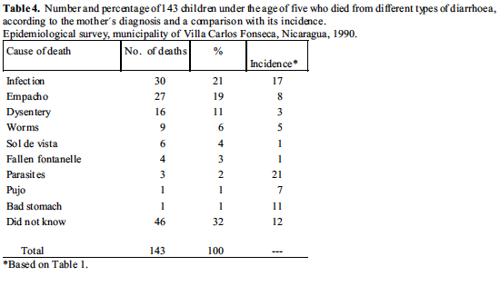
Infections, Empacho, and Dysentery, and worms caused the highest number of deaths.
There was still a factor of uncertainty as the mothers/healers were limited in the knowledge they had of health issues in regards to Diarrhoea.

Slide 20
Other Facts About the Mestizos
“The Creole tend to be wealthier and more educated than their Mestizo counterparts, but also appear to have retained more traditional health behaviors”⁶.
“The largely urban Mestizo and Creole demonstrate the highest levels of wealth and education, but report biomedical solutions to common health problems less often than do the rural Sumu”⁶.
“Four socioeconomic can be used to predict health behavior: (1) location of household, (2) ethnicity of respondent (3) years of education of respondent and (4) household wealth”⁶.
“Average waiting time is longer in each of the four health centers in Bluefields than it is in any of the study villages”⁶.
Conclusion: Health behavior is complicated. Just because an ethnic group is well educated does not mean they do not use traditional medicine. Also in regards to location, it may be more convenient for an ethnic group to stay in their home village where they know they will get some type of help from local health services as opposed to going to the city and having to wait on line.

Slide 21
Childcare References
http://www.fsdinternational.org/country/nicaragua/healthissues
http://www.iadb.org/res/laresnetwork/projects/pr209finaldraft.pdf
http://www.savethechildren.org/site/c.8rKLIXMGIpI4E/b.6151465/k.ED79/Nicaragua.htm
https://www.hindawi.com/journals/jpr/2012/478292/
https://www.researchgate.net/publication/14659497
http://ac.els-cdn.com/0277953693902667/1-s2.0-0277953693902667-main.pdf?_tid=0c011936-a58e-11e6-aa17-00000aacb35e&acdnat=1478594198_eef60886035fc332125b75ae85af65a8

Slide 22
Some Food for Thought

Slide 23
Nicaragua Policies on Health
WHO website:
“There are 2500 persons registered in the registry of traditional medical practitioners. The principal traditional medical specialities are traditional birth attendance, herbalism, spiritualism, and massage”
“The Department of Traditional and Popular Medicine of the Ministry of Health regulates traditional medicine in Nicaragua. No licence is required to practice traditional medicine. While there are no restrictions or legal barriers that limit its practice, the Nicaraguan Academy of Homeopathic Medicine is working towards gaining official status for homeopathy. The National Council of Universities supports homeopathy and accepts its practice by allopathic doctors”
“In 1991, courses in traditional medicine were introduced into allopathic nursing schools, and allopathic nurses began being trained in basic plant therapy and medical anthropology...Though allopathic health personnel may follow these courses, training in traditional medicine is not offered through the official health services”
Notes:
On worldwide status of traditional medicine

Slide 24
Problems with Integrative Medicine
“…many Western doctors are stubborn. They don’t want to recognise that there exist certain [supernatural] things. They want to act like super-doctors, but nobody is a super-doctor.”
Notes:
While many traditional healers will refer their patients to a Western doctor if the cause is biological, not spiritual.
Furthermore, it was a commonly held view among all the traditional healers I interviewed that medical doctors would never send a patient to a traditional healer.
Ex: Grisi Siknis- ‘crazy sickness’, ‘culture-bound’ syndrome

Slide 25
Traditional Knowledge v Belief
“Most of the doctors come from the Pacific [side of Nicaragua]. This is an isolated and abandoned place and many don’t want to come here. When they do, they come with ‘negative expectations’ (mala cara). They clash with our culture, they don’t believe and protest. People ask themselves why they should quarrel and be scolded in a discriminatory way, so they prefer to avoid all this”
Notes:
there also existed a certain uneasiness towards Miskitu healing therapies,
especially nurses and physicians who had little knowledge of Miskitu culture.
For example, it was felt that herbal medicines and other therapies could be toxic and dangerous or that
healers could interrupt biomedical treatments and contribute to non-compliance, or
simply hamper or delay biomedical consultations.
Miskitu medicine was, at best, seen as a possible solution where biomedicine could do no more, rather than a genuine alternative in the daily care of patients.

Slide 26
Possible Solution?
“The doctors here usually don’t send patients to a healer maybe because most of them are from the Pacific [side of Nicaragua] and don’t believe [in Miskitu medicine]. But most of the nurses have also studied traditional medicine at [the local university] URACCAN. [...] Maybe nursing is more open as we accept that a person can go to the healer. We are from the region and from this culture and we understand.”
Notes:
“Biomedical personnel, especially nurses of Miskitu origin, were generally optimistic about therapeutic cooperation and the ongoing development of the New Model of Health. One of them stated that she had ‘…on many occasions recommended a healer’”
Here we can see a quote from a miskitu nurse
A medical doctor with a Miskitu origin who worked in a private clinic in Puerto Cabezas was more open-minded and even claimed that healers are better at treating some ailments. He was positive about therapeutic cooperation, but stated that ‘it has to be well known and respected persons with references if we are to work with them. Then I would do it.’
True working model of health, be it for women or children, need to include not only integration but also an intrinsic understanding of traditional perspectives of health and body.

Slide 27
References
https://www.cia.gov/library/publications/the-world-factbook/geos/nu.html
http://ac.els-cdn.com/0277953693902667/1-s2.0-0277953693902667-main.pdf?_tid=72a4acc8-a1f8-11e6-8ba8-00000aacb360&acdnat=1478200093_4f69cfda26316ac17f6c8db715354896
http://ac.els-cdn.com/027795369400348W/1-s2.0-027795369400348W-main.pdf?_tid=7ae6a406-a200-11e6-b8b5-00000aab0f6c&acdnat=1478203542_1b32da2d706d1fe1e8609b20ccafd13a
http://ac.els-cdn.com/0277953695003363/1-s2.0-0277953695003363-main.pdf?_tid=a9b5dbce-a1f8-11e6-95ec-00000aacb35f&acdnat=1478200185_b099530917967ff5f8b4bc37270eacdc
http://apps.who.int/medicinedocs/en/d/Jh2943e/5.15.html
https://www.researchgate.net/profile/Johan_Wedel/publication/228489007_Bridging_the_Gap_between_Western_and_Indigenous_Medicine_in_Eastern_Nicaragua/links/53dfef5f0cf2a768e49d6ed1.pdf

Slide 28
Summary
Indigenous communities have complicated histories.

Slide 29
Grisi Siknis:
feel anxiety and irritation, followed by headache and dizziness.
Notes:
Grisi Siknis
http://fusion.net/story/17330/nicaraguan-indigenous-village-ravaged-by-crazy-sickness/

Slide 30
History of Indigenous Tensions
Miskitu only wanted to be taught in Miskitu
SUKAWALA (Sumu Kalpapakna Wahaini Lani, or Fraternal Union of Sumu Communities),
MISURASATA (Miskitu, Sumu, Rama and Sandinistas Working Together): radical idealogy
Sandinistas betrayed their ignorance of the cultural complexities of the Coast by ignoring SUKAWALA and simply changing the name of ALPROMISU to MISURASATA, and declared that the exclusively Miskitu leadership of this organisation would now be charged with representing all of the Indian groups on the Coast
Miskitu felt Sandinistas will take their land, MIURA created
Mayangna involved, but today feel bitter and feel deceived.
Notes:
Mayangna ethnic organisation, was permitted to take charge of a literacy campaign in the Mayangna language, not only the first time that many Mayangna learned to read and write,but also the birth of Mayangna itself as a written language
Indian identity in Nicaragua had long been defined in opposition to mestizo identity, as part of a discourse

Slide 31
History of Healthcare
1979 Revolution: Sandinistas won, Somoza lost
‘Health Care Revolution’: unified national health system created, vaccination campaigns, brigadistas (health volunteers)
basic immunization coverage went from <30% - 90%
Contra attacks as early as 1981
By 1986, healthcare development was halted
Notes:
preventive care, medical visits, and pharmaceuticals provided free of charge
brigudistus were provided with training in prevention and treatment of common illnesses.
Each brigudistas was given a kit of eight basic medicines and trained in their use.
Initial training sessions + series of workshops w/ topics such as
maternal-child health, vaccination, oral rehydration, environmental sanitation, malarial prophylaxis and therapy, and treatment of injuries, burns or wounds.
citizen participation in 'peoples health days' (jornadas populares de salud) set records for Nicaragua, for the Central American region, and arguably, for the world. In 1981, more than 80,000 volunteers participated in each of the anti-dengue and anti-malarial health days, more than 20,000 volunteers assisted with polio vaccinations, and over 300,000 children were vaccinated, all in a country of fewer than three million people
polio eliminated, whooping cough, measles, tetanus and TB reduced.
Immunization coverage in the mid-1970s was estimated to be about 10%. By 1983 immunization rates were well over 75% in most areas of Nicaragua, while "mortality due to diseases preventable by immunization in the ages 1-4 dropped from 21 per 10,000 in 1975 to 3 per 10,000 in 1986
infant mortality decreased from more than 100 per 1000 live births in the late 1970s to less than 80 per 1000 by 1983
hindered the development of the national health care system
Clinics were robbed at least 30 times during the years 1981-1985 [39,40]. Dozens of health care workers-mostly brigadistas, but also several doctors and nurses-were killed. Hundreds were scared off. By the time of my arrival in 1986, the revolutionary expansion of health care had ground to a halt.

Slide 32
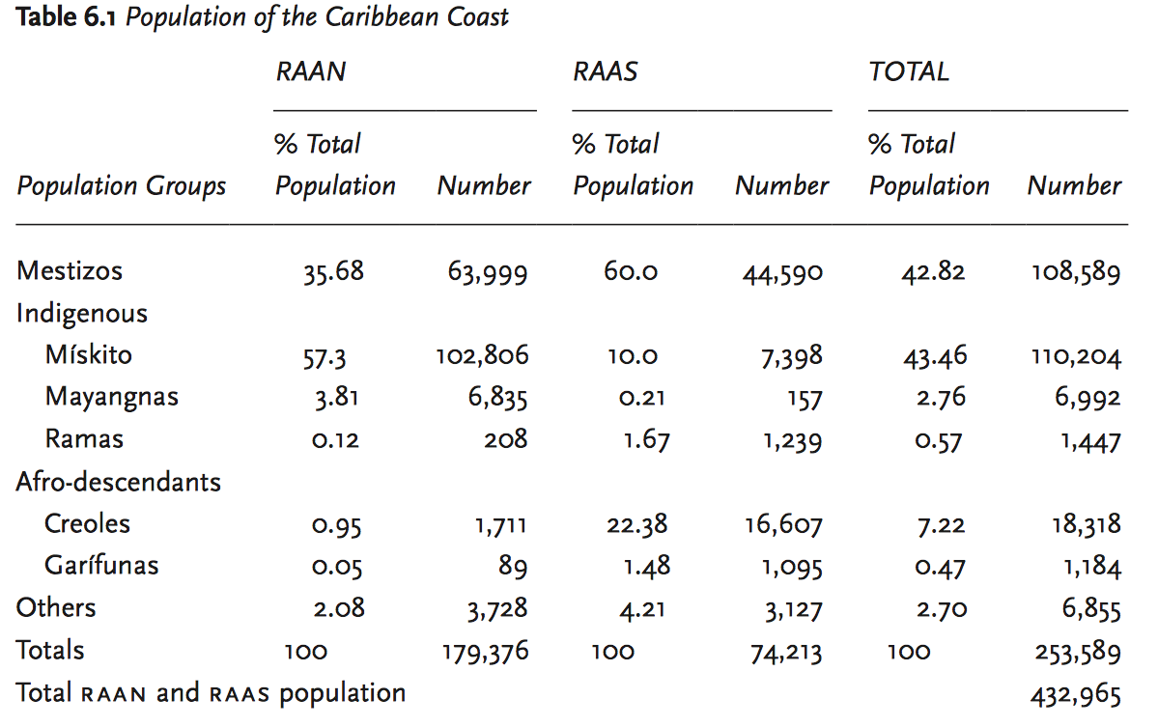
Population Statistics
Total Population of Nicaragua: 5,966,798
Notes:
How many of each group, past & present.
CIA World Factbook: mestizo (mixed Amerindian and white) 69%, white 17%, black 9%, Amerindian 5%
Accuracy? How determined?
Building Partnerships in the Americas (M Krasnoff)
Source: Data consolidated by Acción Médica Cristiana. amc used population data from inide (National Institute for Development Information), “Censo 2005,” Vol. 1. (Managua: inide, 2006), 30. Note that several other sources list higher populations for raan and raas, with up to a 30 percent variance compared to the 2005 census. The exact numbers of the Caribbean Coast population are not consistent even among organizations working in the region.
Est. Pop at beginning of colonization:
Mayangna: 1860s: pre-contact estimate of 30,000 to 5-6,000

Slide 33
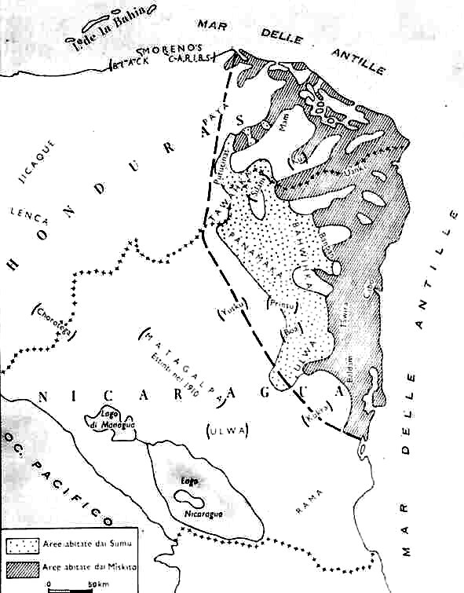
1910 Map
http://www.rivistaetnie.com/wp-content/uploads/2013/02/mappa-miskito.jpg
Notes:
Before Sandonista Revolution (1979)
Note the absence of the names miskito and sumu/mayangna,
Instead there are groups such as ulwa, ulanki, and etc. Shows that modern groups are conglomerations of previously existing tribes
The Mayangna today live mainly in the isolated, mountainous country around the north-western mining centres of Bonanza, Rosita and Siuna, but Mayangna tribes had historically dominated central and eastern Nicaragua, as attested to by the multitude of Mayangna place names that survive across these areas

