Slide 1
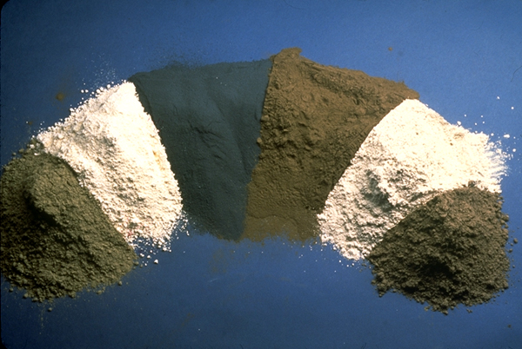
Fly Ash
Presented by Matthew Jones, Andrew Motzkus, and Jason Outlaw.

Slide 2
Production
Fly ash is one of the residues created during the combustion of coal in coal-fired power plants.
Fine particles rise with flue gasses and are collected with filter bags or electrostatic precipitators
Fly ash is a waste by-product material that must be disposed of or recycled
131 million tons of fly ash are produced annual by 460 coal-fired power plants in the U.S. alone.
Notes:
Fly ash is one of the residues created during the combustion process and comprises the fine particles that rise with flue gases.
In the civil and industrial sense the term “fly ash” generally refers to coal fly ash captured from coal-fired power plants which is by far the most predominant fly ash used in construction and industrial applications. Fly ash is a waste by-product material that must be disposed of or recycled. In the past fly ash produced from combustion was simply entrained in flue gases and released into the atmosphere which created environmental concerns that prompted regulation of U.S. emissions down to less than 1% of total fly ash produced.

Slide 3
Production Process

Slide 4
Class F Fly Ash 200x mag.
Bulk fly ash

Slide 5
Chemical Composition
Because fly ash is a by-product material chemical constituents can vary considerably but all fly includes:
Silicon Dioxide (SiO2)
Calcium Oxide (CaO) also known as Lime
Iron (III) Oxide (FeO2)
Aluminum Oxide (Al2O3)
Depending on source coal may include on or more toxic chemicals in trace amounts:
Arsenic, Beryllium, Boron, Cadmium, Chromium, Cobalt, Lead, Manganese, Mercury, Molybdenum, Selenium, Strontium, Thallium, and Vanadium.
Notes:
Depending upon the source and makeup of the coal being burned, the components of fly ash vary considerably, but all fly ash includes substantial amounts of silicon dioxide (SiO2) (both amorphous and crystalline) and calcium oxide (CaO), both being endemic ingredients in many coal-bearing rock strata.

Slide 6
Classes
ASTM C618 Defines two classes of fly ash:
Class C
Class F
ASTM C618 requirements:
Loss of Ignition (LOI) < 4%
75% of ash must have fineness of 45 µm or less
Primary difference between Class C and Class F fly ash is the amount of the amount of calcium, silica, alumina, and iron content in the ash
Notes:
Not all fly ashes meet ASTM C618 requirements, although depending on the application, this may not be necessary. Ash used as a cement replacement must meet strict construction standards, but no standard environmental regulations have been established in the United States. 75% of the ash must have a fineness of 45 µm or less, and have a carbon content, measured by the loss on ignition (LOI), of less than 4%. In the U.S., LOI needs to be under 6%. The particle size distribution of raw fly ash is very often fluctuating constantly, due to changing performance of the coal mills and the boiler performance. This makes it necessary that fly ash used in concrete needs to be processed using separation equipment like mechanical air classifiers. Especially important is the ongoing quality verification. This is mainly expressed by quality control seals like the Bureau of Indian Standards mark or the DCL mark of the Dubai Municipality

Slide 7
Class F
Produced from burning harder, older anthracite and bituminous coal.
Contains less than 20% lime
Requires cementing agent like PC, quick lime, hydrated lime
Used in high sulfate exposure conditions
Addition of air entrainer needed
Used for structural concretes, HP concretes, high sulfate exposure concretes
Useful in high fly ash content concrete mixes
Notes:
Class F- Produced from burning harder, older anthracite and bituminous coal. This fly ash is pozzolanic in nature and contains less than 20% lime (CaO). Class F fly ash requires a cementing agent such as Portland Cement, quick lime, or hydrated lime to react with water and produce cementitious compounds. Class F is generally used in high sulfate exposure conditions. Class F requires the addition of air entrainer. Class F concrete is used in structural concretes, high performance concretes, or high sulfate exposure concretes. Generally high fly ash content mixtures are limited to Class F fly ash. Generated from younger softer coal burned found in mid-west and western coal mines.
Class F fly ash is generally generated when coal from the Appalachian mountain chain is combusted. Such as anthracite or bituminous.

Slide 8
Class C
Produced from burning younger lignite and subbituminous coal
Higher concentration of alkali and sulfate
Contains more than 20% lime
Self-cementing properties
Does not require activator
Does not require air entrainer
Not for use in high sulfate conditions
Primarily residential construction
Limited to low fly ash content concrete mixes
Notes:
Fly ash produced from the burning of younger lignite or subbituminous coal, in addition to having pozzolanic properties, also has some self-cementing properties. In the presence of water, Class C fly ash will harden and gain strength over time. Class C fly ash generally contains more than 20% lime (CaO). Unlike Class F, self-cementing Class C fly ash does not require an activator. Alkali and sulfate (SO₄) contents are generally higher in Class C fly ashes.
At least one US manufacturer has announced a fly ash brick containing up to 50 percent Class C fly ash. Testing shows the bricks meet or exceed the performance standards listed in ASTM C 216 for conventional clay brick; it is also within the allowable shrinkage limits for concrete brick in ASTM C 55, Standard Specification for Concrete Building Brick. It is estimated that the production method used in fly ash bricks will reduce the embodied energy of masonry construction by up to 90%. Bricks and pavers were expected to be available in commercial quantities before the end of 2009

Slide 9
Classes
Class C
Class F

Slide 10
Recycling
General environmental advantages:
Diverts material from wastestream
Reduces the energy investment in processing virgin materials
Conserves virgin materials
Reduces pollution
An Estimated 43% of fly ash generated in the U.S. is re-used.
131 million tons of fly ash are produced annually and approximately 56 million tons of that fly ash is recycled.
Recycling this fly ash saves approximately 36,700 acre-ft of landfill space which is equivalent to roughly 28,200 football fields one foot deep.
Notes:
Environmental advantages by diverting the material from the wastestream, reducing the energy investment in processing virgin materials, conserving virgin materials, and allaying pollution.
In the United States about 131 million tons of fly ash are produced annually by 460 coal-fired power plants. A 2008 industry survey estimated that 43 percent of this ash is re-used. In 2005 U.S. coal-fired power plants reported producing 71.1 million tons of fly ash, of which 29.1 million tons were reused in various applications.[9] If the nearly 42 million tons of unused fly ash had been recycled, it would have reduced the need for approximately 27,500 acre·ft of landfill space.

Slide 11
Recycled Fly Ash Use

Slide 12
Fly Ash Utilization in the U.S.

Slide 13
Disposal
In the past fly ash produced from coal power plants was simply entrained in flue gasses and released into the environment. Now in the U.S., EPA regulations requires greater than 99% of total fly ash produced in a plant to be captured and either stored, recycled, or disposed.
Worldwide, more than 65% of fly ash produced in the world is disposed of in landfills or ash ponds.
In India alone fly ash landfills comprise 40,000 acres of land.
Notes:
In the past fly ash produced from combustions was simply entrained in flue gasses and released into the atmosphere which created environmental and health concern that prompted regulation of fly ash emissions. In the U.S. laws have reduced fly ash emission to less than 1% of total fly ash produced.
Worldwide, more than 65% of fly ash produced in coal power stations is disposed of in landfills or ash ponds. In India alone fly ash landfills comprise 40,000 acres of land.

Slide 14
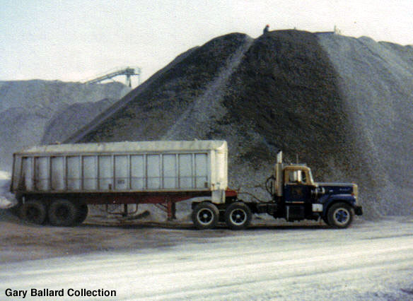
Fly Ash Landfill

Slide 15
Fly Ash Uses
Portland Cement and Grout
Brick and CMU
Embankment/ Structural Fill and Mine Reclamation
Road Subbase
Soil Stabilization
Flowable Fills (CLSM)
Waste Stabilization and Solidification
Raw Feed for Cement Clinkers
Aggregate
Ashphaltic Concrete Mineral Filler
Numerous Agricultural Applications
Notes:
There is no U.S. government tracking or labeling of fly ash reuse. Coal industry survey data, acknowledged as incomplete, is published annually by the American Coal Ash Association Fly ash recycling, in descending frequency, includes usage in:
Portland cement and grout
Embankments and structural fill
Waste stabilization and solidification
Raw feed for cement clinkers
Mine reclamation
Stabilization of soft soils
Road subbase
Aggregate
Flowable fill
Mineral filler in asphaltic concrete
Agricultural uses: soil amendment, fertilizer, cattle feeders, soil stabilization in stock feed yards, and agricultural stakes
Loose application on rivers to melt ice
Loose application on roads and parking lots for ice control
Other applications include cosmetics, toothpaste, kitchen counter tops, ceiling tiles, bowling balls, flotation devices, stucco, utensils, tool handles, picture frames, carpet backing, auto bodies and boat hulls, cellular concrete, geopolymers, roofing tiles, roofing granules, decking, fireplace mantles, cinder block, carpet backing, floor and ceiling tile, PVC pipe, Structural Insulated Panels, house siding and trim, running tracks, blasting grit, recycled plastic lumber, utility poles and crossarms, railway sleepers, highway sound barriers, marine pilings, doors, window frames, scaffolding, sign posts, crypts, columns, railroad ties, vinyl flooring, paving stones, shower stalls, garage doors, park benches, landscape timbers, planters, pallet blocks, molding, mail boxes, artificial reef, binding agent, paints and undercoatings, metal castings, and filler in wood and plastic products.

Slide 16
Fly Ash in P.C. Concrete
Roman structures including the aqueducts and the Pantheon in Rome used volcanic ash which possess very similar properties to fly ash
Use of fly ash as a pozzolanic ingredient was recognized as early as 1914 but first noteworthy study of its use in Portland Cement concrete was in 1937
30% of fly ash in the U.S. is recycled into making concrete.
Notes:
Thirty percent of the flyash in the US is recycled into making concrete.
Owing to its pozzolanic properties, fly ash is used as a replacement for some of the Portland cement content of concrete.The use of fly ash as a pozzolanic ingredient was recognized as early as 1914, although the earliest noteworthy study of its use was in 1937. Before its use was lost to the Dark Ages, Roman structures such as aqueducts or the Pantheon in Rome used volcanic ash (which possesses similar properties to fly ash) as pozzolan in their concrete. As pozzolans greatly improve the strength and durability of concrete, the use of ash is a key factor in their preservation.

Slide 17
Fly Ash in P.C. Concrete
Environmental Benefits
Supplementing cementitious materials with fly ash reduces Portland Cement demand
Reduces volume of landfilled fly ash
Conserves water by reducing water demand in concrete mixes
Physical/Mechanical Benefits
Increased Strength
Decreases Permeability
Generally Increases Durability
Increased Sulfate Resistance (Class F)
Reduces Water Demand/ Increases Workability
Reduces Segregation and Bleeding
Lowers Heat of Hydration
Reduces Corrosion of Reinforcing Steel
Generally (Mostly Class F) reduces Alkali-Silica Reaction (ASR)
Notes:
Flyash affects the plastic properties of concrete by improving workability, reducing water demand, reducing segregation and bleeding, and lowering heat of hydration. Flyash increases strength, reduces permeability, reduces corrosion of reinforcing steel, increases sulphate resistance, and reduces alkali-aggregate reaction. Flyash reaches its maximum strength more slowly than concrete made with only portland cement

Slide 18
Fly Ash in P.C. Concrete
Fly ash acts as a pozzolan when used as a supplementary cementitious material in concrete.
Pozzolans are materials which, when combined with calcium hydroxide, exhibit cementitious properties.
Pozzolans hydrate in the presence of water in a similar fashion as Portland Cement but do not generate the strength that P.C. bonds do and generally gain strength slowly over a much greater period of time.
Many by-product pozzolans exist such as Blast Furnace Slag, Silica Fume, Cement-kiln Dust, and Rice Husk ash which impart varying affects on concrete plastic and mechanical properties but fly ash is by far the most widely used in concrete applications.
Notes:
Pozzolan is a material which, when combined with calcium hydroxide, exhibits cementitious properties. Pozzolans are commonly used as an addition (the technical term is "cement extender") to Portland cement concrete mixtures to increase the long-term strength and other material properties of Portland cement concrete, and in some cases reduce the material cost of concrete. Pozzolans are primarily vitreous siliceous materials which react with calcium hydroxide to form calcium silicates; other cementitious materials may also be formed depending on the constituents of the pozzolan.

Slide 19
Class C vs. Class F Fly Ash Concretes
1. Class C fly ash is typically not as effective as Class F fly ash in mitigation of ASR.
2. Class C will generate more heat of hydration than Class F.
3. Class C will generally not be as resistant to sulfate attack. ASTM C 618 prohibits the use of Class C in high sulfate exposure environments
4. Class C will generate more strength at early ages than Class F.
Generally Class F can be used for high fly ash content concretes (up to 40% of C.M.) whereas Class C is used in low fly ash content concretes

Slide 20
Fly Ash Bricks and CMU’s
Fly ash bricks are durable, have low water absorption, less consumption of mortar, and are economical/eco-friendly.
Fly ash bricks can have up to three times the strength of conventional bricks
Fly ash bricks can utilize up to 50% Class C fly ash.
Fly ash brick production can reduce the embodied energy of masonry construction by up to 90%.

Slide 21
Flowable Fill
Flowable fill is used as a self-leveling, self compacting backfill material that replaces compacted soils or granular fill.
The strength of the flowable fill varies from 50 to 1,200 lbf/in².
Fly ash generally supplements the Portland cement in greater volume than fly ash concretes it also acts as a mineral filler.
Mainly used in place of concrete to reduce dead loads and allow for future excavation if necessary.
The fine particulate of the fly ash acts as ball bearings allowing it to flow freely.
Generally Class C fly ash is used for flowable fill.

Slide 22
Flowable Fill

Slide 23
Soil Stabilization
Soil stabilization is the permanent physical and chemical alteration of soils to enhance their properties.
Using fly ash as a soil stabilization can increase shear strength, control the shrink-swell properties of the soil, and improve the load bearing capacity.
Benefits include higher resistance (R) values, reduction in plasticity, lower permeability, and elimination of excavation.

Slide 24
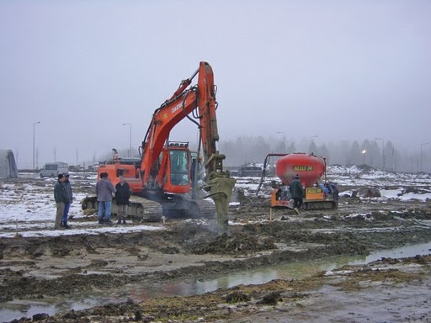
Soil Stabilization
A sheep’s foot roller is commonly used to add the fly ash to the soil.
Also specialized equipment can be utilized to pump fly ash or other stabilizers into the soil.
Class C fly ash is used in soil stabilization

Slide 25
Embankment/Structural Fill
Nearly all fly ash used for embankment fill is Class F fly ash.
Fly ash offers several advantages over soil fills
Lower unit weight reduces dead loads and induced settlement of sub-soil
High shear strength compared with its low unit weight for good bearing support
Ease of placement and compaction can reduce construction time and cost
Disadvantages
Dust control measures may be needed
Fly ash is subject to erosion which must be accounted for

Slide 26
Environmental Impacts
Pros
Reduces green house gas emission as a cement replacement material
For every one ton of cement produced about 6.5 million BTUs of energy is consumed. Replacing that 1 ton of cement with fly ash would save enough electricity to power the average American home for almost a month.
For every one ton of cement produced about one ton of carbon dioxide is released.
Reduces volume of landfill space used for disposal of fly ash

Slide 27
Environmental Impacts
Cons
Possibility of leaching toxic substances in into soil, water, atmosphere.
EPA has proven that heavy metals have been leached from fly ash into ground water and underground aquifers in 39 locations in the U.S.
The extent of leaching and hazardousness to humans of fly ash leachate is still unclear but the EPA is investigating it currently
Large ruptures of fly ash ponds, dams, or retention walls can cause catastrophic environmental damage to ecosystems and contaminate large areas with toxic substances.

Slide 28
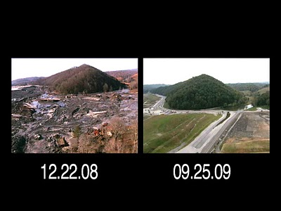
TVA Coal Ash Pond Rupture- 2008
Notes:
-40-acre pond holding coal combustion waste for a Tennessee Valley Authority (TVA) steam power plant ruptured
-largest coal slurry spill in U.S. history
-contained 2.6 million cubic yards of fly ash and bottom ash
-heavy rains and freezing temperatures could be to blame

Slide 29
Go Cocks!

Slide 30
References
http://www.flyash.com/
http://www.epa.gov/osw/conserve/rrr/imr/ccps/flyash.htm
http://www.flyash.info/l
redgreenandblue.org/.../tva-coal-ash-disaster-much-worse-than-originally- thought/ -
http://pubs.usgs.gov/fs/1997/fs163-97/FS-163-97.htm
http://en.wikipedia.org/wiki/Fly_ash

