Slide 1
Fly Ash Utilization in Concrete
Dr. Earl Ingram, P.E.
President
Ingram Readymix, Inc.

Slide 2
Supplementary Cementitious Material (SCM)
SCM’s are materials that contribute to the properties of hardened concrete through hydraulic and/or pozzolanic activity.
Fly Ash is a pozzolan that possesses little or no cementitious properties by itself.
Fly Ash will react with calcium hydroxide generated during cement hydration to form compounds having cementitious properties.

Slide 3
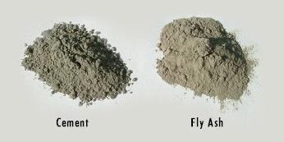
Typical Fly Ash Usage Rates
Normal cement replacement with fly ash ranges from 15% to 30% by weight
LEED projects often specify cement replacement in the range of 40% to 60%

Slide 4
Short Term Benefits of Concrete Containing Fly Ash
Reduced heat of hydration
Increased set times (retardation)
Decreased water demand
Reduced bleeding
Easier to pump
Increased workability (at moderate replacement rates ,<30%)

Slide 5
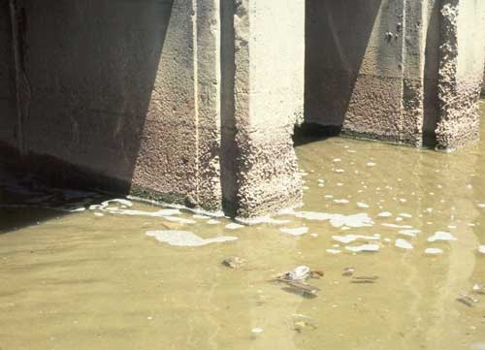
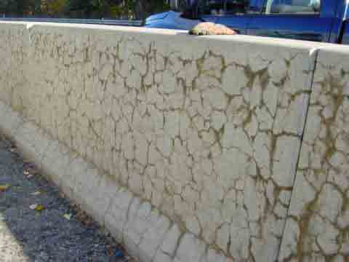
Long Term Benefits of Concrete Containing Fly Ash
Increased sulfate resistance
Alkali-Silica Reaction (ASR) mitigation

Slide 6
Long Term Benefits of Concrete Containing Fly Ash
Reduced permeability
Reduced cost
Reduction in use of virgin raw materials

Slide 7
Disadvantages of Concrete Containing Fly Ash
Supply uncertainty
Increased/variable set times (retardation)
Reduced bleeding
Slower strength gain
Difficult to entrain air

Slide 8
Logistical Impact on Cement Industry
Texas annual cement consumption in concrete is approximately 14 million tons, while Texas cement production is approximately 12 million tons.
Texas annual fly ash consumption in concrete is approximately 3-4 million tons.
Since every ton on fly ash used is replaces a ton of manufactured cement, the elimination of fly as would create an additional cement demand of 3-4 million tons in Texas, annually.
Texas cement consumption already surpasses the amount of cement produced in Texas.

Slide 9
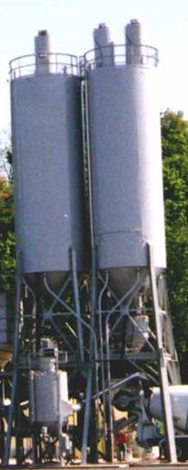
Logistical Impact on Concrete Industry
Fly Ash and Cement are stored in silos. Most concrete plants have 1 cement silo, and 1 fly ash silo. Emptying silos to change products is a slow and difficult task.
Engineered jobs do not allow material changes without significant testing, thereby causing significant delays.

Slide 10
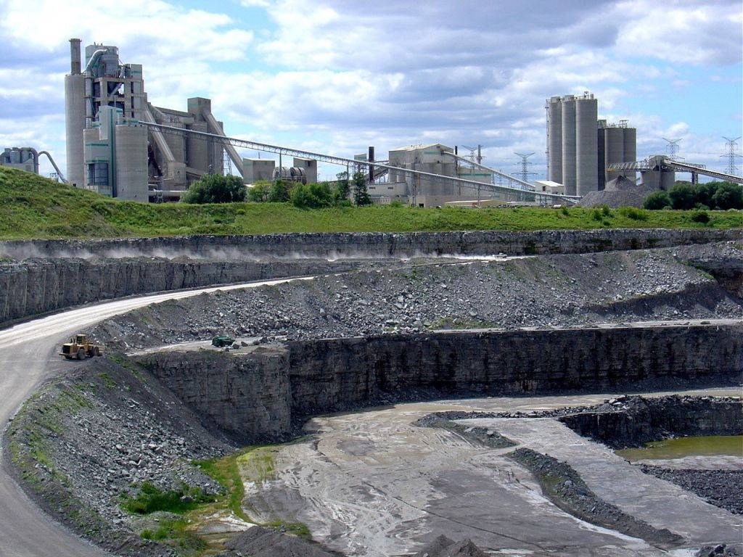
Environmental Impact
Approximately 1.8 tons of aggregate must be mined to create 1 ton of cement.
Coal-fired kiln used to produce clinker

Slide 11
Conclusion
Fly Ash supply is vital to ASR mitigation, sulfate attack resistance, construction cost reduction, and natural resource preservation
Texas cement consumption has already surpassed domestic production.

Slide 12
References
Thomas, Michael, “Optimizing the Use of Fly Ash in Concrete,” www.cement.org, Portland Cement Association, Skokie, IL, 2007
Kosmatka, S.H.; Kerkhoff, B.; and Panarese, W.C., “Design and
Control of Concrete Mixtures,” 13th Edition, Portland Cement Association, Skokie, IL, 1990
ACI Committee 305, “Hot Weather Concreting (ACI 305R-99),”
American Concrete Institute, Farmington Hills, MI, 1999
ACI Committee 308, “Guide to Curing Concrete (ACI 308R-01),”
American Concrete Institute, Farmington Hills, MI, 2001
NRMCA, Concrete In Practice, “CIP 12- Hot Weather Concreting,” National Ready Mixed and Concrete Association, Silver Spring, MD, 2000

Slide 13
Questions?

