Slide 1
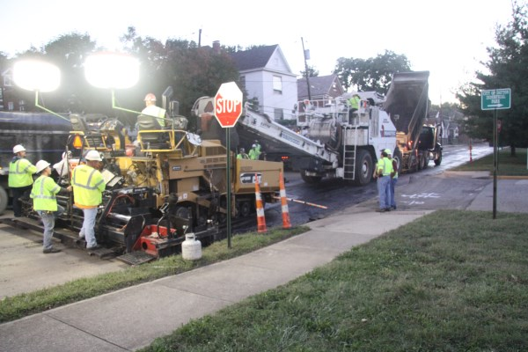
Rubberized Asphalt Pavement
Waste Tire Working Group
Department for Environmental Protection
Energy and Environment Cabinet
December 3, 2013
Notes:
I-35 San Antonio TX RPA

Slide 2
Rubberized Asphalt Pavements
Topics
Why Rubberized Asphalt?
Common Questions & Answers
Possible Kentucky Uses
Pilot Project
Where do we go from here?
Resources
Notes:
Specs written without much thought.
Trial-and-error projects commenced
Was to be the primary scrap tire market in U.S.

Slide 3
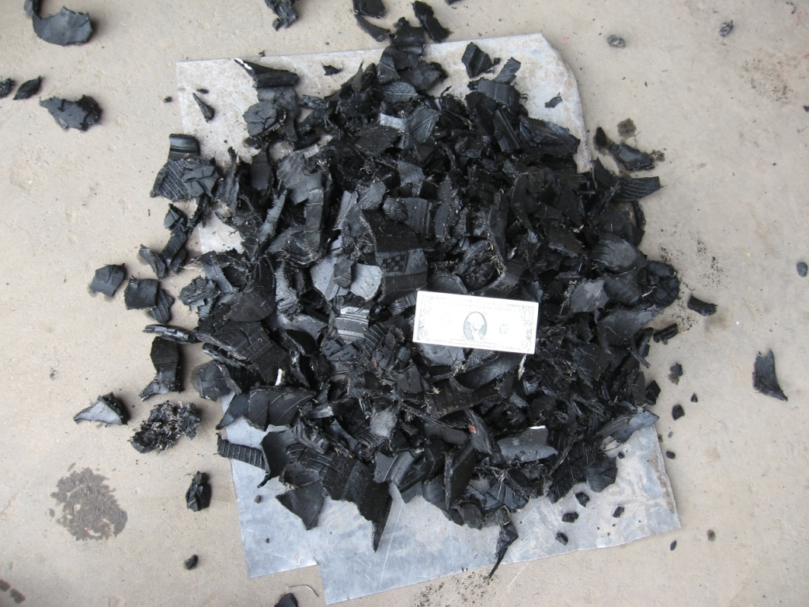
Why Rubberized Asphalt?
Tire Derived Fuel $20-40/ton
Notes:
Specs written without much thought.
Trial-and-error projects commenced
Was to be the primary scrap tire market in U.S.

Slide 4
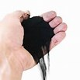
Why Rubberized Asphalt?
Crumb rubber $200-400/ton
Notes:
Specs written without much thought.
Trial-and-error projects commenced
Was to be the primary scrap tire market in U.S.

Slide 5
Rubberized Asphalt Pavements
81% Waste Tires Recycled in KY
18% still landfilled
Notes:
Specs tried & true
Evaluate based on engineering properties

Slide 6
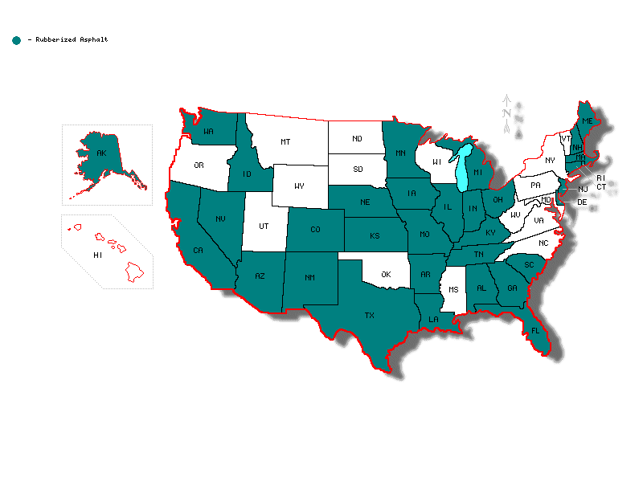
U. S. Markets or Tests

Slide 7
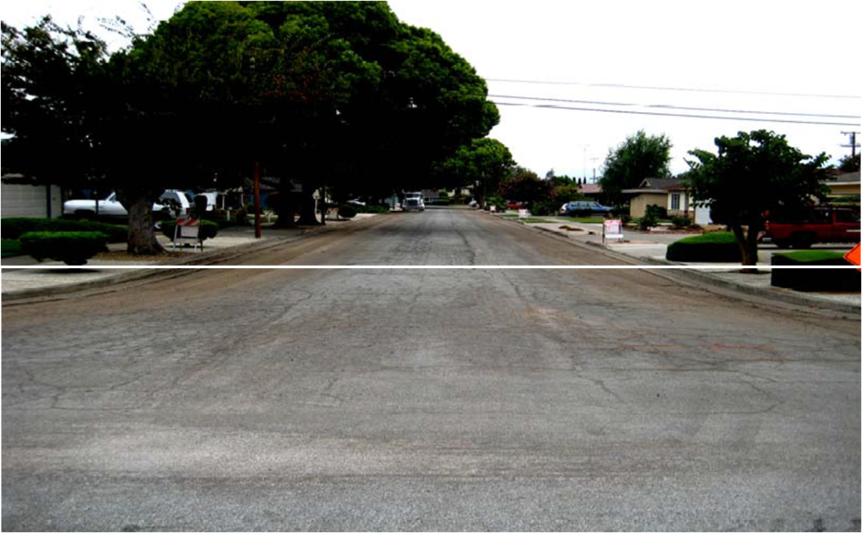
Binder and Pavement Rehabilitation
Stress Absorbing Membrane Interlayer (SAMI)
SAM with Rubberized Gap Graded Asphalt overlying layer
Before: San Jose, p. 4 Western Pavement Maintenance Forum
2009 Award of Excellence in Contracting Chip Seal / Innovation Category

Slide 8
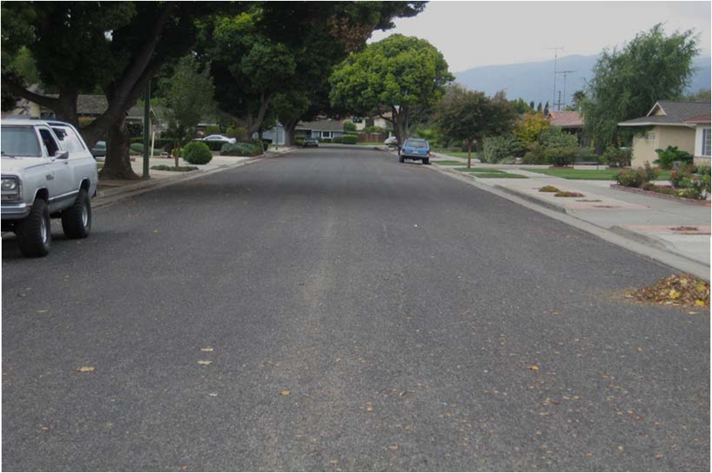
Binder and Pavement Rehabilitation
After: San Jose, p. 5 Western Pavement Maintenance Forum
2009 Award of Excellence in Contracting Chip Seal / Innovation Category

Slide 9
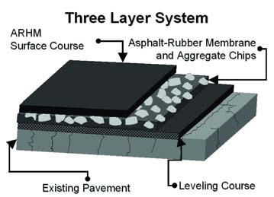
Binder and Pavement Rehabilitation
TWO AND THREE LAYER SYSTEMS
Asphalt-rubber SAMI and either the gap or open graded hot mix material as the final wearing course
Avoids costly reconstruction

Slide 10
Frequently Asked Questions
How many waste tires can be used?
A two-inch-thick RAC resurfacing project uses about 2,000 scrap tires per lane mile (CAL Recycle)
Depending on type of use, 500-2,000 tires per lane-mile (Liberty Tire)

Slide 11
Frequently Asked Questions
How many waste tires are used?
rubberized asphalt uses 100 million pounds of crumb rubber per year (RMA Market Report for 2007).
2% U.S. Waste Tire Generation
FL highest with 5% of annual
waste tire generation

Slide 12
Frequently Asked Questions
Why isn’t it more widely used?
“Experimental”
Engineers expected comfort with the usual materials
Test sections needed to familiarize engineers, contractors, plant operators
Training of asphalt plant hot mix operators by AR operators is required

Slide 13
Frequently Asked Questions
Does the use of rubber cause dangerous emissions?
New additives reduce emissions
NIOSH finds emissions no more generally than conventional asphalt
Aroma is different

Slide 14
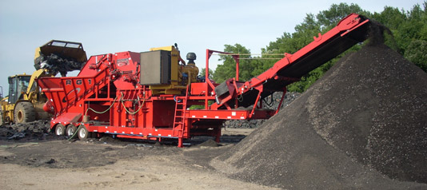
Frequently Asked Questions
Can rubberized asphalt be recycled?
City of Los Angeles. LA., recycled a 12-year old RA pavement
Met specifications and passed all tests

Slide 15
Frequently Asked Questions
Can RA be used in cold climates?
California uses in Sierra Mountains
Alaska and Sweden use to counter snow tires stud damage
Massachusetts and New Jersey use
Proper mix design and construction practices are critical (no OGFC)

Slide 16
Possible Uses in KY
Polymer Replacement
Polymer shortage increased cost in 2008 and changed projects
KY TC paved interstates using PG specs without polymer
Rutting susceptibility potential increased and pavement endurance decreased
TC wants to be in a position to continue paving should polymer shortage return

Slide 17
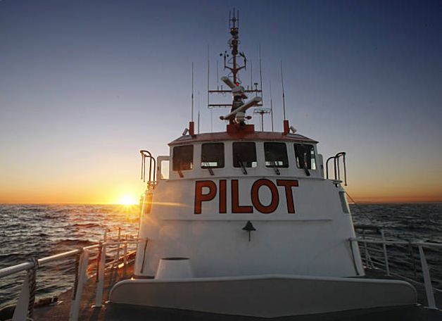
Pilot Project
Eaton Asphalt Paving Co.
To Protect and Enhance Kentucky’s Environment
TAG Resource Recovery
Modified Asphalt Solutions, Inc

Slide 18
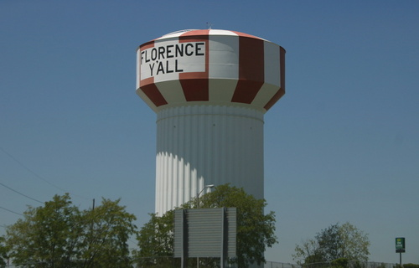
Pilot Project
July 24, 2013 Planning Meet at District 6, Florence:
Rejected KY 18 (Road to Florence Mall from I-75) due to structural problems with underlying concrete
Selected KY 8 (2.2 mile from I-471 to Dayton KY)

Slide 19
Pilot Project
July 24, 2013 Planning Meet at District 6, Florence:
One lane is control using standard asphalt and 0.38A PG 76-22 (interstate grade) Superpave 0.38 spec.
Both 6.0% base asphalt, 5.0-5.2% liquid with 20% RAP
Other lane is same as above plus 14% ground tire rubber with 100% passing #30 size

Slide 20
Pilot Project
July 24, 2013 Planning Meet at District 6, Florence:
EEC to pay $85,000 over initial $651,000 project costs
$70,000 to TC for rubberized asphalt and interstate quality asphalt over regular street asphalt
$15,000 to UK for long-term testing

Slide 21
Pilot Project
September 25, 2013 Preconstruction Meet and Project Start:
Discussed testing
Ingredient added to make rubberized asphalt handle similar to regular asphalt, decreases rubber smell

Slide 22
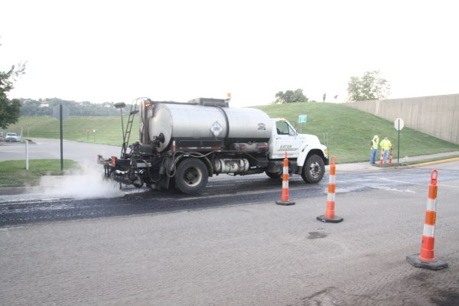
Pilot Project
Spraying the tack coat looking northeast. Ohio River floodwall on right and background. Photo by Mark Belshe RPA

Slide 23
Pilot Project
Paving train applying rubberized asphalt looking west. Photo by Mark Belshe RPA

Slide 24
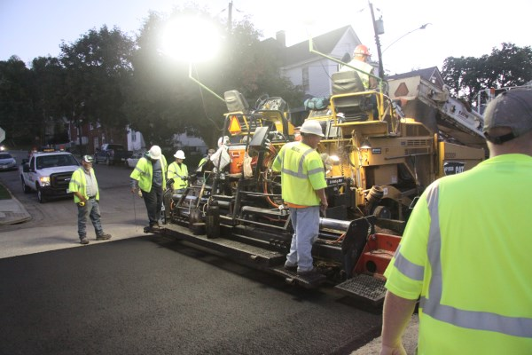
Pilot Project
Paving train applying rubberized asphalt looking southwest. Photo by Mark Belshe RPA

Slide 25
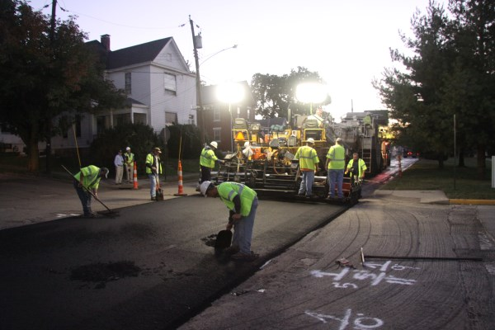
Pilot Project
Workers smoothing rubberized asphalt around manholes looking southwest. Photo by Mark Belshe RPA

Slide 26
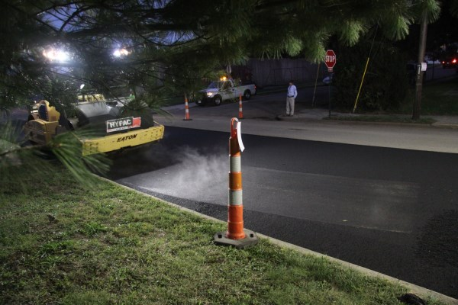
Pilot Project
Vibratory roller with view to southeast.
Photo by Mark Belshe RPA

Slide 27
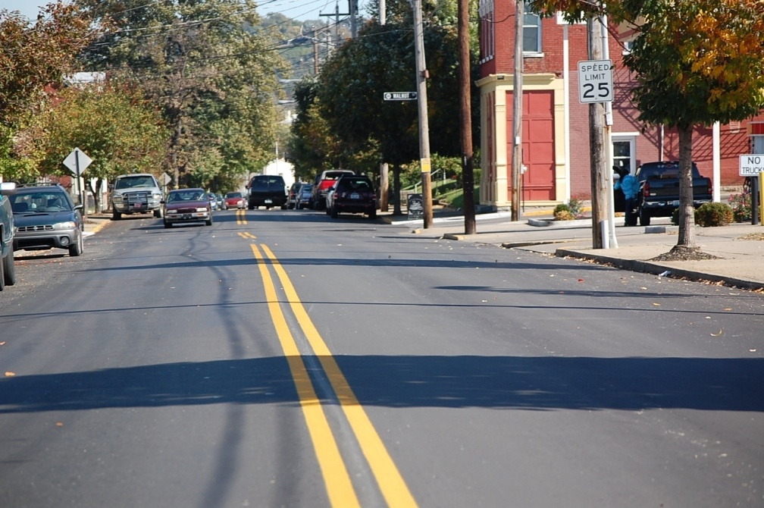
Pilot Project
Downtown Dayton KY rubberized and polymer asphalt. Photo by Brian Donnelly TC

Slide 28
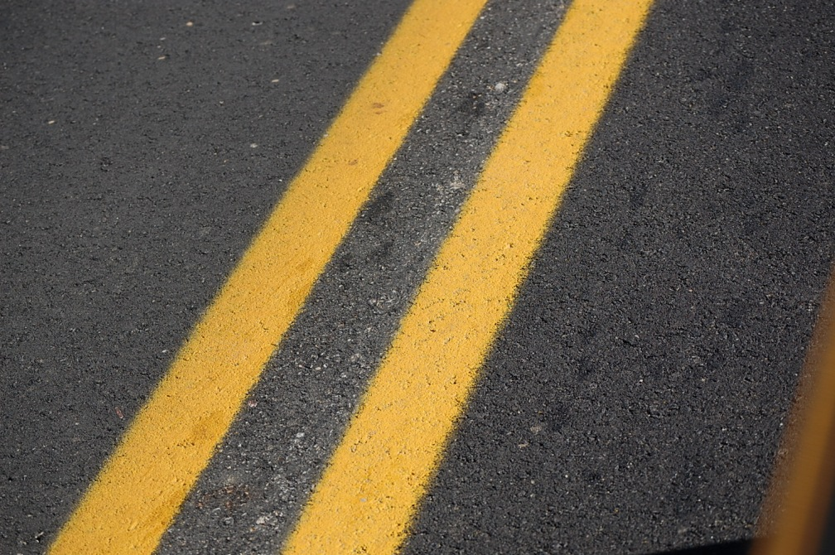
Pilot Project
Close-Up of control and rubberized asphalt. Photo by Brian Donnelly TC.

Slide 29
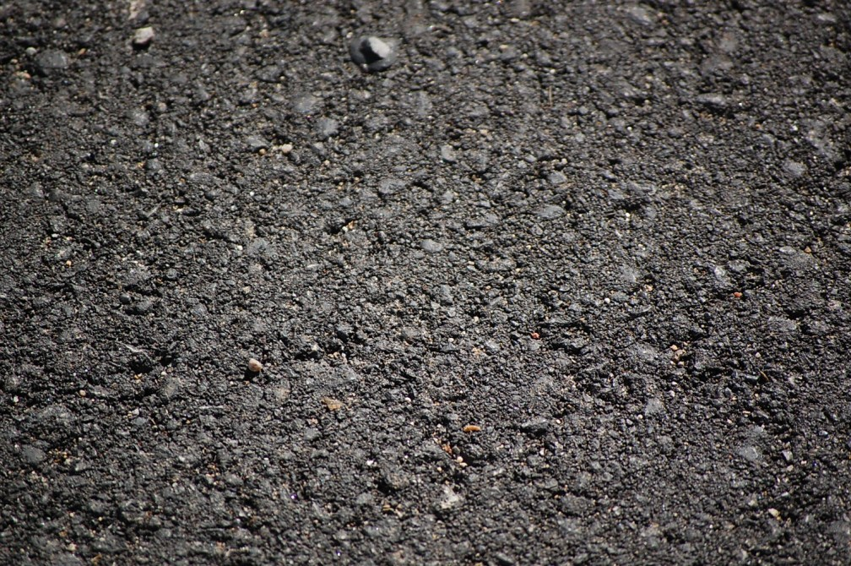
Pilot Project
Close-up of rubberized asphalt. Photo by Brian Donnelly TC.

Slide 30
Pilot Project Results
Density Tests: 100% payment or 92% density
Initially there were high void content in the mix, but this was quickly brought under control with deletion of sand and add 0.3% asphalt.

Slide 31
Pilot Project Results
Constant adjustments made at plant
District 6 QA suspects rubber settlement occurred
Contractor says 14% AR too high
Rubber particles meet spec (100% passing #30 sieve)
RPA engineer says worked like regular asphalt
FL DOT says watch settling of rubber particles (stir, haul distance)

Slide 32
KTC Pilot Project Results
KY Transportation Center permeability tests yield normal results
Spring: Skid testing, visual survey, another round of cores

Slide 33
Pilot Lessons Learned
Look at lower AR% used by other states: FL 10%, GA 5%
May require +polymer or additive
May require KY to lower elasticity spec from 75% to 70% or lower (KY highest in U.S.)

Slide 34
Pilot Lessons Learned
Do another pilot project that meets 70-22 GTR spec and do long-term testing (contractor)
Not many contractors in state have vertical tanks or stirring equipment like Eaton
KY not ready if polymer prices increase

Slide 35
Pilot lessons Learned
Rubberized Asphalt currently costs $12.00 per ton vs. $8.00 polymer-modified asphalt
Costs good only for this project
Costs varies with transportation distance and other factors
May swing the other direction with polymer shortage

Slide 36
After Pilot
KTC & DWM attended Rubberized Asphalt Conference in AZ Oct. 14-17, 2013
DWM led round table at KACo annual meeting November 21
Presentation to Annual Meeting for Plantmix Asphalt Industry of Kentucky in February 2014 at Louisville

Slide 37
After Pilot
Plot polymer shortage strategy with Division of Materials to adjust specs , tests or recommendations
Pursue future hot-mix pilot with Transportation Cabinet
Pursue chip-seal pilots with counties

Slide 38
Resources

Slide 39
Resources

Slide 40
Resources
http://rubberpavements.org/
http://www.ra-foundation.org/

Slide 41
Resoruces
http://www.rma.org/scrap-tires/
Notes:
For scrap tires, Divert 85% of newly generated scrap tires to reuse, recycling or energy recovery by 2008 (vs. 70% in 2003)
The goal of the RCC is to achieve a 35% US Recycling rate by 2008 (with 2003 as a baseline).
I am Vice-Chair of the U.S. EPA RCC Scrap tire TDF committee. It is made up of federal, state and industry professionals. Mike Giuranna of U.S. EPA, Region III is the chairman.

Slide 42
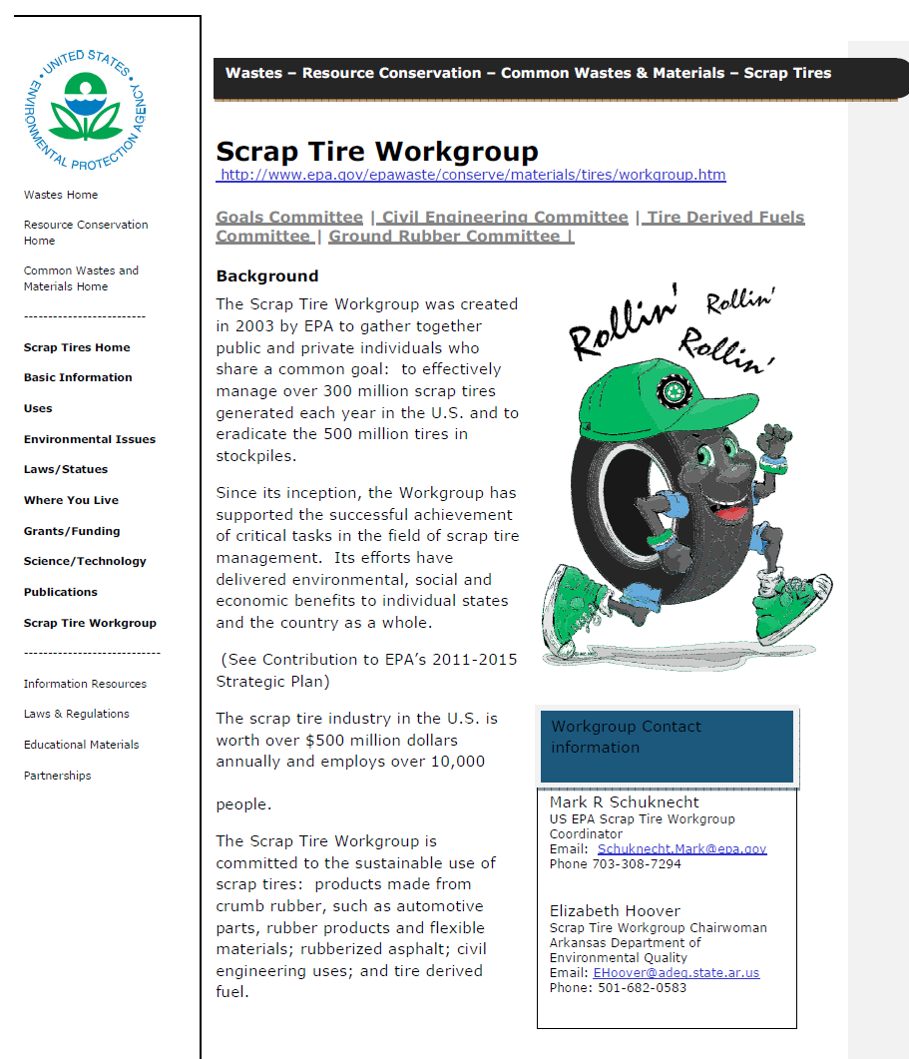
Resources
U.S. EPA
Scrap Tire Workgroup Website
http://www.epa.gov/wastes/conserve/materials/tires/workgroup.htm
Notes:
For scrap tires, Divert 85% of newly generated scrap tires to reuse, recycling or energy recovery by 2008 (vs. 70% in 2003)
The goal of the RCC is to achieve a 35% US Recycling rate by 2008 (with 2003 as a baseline).
I am Vice-Chair of the U.S. EPA RCC Scrap tire TDF committee. It is made up of federal, state and industry professionals. Mike Giuranna of U.S. EPA, Region III is the chairman.

Slide 43
Questions?
George Gilbert, P.E.
Environmental Engineer Consultant
Director’s Office
KY Division of Waste Management
george.gilbert@ky.gov
(502) 564-6716
Member U.S. EPA Scrap Tire Committee
To Protect and Enhance Kentucky’s Environment

