Slide 1
Nitrogen Fixation

Slide 2
Introduction
Plants, animals and microorganisms can die of nitrogen deficiency.
All organisms use the ammonia (NH3) form of nitrogen
to manufacture amino acids, proteins, nucleic acids
and other nitrogen-containing components
necessary for life.

Slide 3
Introduction
The air we breathe is 78% N2 and only 21% oxygen
Nitrogen is the most abundant element in our atmosphere. It is a vital element as many classes of compounds essential to living systems are nitrogen-containing compounds.
Nitrogen is a primary nutrient for all green plants, but it must be modified before it can be readily utilized by most living systems.

Slide 4
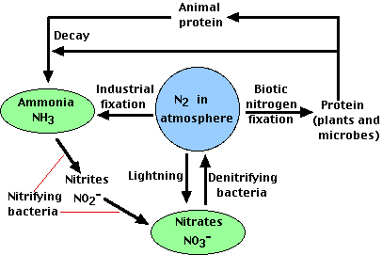
Nitrogen Fixation

Slide 5
Nitrogen fixation
Nitrogen fixation is one process by which molecular nitrogen is reduced to form ammonia. This complex process is carried out by nitrogen-fixing bacteria present in the soil. Although nitrogen-fixation involves a number of oxidation-reduction reactions that occur sequentially, that reaction which describes its reduction can be written in a simplified way as:
N₂ + 6 e⁻ + 8H⁺ ---> 2 NH₄⁺ (ammonium ion)

Slide 6
Nitrification
Nitrification is the biological conversion of ammonium to nitrate
Nitrification is a two-step process.
In the first step of nitrification, ammonia-oxidizing bacteria oxidize ammonia to nitrite
NH3 + O2 → NO2-+ 3H+ + 2e- (1)
Bacteria known as Nitrosomonas convert ammonia and ammonium to nitrite

Slide 7
Nitrification
In the second step of the process, nitrite-oxidizing bacteria oxidize nitrite to nitrate
NO2- + H2O → NO3- + 2H+ +2e-
Nitrobacter oxidize the nitrites to nitrates (NO₃⁻).

Slide 8
Denitrification
Denitrification is the biological reduction of nitrate (NO3) to nitrogen gas (N2)
When bacteria break apart nitrate (NO3-) to gain the oxygen (O2), the nitrate is reduced to nitrous oxide (N2O), and, in turn, nitrogen gas (N2).
6NO3- + 5CH3OH ---> 3N2 + 5CO2 + 7H2O + 6OH
When the O depleted and nitrate becomes the primary oxygen source for microorganisms.

Slide 9
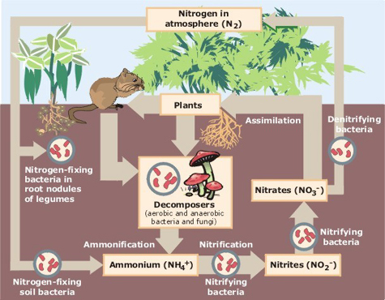
Nitrogen fixation by cyanobacteria

Slide 10
Case Study
Toxic cyanobacteria had become a major concern throughout the
world and the WorldHealth Organization:
identify toxic cyanobacteria throughout your study?
What methods used to detect and identify cyanotoxins?
Evidence results from your study of human populations that have shown symptoms of poisoning or injury attributed to the presence of cyanotoxins?

