Slide 1
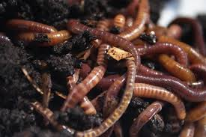
Effects of Pesticide use on Vermicompost

Slide 2
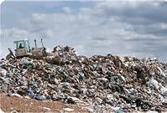
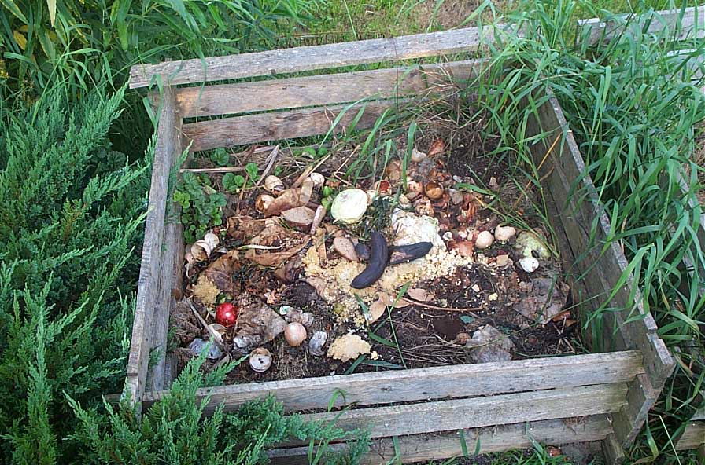
Importance of Composting
Proper disposal of organic wastes.
Done on a large agricultural scale or in backyard gardens.
Allows for recycling of nutrients and can increase soil fertility.

Slide 3
A Method of Composting - Vermiculture
Uses earthworms to break down organic wastes.
Wastes are ingested and are broken down as they pass through the gut.
Castings are very nutrient rich.

Slide 4
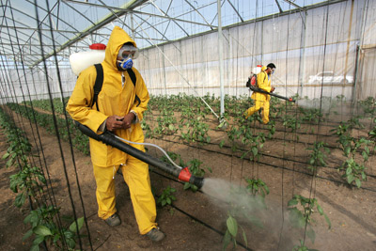
Pesticides and Vermiculture

Slide 5
Our hypotheses:
H_{o}: There will be no difference in decomposition rates between organically grown food and produce grown with pesticides by Red Wiggler worms (Eisenia fetida).
H_{a}: There will be a difference in decomposition rates between organically grown food and produce grown with pesticides by Red Wiggler worms (Eisenia fetida).

Slide 6
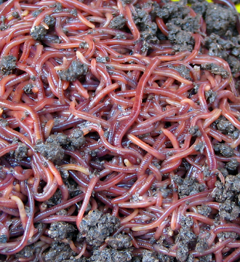
Eisenia fetida

Slide 7
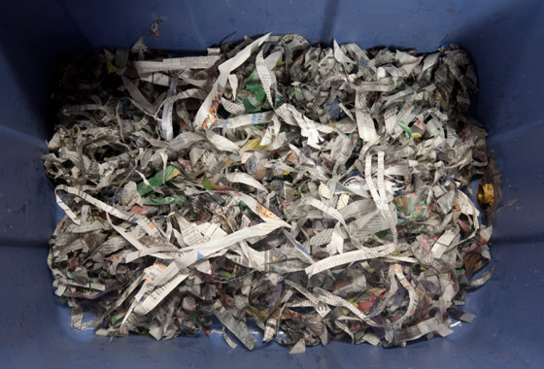
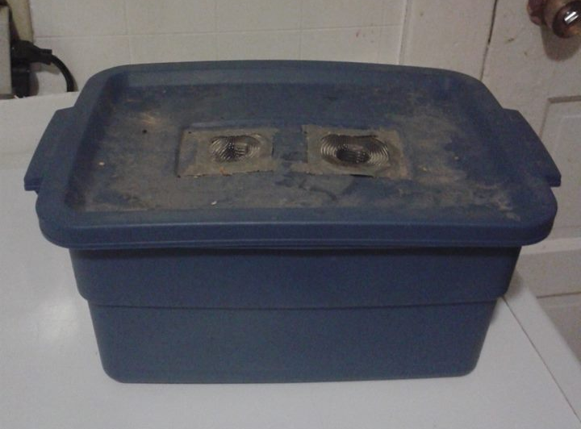
Methods
Set up two separate worm bins.
Newspaper and soil were the bedding materials used.
Same mass of worms was added to each bin.

Slide 8
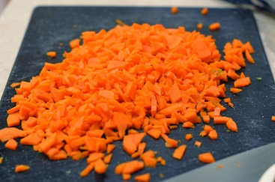
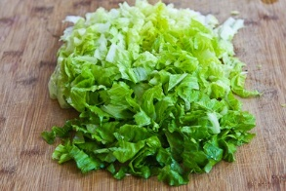
Methods
Produce was cut into small, uniform, pieces and added to the bins.
Carrots were tested in both bins first, followed by lettuce.
Decomposition was measured by loss in mass of vegetables over time.

Slide 9
Methods
Measurement was done by removing vegetables from the bins and weighing them over specific time intervals.
Improvement was made after troubleshooting the carrot experiment.

Slide 10
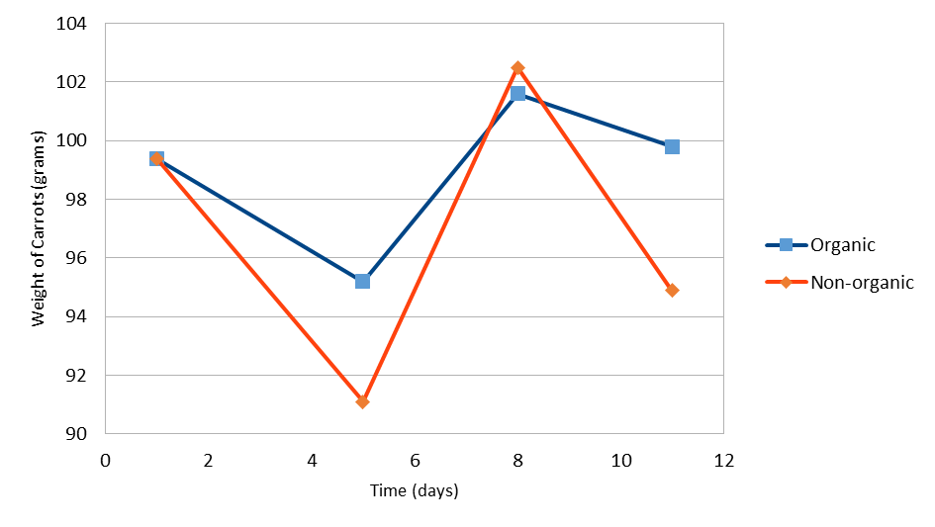
Our Findings
Carrot data was flawed and was omitted.

Slide 11
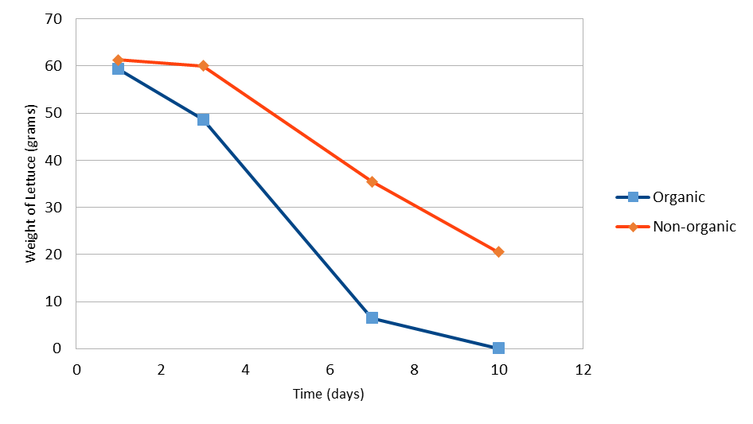
Our Findings
Both organic and non-organic lettuce showed a decrease in mass over time.
The worms broke down the organic lettuce at a faster rate.

Slide 12
What do our Results Mean?
From the lettuce data, our results suggest that pesticides do have an effect on worms’ ability to break down organic materials.
Results from other studies also suggest that this may be the case.

Slide 13
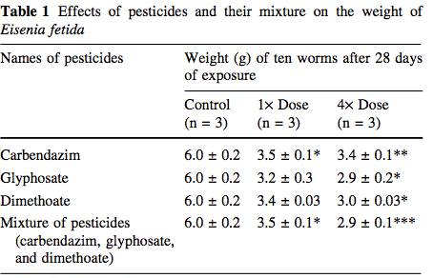
Yasmin and D’Souza (2007)
Found that reproduction and growth rates of Red Wigglers were negatively affected by pesticides.
However, it was unclear if the pesticides affected worms feeding rate of ability to uptake nutrients because food was not weighed.

Slide 14
De Silva et al (2010)
Effects of pesticide chlorpyritos on decomposition by earthworms and termites in the soil litter layer.
Less turnover of organic material was observed with pesticides present.
This was attributed to reduced biomass of earthworms and termites.

Slide 15
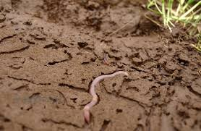
Earthworms as Bioindicators
Sensitive to changes in soil conditions
Play an important rule in aerating soils and cycling nutrients
Can act as a bioindicator for the general health of other organisms living in the soil

Slide 16
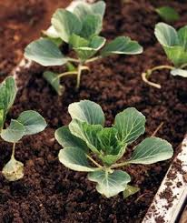
Ecological Implications
After being sprayed plants will dilute pesticides internally through a series of reactions
When worms consume the plants they are ingesting the pesticides at lowered concentrations yet they are still physiologically effected
What does this say about the strength of the pesticides used in agriculture?

Slide 17
Longer sampling period
Larger sample size
Future Research- Biochemical mechanism???
Weigh food and worms
Greater variety of food
Use known pesticides

